Slide 1
P
ProcureFlow
Procurement Management System
Request → Approval → Payment → Tracking → Delivery
React + Spring Boot + MySQL | JWT Authentication
01

Slide 2
Project Overview
A single portal for managing the complete procurement lifecycle.
What is it?
Why was it built?
Core outcome
A web-based procurement platform that connects users, administrators and suppliers through one controlled workflow.
To reduce manual coordination, improve visibility of requests and payments, and provide real-time shipment status.
Every purchase request can be followed from creation to approval, payment, shipment and delivery.
• Role-based workspaces for User, Admin and Supplier
• Purchase request approval and rejection management
• Supplier payment details and user payment confirmation
• Shipment tracking updates and user rating
• CSV reports and product board for operational visibility
02

Slide 3
Problem Statement & Objectives
The system addresses common gaps in manual procurement operations.
Problems in manual procurement
Project objectives
• Requests are scattered across email and spreadsheets
• Approval status is difficult to track
• Payment information needs repeated communication
• Shipment updates are not centralized
• Reporting and supplier performance are time-consuming
• Centralize purchase requests and approvals
• Automate email notifications
• Track payment and shipment status
• Give each role a focused dashboard
• Provide downloadable CSV reports
• Improve transparency from request to delivery
03

Slide 4
System Architecture
Three-tier web architecture with secure REST APIs.
React Frontend
Axios + JWT
Spring Boot REST API
MySQL
Frontend
Backend
Security
Database
React
React Router
Lucide icons
Responsive dashboards
Product images
Spring Boot
REST Controllers
Service layer
JPA / Hibernate
Email service
JWT login
Role-based access
Protected APIs
Users
Products
Suppliers
Requests
Payments
Shipments
Ratings
SMTP / Email Notifications
Tech: React + Vite | Spring Boot + Java | MySQL + JPA/Hibernate | JWT | SMTP
04

Slide 5
User Module
The user workspace focuses on ordering, payment and delivery visibility.
Dashboard
New Request
My Requests
Shows request/payment/tracking information and provides quick access to procurement actions.
User selects a product, enters purchase details and submits a request for approval.
Displays request history, approval state and related purchase information.
Payments
Tracking
Rating
Shows supplier payment details and lets the user confirm payment.
Displays shipment progress and tracking history after supplier updates.
User can submit a supplier rating after the procurement process.
08

Slide 6
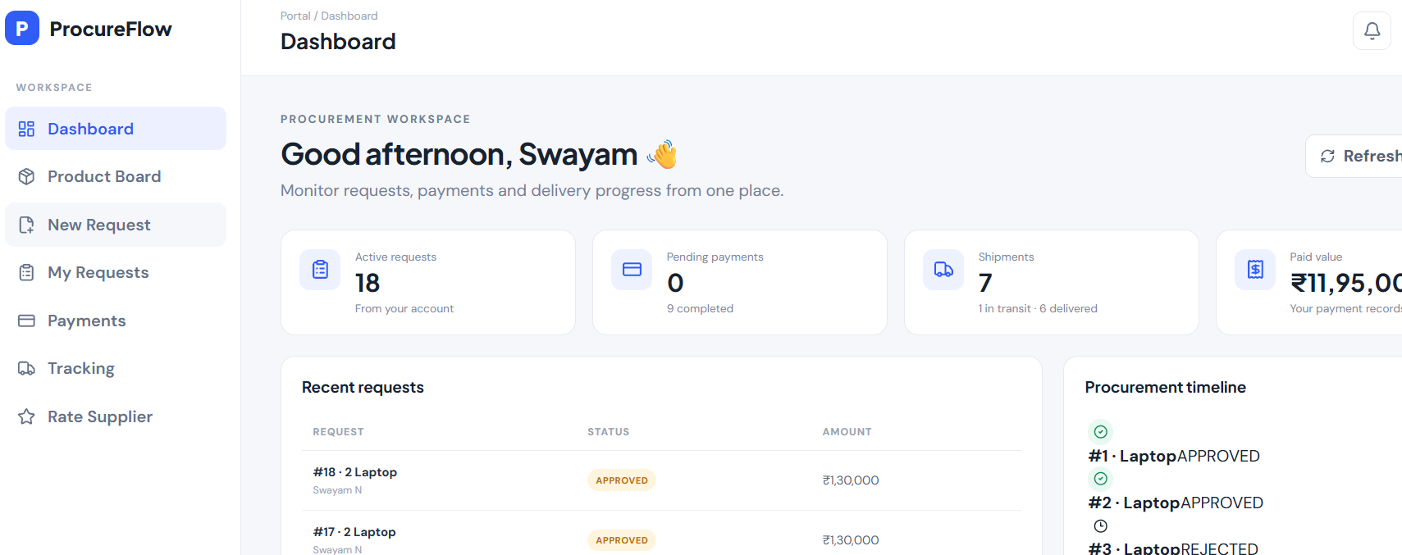
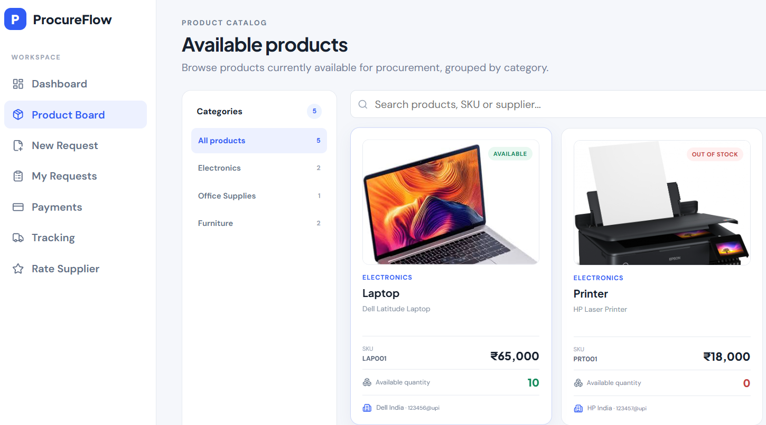
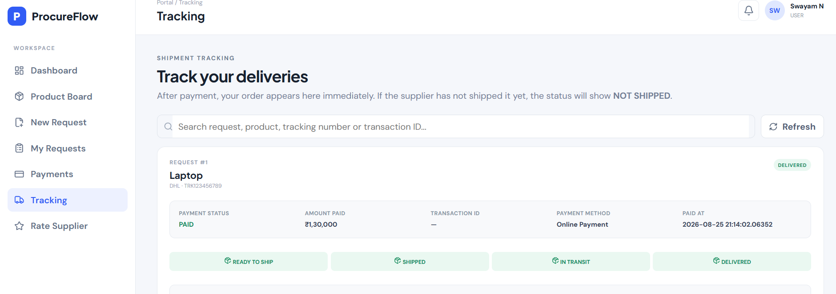
03

Slide 7
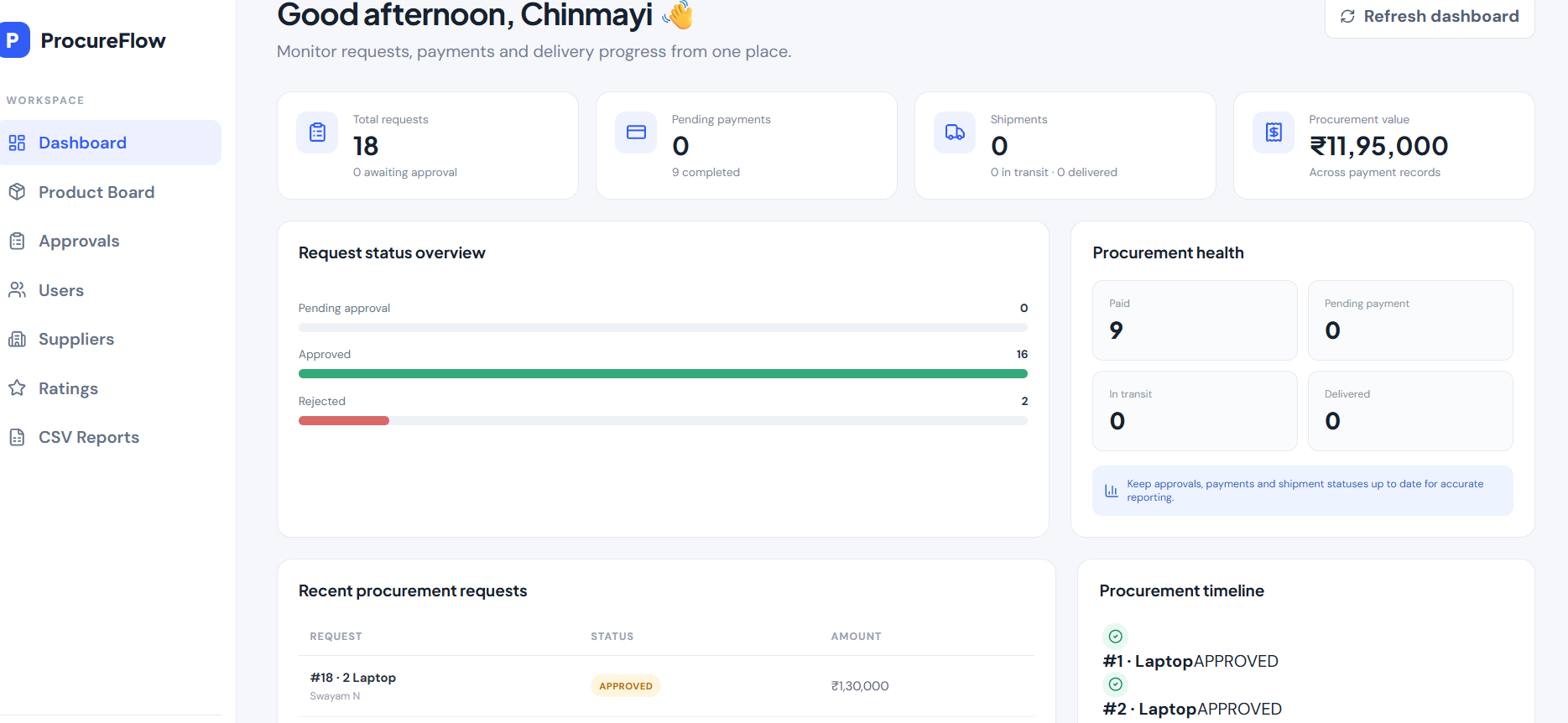
Admin Module
Administration provides control, approval and reporting capabilities.
• Approval queue: review pending purchase requests
• Approve / reject requests and trigger workflow notifications
• Product Board: view available products and categories
• Users & Suppliers: maintain procurement master data
• Ratings: monitor supplier feedback
• CSV Reports: export operational and payment information
Admin Control Center
Pending Requests
Approved
Payments
Suppliers
5
Export → CSV
09

Slide 8

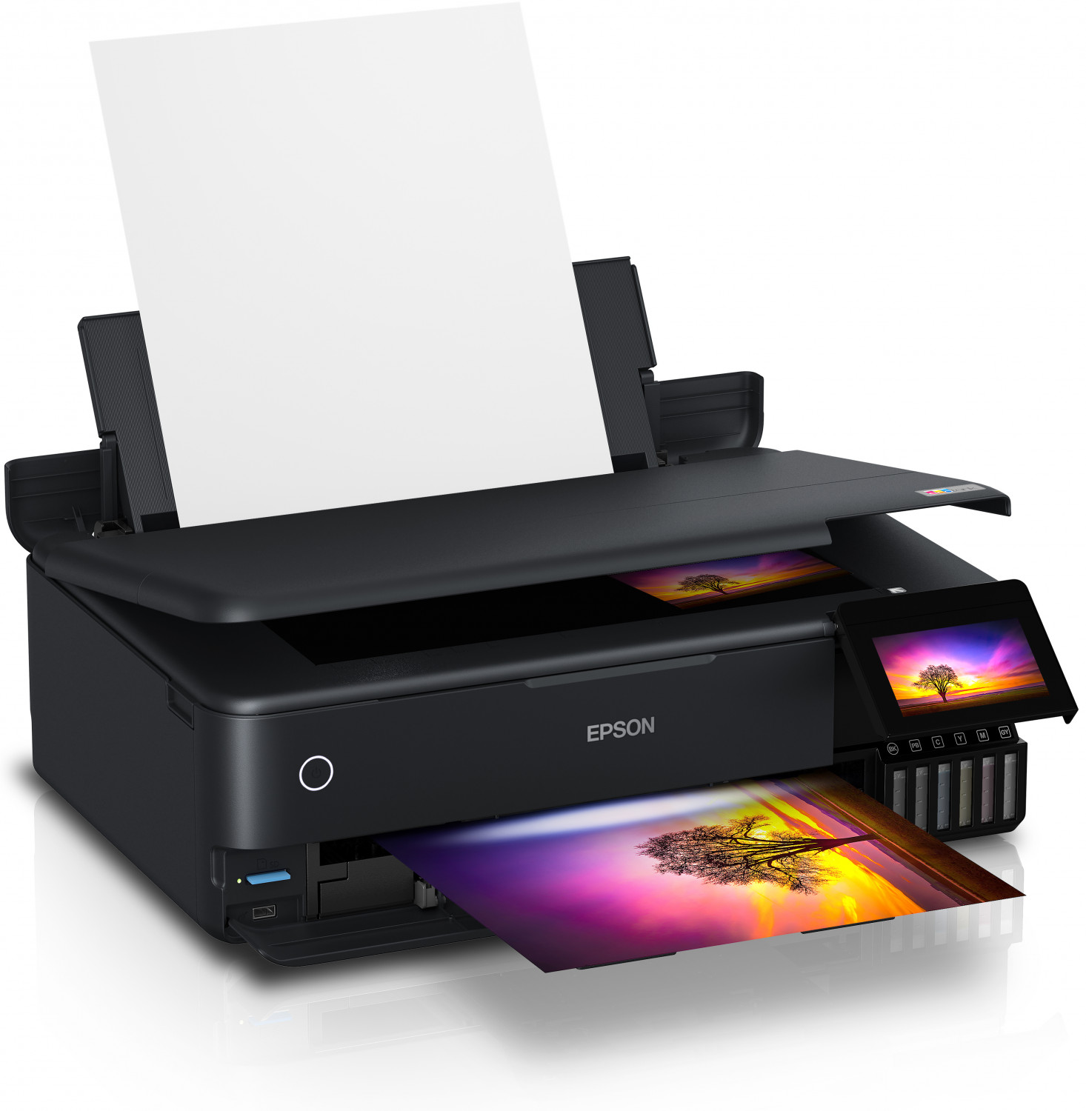



Supplier Module & Product Board
Supplier tools connect payment information, inventory visibility and shipment updates.
• View products assigned to the supplier
• Provide payment details such as amount and payment information
• View payment history for supplier products
• Update shipment status through defined tracking stages
• View user ratings and supplier performance
Laptop
Printer
Chair
Table
A4 Sheets
Product images are preloaded in frontend/public/product-images/
Ready to Ship
Shipped
In Transit
Delivered
Supplier tracking view is focused on active / pending-to-delivered shipments.
10

Slide 9
Payment, Email & Tracking Notifications
Important events are communicated through the backend email service.
Payment lifecycle
Tracking lifecycle
Notifications
1. Request approved
2. Supplier submits payment details
3. User receives payment information
4. User completes payment
5. Supplier is notified
6. Payment status is stored for reporting
1. Supplier marks ready to ship
2. Shipped
3. In transit
4. Delivered
5. User sees tracking history
6. User can rate supplier
Spring Mail / SMTP is integrated through EmailService.
Typical events include:
• Request raised
• Approved / rejected
• Payment details available
• Payment completed
• Tracking updates
11

Slide 10
Conclusion & Future Scope
Current achievement
Possible enhancements
A connected procurement workflow covering request creation, approval, supplier communication, payment, shipment tracking, ratings and reporting.
• Real payment gateway integration
• Push / in-app notifications
• Advanced analytics dashboard
• Inventory threshold alerts
• Cloud deployment and CI/CD
• Stronger audit and approval controls
Procurement made visible, traceable and easier to manage.
12

Slide 11
THANK YOU
Current achievement
Possible enhancements
12

