Slide 1
Customer Relationship Management + Sales+ Opportunities
Data Analytics Project
Data Collection & Sources
Extracted dataset files
Load them into Power BI
Check relationships
Data Cleaning & Preparation
Remove duplicates using Power Query
Fix data types
Replace or remove null values
Data Exploration (EDA)
Number of opportunities per agent
Deal age ranges
Data Visualization
Power BI Dashboard

Slide 2
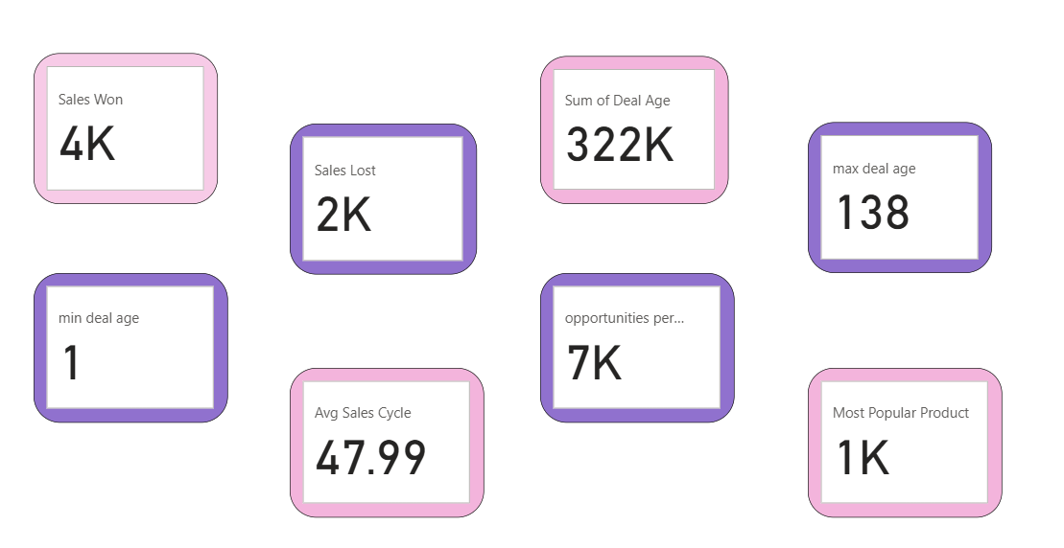
Measures

Slide 3
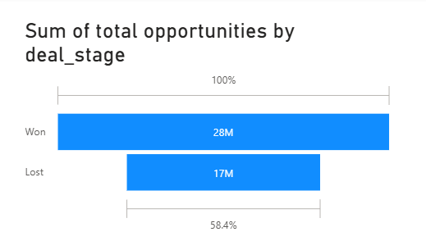
Visualizations from Power BI
🔹 1. Sum of total opportunities by deal_stage
Chart Type: 100% Stacked Bar Chart
Operation: SUM of opportunities grouped by Deal Stage (Won vs Lost).
Purpose: Shows total value of opportunities split into won and lost, along with % distribution.

Slide 4
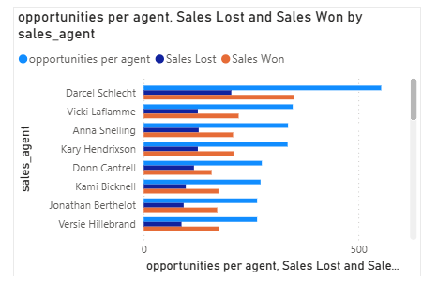
🔹 2. Opportunities per agent, Sales Lost and Sales Won by sales_agent
Chart Type: Clustered Bar Chart
Operation: COUNT (opportunities per agent) + comparison of Sales Lost vs Sales Won.
Purpose: Highlights performance of each sales agent (how many opportunities they handled, wins vs losses).

Slide 5
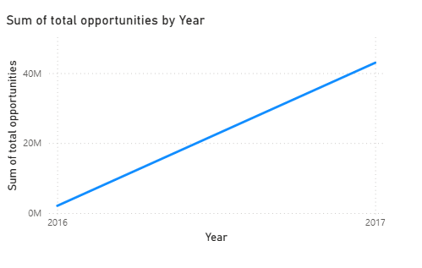
🔹 3. Sum of total opportunities by Year
Chart Type: Line Chart
Operation: SUM of opportunities, grouped by Year from Close Date.
Purpose: Shows year-over-year growth in total opportunities.

Slide 6
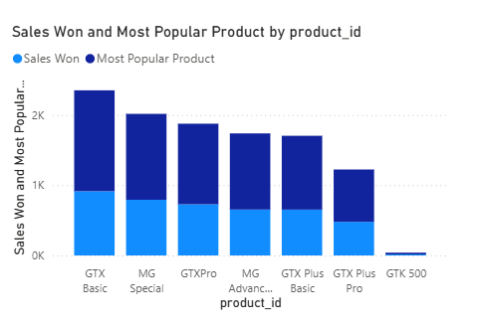
🔹 4. Sales Won and Most Popular Product by product_id
Chart Type: Stacked Column Chart
Operation: COUNT/SUM of Sales Won by Product ID, with an additional measure for most popular product.
Purpose: Identifies best-selling and most popular products in the pipeline.

Slide 7
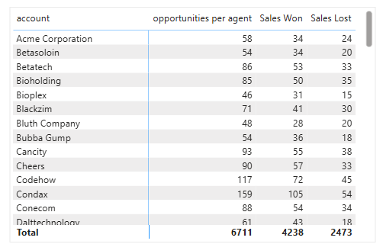
🔹 1. Opportunities per agent, Sales Won and Sales Lost by sales_agent
Chart Type: Table (Matrix Visual)
Operation: COUNT of opportunities grouped by Sales Agent, split into Won and Lost.
Purpose: Shows detailed performance of each sales agent (how many deals they won or lost).

Slide 8
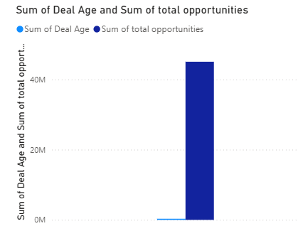
🔹 2. Opportunities per account (with Won/Lost breakdown)
Chart Type: Clustered column chart.
Operation: COUNT of opportunities grouped by Account, split into Sales Won and Sales Lost.
Purpose: Identifies which accounts contribute most to sales success or losses.

Slide 9
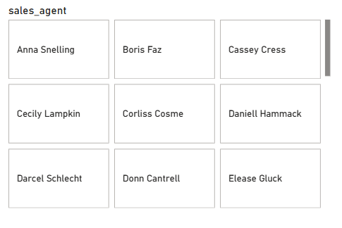
🔹 3. Sales Agent Tiles (individual boxes with names)
Chart Type: Button slicer
Operation: List of unique Sales Agents.
Purpose: Used as a filter/slicer to quickly focus on one sales agent’s performance.

Slide 10
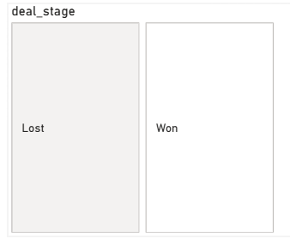
🔹 4. Deal Stage Tiles (Won / Lost boxes)
Chart Type: Button Slicer
Operation: Distinct values of Deal Stage.
Purpose: Lets users filter dashboard visuals by deal stage (Won vs Lost).

Slide 11
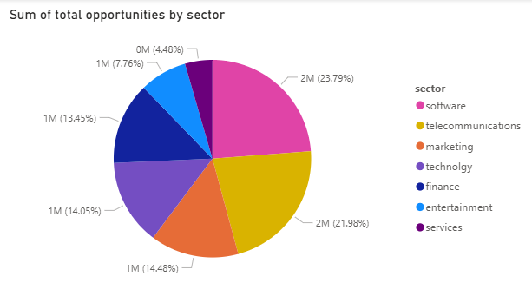
🔹 1. Sum of Total Opportunities by sector
Chart Type: Pie Chart
Operation: SUM of total opportunities by sector

Slide 12
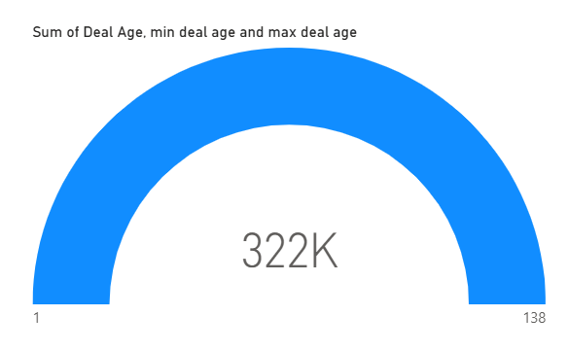
🔹 2. Sum of Deal Age (Min–Max Range)
Chart Type: Gauge Chart
Operation: SUM of Deal Age with Min and Max boundaries applied.
Purpose: Tracks the total age of deals in pipeline, highlighting deal timelines and bottlenecks.

Slide 13
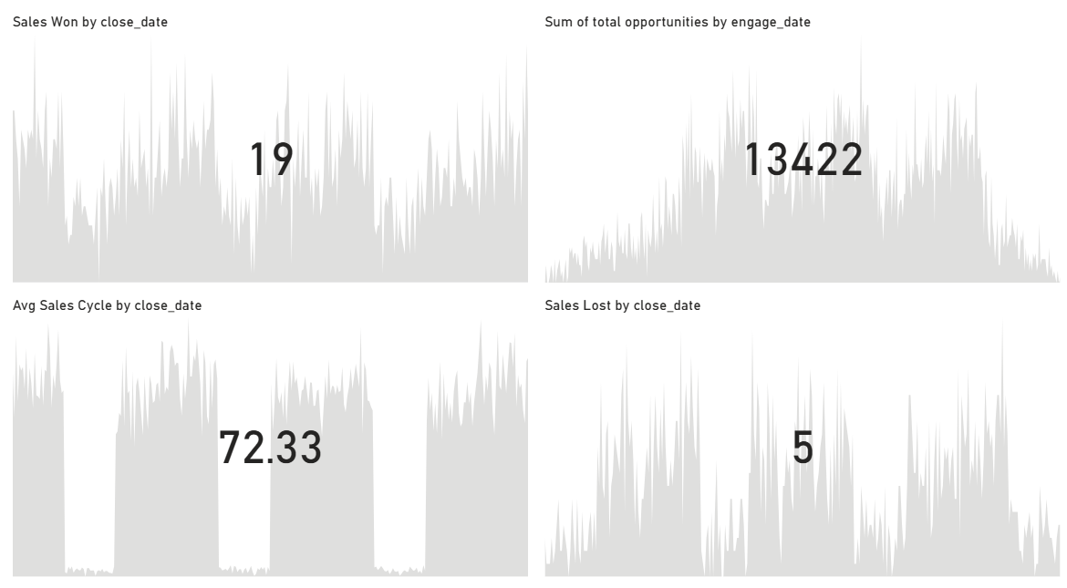
KPIs Give a time-based performance

Slide 14
Conclusion:
Sales performance shows strong wins from a few agents and products, but overall win rate is below target.
The sales cycle is longer than expected, creating pipeline delays .
Focusing on high-performing products and improving follow-ups can boost efficiency and revenue.

