Slide 1

TITLE: CYBERBULLYING DETECTION
Internship Mentors
Mrs. Y. Sowmya
Mrs. D. Indu
Mrs. V. Gowtami Annapurna
Assistant Professors
CSE Department
Internship Members
Jampana Sreeja(3231032100086)
Kanagala Chinmayi(323103210097)
Kanda Roopadevi(323103210099)
Karri Sowjanya (323103210103)
Department of Computer Science and Engineering
GAYATRI VIDYA PARISHAD COLLEGE OF ENGINEERING FOR WOMEN(A)
[Approved by AICTE NEW DELHI, Affiliated to AU Visakhapatnam]
[Accredited by National Board of Accreditation(NBA) for B.Tech. CSE, ECE & IT – valid from 2019-22 and 2022-25]
[Accredited by National Assessment and Accreditation Council (NAAC) with A Grade – valid from 2022-27]
Kommadi, Madhurawada, Visakhapatnam – 530048
Academic Batch : 2024-25

Slide 2
Contents
Abstract
Problem Statement
Limitations in Existing System
Internship Project Workflow (Architectural Diagram)
Flow Graph
Proposed System
Implementation
Output Screenshots
Conclusion
References

Slide 3
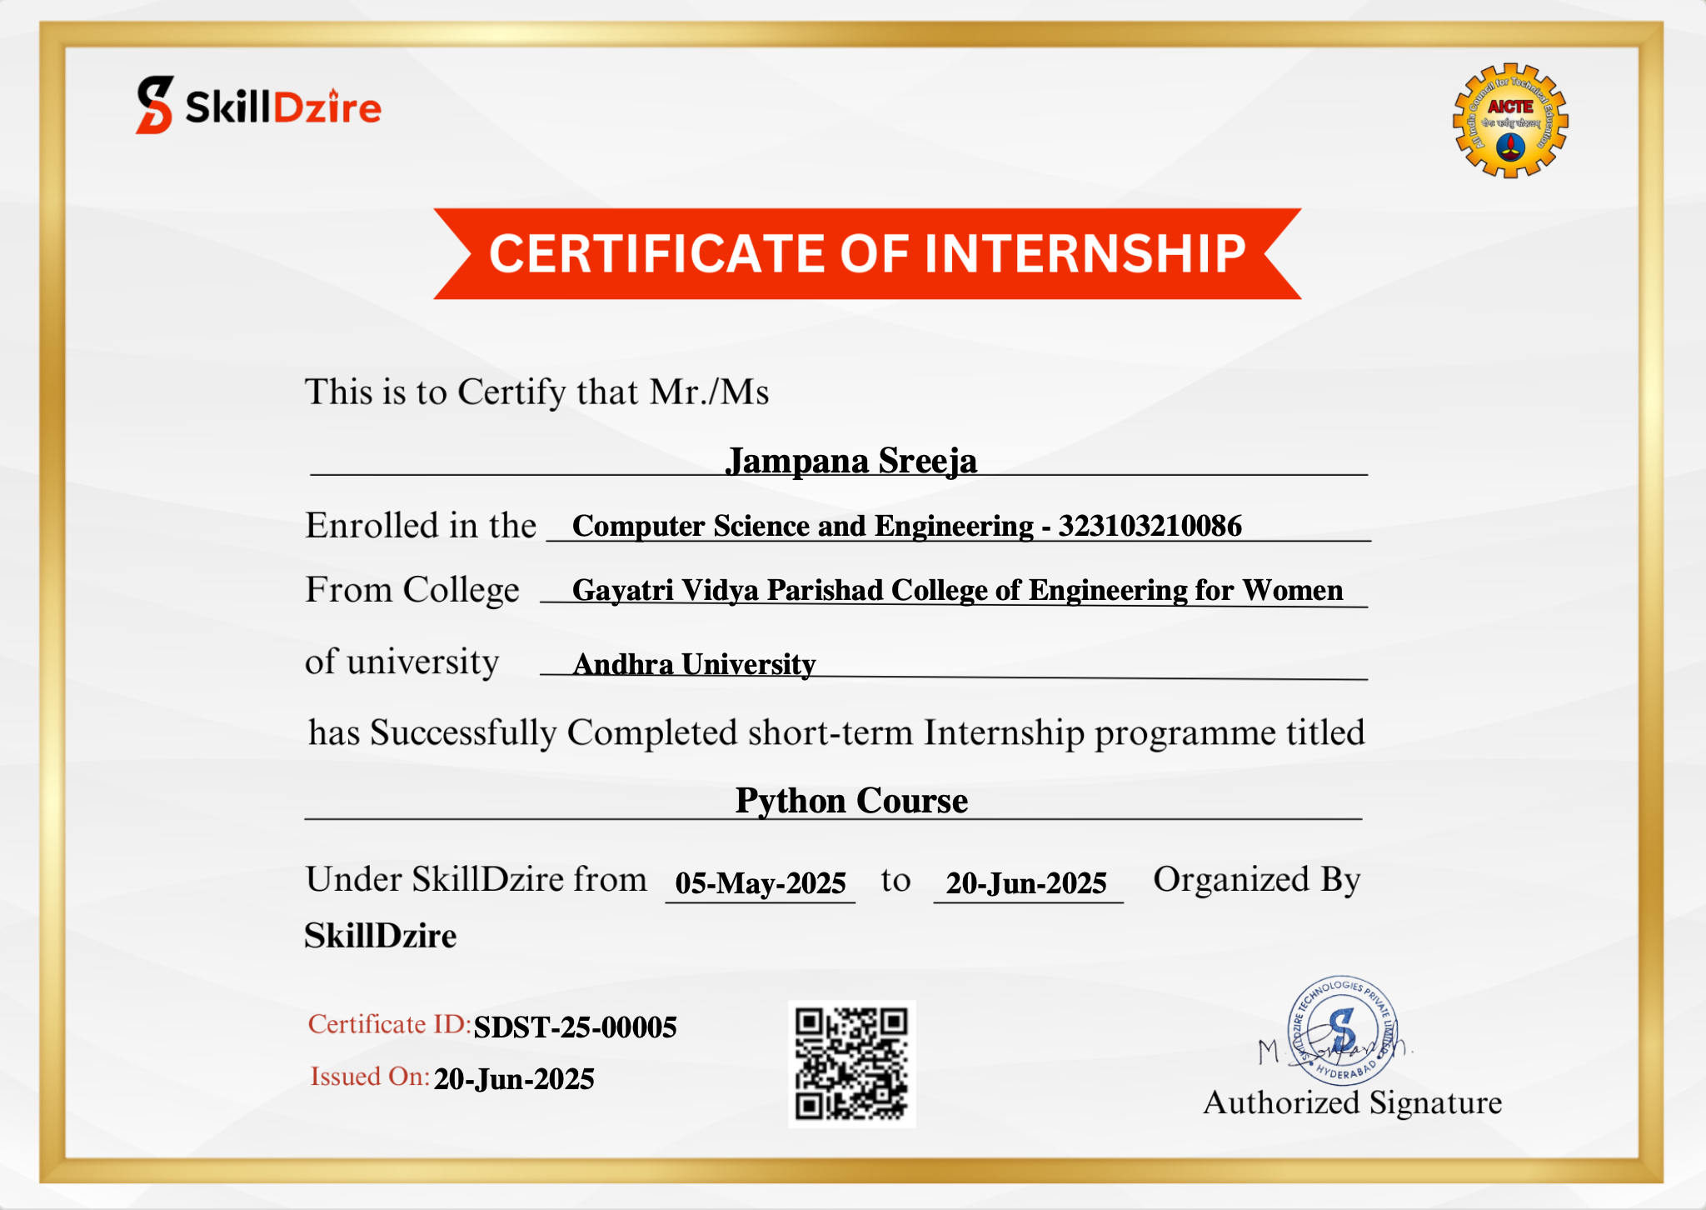
CERTIFICATE

Slide 4
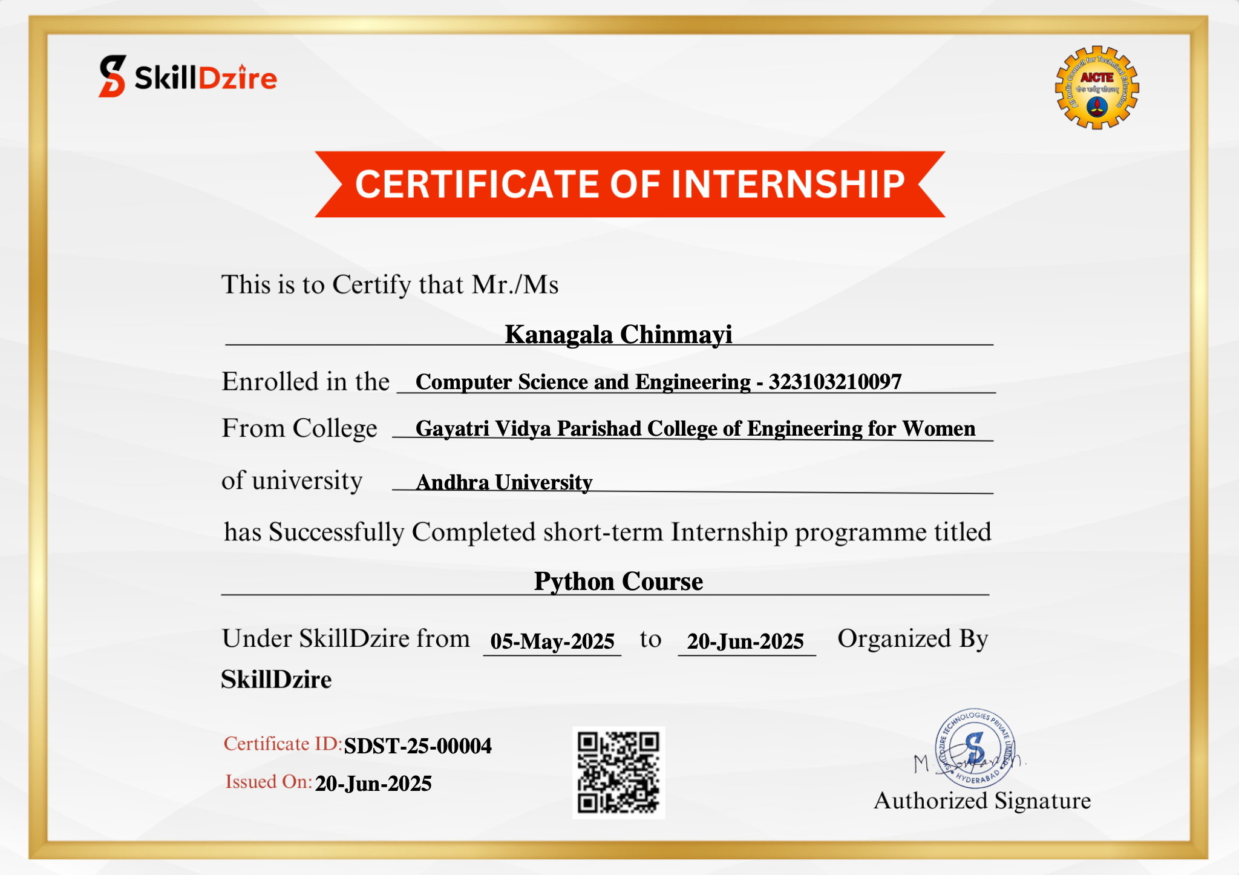

Slide 5


Slide 6
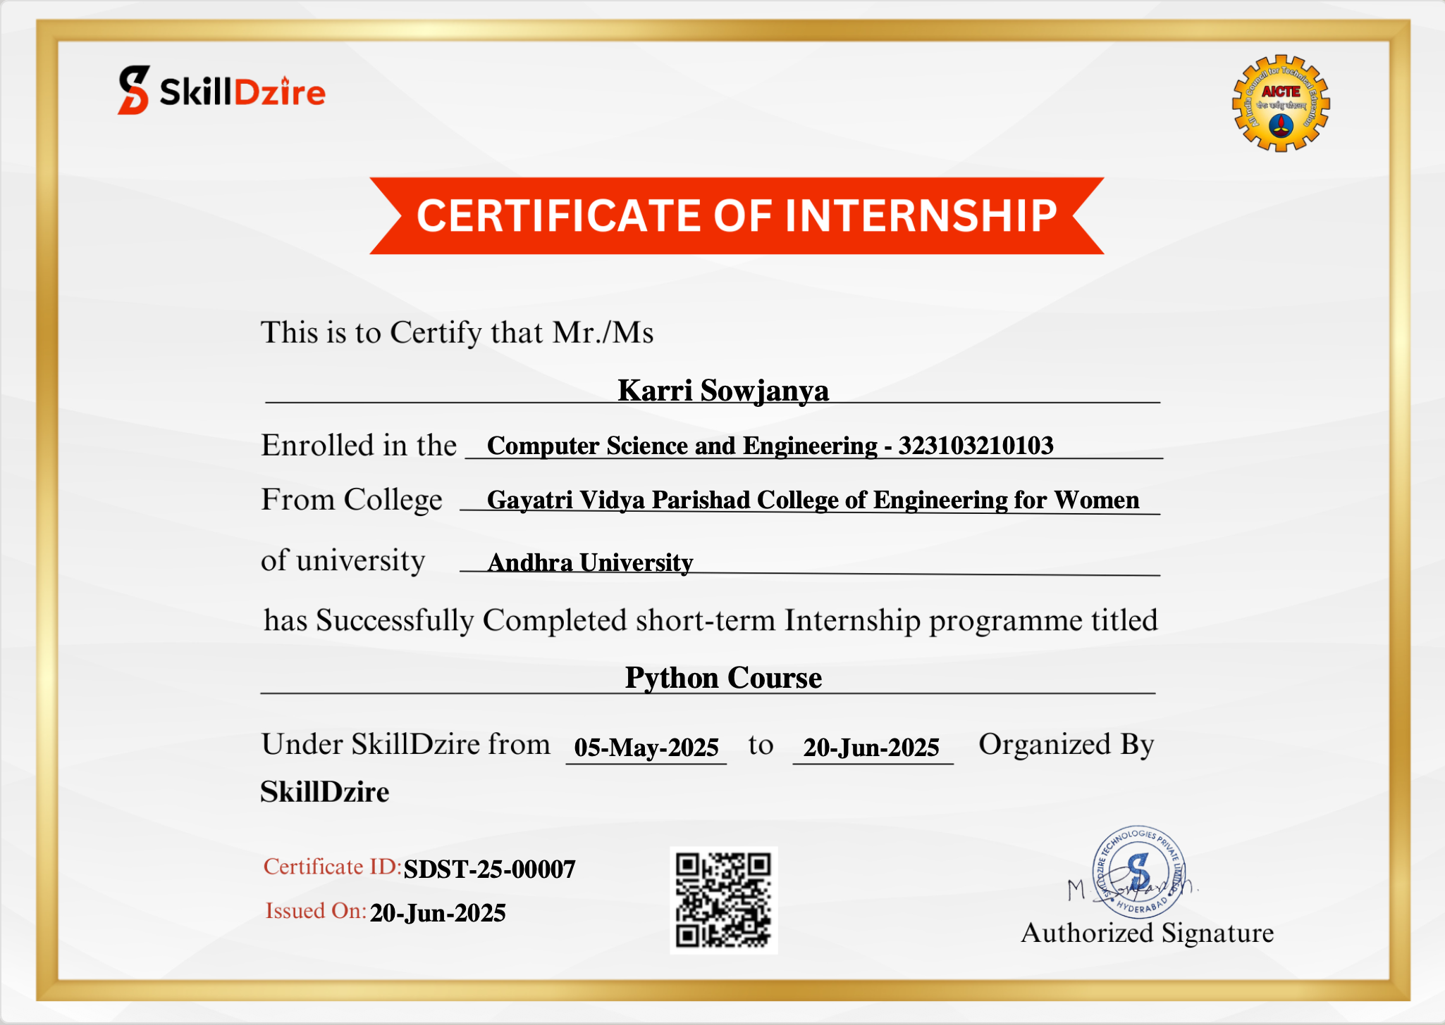

Slide 7
ABSTRACT
The Cyberbullying Detection System is a machine-learning based web service that identifies abusive or harmful text in real time. It is built using Python, FastAPI, and scikit-learn with a Logistic Regression classifier. User input is cleaned, converted into TF-IDF vectors, and classified as safe or cyberbullying using NLP techniques. Detected abusive messages are logged and offense counts are maintained for each user. The system issues warnings and automatically blocks users after three offenses. A PDF report generator provides statistics for monitoring, cybersecurity analysis, and digital safety research. A browser-accessible FastAPI interface makes the application lightweight and easy to integrate.

Slide 8
PROBLEM STATEMENT
The rapid growth of online communication platforms has led to an increase in cyberbullying incidents, which negatively impact mental health and digital safety. Existing systems rely heavily on manual monitoring, making it difficult to detect abusive content in real time. Delayed responses allow harmful comments to remain visible and repeat offenders to continue their behavior. There is a lack of automated mechanisms to classify text, issue warnings, block users, and generate reports. Hence, an efficient system is required to automatically detect cyberbullying using Machine Learning and NLP techniques, enforce moderation rules, and provide analytical insights for administrators.

Slide 9
LIMITATIONS IN EXISTING SYSTEM
Cyberbullying detection is mainly performed manually, which is time-consuming and inefficient.
Human moderation causes delays in identifying abusive content, allowing harmful messages to remain visible.
There is no automated warning or blocking mechanism for repeat offenders.
Existing systems lack intelligent analysis using Machine Learning or NLP.
Maintaining records of abusive users and messages is unstructured or inconsistent.
Administrators have limited visibility and analytics on cyberbullying patterns.
There is no automated report generation for monitoring and documentation purposes.

Slide 10
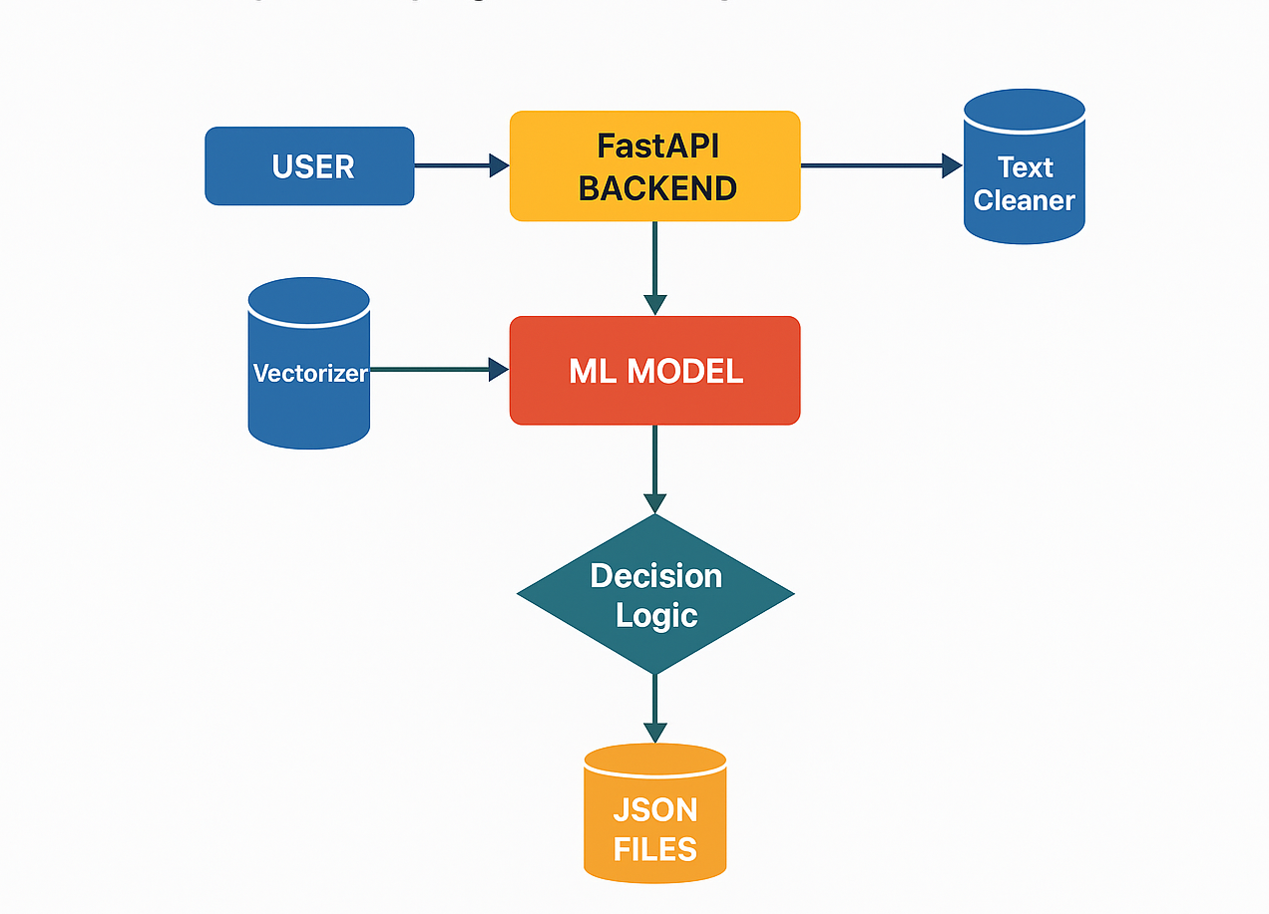



PROPOSED METHODOLOGY/ARCHITECTURE
[Work Flow Diagram ]

Slide 11
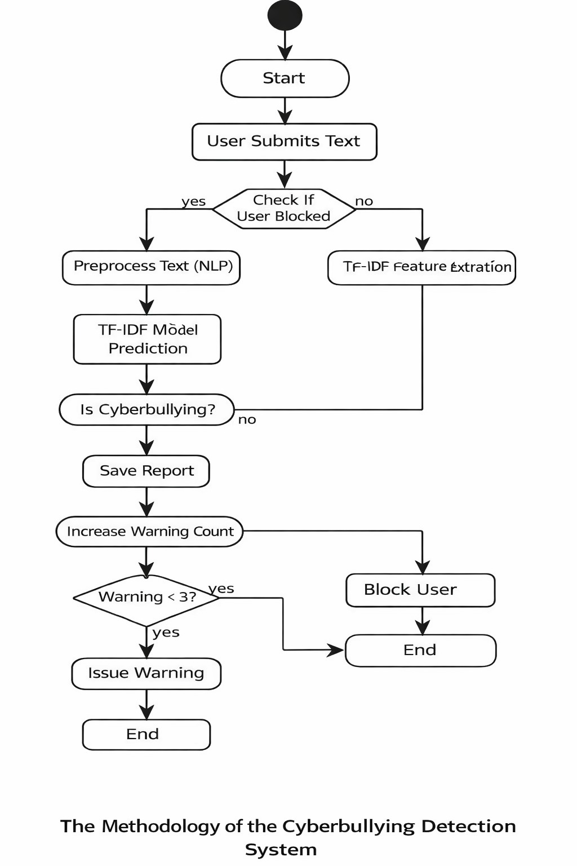
FLOW GRAPH:

Slide 12
PROPOSED SYSTEM
The proposed system implements an automated cyberbullying detection framework using Machine Learning and NLP. User comments are analyzed in real time and classified as safe or abusive using a trained Logistic Regression model with TF-IDF features. Abusive comments are hidden automatically, warnings are issued, and repeat offenders are blocked after multiple violations. All activities are stored in structured JSON files. The system also provides an admin dashboard and generates PDF reports for monitoring and documentation, ensuring efficient and timely moderation.

Slide 13

IMPLEMENTATION [ CODING FILES ]
The Cyberbullying Detection System is implemented using Python and FastAPI, with Machine Learning and NLP for text classification. A Logistic Regression model is trained offline using a labeled dataset, where text is preprocessed and converted into numerical features using TF-IDF vectorization. The trained model and vectorizer are saved using joblib.
In the backend, FastAPI loads the trained model and processes user input through API endpoints. When a comment is submitted, the system first checks whether the user is blocked, then cleans the text and predicts whether it is safe or abusive. Abusive comments trigger warnings, and repeated offenses lead to permanent user blocking. All moderation data is stored in JSON files. An admin dashboard displays system statistics, and PDF reports are generated using ReportLab for monitoring and documentation.

Slide 14
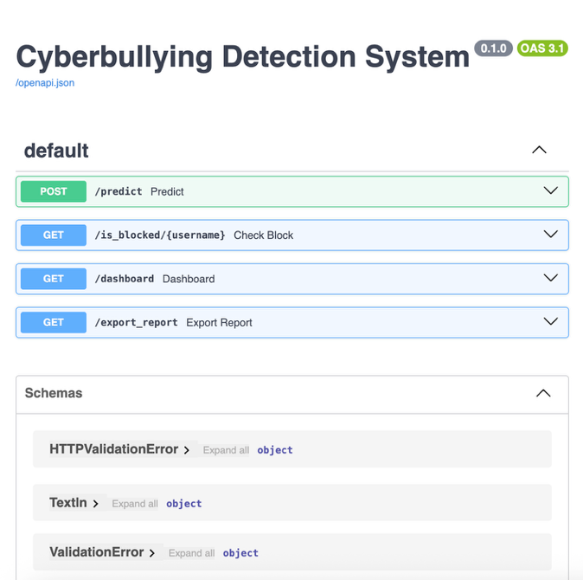
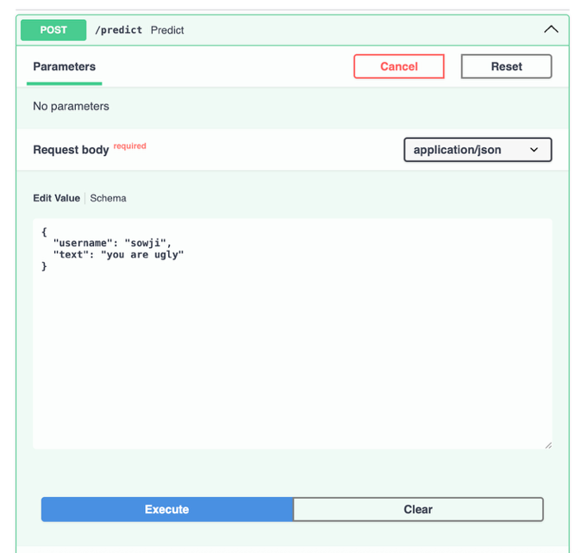
OUTPUT SCREENSHOTS

Slide 15
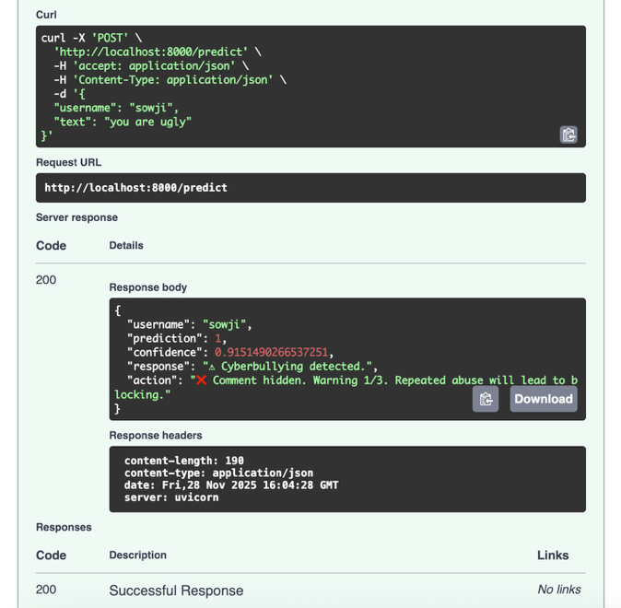
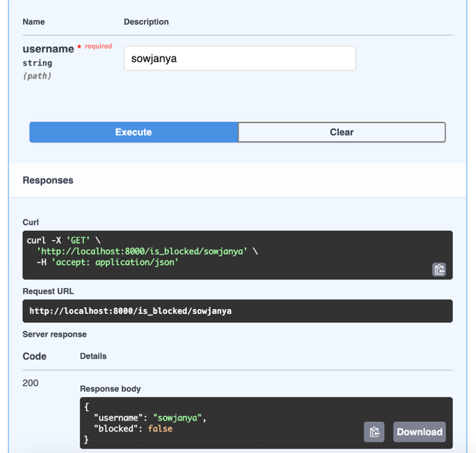
OUTPUT SCREENSHOTS

Slide 16
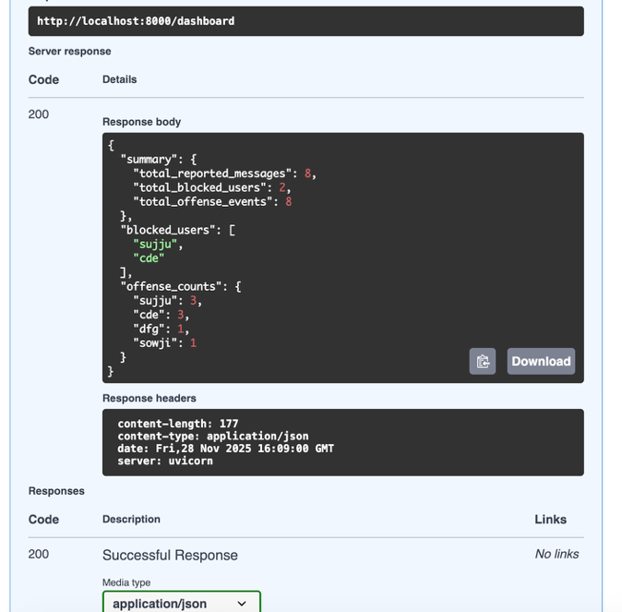
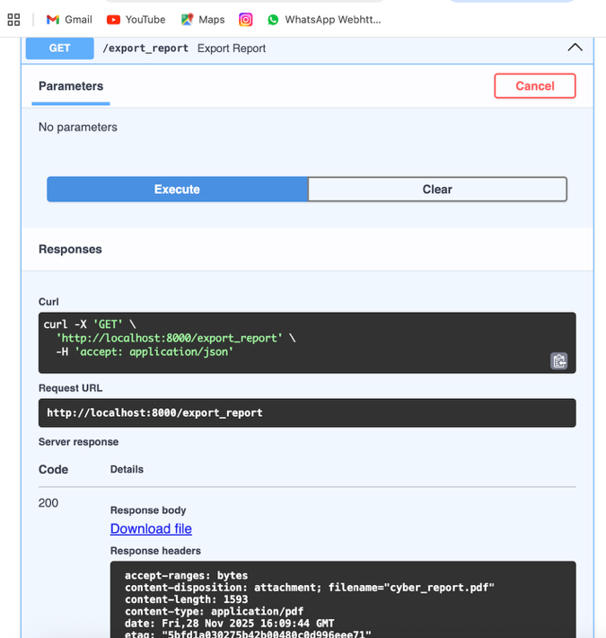
OUTPUT SCREENSHOTS

Slide 17
CONCLUSION
The Cyberbullying Detection System successfully demonstrates the use of Machine Learning and NLP to automatically identify and manage abusive text content. By integrating a Logistic Regression model with FastAPI, the system efficiently detects cyberbullying, issues warnings, blocks repeat offenders, and maintains structured records. The inclusion of an admin dashboard and PDF report generation enhances monitoring and documentation. Overall, the project provides an effective, scalable, and practical solution for improving online safety and reducing manual moderation efforts.

Slide 18
REFERENCES
• Wikipedia – Cyberbullying:
https://en.wikipedia.org/wiki/Cyberbullying
• SkillDzire – Dataset Source for Cyberbullying Project
https://skilldzire.com/
(Primary dataset provider used for model training and testing.)
• Scikit-Learn Documentation:
https://scikit-learn.org/
• TutorialsPoint – Machine Learning & NLP Basics:
https://www.tutorialspoint.com/

Slide 19
Thank You

