Slide 1

Pimpri Chinchwad Education Trust's
Pimpri Chinchwad College of Engineering
Department of CSE (AI&ML)
CEP Presentation
Research Paper Title: An Intelligent Harvest Advisory and Mandi Price Prediction Framework Using Ensemble Regressors and Multi-Criteria Decision Analysis (MCDA)
Student Name: Chinmay Jain
Student Name: Prithviraj Sapkal
Student Name: Tanmay Joshi
Guide Name: Prof. Sarika Bartakke

Slide 2
Introduction & Problem Statement
Domain Context
Small farmers decide what to grow, harvest, and sell under severe climatic variability and price uncertainty.
Perishable cash crops like Potato, Tomato, and Onion are most exposed to abrupt market shocks.
The Core Bottleneck
Price forecasts are disconnected from farm decisions: conventional systems deliver static prices, fixed risk assumptions, and single-objective alerts.
Quoted wholesale prices ignore transport tariffs, APMC market cess, and intermediary commissions.
Business / Research Impact
Bridging predictive ML with prescriptive MCDA enables better crop selection pre-sowing and optimal sell timing at harvest.
Reduces information asymmetry and significantly improves realized net farm-gate income for smallholders.
CSE (AI&ML) Pioneers Summit 2026
PAGE NO. 1

Slide 3
Objectives & Scope
Primary Goal
Key Targets
Scope & Constraints
• Integrated harvest advisory and mandi price prediction engine.
• Dynamic ensemble ML coupled with TOPSIS multi-criteria decision making.
• Transparent pre-sowing crop selection and post-harvest sales advice.
• Accurate multi-horizon forecasts (7d, 14d, 30d) evaluated by RMSE, MAE, RRMSE.
• Explainable AI (TreeSHAP) feature attribution for farmer trust.
• Net Farm-Gate Price realization after deducting logistics and mandi costs.
• Dual-mode TOPSIS ranking for crop planning and timing arbitrage.
• Geographic focus: Pune District, Western Maharashtra (Pune & Junnar APMCs).
• Target crops: Potato, Tomato, Onion.
• Historical APMC data spanning 25 years (2001–2026).
• Deployed via Streamlit interactive web portal + REST fallback panel.
• Leverages Open-Meteo 14-day weather forecasts.
CSE (AI&ML) Pioneers Summit 2026
PAGE NO. 2

Slide 4
Dataset & Preprocessing
Dataset Specification (Updated)
Preprocessing & Feature Engineering
Source: APMC Records (Agmarknet) + Open-Meteo Weather Archive
Period: 2001–2026 (25 Continuous Years)
Volume: 75,890 Verified Mandi Records (Potato: 20k, Tomato: 26.7k, Onion: 29.1k)
Weather: 18,890 Daily Weather Days + 14-Day Forecasts
Crops: Solanum tuberosum, Solanum lycopersicum, Allium cepa
Data Split: Chronological Out-of-Sample: Train pre-2025 | Test: Last 12 months
• Data Cleansing: Anomaly filtering, non-trading Sunday handling via forward-fill with rolling 14-day median fallback.
• 47 Engineered Predictors: Autoregressive price lags (1, 2, 3, 7, 14, 21, 30 days) and rolling volatility windows.
• Deterministic Seasonality: Fourier harmonic transforms (sin/cos cycles) capturing annual monsoon harvest flushes.
• Bioclimatic Indicators: Growing Degree Days (GDD), Temperature-Humidity Index (THI), and 14-day cumulative rainfall.
• Temporal Integrity: Strict chronological validation preventing lookahead bias or future data leakage.
CSE (AI&ML) Pioneers Summit 2026
PAGE NO. 3

Slide 5
Dataset Snapshot & Data Schema
Arrival Date | Commodity | Market | Min / Max (₹/q) | Modal Price (Target)
08/01/2025 | Potato | Junnar | 1000 / 1300 | ₹1,100 / q
18/01/2025 | Potato | Junnar | 700 / 1600 | ₹1,300 / q
22/02/2025 | Potato | Pune | 400 / 1200 | ₹800 / q
15/03/2025 | Tomato | Junnar | 500 / 1100 | ₹900 / q
29/03/2025 | Onion | Pune | 800 / 1200 | ₹1,000 / q
18/10/2025 | Onion | Junnar | 1200 / 2600 | ₹2,200 / q
Core Target Variable:
Modal Price represents prevailing daily transaction price for wholesale lots.
Key Fields:
Date, Commodity, Market, Variety, Min Price, Max Price, Modal Price.
Temporal Structure:
Raw rows arrive unordered across APMCs; pipeline indexes chronologically to enforce causality.
Integrated SQLite Database:
Stores 75,890 records with ACID compliance and instant indexed retrieval.
CSE (AI&ML) Pioneers Summit 2026
PAGE NO. 4

Slide 6
Literature Survey & Benchmark Insights
Paper (Year) | What They Did | What We Learnt | Limitation | How It Benefits Us
Qureshi et al., 2026 Ensemble Learning | Reviewed Bagging, Boosting, and Stacking architectures. | Combining learners cuts variance and corrects residual errors. | General ML review; not agricultural price specific. | Theoretical basis for our RF, boosting, and Stacking layer.
Pahmeyer et al., 2021 'Fruchtfolge' DSS | Crop-choice decision support under spatial constraints. | Farm planning requires multi-criteria data, not price alone. | Static decision model; not coupled with dynamic price forecasts. | Supports coupling price predictions with agro-climatic suitability.
Bergquist & Dinerstein, 2020 Kenya Markets | Field experiment on market competition and trader entry. | Wholesale price does not equal farm-gate income. | Kenyan context; no predictive machine learning forecasting. | Directly motivates our Net Realized Farm-Gate Price adjustment.
Assouto et al., 2020 Benin Farmers | Investigated price and yield production uncertainty. | Price risk and limited hedging shape farmer decisions. | Single case study; no dynamic advisory tool. | Motivates joint market, weather, and economic multi-criteria.
Mitra et al., 2018 Indian Potato Farmers | Experiment on middleman margins & information asymmetry. | Farmers receive significantly less than wholesale rates. | Potato only; purely retrospective econometric study. | Supports transport, cess, handling, and commission deductions.
CSE (AI&ML) Pioneers Summit 2026
PAGE NO. 5

Slide 7
Proposed Solution & Multi-Criteria Innovation (MCDA)
Dynamic Ensemble
Prediction
RF, XGBoost, LightGBM, and Stacking retrained dynamically as new market data arrives.
Supply-Chain
Adjustment
Net Farm-Gate Price = Mandi Price minus transport, cess, commission, and handling fees.
TOPSIS Multi-Criteria
Ranking
Ranks alternatives on price, weather risk, yield, and suitability—not price alone.
Explainable AI
by Design
TreeSHAP game-theoretic attributions explain every prediction and ranking in plain language.
How TOPSIS MCDA Works
1. Decision Matrix: Evaluates candidate crops across 5 heterogeneous criteria.
2. Normalization: Vector normalization puts benefit and cost criteria on comparable scale.
3. Ideal & Negative-Ideal: Computes Euclidean distances (S_i+, S_i-) to best & worst points.
4. Closeness Ranking (C_i* in [0, 1]): Recommends the alternative closest to ideal.
Why It Sets Our Framework Apart
• Highest Price ≠ Best Crop: A crop with high gross price but 40% disease risk or high input cost is penalized.
• Most Tools Stop at Price: We convert raw predictions into prescriptive farm actions.
• Solves the Transit Illusion: Accounts for ₹1.75/km freight so farmers avoid uneconomic central market trips.
• Dual-Mode Utility: Solves Mode A (What to sow?) and Mode B (When & where to sell?).
CSE (AI&ML) Pioneers Summit 2026
PAGE NO. 6

Slide 8
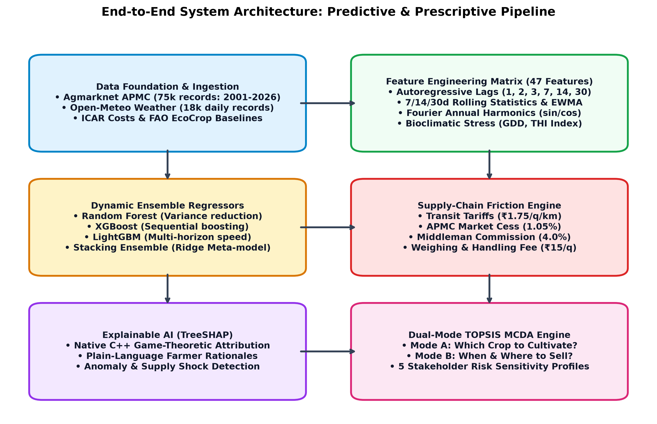
System Architecture & End-to-End Pipeline
CSE (AI&ML) Pioneers Summit 2026
PAGE NO. 7

Slide 9
Methodology & Multi-Horizon Benchmarking Results
Crop | Horizon | Best Model | RMSE (₹/q) | RRMSE vs Naive
Onion | 7-Day | LightGBM ⭐ | 468.30 | 0.7229 (+27.7%)
Onion | 14-Day | LightGBM ⭐ | 483.86 | 0.7324 (+26.8%)
Onion | 30-Day | LightGBM ⭐ | 564.10 | 0.8236 (+17.6%)
Potato | 14-Day | XGBoost ⭐ | 171.13 | 0.8900 (+11.0%)
Potato | 30-Day | LightGBM ⭐ | 194.46 | 0.7756 (+22.4%)
Tomato | 30-Day | Stacking ⭐ | 587.01 | 0.8466 (+15.3%)
When Do Ensembles Beat Naive?
• Multi-Week Turning Points (14d & 30d): Naive persistence (y_{t+h} = y_t) fails during harvest gluts. Tree ensembles cut error by 22.4% (Potato 30d) and 26.8% (Onion 14d) using Fourier harmonics and EWMA momentum.
• Speculative Spikes (Onion): Onion exhibits extreme policy and arrival volatility; LightGBM beats naive baseline even at 7 days by 27.7%.
• Short-Term Inertia Regime (7d Potato/Tomato): High price autocorrelation (>0.92) makes yesterday's price hard to beat over 24-48 hours (RRMSE ~0.97).
• Stacking Meta-Learner: Combines complementary regressors using Ridge meta-model, preventing overfitting during volatile tomato swings.
CSE (AI&ML) Pioneers Summit 2026
PAGE NO. 8

Slide 10
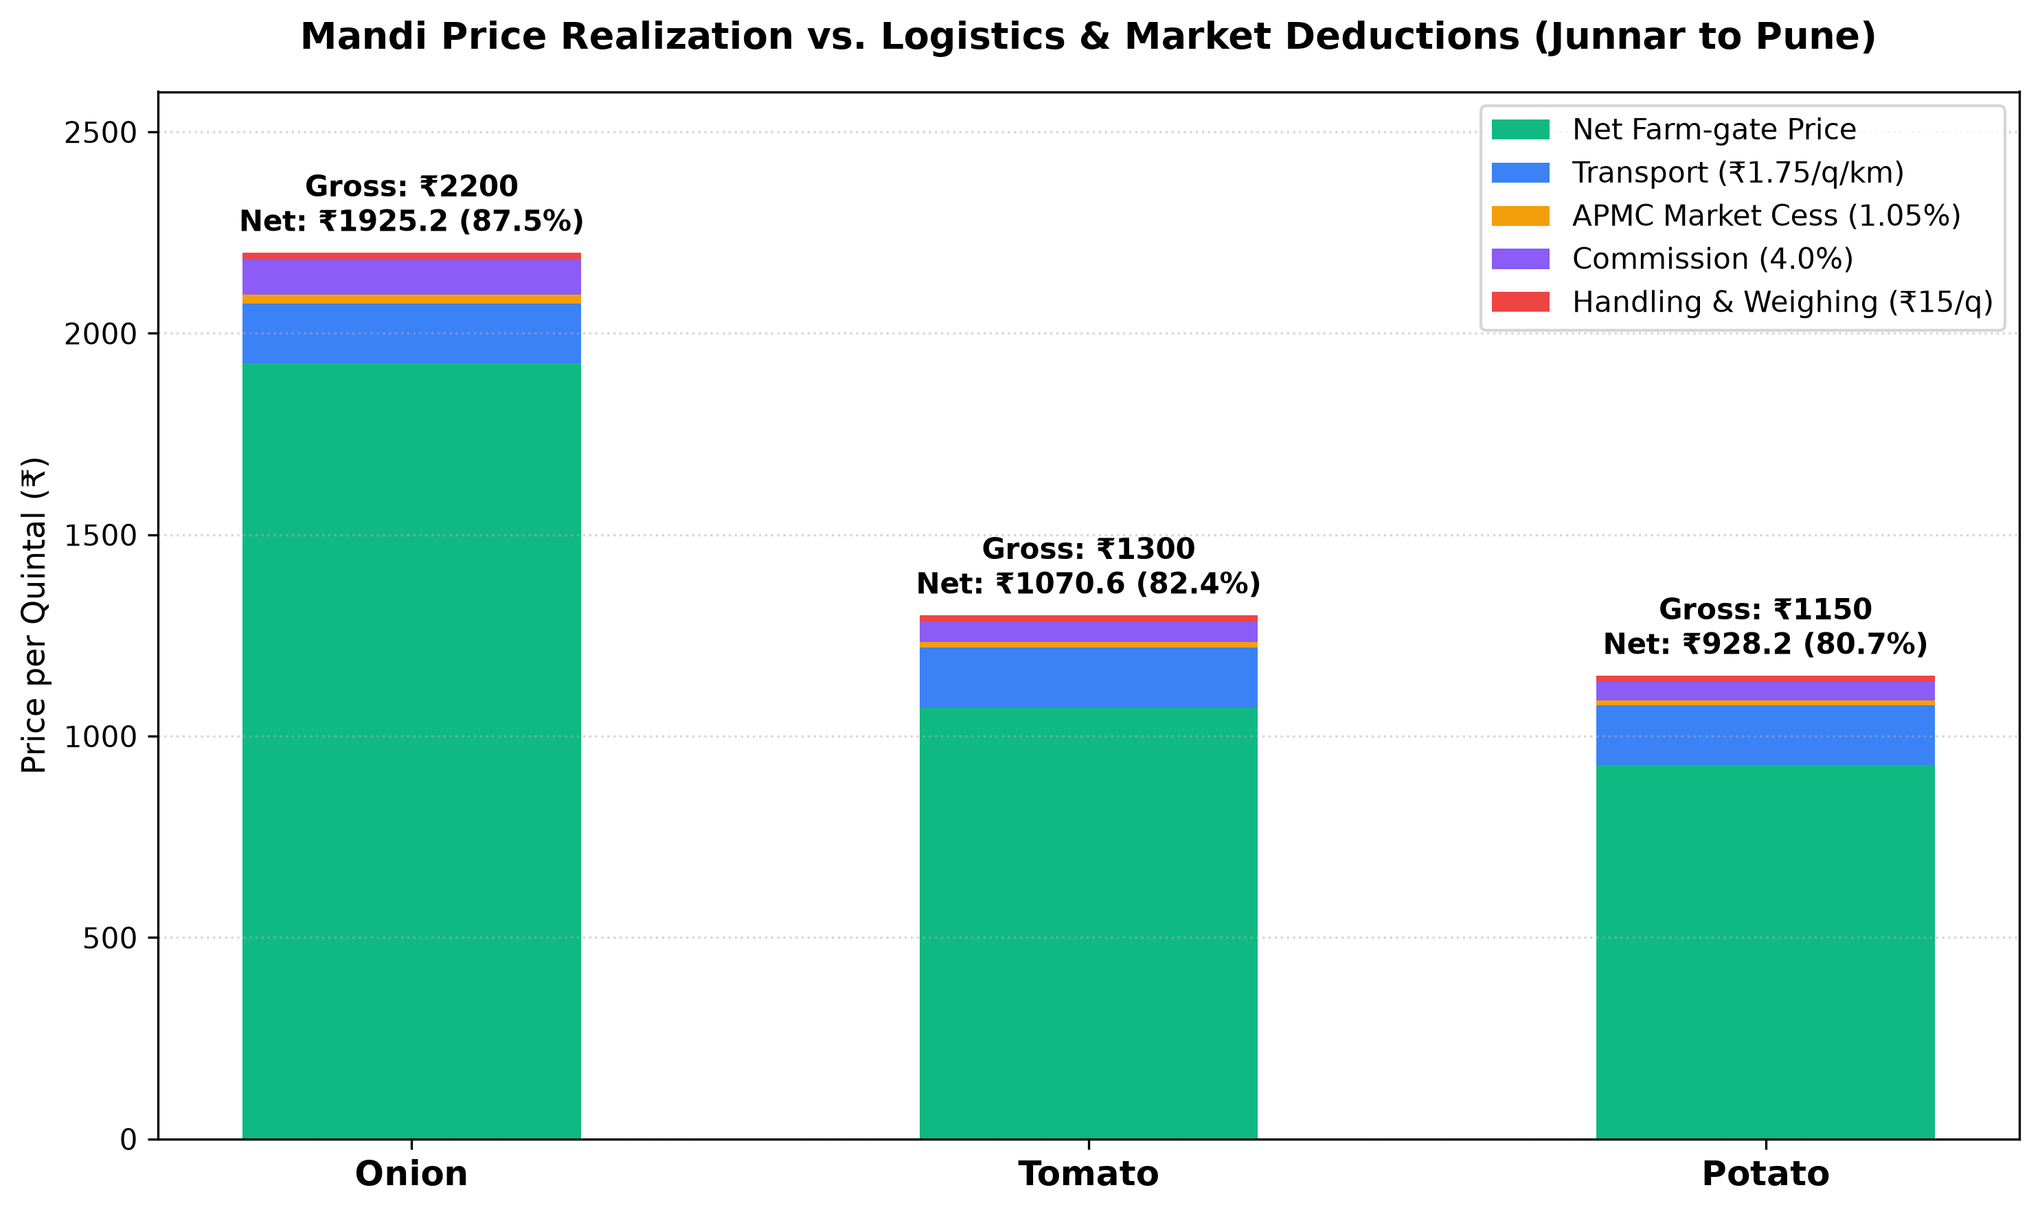
Prototype Implementation: Resources & Farm-Gate Price Engine
Prototype Resources & Pipeline Architecture
Tech Stack: Python 3.14, Streamlit, Plotly, Scikit-learn, XGBoost, LightGBM, SQLite3.
Live Data Ingestion: Real-time daily sync with Agmarknet APMC APIs + Open-Meteo weather.
Historical Replay Simulator: Allows examiners to step forward in time to simulate market dynamics.
How Price Forecasts are Generated: 47 engineered features feed pre-trained multi-horizon tree ensembles generating 7d, 14d, and 30d modal projections with confidence bounds.
Zero-Dependency Server: Fallback native Python HTTP server on port 8000 for low-resource devices.
CSE (AI&ML) Pioneers Summit 2026
PAGE NO. 9

Slide 11
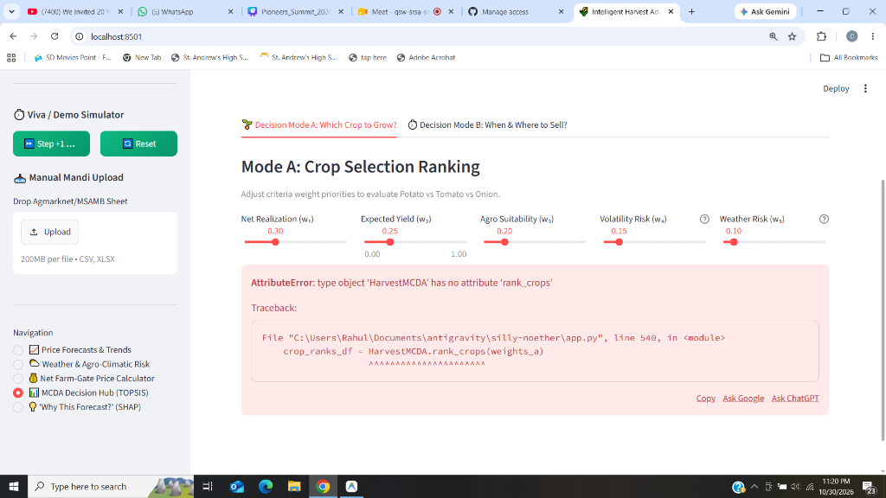
Prototype Implementation: TOPSIS Decision Hub & Case Studies
Tactical Case | Naive Action | System Action | Net Financial Gain
Tomato Glut (Falling Trend) | Hold 14d & ship to Pune (₹70,740) | Sell locally today at Junnar (₹1,19,622) | +₹48,881 (+69.1%) Avoids 16% decay
Onion Shortage (Rising Trend) | Spot sale today at Junnar (₹2,07,590) | 14d chawl storage & Pune haul (₹2,47,402) | +₹39,812 (+19.2%) Captures ₹650/q rise
Potato Rain Threat (75mm Rain Shock) | Delay harvest in rain (₹40,630) | Pre-rain 48h harvest sprint (₹1,03,420) | +₹62,790 (+154.6%) Prevents 35% rot
How TOPSIS Solves the Farmer's Decision:
• Mode A (Pre-Sowing): Onion ranks #1 (₹2.71L/ha net profit) over tomato across 4 of 5 risk profiles.
• Mode B (Harvest Timing): For tomato, selling locally today beats distant shipping due to 7% weekly rot.
CSE (AI&ML) Pioneers Summit 2026
PAGE NO. 10

Slide 12
Future Scope & Key References
Model Enhancements
• Expand to more crops (Garlic, Ginger, Cabbage)
• Soil moisture & disease risk integration
• IoT field sensor telemetry
System Scaling
• Spatial scaling across 36 Maharashtra districts
• National e-NAM marketplace integration
• Low-bandwidth SMS/WhatsApp advisory bot
Research Vision
• Satellite remote sensing + DSSAT crop models
• LLM/NLP extraction of policy & export shocks
• Real-time participatory farmer feedback in MCDA
Live Prototype Demo
Web Portal:
http://localhost:8501
GitHub Repo:
github.com/chinmayjain07/
harvest-advisory-system
Key Academic References
[1] H. Qureshi et al., 'Ensemble learning techniques: Bagging, boosting, and stacking,' arXiv preprint, 2026.
[2] L. F. Bergquist & M. Dinerstein, 'Competition and entry in agricultural markets: Evidence from Kenya,' Am. Econ. Rev., 2020.
[3] S. Mitra et al., 'Asymmetric information and middleman margins: An experiment with Indian potato farmers,' Rev. Econ. Stat., 2018.
[4] C. Pahmeyer et al., '“Fruchtfolge”: A crop rotation decision support system,' Comput. Electron. Agric., 2021.
[5] S. L. Gebre et al., 'Multi-criteria decision making methods to address rural land allocation,' Int. Soil Water Conserv. Res., 2021.
CSE (AI&ML) Pioneers Summit 2026
PAGE NO. 11

