Slide 1
EDA on Global Terrorism
By Chinmay Khisti

Slide 2
Outline
Data Preparation
Details of data
Insights
Top Insights
Number of Attacks by year
Terrorist attacks hotspots on world map
Over all insights of attacks
Contribution of each attack type
Terrorist activity by region
Top 5 Worst attacks so far
Top countries affected by attacks
Kill count vs Type of Attack
Next steps

Slide 3
Data Preparation
STAGE 01
Importing required libraries(pandas, matplotlib, seaborn)
Importing Data from relevant sources
STAGE 03
Operating on null values
STAGE 02
STAGE 04
STAGE 05
Plotting boxplots, scatterplots for determining outliers and skewed values and rectifying it.
Cleaning any anomalies and importing required features in a dataframe to perform analysis

Slide 4
Details of data
 | eventid | city | region_txt | iyear | imonth | gname | attacktype1_txt | nkill | nwound | latitude | longitude
0 | 197000000001 | Santo Domingo | Central America & Caribbean | 1970 | 7 | MANO-D | Assassination | 1.0 | 0.0 | 18.456792 | -69.951164
1 | 197000000002 | Mexico city | North America | 1970 | 0 | 23rd of September Communist League | Hostage Taking (Kidnapping) | 0.0 | 0.0 | 19.371887 | -99.086624
2 | 197001000001 | None | Southeast Asia | 1970 | 1 | None | Assassination | 1.0 | 0.0 | 15.478598 | 120.599741
3 | 197001000002 | Athens | Western Europe | 1970 | 1 | None | Bombing/Explosion | NaN | NaN | 37.997490 | 23.762728
4 | 197001000003 | Fukouka | East Asia | 1970 | 1 | None | Facility/Infrastructure Attack | NaN | NaN | 33.580412 | 130.396361
location, propcomment, propextent, propextent_txt, scite2, ransom, nperps, nperpcap, nwoundte, weapdetail, nkillter, scite1, summary, claimed, nwoundus, nkillus, corp1, weapsubtype1, weapsubtype1_txt, nwound, targsubtype1, targsubtype1_txt, nkill, longitude, latitude, natlty1, natlty1_txt, target1, city, provstate, guncertain1, ishostkid, specificity, doubtterr, multiple, crit1, iyear, iday, imonth, targtype1_txt, gname, individual, dbsource, country, INT_LOG, INT_IDEO, INT_MISC, INT_ANY, extended, region_txt, country_txt, region, crit2, targtype1, weaptype1, weaptype1_txt, attacktype1_txt, attacktype1, vicinity, suicide, success, crit3, property, eventid

Slide 5
Top Insights
Countries with most attacks | Iraq
City with most attacks | Baghdad
Region with most attacks | Middle East & North Africa
Year with most attacks | 2014
Month with most attacks | May
Group with most attacks | Taliban
Most attack Type | Bombing/Explosion

Slide 6
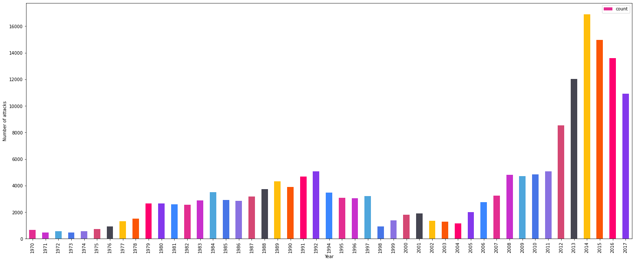
Number of Attacks by year

Slide 7
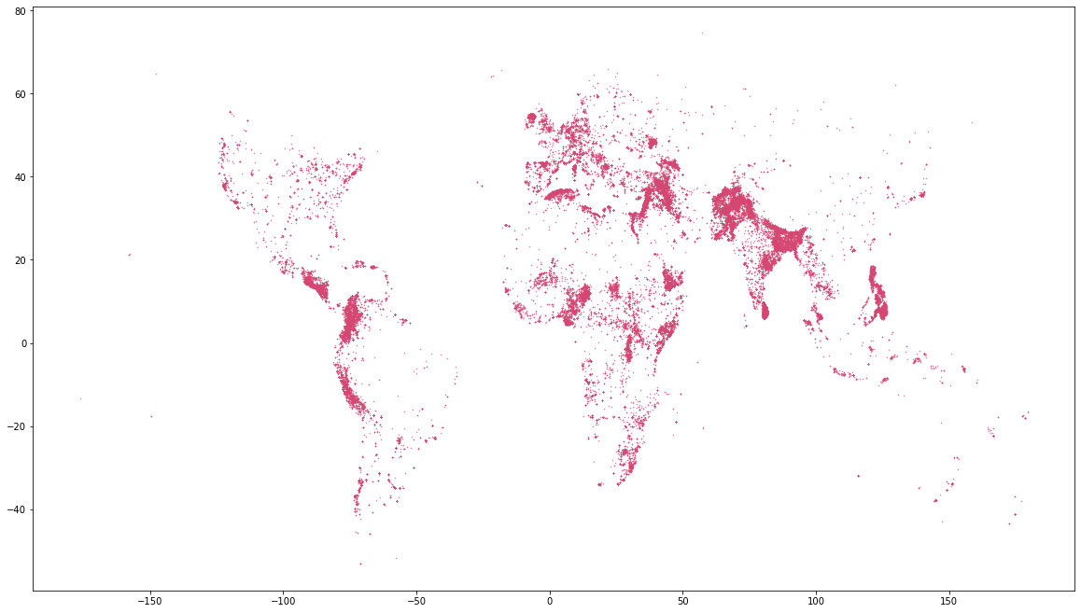
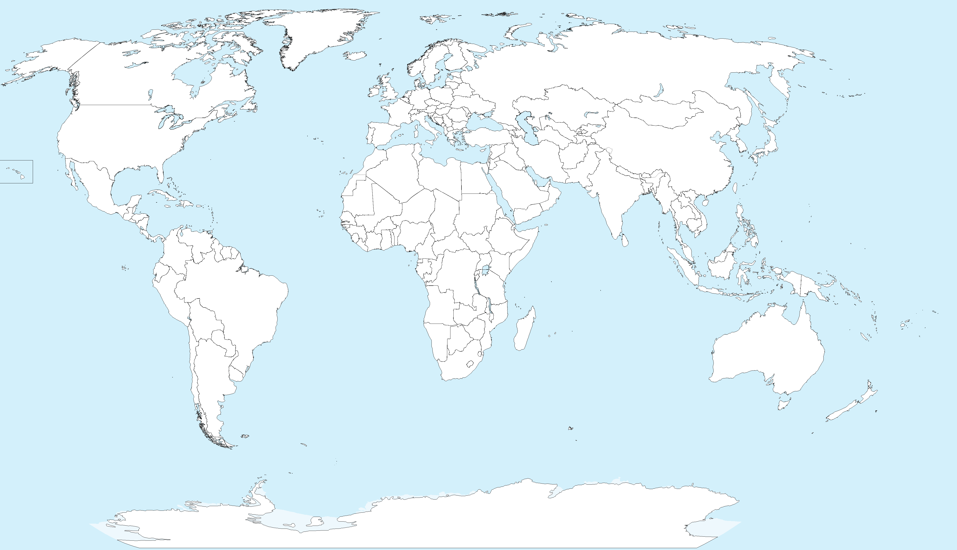
Terrorist attack locations worldwide

Slide 8
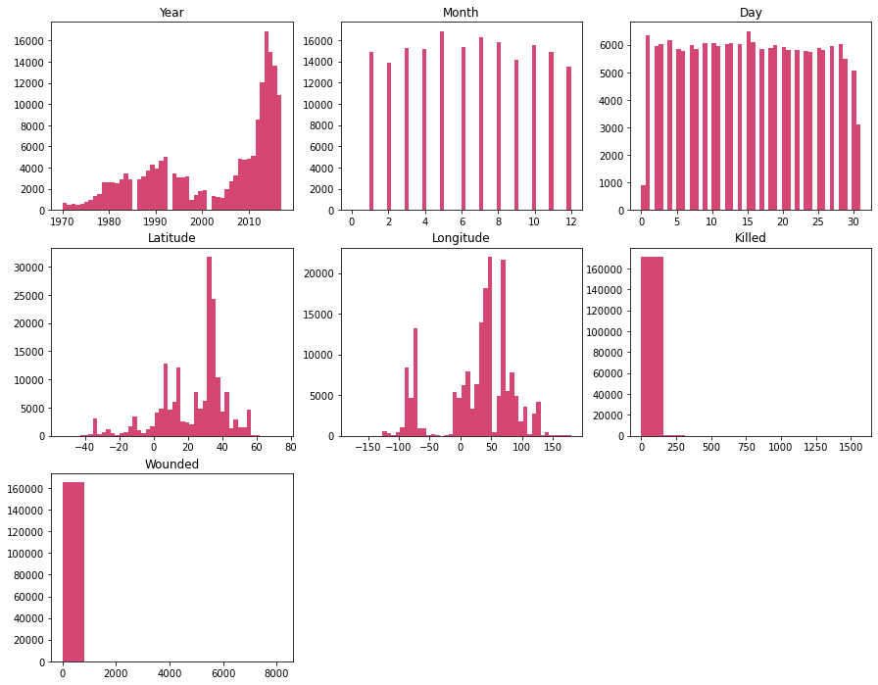
Number of Attacks vs some stats

Slide 9
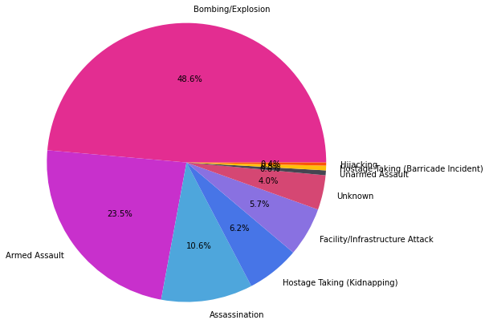
Attack type

Slide 10
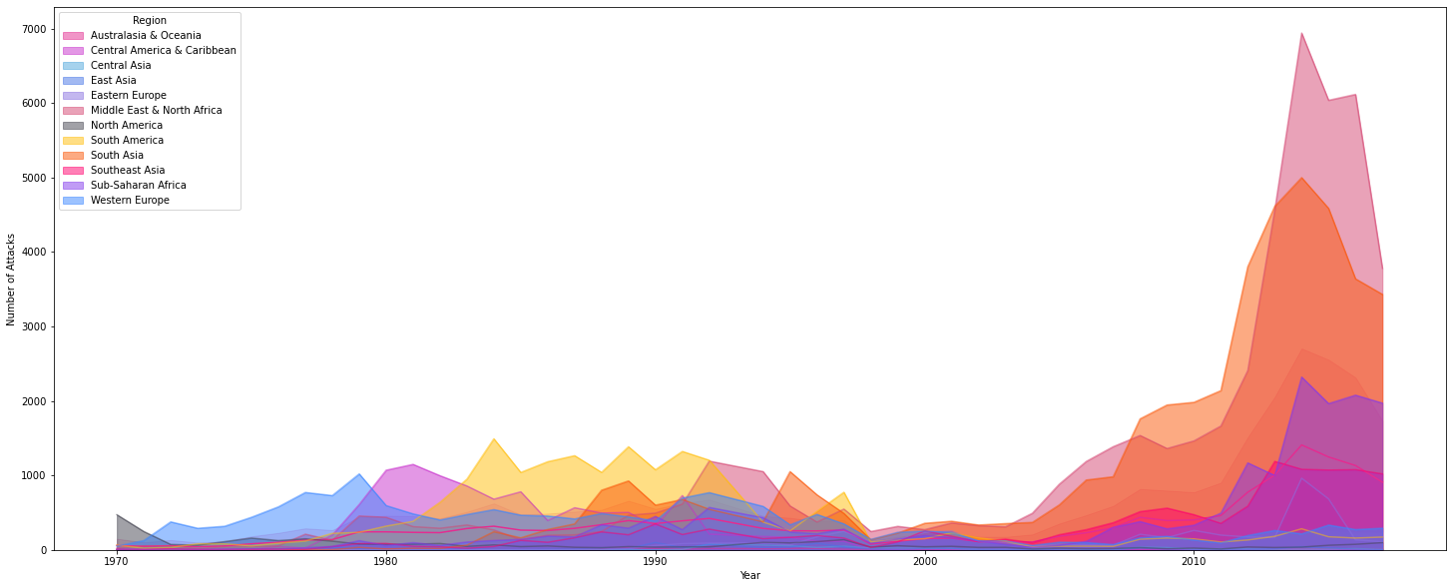
Terrorist activity by region

Slide 11
Top 5 Worst attacks so far
City | Region | Country | Year | Month | Day | Group | Attack type | People affected(avg) | latitude | longitude
New York City | North America | United States | 2001 | 9 | 11 | Al-Qaida | Hijacking | 3085.50 | 40.697132 | -73.931351
New York City | North America | United States | 2001 | 9 | 11 | Al-Qaida | Hijacking | 3085.00 | 40.697132 | -73.931351
Tokyo | East Asia | Japan | 1995 | 3 | 20 | Aum Shinri Kyo | Unarmed Assault | 1384.75 | 35.689125 | 139.747742
Nairobi | Sub-Saharan Africa | Kenya | 1998 | 8 | 7 | Al-Qaida | Bombing/Explosion | 1168.00 | -1.285180 | 36.821107
Gikoro | Sub-Saharan Africa | Rwanda | 1994 | 4 | 13 | Hutu extremists | Armed Assault | 885.00 | -1.932787 | 30.332456

Slide 12
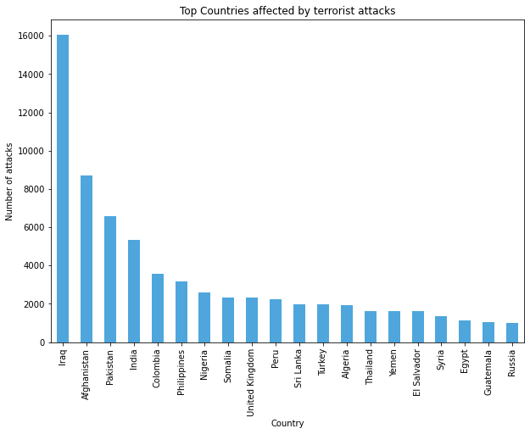
Top Countries affected by terrorist attacks

Slide 13
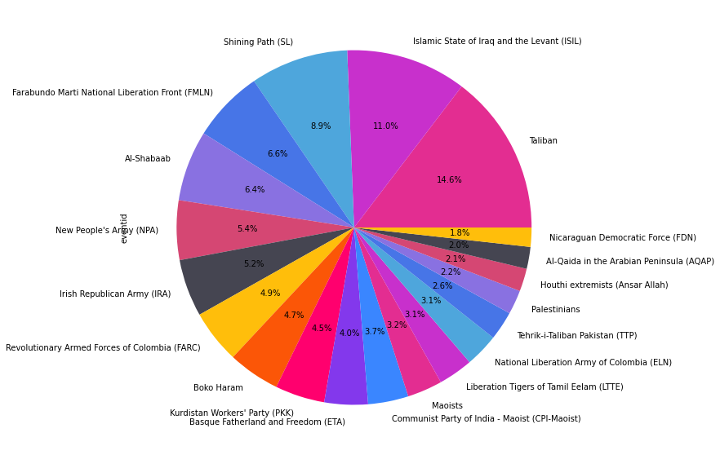
Attack share of top 20 groups

Slide 14
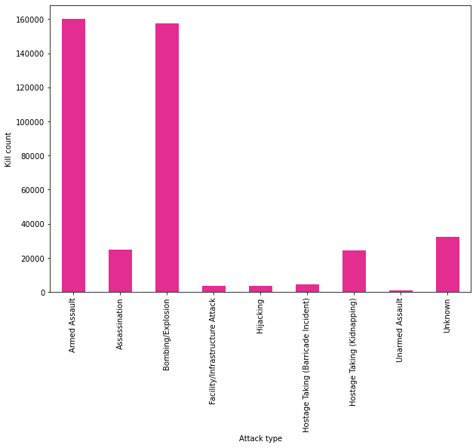
Kill count vs Type of Attack
Total Killed so far
411868

Slide 15
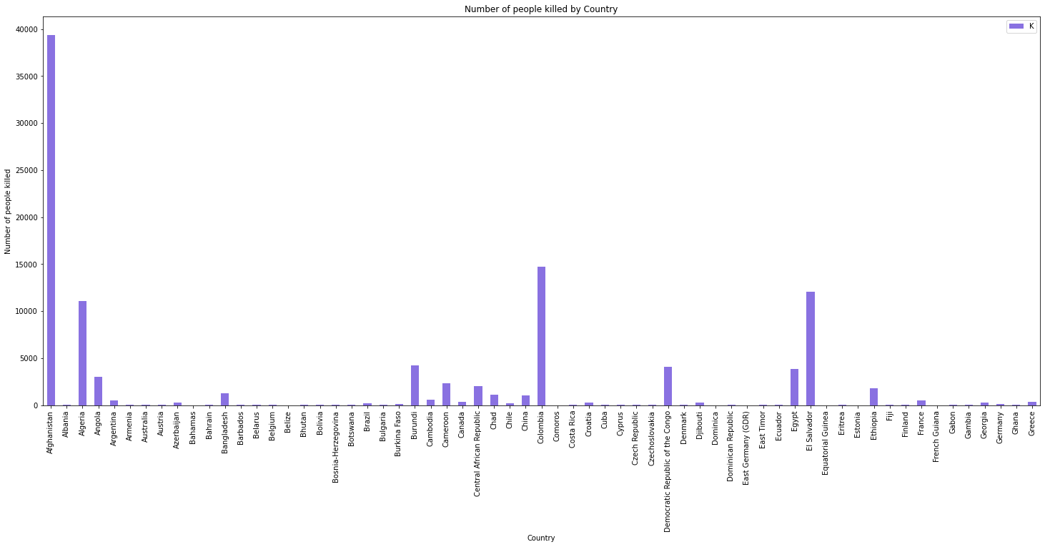
County wise casualties

Slide 16
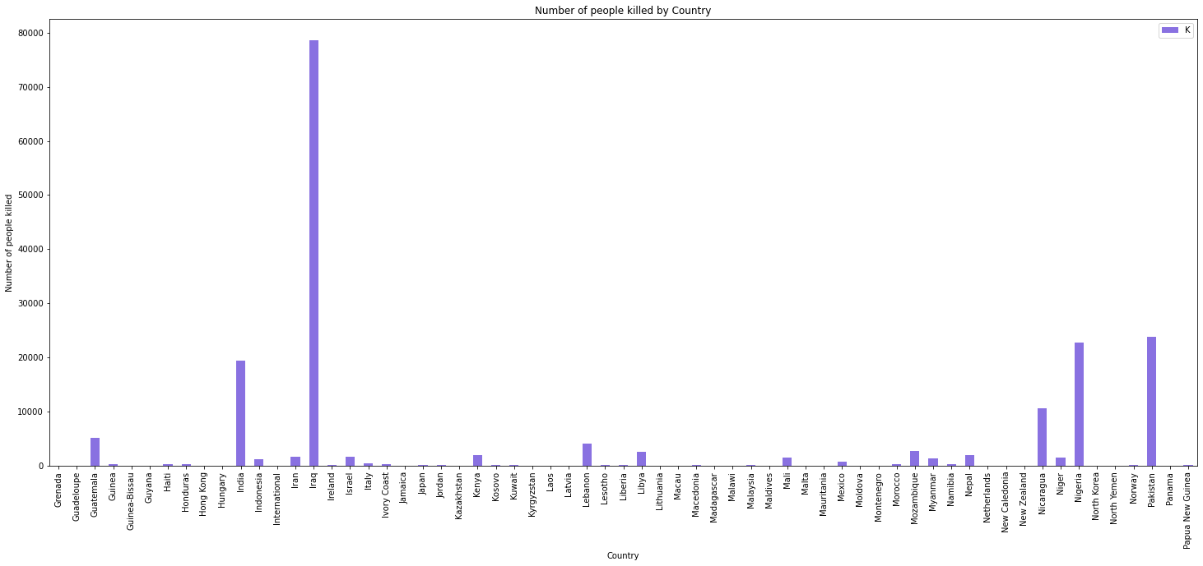

Slide 17
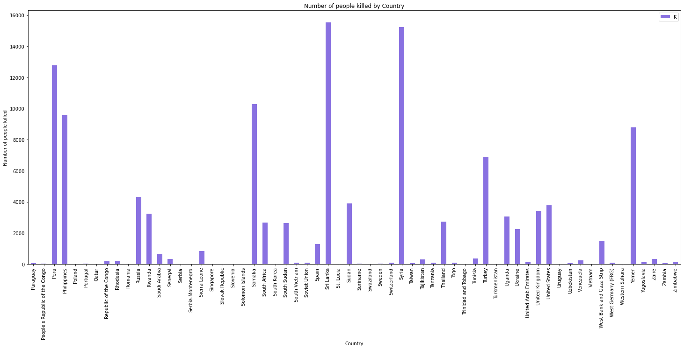

Slide 18
Top casualties count in each country and the group responsible
Terrorist Group | Country | Casualties
Islamic State of Iraq and the Levant (ISIL) | Iraq | 31058.0
Taliban | Afghanistan | 29269.0
Boko Haram | Nigeria | 16917.0
Shining Path (SL) | Peru | 11595.0
Liberation Tigers of Tamil Eelam (LTTE) | Sri Lanka | 10928.0
Al-Shabaab | Somalia | 8176.0
Farabundo Marti National Liberation Front (FMLN) | El Salvador | 8019.0
Islamic State of Iraq and the Levant (ISIL) | Syria | 6883.0
Nicaraguan Democratic Force (FDN) | Nicaragua | 6630.0
Tehrik-i-Taliban Pakistan (TTP) | Pakistan | 6014.0
Revolutionary Armed Forces of Colombia (FARC) | Colombia | 5644.0
Kurdistan Workers' Party (PKK) | Turkey | 4845.0
New People's Army (NPA) | Philippines | 4385.0
Al-Qaida in Iraq | Iraq | 4273.0
Al-Qaida in the Arabian Peninsula (AQAP) | Yemen | 3504.0
Al-Qaida | United States | 3001.0
Fulani extremists | Nigeria | 2986.0
Al-Nusrah Front | Syria | 2926.0
Houthi extremists (Ansar Allah) | Yemen | 2834.0
National Union for the Total Independence of Angola (UNITA) | Angola | 2700.0

Slide 19

Conclusion and Next steps
Conclusion.
Utilizing unused features like target, suicide, etc. from dataset.

Slide 20



QUESTIONS

Slide 21

Contact us
Email chinmay.khisti.ck@gmail.com

