Slide 1
Interview Trainer Agent
IBM
watsonx
IBM SkillsBuild Internship Project
Student:
K Chinmay Krishna
✓ IBM Cloud
Institute:
GITAM University, Hyderabad
✓ RAG
Internship ID:
INTERNSHIP_177549002069d3d3e4f3903
✓ GPT-OSS 120B
AICTE ID:
STU69e08fd499edf1776324564
✓ Agentic AI
Duration:
15 May 2026 – 15 June 2026
✓ Knowledge Base
Problem:
No. 22 – Interview Trainer Agent
Edunet Foundation · IBM SkillsBuild · AICTE | AI & Cloud Emerging Technologies

Slide 2
Problem Statement & Solution
⚡ The Challenge
✅ Our Solution
Job seekers lack structured, personalized interview prep
RAG-powered agent using trusted knowledge base PDFs
Existing tools give generic answers — not role-specific
Generates role-specific HR, behavioral & technical Qs
No system adapts to experience level (fresher vs expert)
Tailors difficulty by experience level (Beginner → Expert)
HR + Technical + Behavioral rounds all need different prep
Provides model answers + STAR framework coaching
No AI-powered model answer generation with STAR guidance
Deployed on IBM Cloud via watsonx Orchestrate
Problem Statement No. 22 – Interview Trainer Agent | IBM watsonx Orchestrate

Slide 3
Technology Stack & Agent Workflow
☁ IBM Cloud
🤖 watsonx
Orchestrate
🧠 GPT-OSS 120B
📚 RAG Knowledge
Base
Lite / Trial Plan
Dallas Region
Agent Builder
ReAct Style
LLM Backbone
OpenAI compatible
8 Interview PDFs
CS + HR + DSA
Agent Workflow
User Input
(Job Role +
Exp. Level)
IBM watsonx
Orchestrate
Agent
RAG Retrieval
from Knowledge
Base
GPT-OSS 120B
LLM Processing
Interview Qs +
Model Answers
+ Tips
▶
▶
▶
▶
IBM watsonx Orchestrate | RAG + GPT-OSS 120B | IBM Cloud Dallas

Slide 4
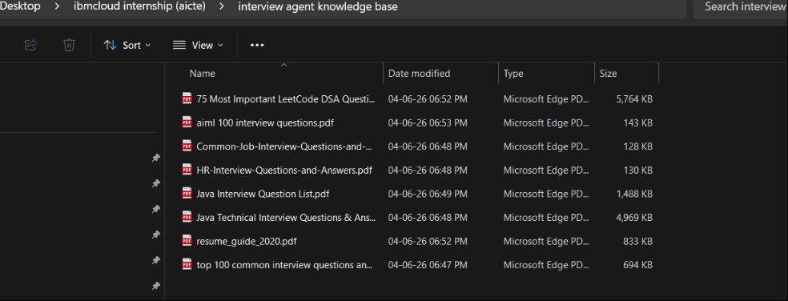
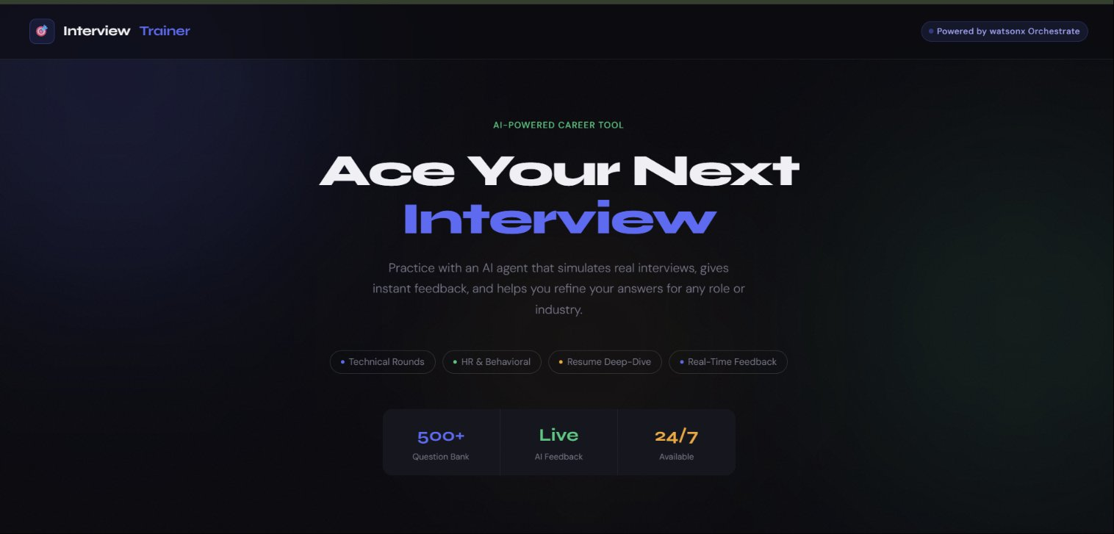
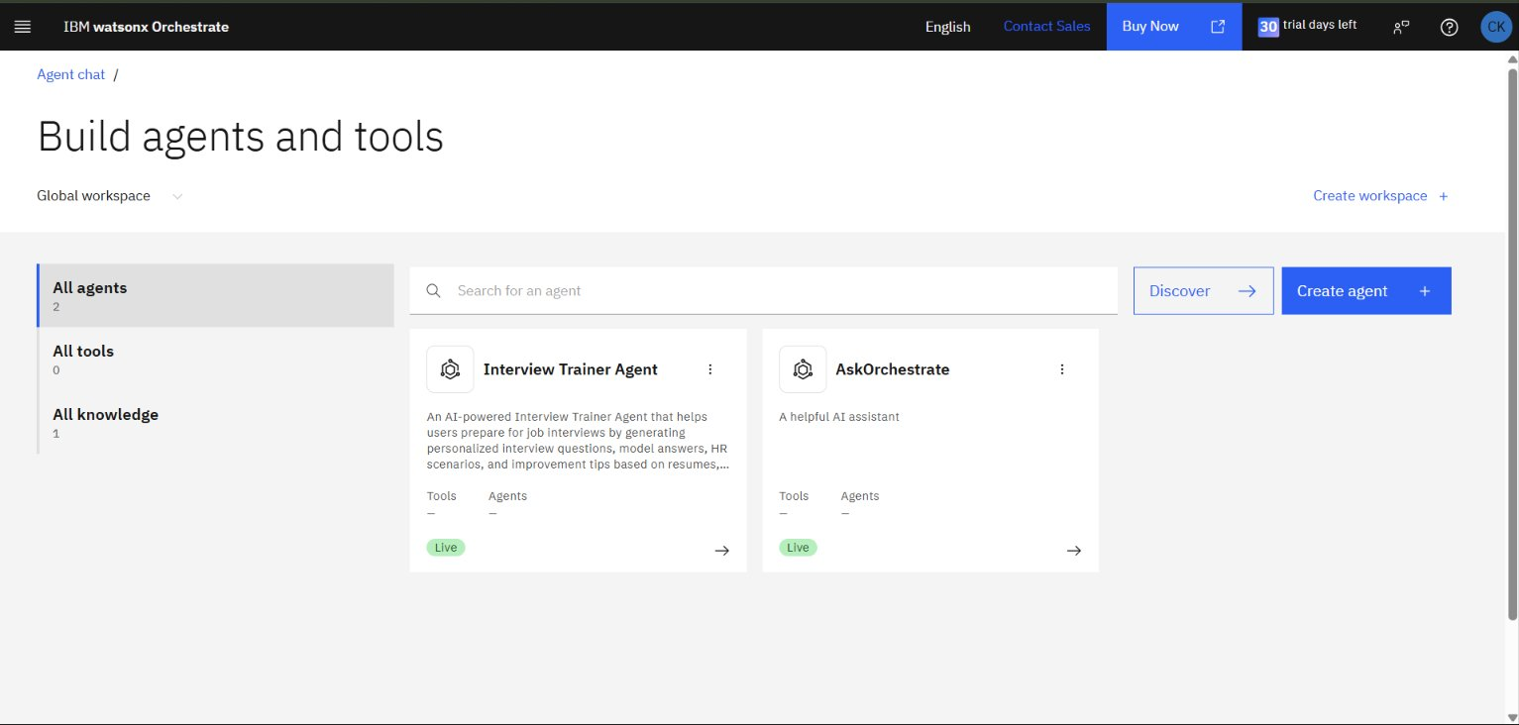
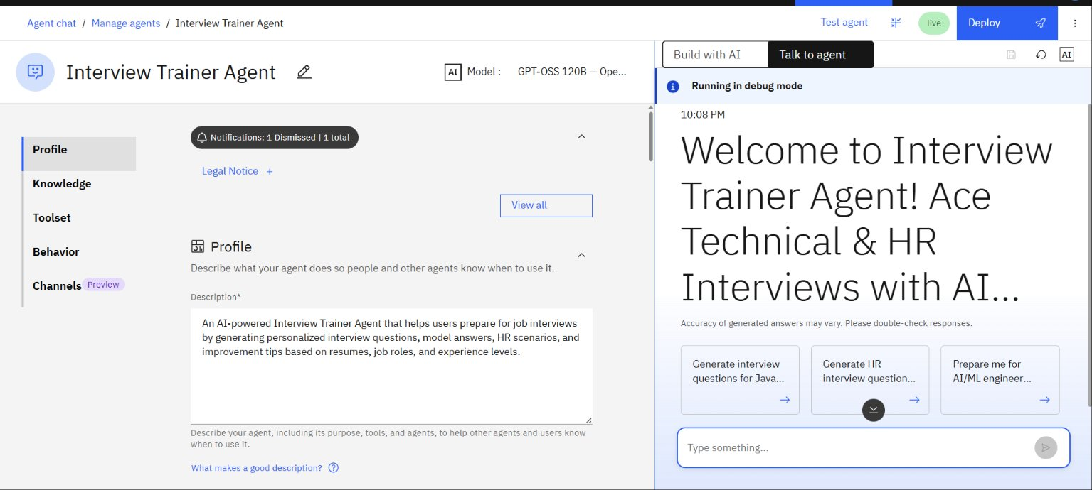
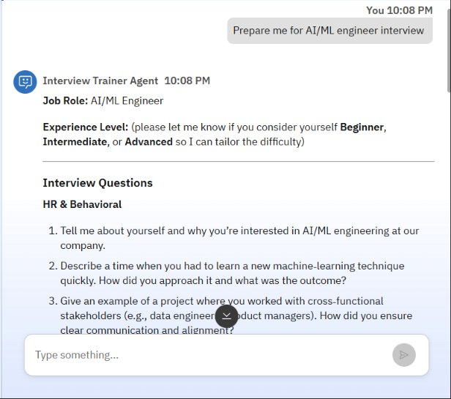
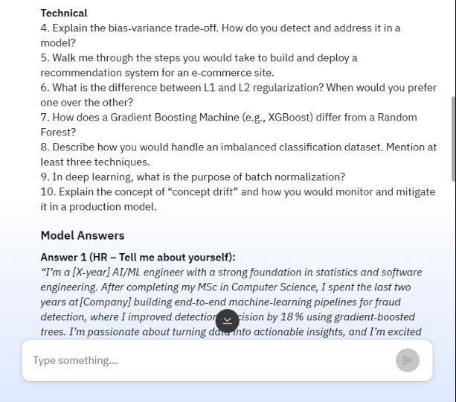
Project Screenshots — Live Demo
Knowledge Base Files
Website Frontend
watsonx Orchestrate Dashboard
Agent Profile Config
Agent Response — AI/ML Interview
Technical Questions Generated
Interview Trainer Agent | Live on IBM watsonx Orchestrate

Slide 5
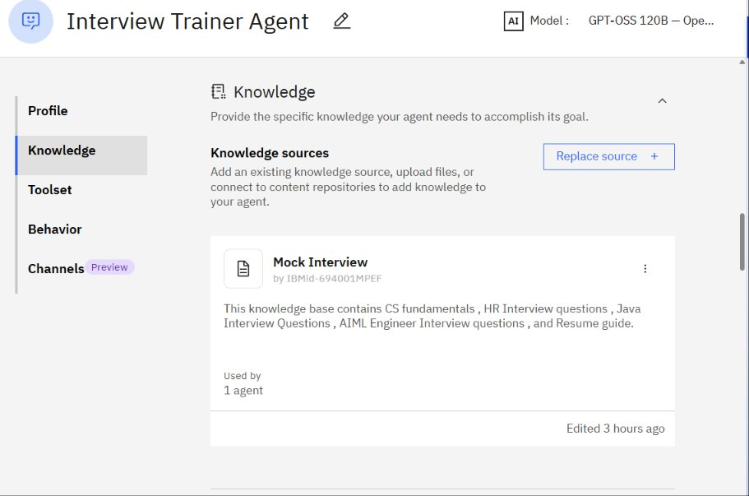
Knowledge Base, Agent Demo & Future Scope
📂 RAG Documents Uploaded
🚀 Future Scope
📄 75 Most Important LeetCode DSA Questions
Resume upload & personalized analysis
📄 AI/ML 100 Interview Questions
Voice-based mock interview mode
📄 Common Job Interview Questions
Confidence scoring & feedback system
📄 HR Interview Questions & Answers
Multi-language support
📄 Java Interview Question List
Integration with LinkedIn job roles
📄 Java Technical Interview Q&A
PDF report generation after session
📄 Resume Guide 2020
ATS score checker for resumes
Knowledge Base — Mock Interview
📄 Top 100 Common Interview Q&A
✅
📚
🔗
🏆
Agent Live
8 PDFs
Embedded
3 IBM Badges
IBM Orchestrate
Knowledge Base
Web Frontend
SkillsBuild
Interview Trainer Agent | K Chinmay Krishna | GITAM University | IBM SkillsBuild 2026

