Slide 1


BE Project Review-3 Presentation On “DeChord-Real-Time Music Key and Chord Recoginition Tool”
Guided By
Prof S.P. Jagtap
Presented by
Chinmay Krishna Roy C43382
Sujit Gupta C43390

Slide 2
Outline
1. Introduction
2. Motivation
3. State of Art
4. State of art Evaluation
5. Problem statement
6. Objectives
7. Social Impact
8. System Architecture
9. System diagrams
10. Feasibility and scope
11. Proposed algorithm
12. Advantages and Limitations
13. Conclusions and Future work.
14. References

Slide 3
INTRODUCTION
What is DeChord?
DeChord is a cutting-edge music analysis tool designed to provide real-time key and chord recognition for audio files. Built with a user-friendly interface and advanced algorithms, DeChord caters to musicians, music enthusiasts, and learners who seek an intuitive way to analyze harmonic structures in music. Music theory can often be challenging, especially when it comes to identifying chords and musical keys in a composition. With DeChord, users can instantly see the key and chords as they play along with their favorite tracks, enabling a deeper understanding of music without needing advanced theoretical knowledge.

Slide 4
The application leverages the powerful madmom library, which is widely used in music signal processing for its ability to accurately detect musical components. By integrating this with a responsive GUI built using PyQt5, DeChord ensures that users can not only visualize chords but also interact with the audio in real-time through playback controls like play, pause, volume adjustments, and seeking. This tool is designed to enhance the music learning process by making it easier to break down complex songs, learn different progressions, and practice improvisation, all while visually confirming the harmonic components.
DeChord stands out by offering a free, accessible solution that is particularly useful for those looking to refine their musical ear, practice songwriting, or analyze compositions in a practical, hands-on manner.

Slide 5
MOTIVATION
Why This Project?
Many musicians struggle with identifying chords and keys while learning music.
Existing tools are either too expensive or lack real-time feedback.
Personal passion for both music and technology drove the development of an affordable, real-time recognition tool for all levels of musicians.

Slide 6
State of Art
Chordify :
Description:
An online tool for automatic chord extraction.
Features:
Provides chord diagrams but lacks real-time capabilities.
Limitations:
Limited real-time feedback and interactivity.
Melodyne :
Description:
Advanced software for pitch and time correction, with chord recognition features.
Features:
High accuracy in chord recognition.
Limitations:
Expensive and complex for beginners.

Slide 7
Chordino :
Description:
An open-source library for chord detection.
Features:
Provides basic chord recognition functionalities.
Limitations:
No integrated GUI and limited support for real-time processing.
Guitar Pro :
Description:
A tool for guitarists with features for chord analysis and music notation
Features:
Focuses on string instruments.
Limitations:
Not suited for multi-instrument or real-time analysis.

Slide 8
State of the Art Evaluation
Tool | Real-Time | Chord Detection | User-Friendly | Cost
Chordify | No | Moderate | High | Free
Melodyne | Yes | High | Low | Paid
Chordino | No | Moderate | Low | Free
Guitar Pro | No | Low | High | Paid
Gap Analysis:
Most tools lack real-time feedback, are not user-friendly, and are expensive. DeChord addresses these gaps by providing real-time chord and key recognition with an easy-to-use interface.

Slide 9
Problem Statement
Despite the availability of various music analysis tools, there remains a significant gap in accessible, real-time key and chord recognition applications tailored for musicians and learners. Existing solutions often fall short due to limitations such as high costs, lack of real-time feedback, complexity, or instrument-specific designs. Addressing these shortcomings, DeChord is developed as an intuitive, real-time tool that provides accurate key and chord recognition, catering to musicians of all skill levels.

Slide 10
OBJECTIVES
Real-Time Chord and Key Detection:
Develop a user-friendly application capable of recognizing and displaying musical chords and key in real-time from any audio file, offering instant feedback to musicians during live performance or practice.
Accessibility and Usability:
Create an intuitive graphical user interface that allows both beginners and advanced users to easily interact with the application, including features like drag-and-drop functionality, theme customization, and playback controls.
Cross-Platform Compatibility:
Ensure compatibility with a wide range of audio file formats (.mp3, .wav, .m4a, etc.), allowing users to analyze various types of music files without format limitations.
Audio Playback and Control:
Integrate essential audio controls, including play, pause, seek, and volume adjustment, enabling users to manipulate audio files while analyzing chords and key in real-time.
Chord Export and Analysis:
Provide the functionality to export the recognized chord progression to a text file, enabling users to save and study their findings for future reference or composition purposes.

Slide 11
Social Impact
Music Education:
Simplifies music theory learning, making it accessible to beginners and students.
Support for Independent Artists:
Provides affordable, real-time music analysis, helping artists improve compositions without expensive
tools.
Inclusivity:
Enables people from diverse backgrounds to engage with music theory, fostering creativity and participation.
Creative Collaboration:
Enhances collaboration among musicians and producers through real-time harmonic analysis.
Cultural Preservation:
Assists in analyzing and preserving traditional music from different cultures, supporting ethnomusicological studies.

Slide 12
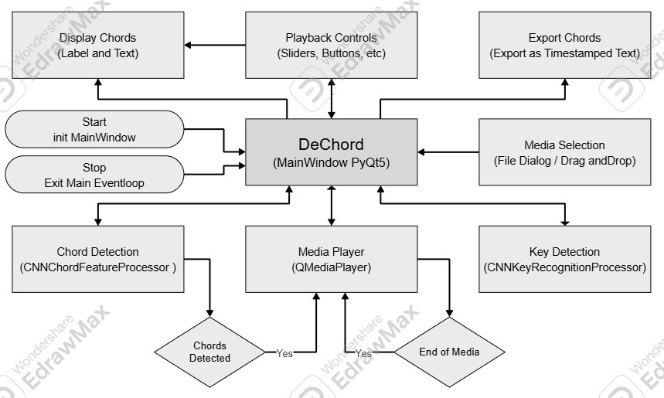
System Architecture

Slide 13
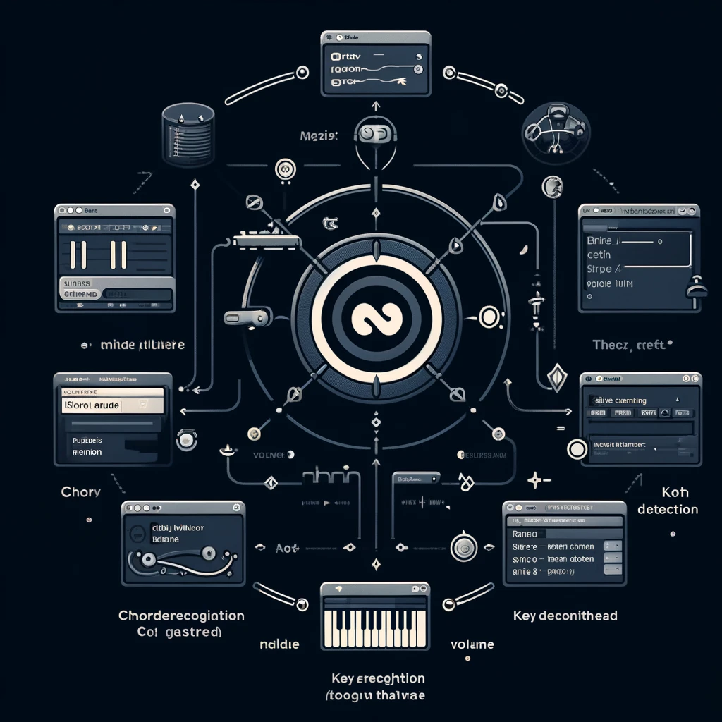
System Diagrams

Slide 14
Feasibility and Scope
Software Requirements:
Python 3.7 or higher, PyQt5 for GUI, madmom for audio analysis.
Hardware Requirements:
Standard desktop or laptop with audio playback capabilities.
Project Timeline:
Outline phases for planning, development, testing, and review.
Technical Risks:
Real-time performance might be hindered by hardware limitations.
Backup Plan:
Include an offline analysis mode if real-time recognition proves challenging.

Slide 15
Proposed Techniques and Algorithms:
Fast Fourier Transform (FFT):
Description: A mathematical algorithm used to analyze the frequency components of a signal.
Application: Useful for identifying musical features in real-time.
Machine Learning Approaches:
Description: Techniques like neural networks and deep learning for improved accuracy in chord and key recognition.
Examples: Convolutional neural networks (CNNs) and recurrent neural networks (RNNs).
Harmonic Analysis:
Description: Methods for analyzing the harmonic structure of music, including pitch class profiles and harmonic dictionaries.

Slide 16
Advantages and Limitations
Advantages:
Real-time recognition of chords and keys.
Easy-to-use interface suitable for beginners.
Multi-instrument support.
Limitations:
May face difficulties in noisy environments.
Requires moderate computational power for smooth real-time operations.

Slide 17
Conclusion and Future Work
Conclusion:
DeChord fills the gap in real-time music key and chord recognition for musicians by providing an intuitive, accessible tool.
Future Work:
Expanding support for more instruments and genres.
Development of a mobile version of the app.
Integration of AI-driven music composition tools.

Slide 18
References
Chordify: https://chordify.net
Melodyne: https://www.celemony.com/en/melodyne
Chordino: https://github.com/CPJKU/chordino
Guitar Pro: https://www.guitar-pro.com
Madmom Library: https://github.com/CPJKU/madmom

