Slide 1


JSPM’s
Rajarshi Shahu College of Engineering, Tathawade, Pune
(An Autonomous Institute affiliated to Savitribai Phule Pune University)
Department of Computer Science and Business Systems
Academic Year: 2026-27
Project Title:
CampusCare – College Complaint & Service Management System
Students Name and PRN no: Chinmay Meshram (RBT24CB028)
Date: 15 October 2026
Course Name: Skill Development Lab-II
Course Coordinator: Prof. Rutuja S. Bachhav

Slide 2
Index
Introduction
Problem Definition & Objectives
Literature Survey
Feasibility Study
System Design & Architecture
Technology & Tools Used
Implementation & Results (Screenshots)
Testing & Results
Conclusion & Future Scope
References

Slide 3
Introduction / Background
Definition: CampusCare is a full-stack, role-based web application for lodging, routing, tracking and resolving college complaints and service requests.
Overview: Students raise complaints, the admin assigns them to staff, staff report progress, and every step is shown on a live timeline with notifications.
Background: Campuses still depend on paper registers, calls and WhatsApp groups – complaints get lost and nobody is accountable.
Evolution: Enterprise platforms (Jakarta EE: EJB, JPA, JAX-RS, JMS) now make robust, transactional workflow systems straightforward to build.
Motivation: Transparency, faster resolution and data-driven decisions for campus administration.

Slide 4
Problem Definition & Objectives
Problem: No single, transparent channel to report campus issues; no priority, ownership, status or history.
Objectives:
  Online complaint lodging with category and priority
  Role-based access: Student / Staff / Administrator
  Life-cycle tracking: PENDING → ASSIGNED → IN_PROGRESS → RESOLVED → CLOSED
  Asynchronous notifications using JMS + Message-Driven Bean
  Admin analytics and department management
  REST/JSON APIs (JAX-RS) with JPA persistence in MySQL

Slide 5
Literature Survey
Existing approach | Strengths | Limitations
Paper register / complaint box | No technology needed | Lost entries; no tracking, priority or analytics
Phone / e-mail / WhatsApp | Fast and familiar | Unstructured; no status, history or accountability
Generic helpdesk tools | Rich workflow | Paid, over-complex, not campus/department specific
College ERP grievance module | Linked to student data | One-way submission; little live tracking; rigid
CampusCare (proposed) | Transparent, auditable, free, extensible | Prototype: no attachments / e-mail / SMS yet
• Gaps found: no visibility, no accountability, no prioritisation, no analytics, tightly-coupled notifications.
• Our answer: structured data, enforced workflow, timeline, department routing, dashboards, JMS-based async design.

Slide 6
Feasibility Study
Technical Feasibility
  Mature, standard stack: Java 17, Jakarta EE 10, GlassFish 7, MySQL, Maven, NetBeans – all free and well documented
  Runs on an ordinary laptop; verified end-to-end (API responses about 3–35 ms locally)
Financial / Business
  Zero licence cost (open-source stack); only hosting needed for production
  Saves staff time and gives management analytics to prioritise maintenance spending
Operational Feasibility
  Simple SPA UI with one-click demo login; no training needed for students
  Fits existing roles: students, maintenance staff, administration

Slide 7
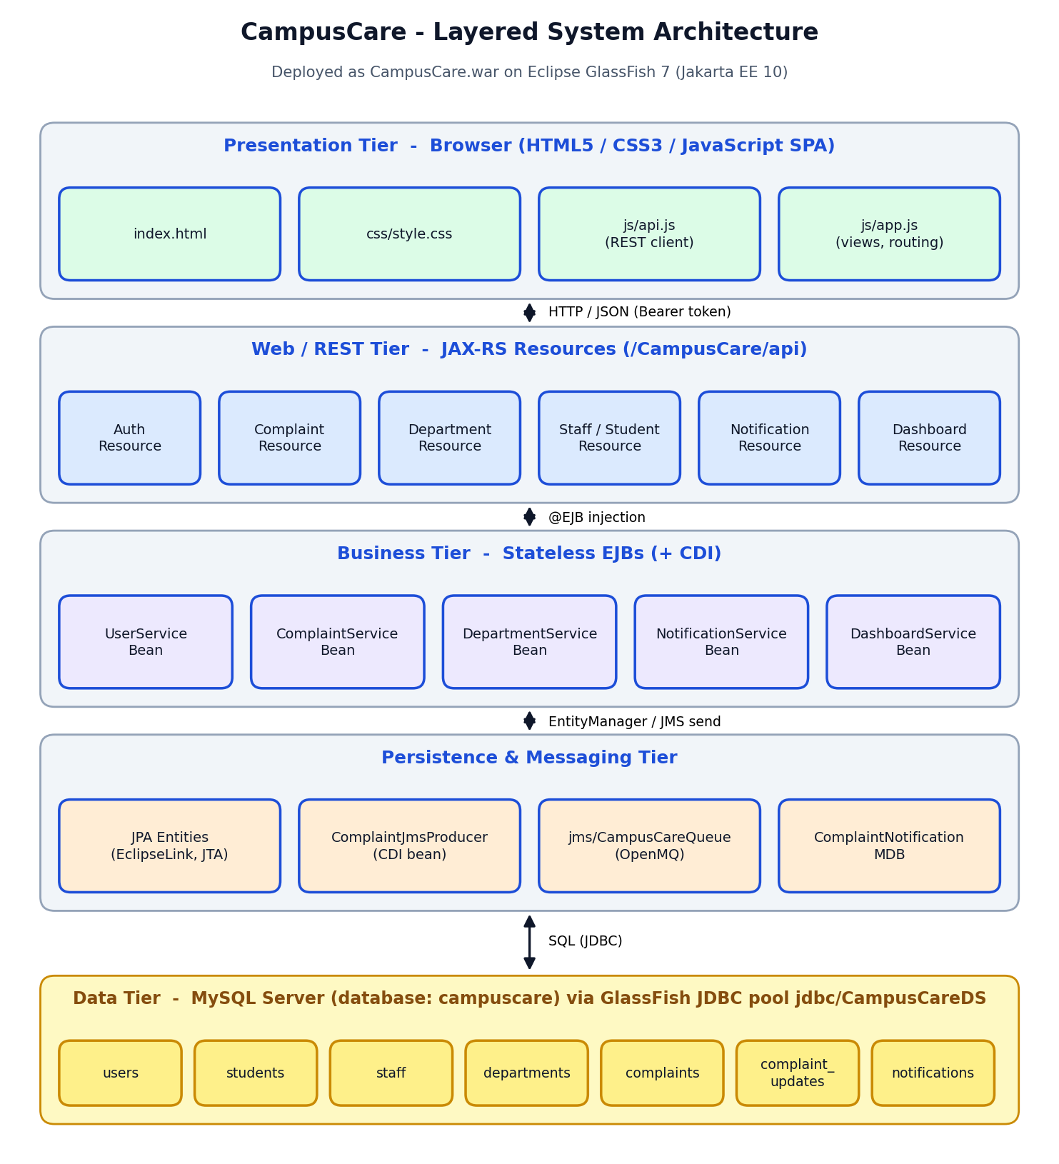
System Design & Architecture
• Presentation: HTML5/CSS3/JS single-page app
• REST tier: JAX-RS resources under /CampusCare/api (JSON)
• Business tier: Stateless EJBs + CDI
• Persistence: JPA / EclipseLink, JTA datasource
• Messaging: JMS queue → Message-Driven Bean
• Data tier: MySQL database campuscare (7 tables)
• Security: PBKDF2 passwords, HMAC-SHA256 tokens, role checks
• Deployment: CampusCare.war on GlassFish 7.0.18

Slide 8
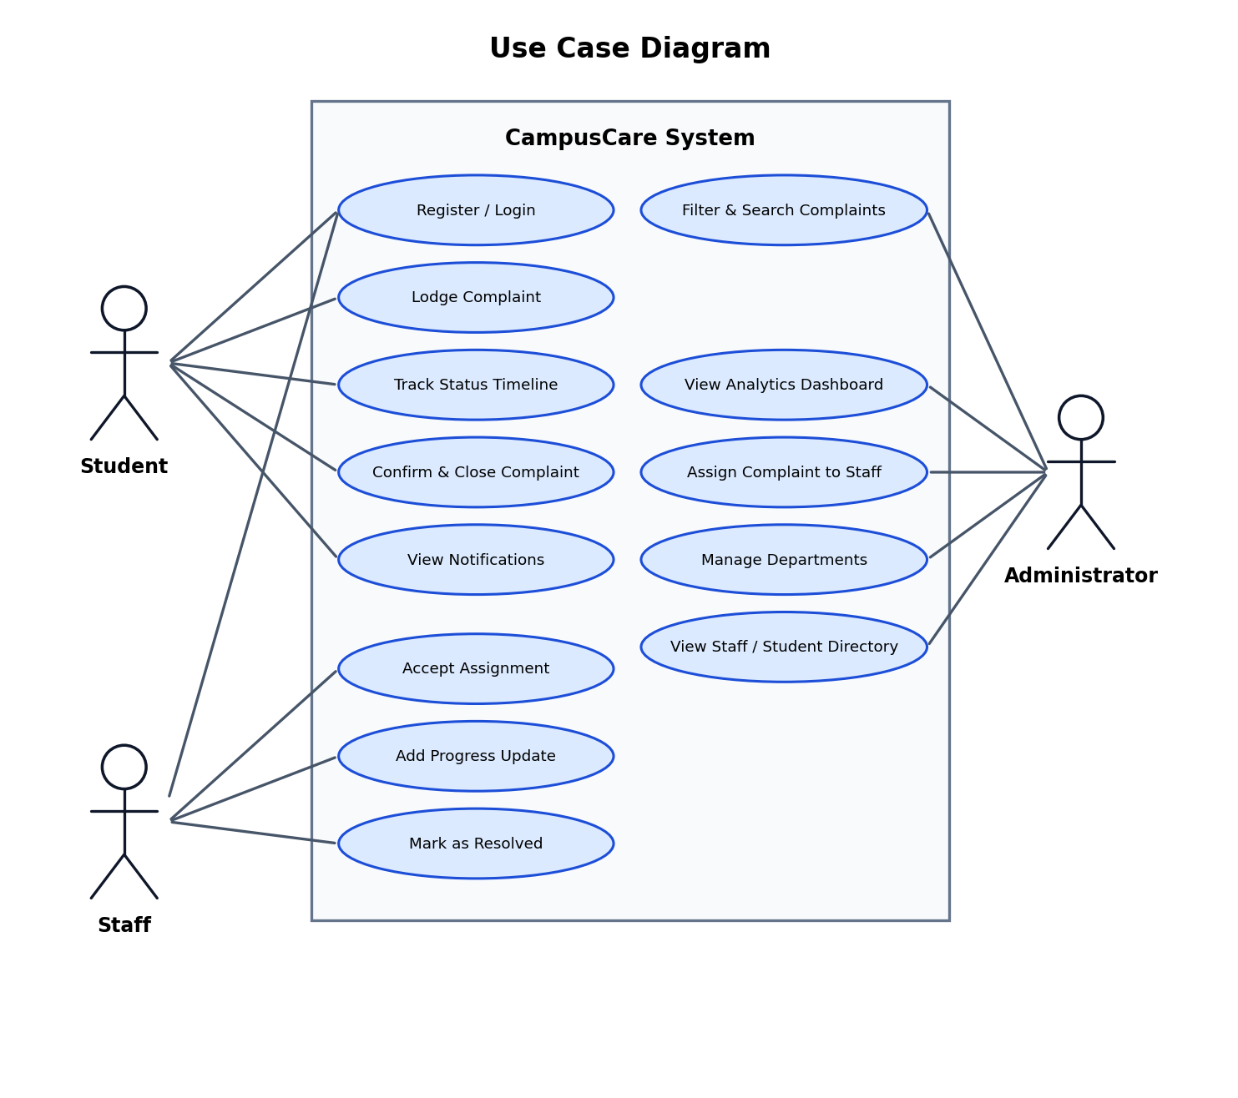
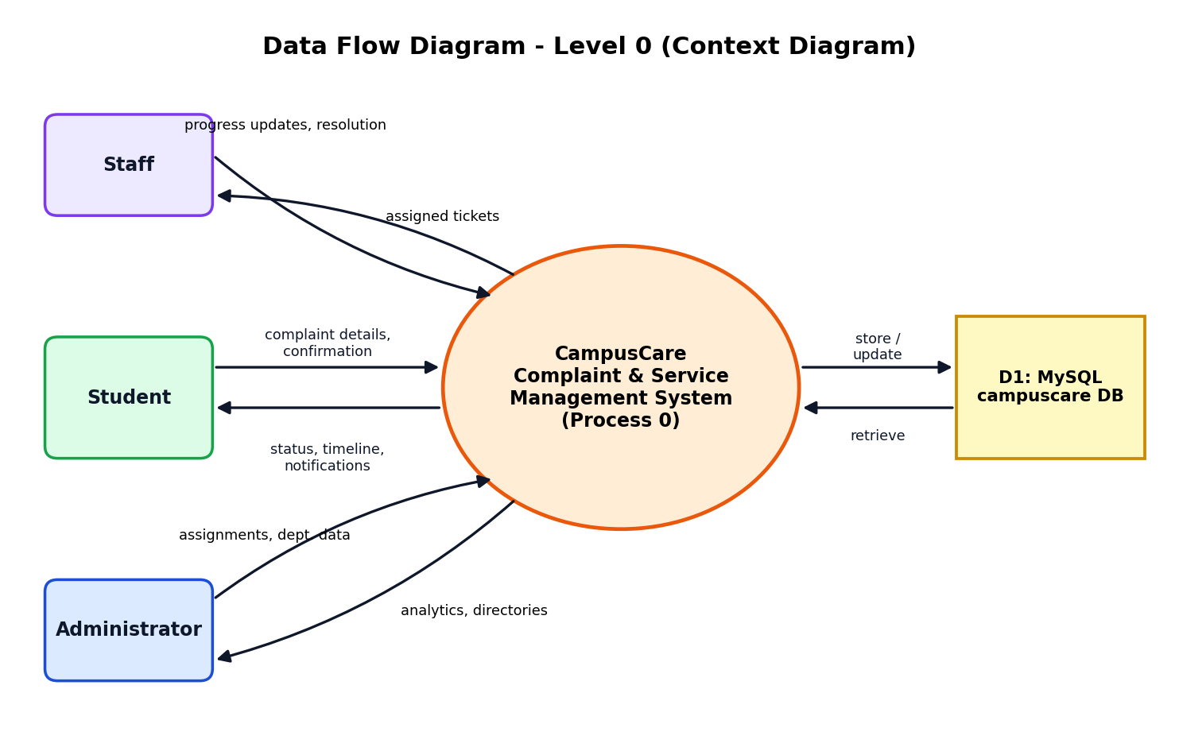
Use Cases & Data Flow
DFD level 0 (context)
Use case diagram

Slide 9
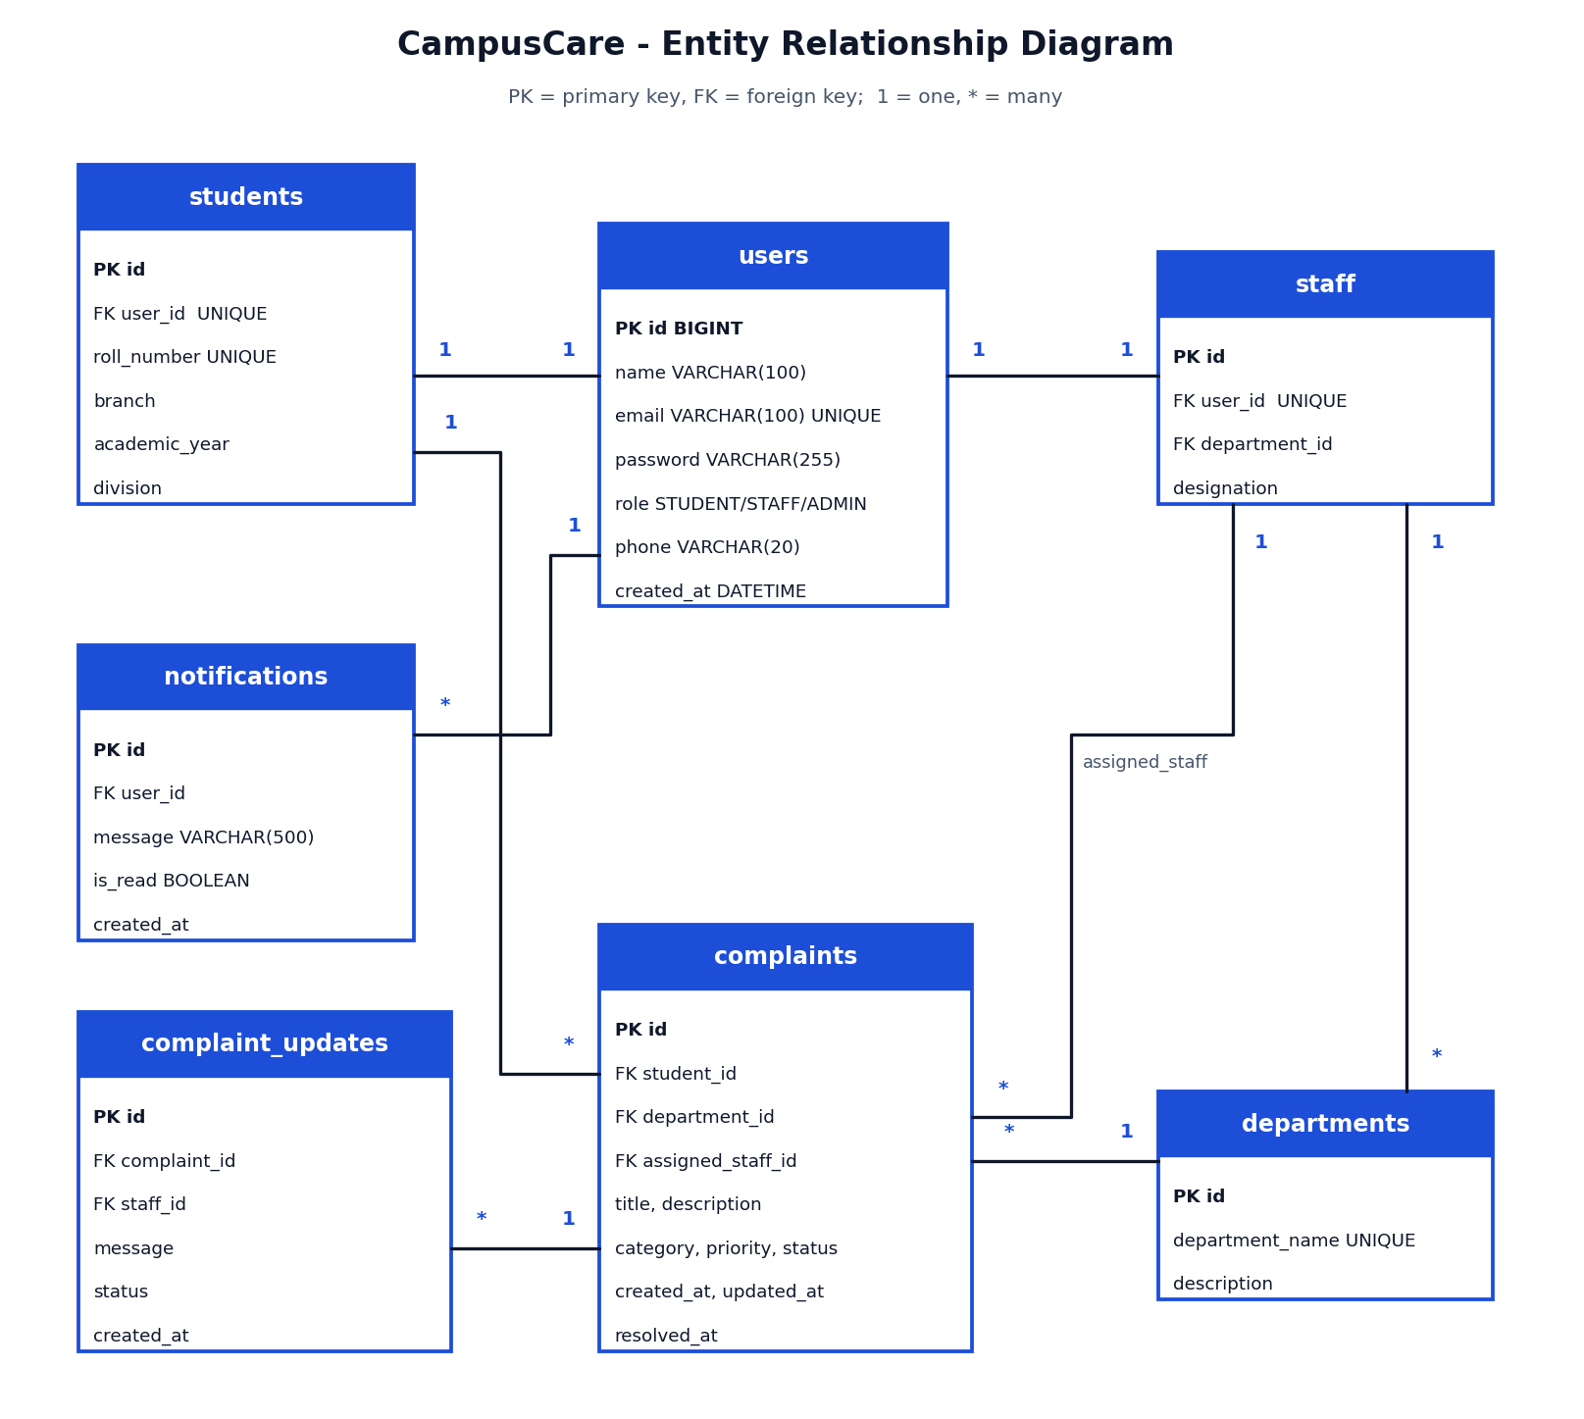
Database Design (ER Diagram)
• User 1:1 Student or Staff
• Department 1:* Staff
• Department 1:* Complaint
• Student 1:* Complaint
• Staff 1:* Complaint (assigned)
• Complaint 1:* ComplaintUpdate (timeline)
• User 1:* Notification
Entity relationship diagram – 7 JPA entities

Slide 10
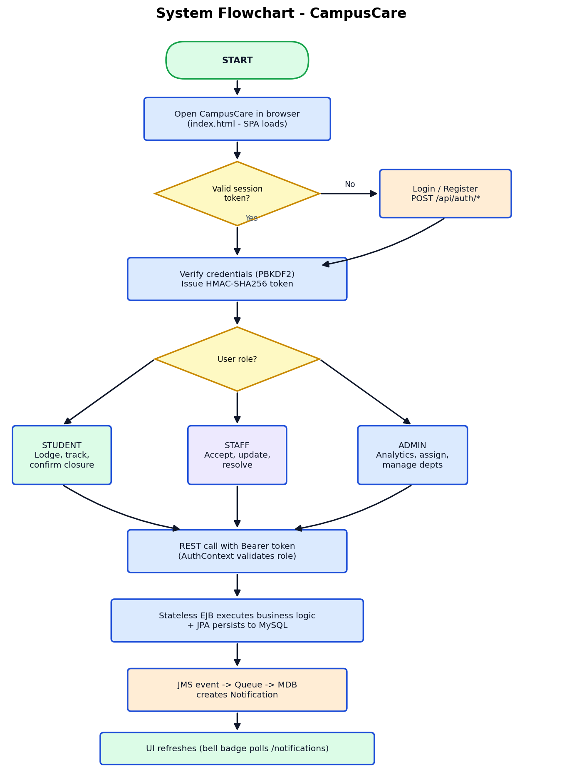
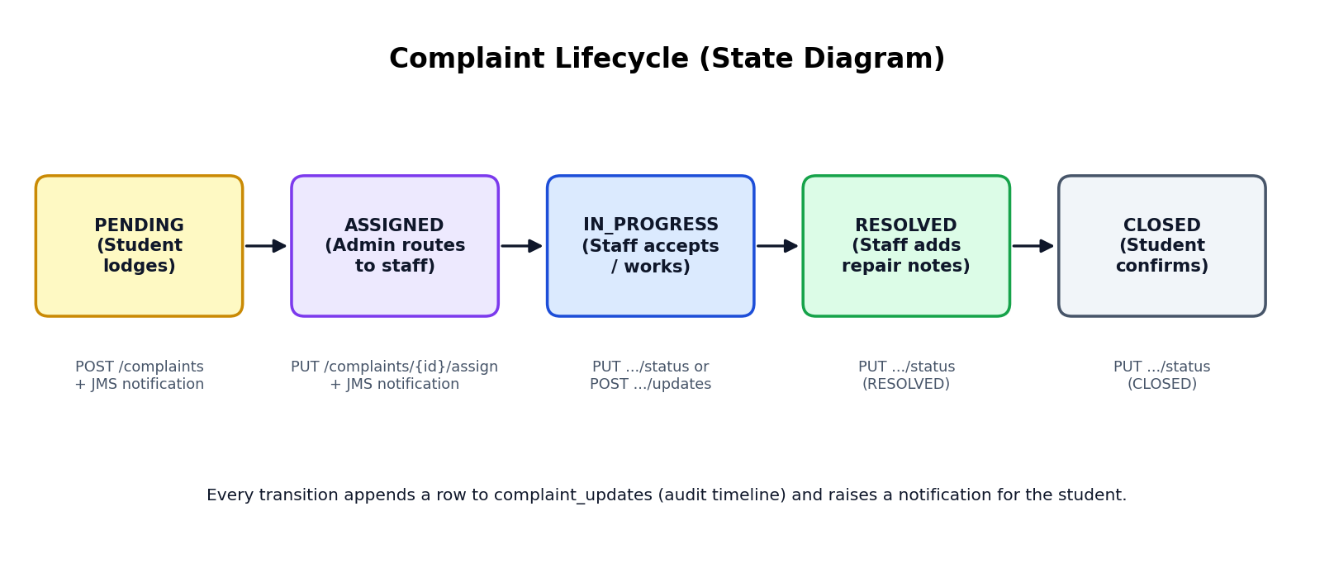
Flowchart & Complaint Life Cycle
Complaint life cycle
• Student can only close RESOLVED complaints
• Staff: ASSIGNED → IN_PROGRESS → RESOLVED
• Admin can manage any transition
• Every change adds a timeline row + notification
System flowchart

Slide 11
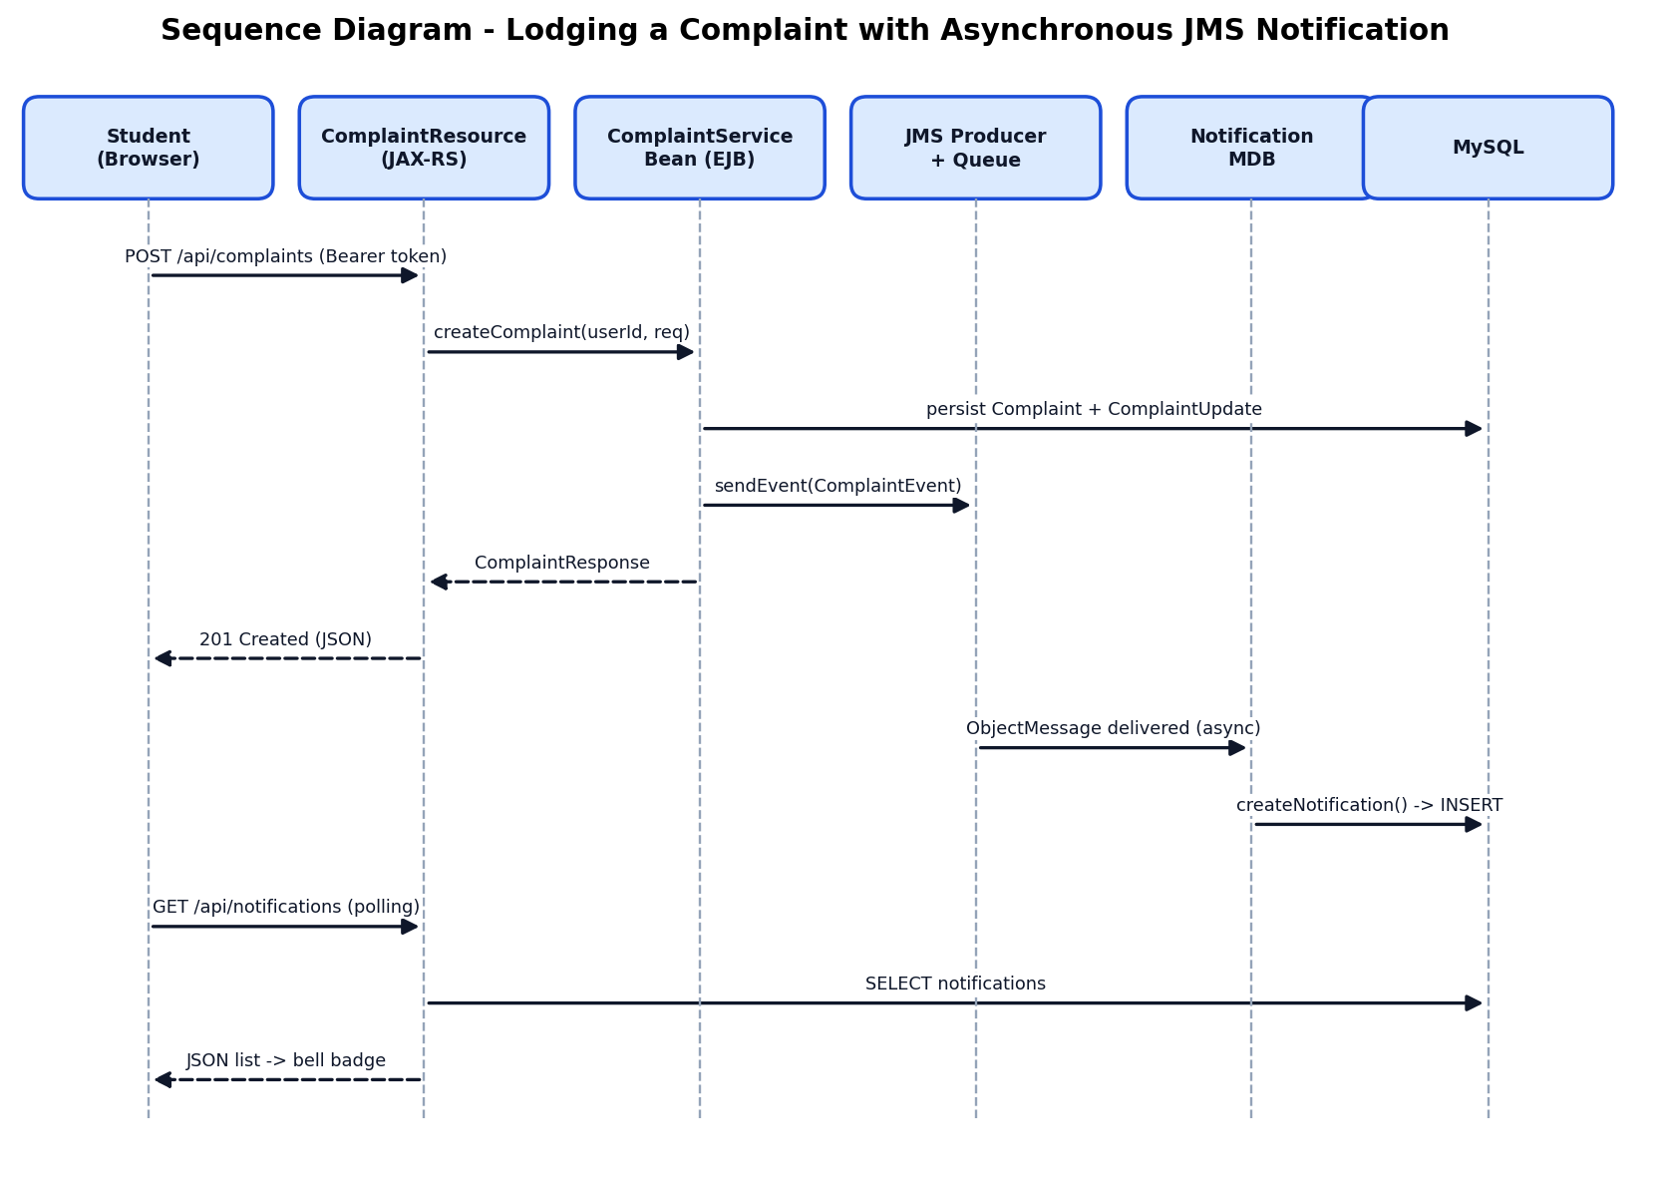
Asynchronous JMS Notification Flow
Sequence: lodge complaint → JMS queue → MDB → notification

Slide 12
Technology & Tools Used
Layer | Technology
Language / Platform | Java 17, Jakarta EE 10
Application server | Eclipse GlassFish 7.0.18
Business logic | EJB 4.0 (@Stateless, @Singleton @Startup), CDI 4.0
Persistence | JPA 3.1 (EclipseLink), Bean Validation 3.0
REST API | JAX-RS 3.1 (JSON)
Messaging | JMS 3.1 (OpenMQ), @MessageDriven bean
Database | MySQL (utf8mb4), Connector/J 8.3.0
Front-end | HTML5, CSS3, vanilla JavaScript SPA
Build / IDE | Apache Maven, Apache NetBeans

Slide 13
Implementation – Modules
Module | Key classes | What it does
Security | AuthResource, UserServiceBean, PasswordUtil, TokenUtil, AuthContext | Login/register, PBKDF2 hashing, signed 24 h tokens, role checks
Complaints | ComplaintResource, ComplaintServiceBean | Create, filter, assign, update, transition rules, timeline
Departments / Users | DepartmentServiceBean, Staff/Student resources | Departments, staff and student directories
Notifications | ComplaintJmsProducer, ComplaintNotificationMDB | Queue events and persist notifications asynchronously
Dashboard | DashboardServiceBean | JPQL aggregates by status, category, priority, department
Start-up seed | DataInitializer | Seeds departments, demo users and sample complaints
Front-end | index.html, api.js, app.js (~1,480 lines) | SPA views, modals, filters, timeline, notification bell

Slide 14
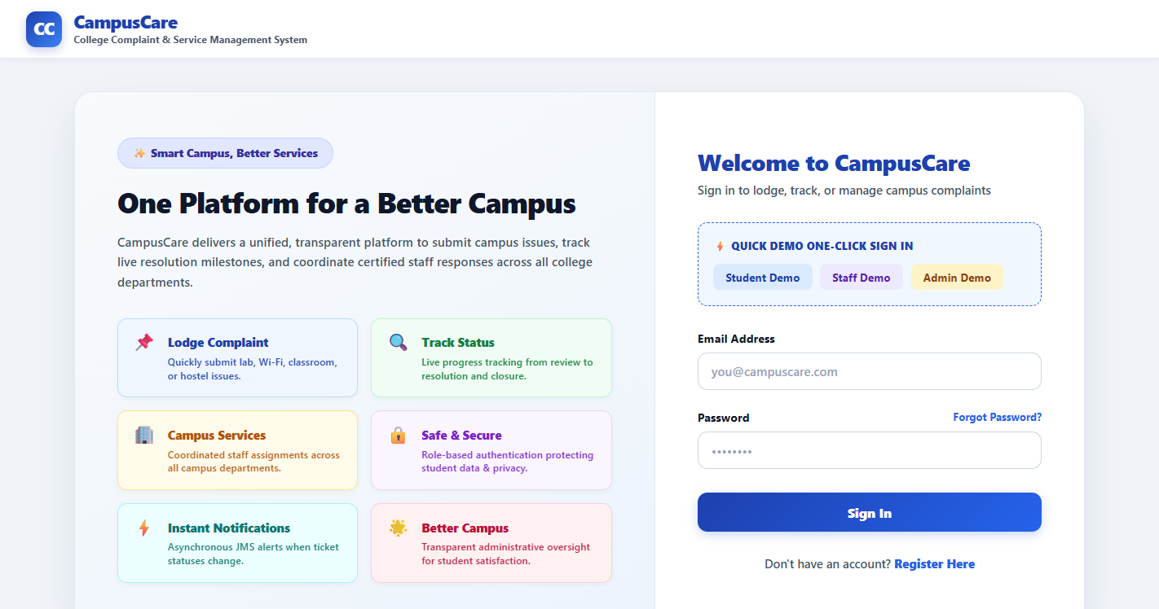
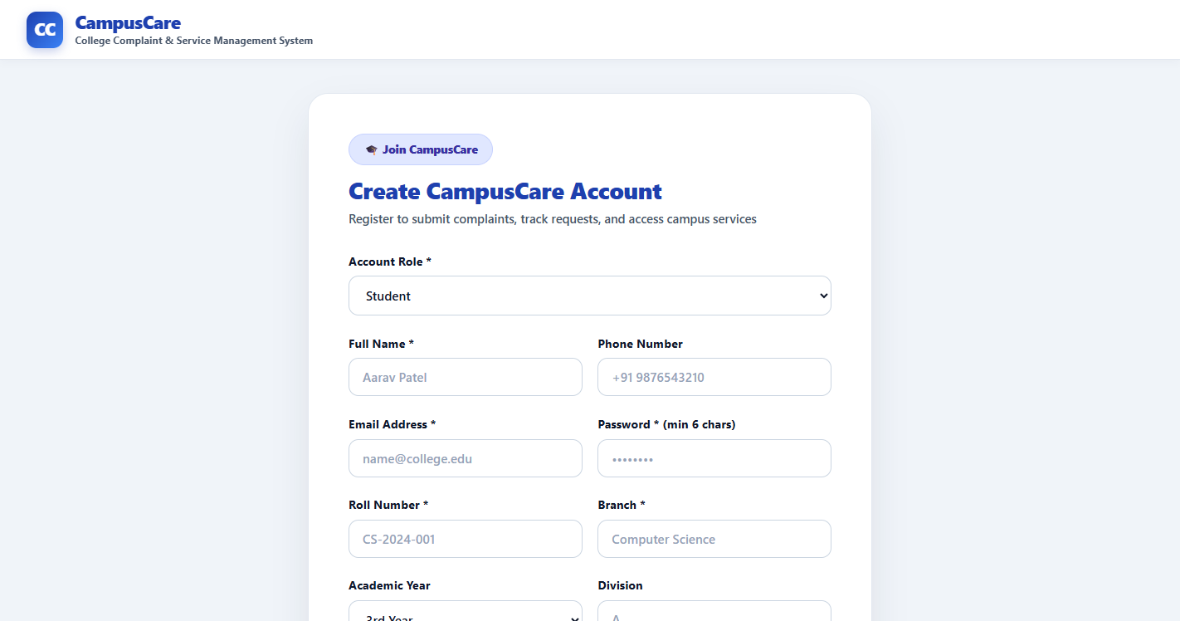
Results – Login & Registration
Login page with Quick Demo buttons
Student registration

Slide 15
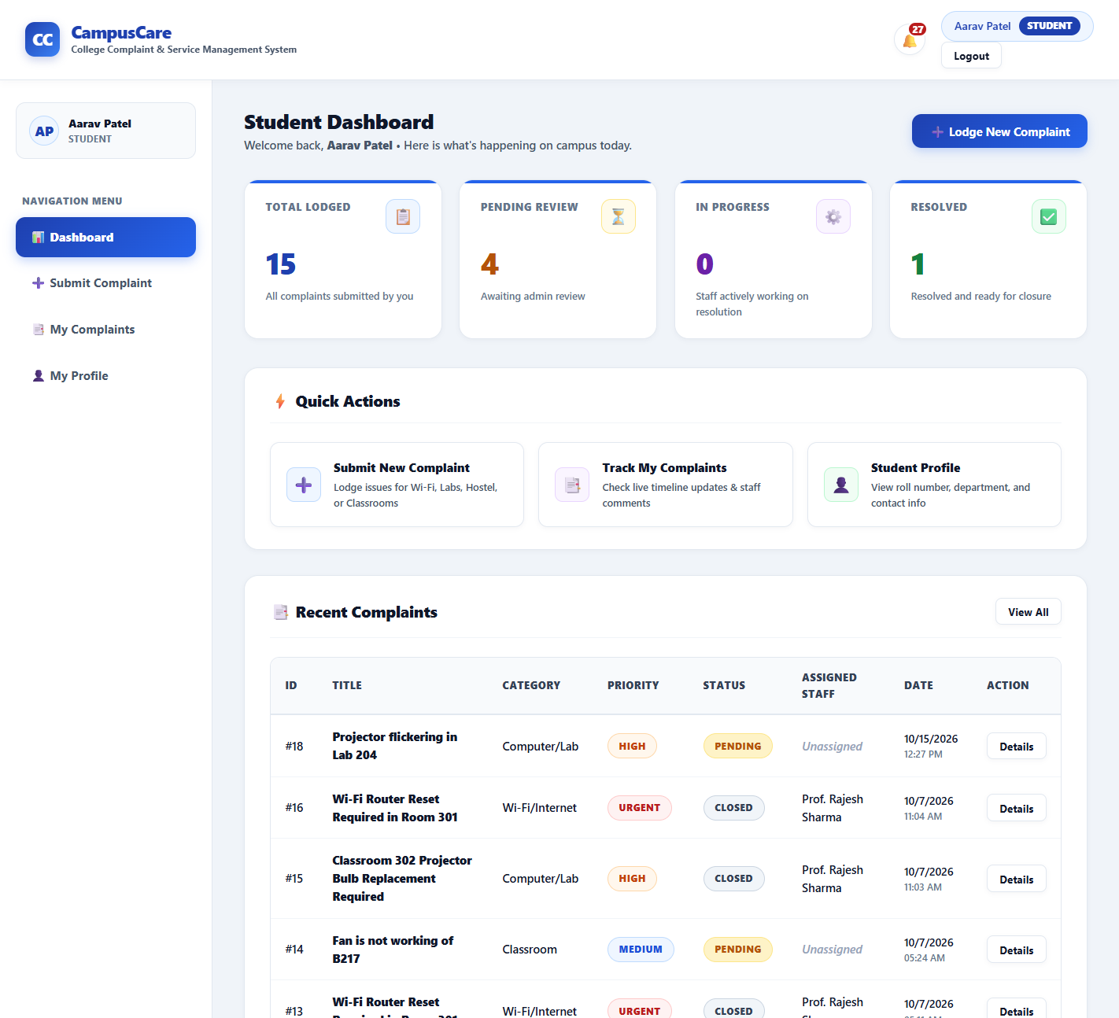
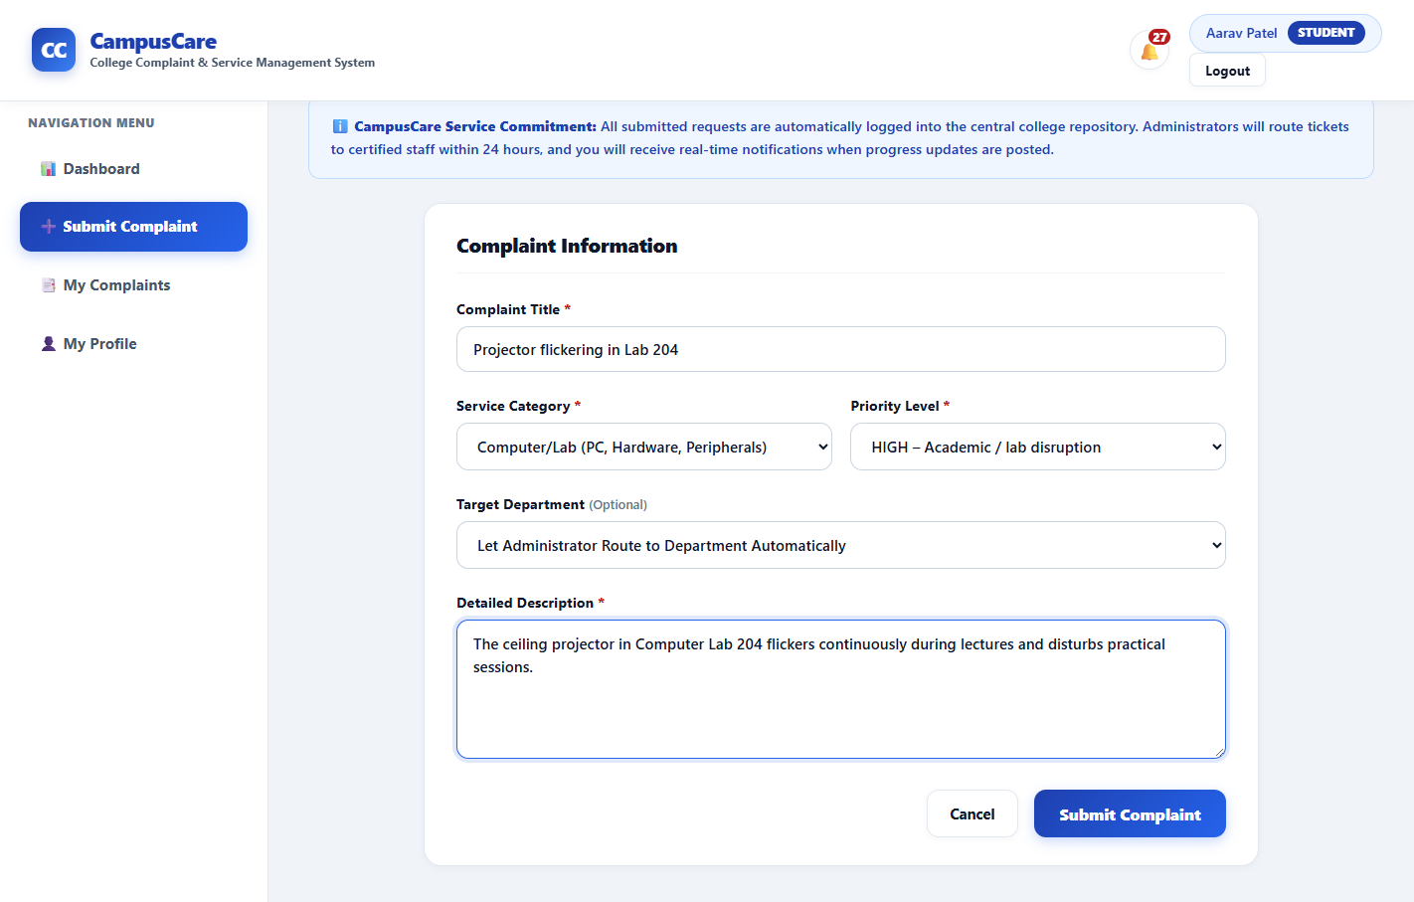
Results – Student Portal (1)
Lodge complaint form
Student dashboard

Slide 16
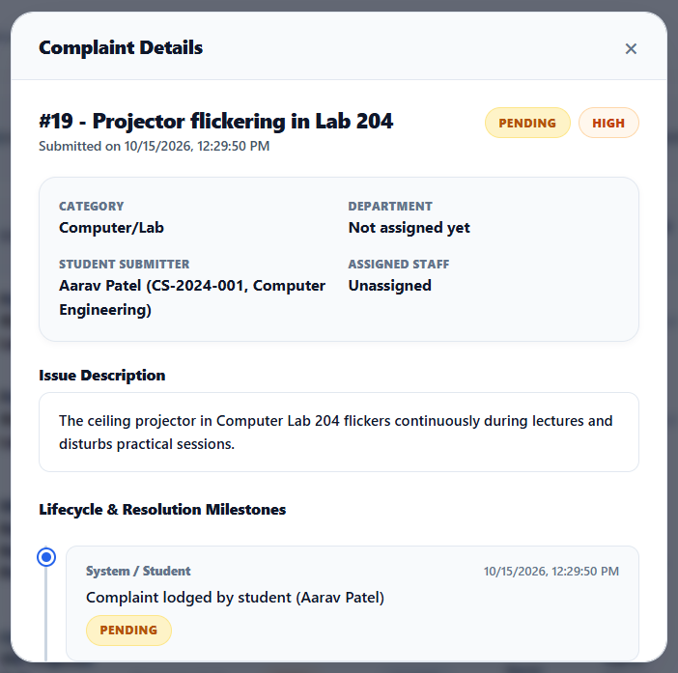
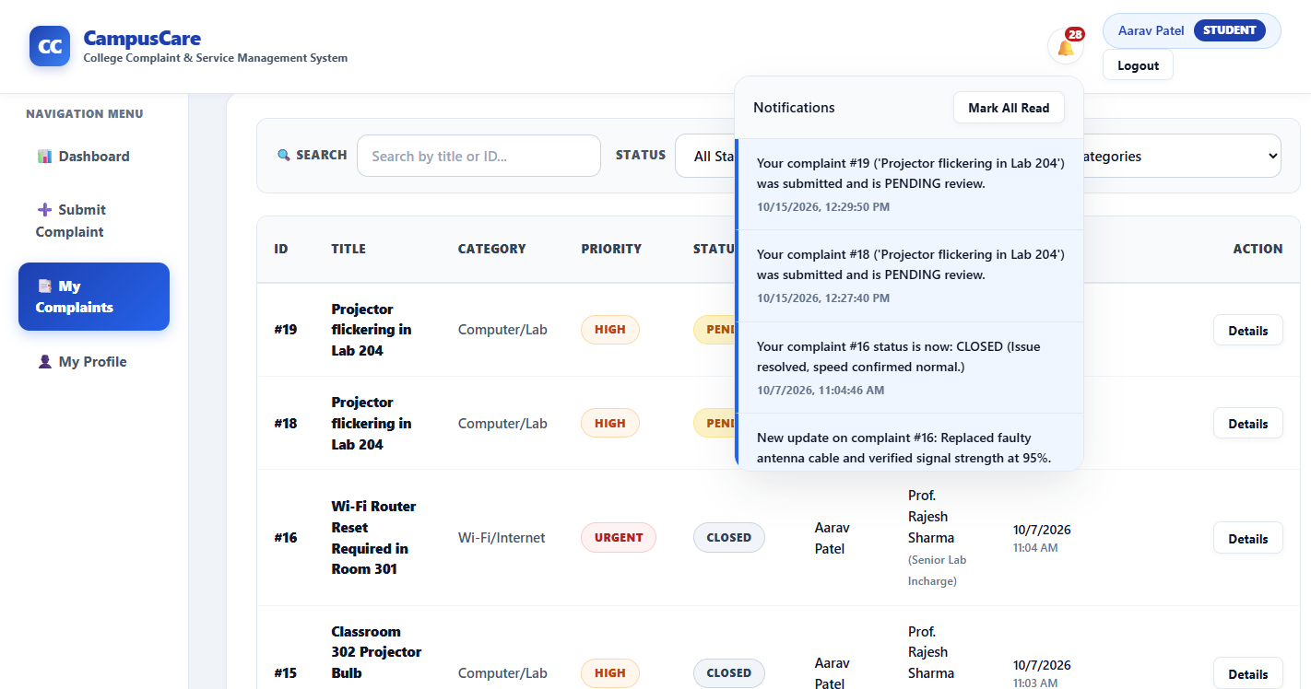
Results – Student Portal (2)
JMS-driven notifications
Complaint details with life-cycle timeline

Slide 17
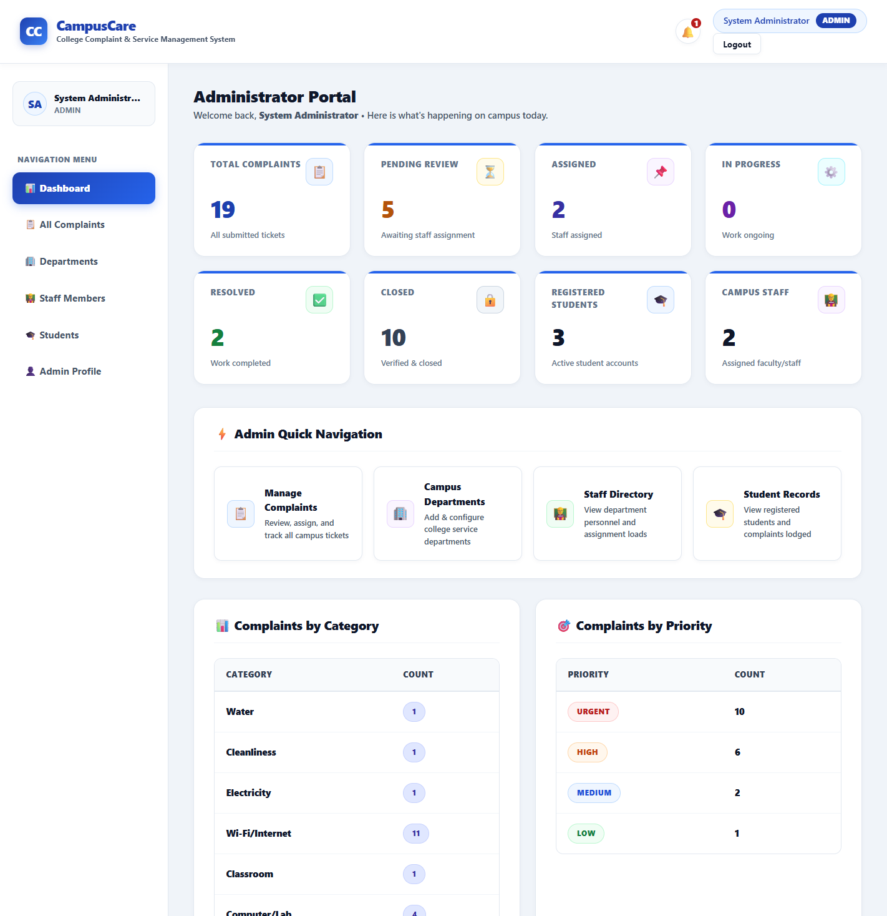
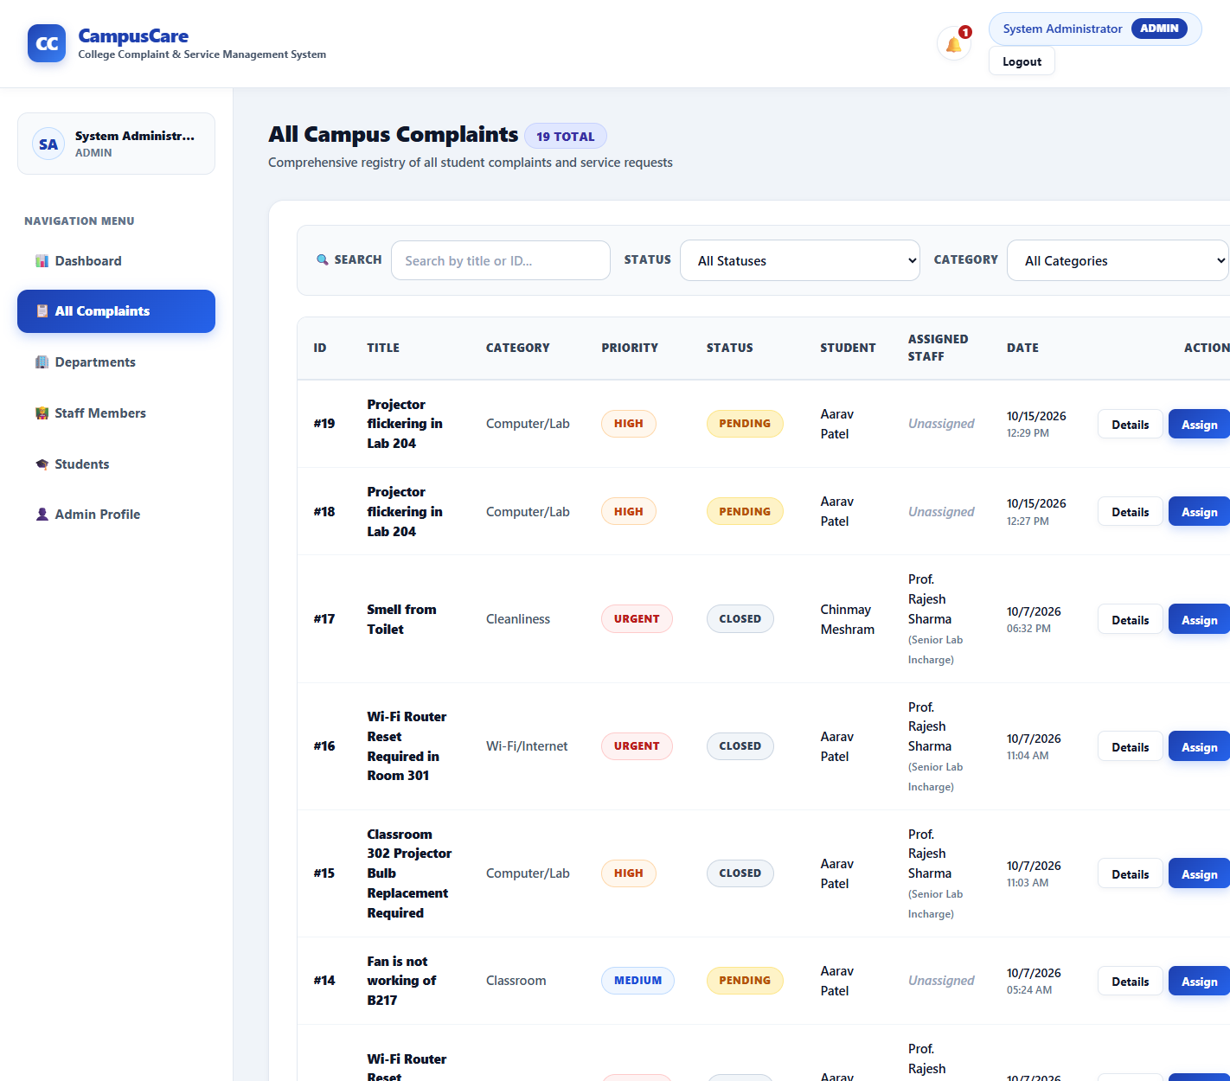
Results – Administrator Portal (1)
Admin analytics dashboard
All complaints – assign action

Slide 18
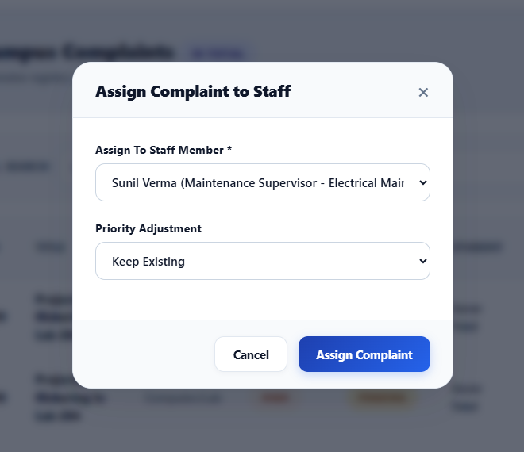
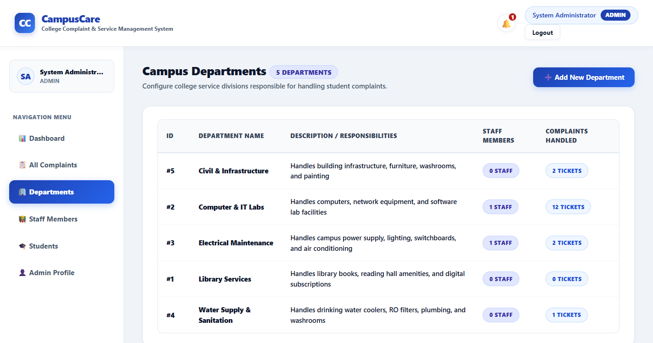
Results – Administrator Portal (2)
Department management
Assign complaint to staff

Slide 19
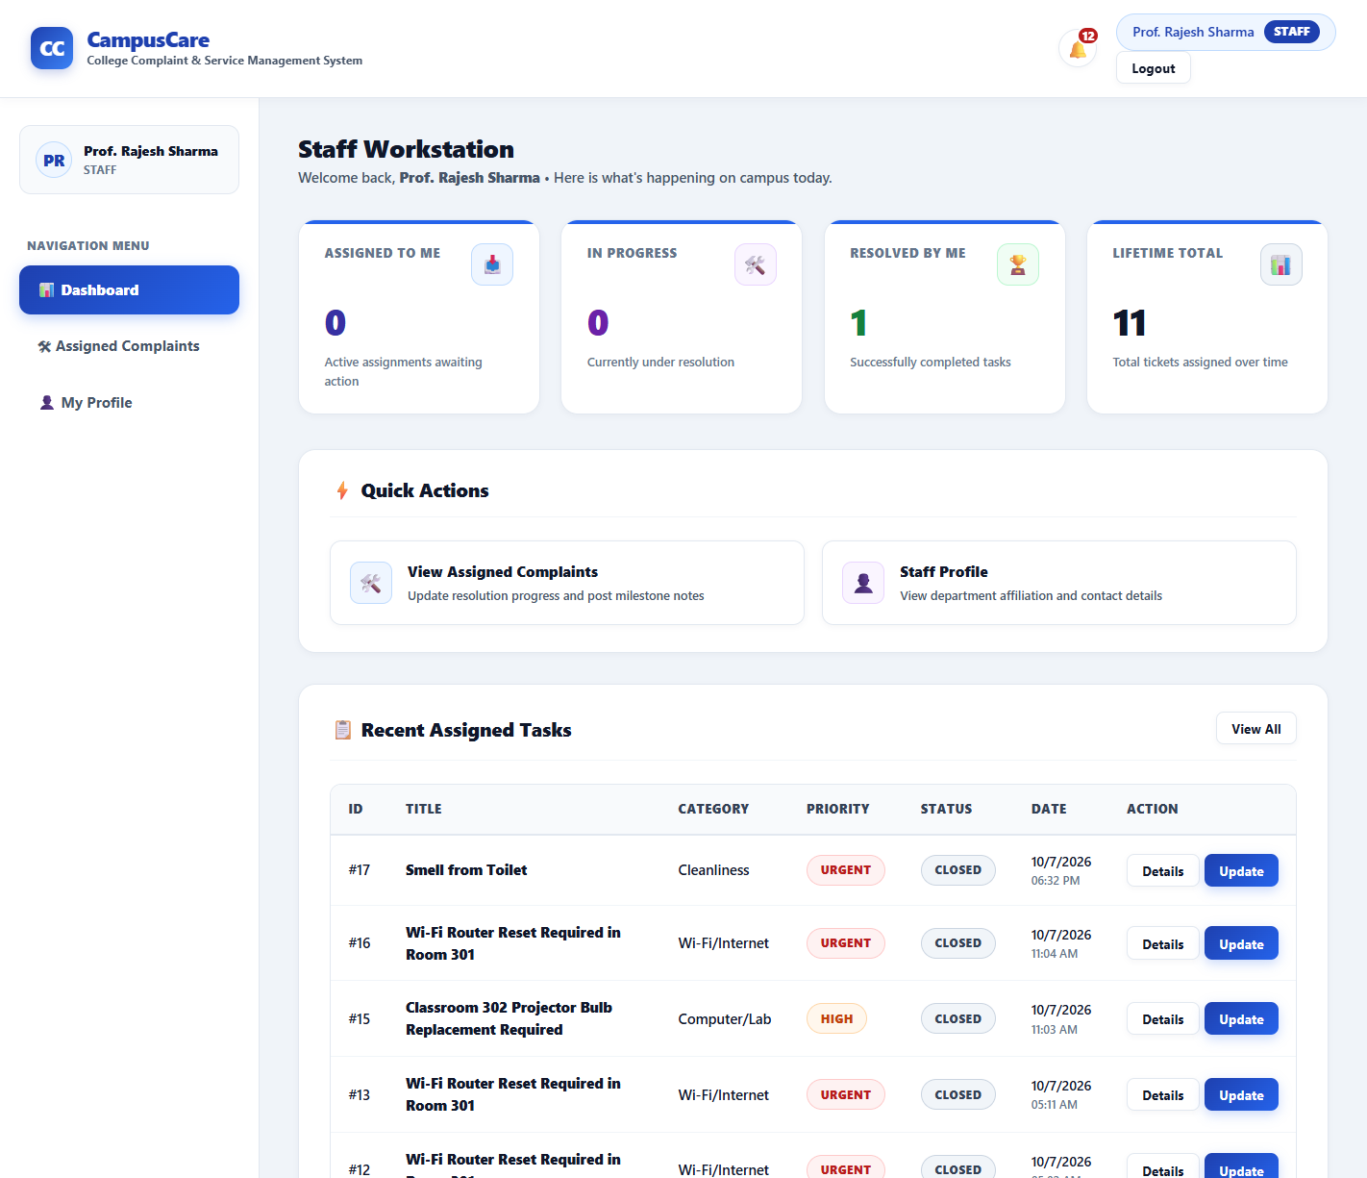
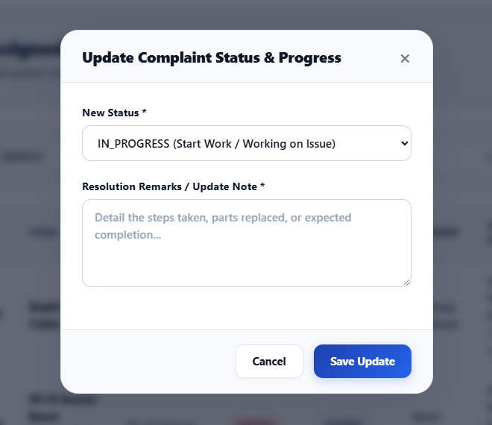
Results – Staff Portal
Staff dashboard
Progress update / resolve dialog

Slide 20
Testing & Results
Test case | Expected | Result
Login with valid / wrong credentials | 200 + token / 401 | Passed (401 in ~27 ms)
Call API without token | 401 | Passed
Student calls admin-only assign API | 403 | Passed
Complaint with short title/description | 400 validation | Passed
Valid complaint lodged | PENDING + timeline + JMS notification | Passed
Staff attempts RESOLVED → CLOSED | 400 invalid transition | Passed
Register with duplicate e-mail | 400 rejected | Passed
Passwords in MySQL | salt:hash, not plain text | Passed
• Outcome: all 8 scenarios behaved as designed; list/auth calls took about 3–35 ms on a local server.

Slide 21
Conclusion
Achieved: a working, secure, role-based complaint management system on Jakarta EE (EJB, JPA, JAX-RS, CDI, JMS, MDB) with MySQL.
Impact: transparent complaint tracking, accountable staff assignment and admin analytics.
Limitations: no attachments; in-app notifications only; secrets in config; complaint delete needs a fix.
Future scope: file/photo upload, e-mail/SMS/WebSocket alerts, SLA timers & escalation, feedback ratings, report export, mobile app.

Slide 22
References
Eclipse Foundation, Jakarta EE 10 Platform Specification – jakarta.ee/specifications/platform/10
Eclipse GlassFish 7 Documentation – glassfish.org/docs
EclipseLink JPA Documentation – eclipse.dev/eclipselink
Jakarta EE Tutorial – eclipse-ee4j.github.io/jakartaee-tutorial
Oracle, MySQL Reference Manual – dev.mysql.com/doc
RFC 2898 (PBKDF2) and RFC 2104 (HMAC), IETF
OWASP Password Storage Cheat Sheet – cheatsheetseries.owasp.org
Apache Maven and Apache NetBeans documentation

Slide 23
Thank You
Queries?
CampusCare – College Complaint & Service Management System
Chinmay Meshram | RBT24CB028

