Slide 1
Machine Learning Based Classification of Twitter Accounts
By,
Chinmay Sumant
Vishesh Kakarala
Suril Shah

Slide 2
Preprocessing
Converted to Boolean type –
Verified
Default_profile
Default_profile_image
Has_extended_profile
String Variables Converted to Boolean based on key words –
Name
Description

Slide 3
Preprocessing
Numerical variables -
Followers_count
Listed_count
Favourites_count
Statuses_count
date
Unused variables:
Location
url
Lang
Status
Screen_name
Target Variable - Bot

Slide 4
Methodology
Algorithms Used
Bernoulli Naïve Bayes
Logistic Regression
Multinomial Naïve Bayes
Random Forrest Classifier
Decision Tree
Gradient Boosting

Slide 5
Methodology
Model | Accuracy | AUC Score | CV Score
 |  |  | Mean | STD | Min | Max
Gradient Boosting | 0.9414 | 0.986656 | 0.965196 | 0.0065 | 0.9562 | 0.9709
Random Forrest | 0.9936 | 0.999841 | 0.956191 | 0.009 | 0.9439 | 0.96849
Decision tree | 0.9993 | 0.9999 | 0.860838 | 0.01509 | 0.84219 | 0.874936
Multinomial Naïve Bayes | 0.6643 | 0.681141 | 0.680823 | 0.023005 | 0.6451 | 0.71522
Bernoulli Naïve Bayes | 0.779 | 0.849602 | 0.846674 | 0.01044 | 0.835998 | 0.866442
Logistic Regression | 0.7515 | 0.835391 | 0.837327 | 0.023891 | 0.804078 | 0.873241

Slide 6
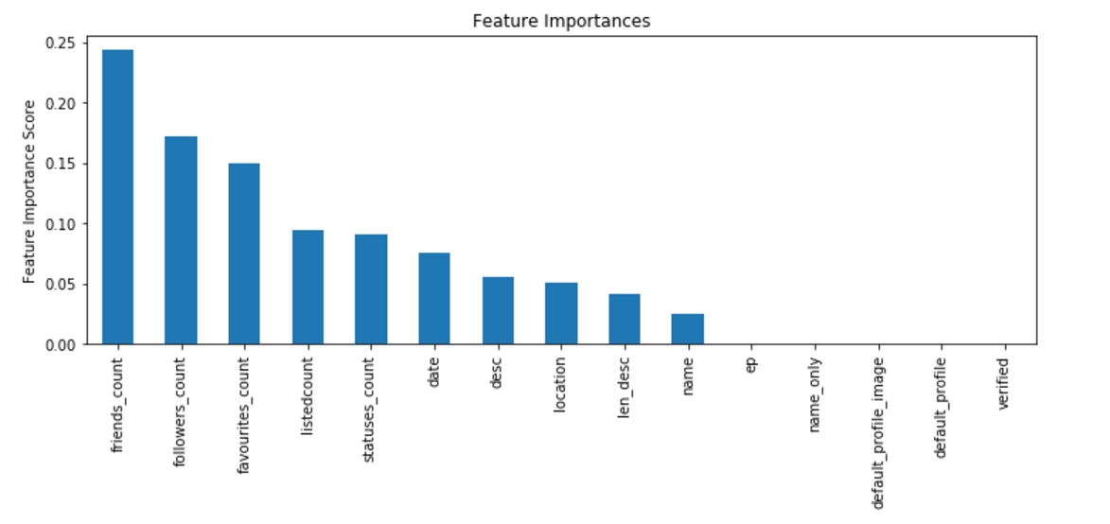
Random Forrest - Feature Selection

Slide 7
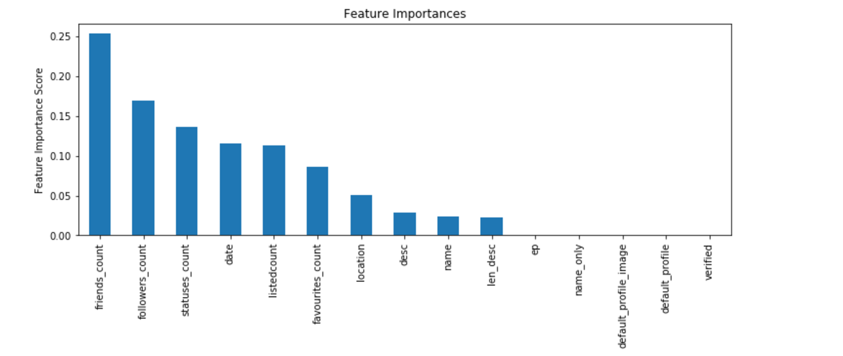
Gradient Boosting - Feature Selection

Slide 8
Final Model Selection and parameter tuning – Random Forest
N_estimators = default -10, 50, 100
'max_depth‘ = 1, 3, 6, 9, 12, 15, None
'max_features': ['auto','log2',None],
'min_samples_split': [2,4,6,8,10],
'min_samples_leaf': [1, 3, 6, 9, 12, 15],
'bootstrap': [True, False],
'criterion': ['gini', 'entropy']}

Slide 9
Final Model Selection and parameter tuning – Gradient Boosting
loss : {‘deviance’, ‘exponential’}
N_estimators = default -10, 50, 100
max_depth = 1, 3, 6, 9, 12, 15, None
max_features: ['auto','log2',None],
min_samples_split: [2,4,6,8,10],
min_samples_leaf: [1, 3, 6, 9, 12, 15],
'criterion': [‘friedman_mse’,‘mse', ‘mae']}

Slide 10
Model Evaluation and Results
Playing around with different features and parameters of random forest using sklearn provided different results every time and gave us an opportunity to learn more about the dataset and tune parameters for max results and accuracy.
Text data in spite cleaning, tokenizing and stemming did not provide any boost to the classifier.
TF/IDF tokenizing and NLTK stemmers reduced the accuracy of the model which is very odd.
Given more time, we would have worked on integrating text features smoothly into the model so as to provide meaningful insights inside the text patterns of bots and non-bots.
Another aspect is, to add more features using twitter API to look at other account characteristics which were not looked at during this attempt over the semester and could add more value to the current model to increase accuracy further.

