Slide 1
Comparative Analysis of Simple and Complex Cloud Pricing Schemes with Resources
Chinmay Nautiyal (cnauti2@uic.edu)
Mayank Raj (mraj3@ui.edu)

Slide 2
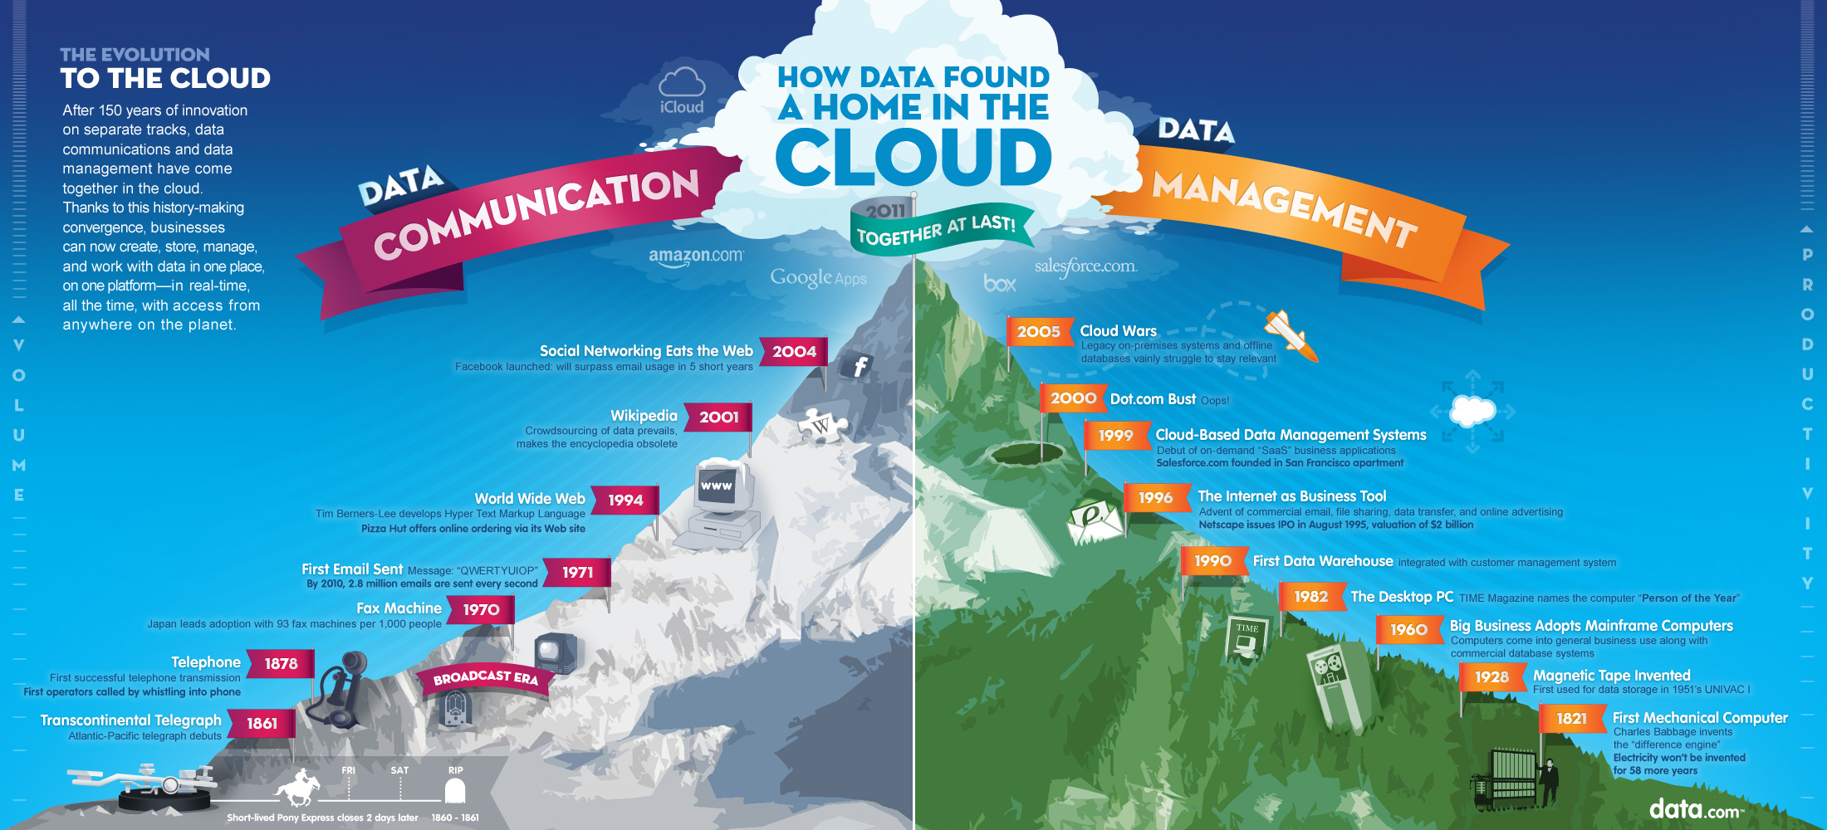

Slide 3

Cloud Pricing
Cloud computing generates billions of dollars and forms a significant portion of revenue for software companies.
The problem of pricing cloud resources and services is of great importance.
The pricing scheme must provide strong welfare and revenue guarantee

Slide 4

Pricing of cloud services is confusing:
They use varying terminology
Multitudes of variables
Its hard to see what you are spending
Its based on what you provision and not what you use
They offer cost saving options, but difficult to understand
Each service might be billed in a different way.

Slide 5
Simple Pricing Scheme for the Cloud
As mentioned in Kash et. al. for simple pricing of cloud resources:
It is often desirable that the pricing scheme be simple and guarantee strong welfare and revenue guarantee at the same time.
A stochastic model to show that its possible to obtain good welfare and revenue guarantee with simple mechanisms.
They proved that a mechanism that sets the same price per time step for jobs of any length achieves at least 50% of the welfare and revenue obtained by a mechanism that can set different prices for different job lengths.
This is the lower bound that is achieved and can be better in cases where we have more specific knowledge of some parameters.
The model can be extended from one price per server to multiple price per server
The following equation is for a single server which receives jobs of multiple lengths
Assume at any time step a job length 1 or 2 appears with 50% probability.
The value per time step of a job is drawn from a uniform distribution over[0,1]
Suppose that we set a price per time step p1 for job lengths 1 and p2 for job lengths 2
Consider an arbitrary time, when server is free

Slide 6
Model
We consider the case with jobs coming in with demands over resources
This is captured by a resource vector which specifies how many types and how much quantity of a resource type the job requires
Prices are drawn randomly from a distribution

Slide 7
Posted Price
We draw a new price for each incoming job from the given distribution
In the complex setting the posted price is calculated by setting individual prices for different quantities
For the simple setting we set a single price per unit of a resource type
Job Acceptance criteria: accepted if the value for a job is greater than the posted price

Slide 8
Assumptions
For the numerical experiments, certain assumptions were made:
If a job is accepted, it can’t be preempted and that job executes for its required time period; if rejected, the job is lost
There are at most 10 types of available resources
Any incoming job takes at most 100 seconds to complete

Slide 9
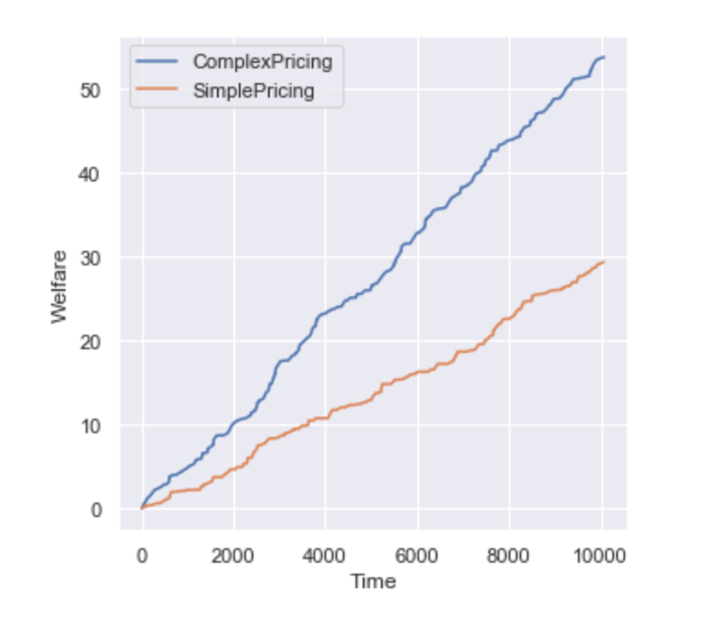
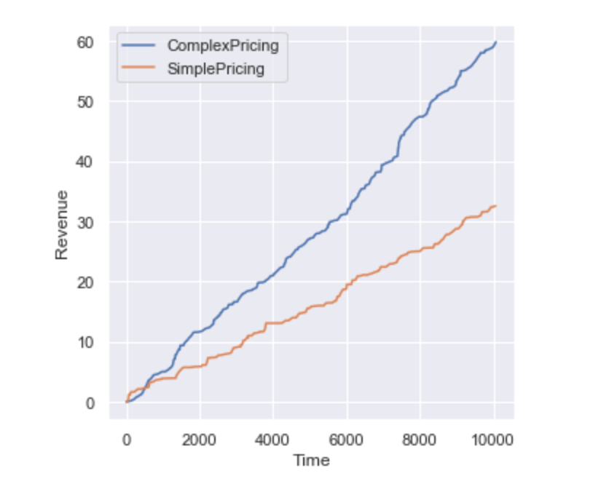
Simulation Results

Slide 10
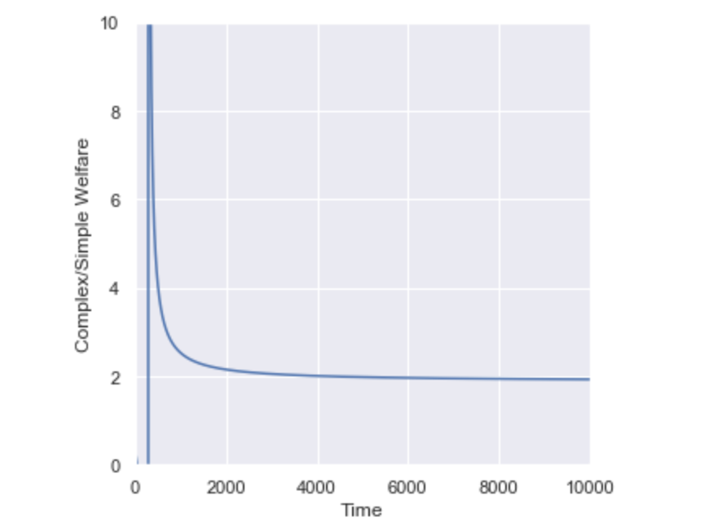
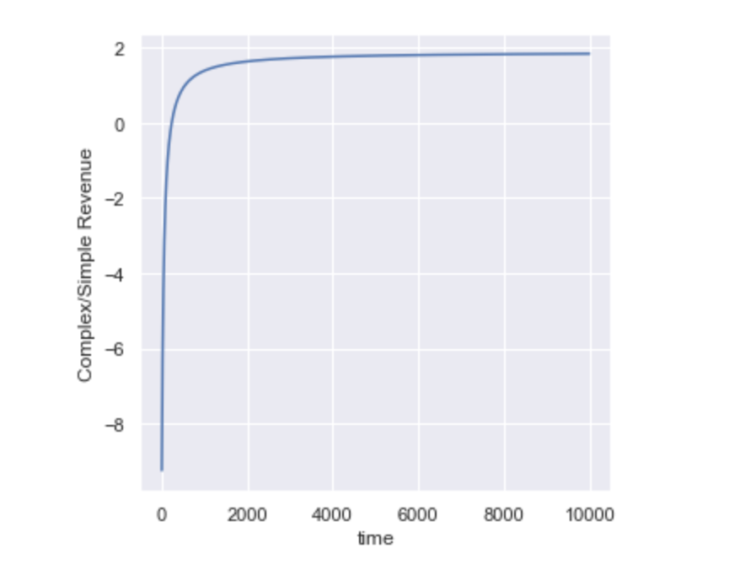
Complex to Simple Ratios
(For uniform distribution)

Slide 11
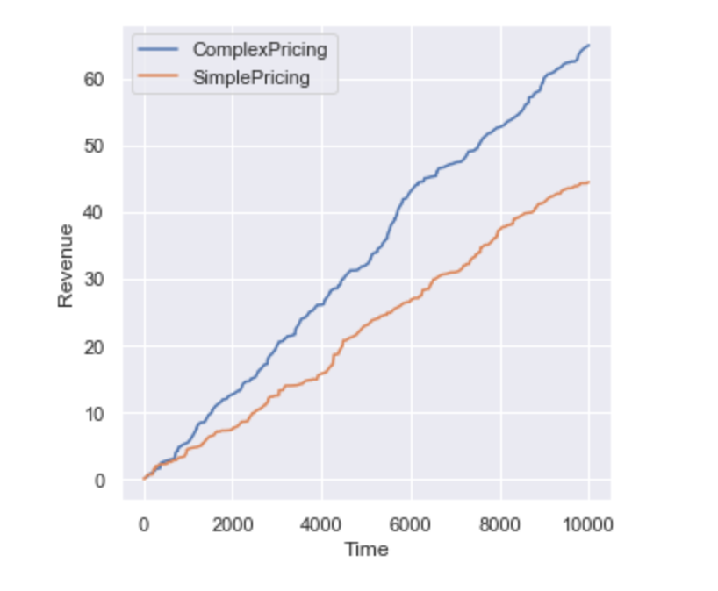
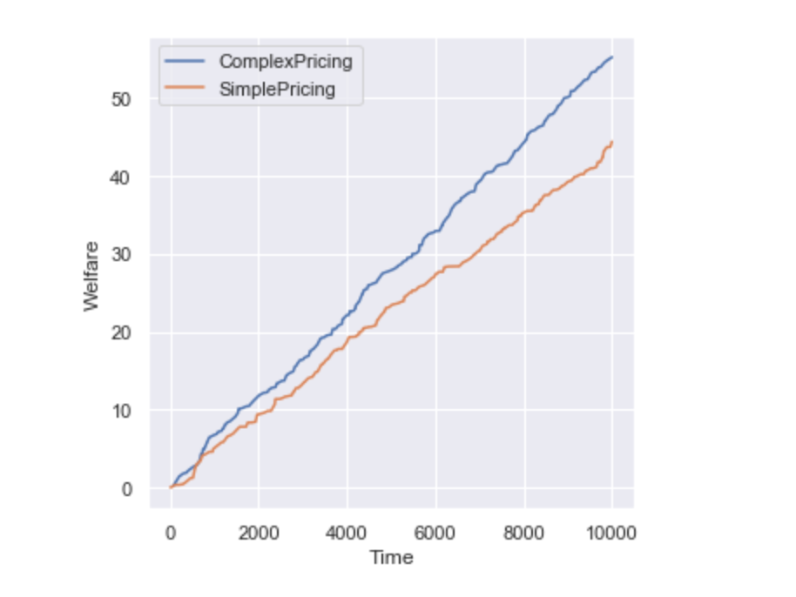
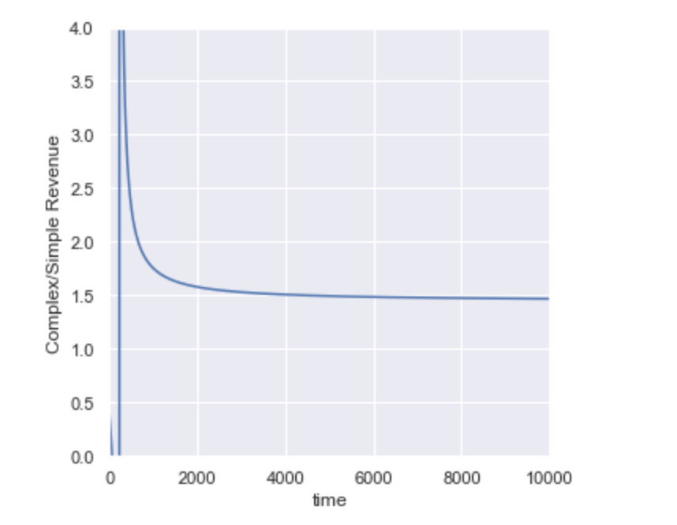
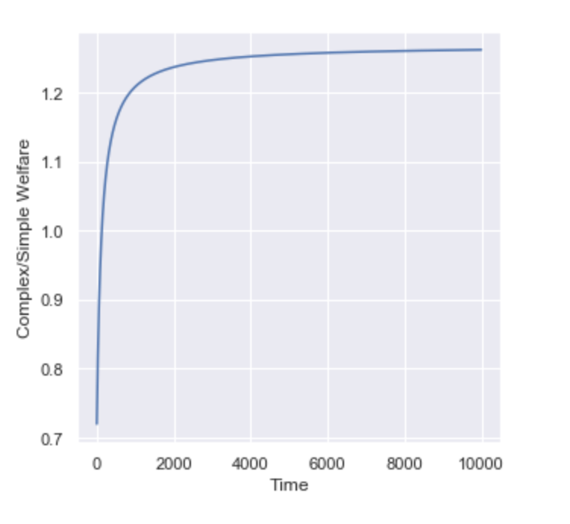
Beta (1,2)

Slide 12
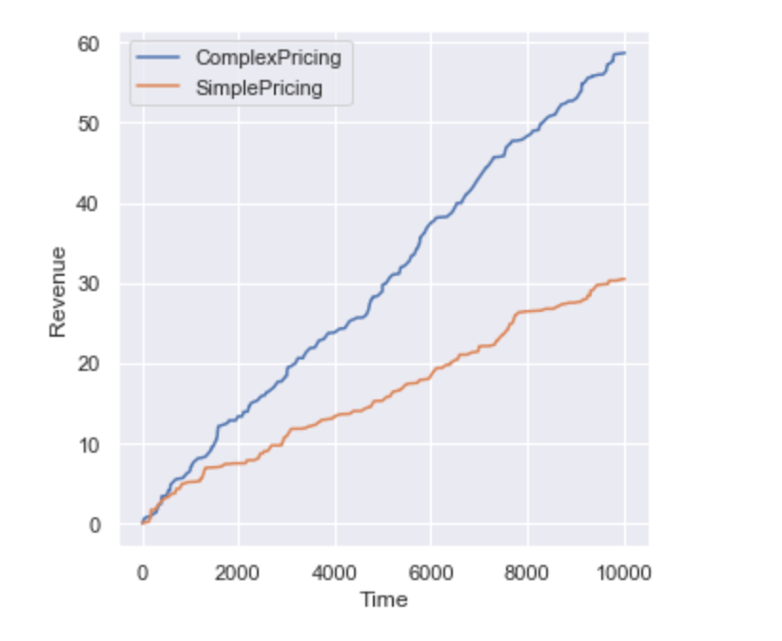
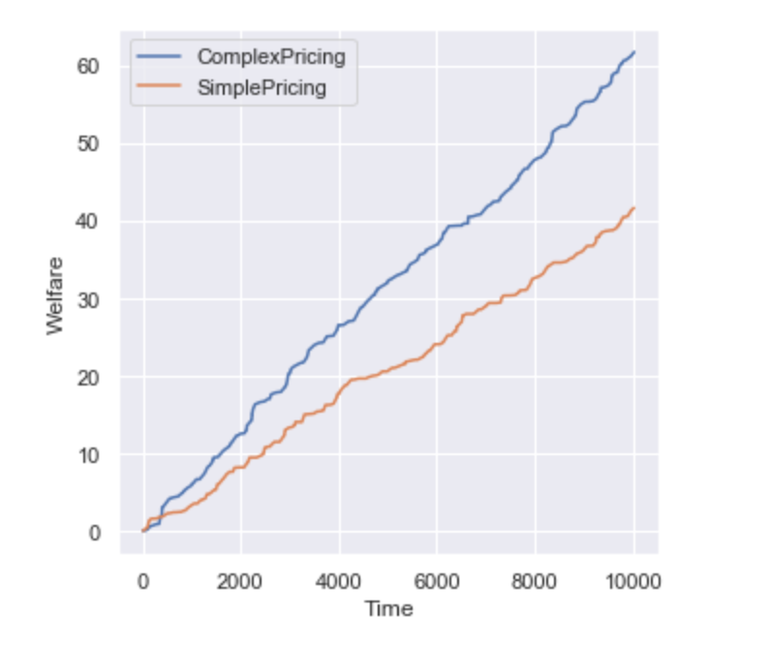
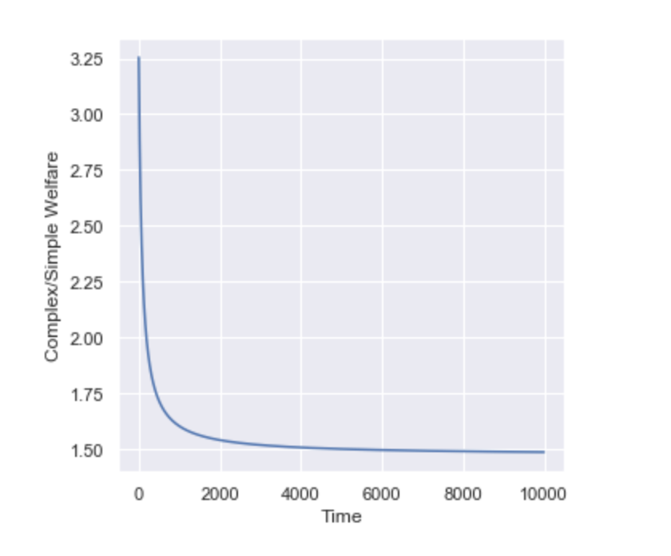
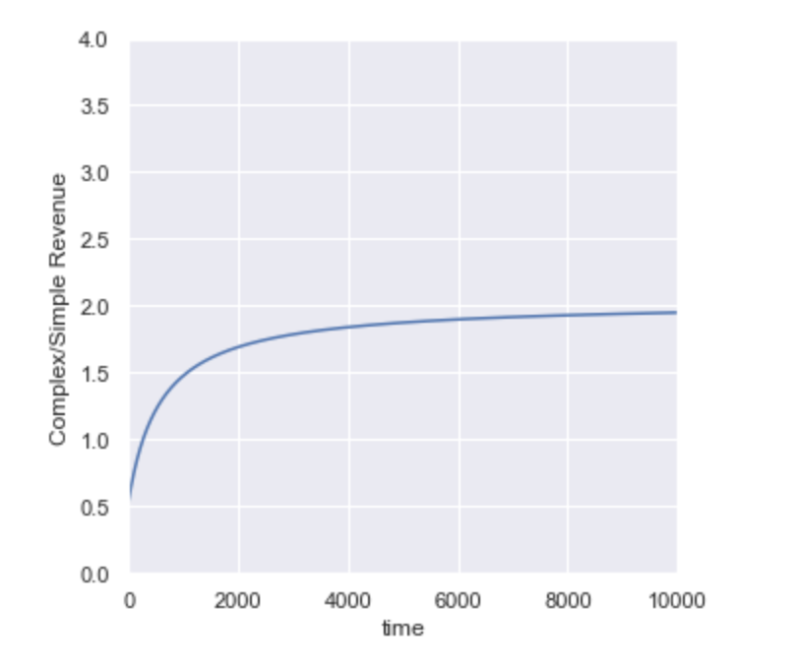
Beta (0.5, 0.5)

Slide 13
Conclusion and Future Work
We look at potential theoretical bounds that these results might point towards
We want to try simulations with prices drawn up front and see what effect that has on revenue and welfare
Potentially try to model a situation where multiple jobs can come in at a time step

Slide 14
Thank you!

