Slide 1


BOTSON 2.0

Slide 2
Flowchart
Arduino UNO R3
01
Motor and motor driver
03
Ultrasonic module
04
Bluetooth Module
05
Laser diode
06
LDR
07
Voltage Regulator
02
Servo Motor
08
Assembling robot
09

Slide 3
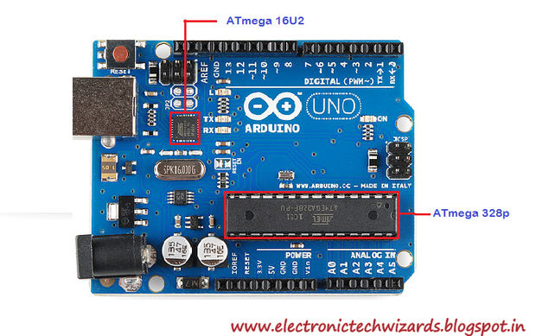
Arduino uno 3
Arduino is an open-source electronics platform based on easy-to-use hardware and software.
Arduino boards are able to read inputs - light on a sensor, a finger on a button, or a Twitter message - and turn it into an output - activating a motor, turning on an LED, publishing something online.

Slide 4
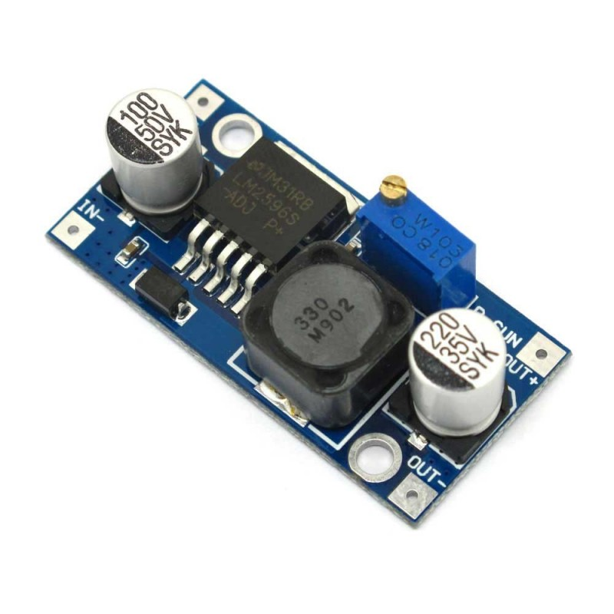
Voltage regulator
A voltage regulator is designed to automatically maintain a constant voltage level.
A voltage regulator may be a simple feed-forward design or may include negative feedback
It may use an electromechanical mechanism, or electronic components. Depending on the design, it may be used to regulate one or more AC or DC voltages.

Slide 5
Motor and motor drivers
The L293D is a 16-pin Motor Driver IC which can control a set of two DC motors simultaneously in any direction.
The L293D is designed to provide bidirectional drive currents of up to 600 mA (per channel) at voltages from 4.5 V to 36 V (at pin 8!)
You can use it to control small dc motors - toy motors.
Sometimes it can be extremely hot

Slide 6
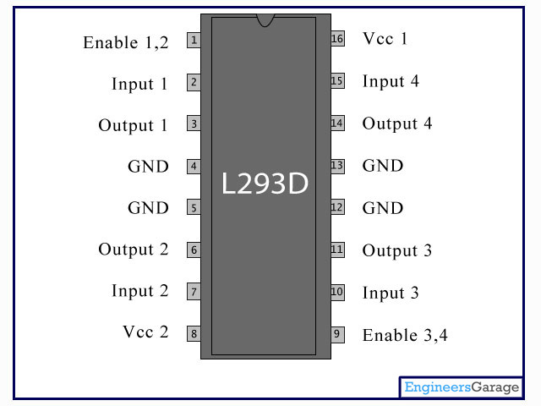
L293D Motor Driver
A motor driver is an integrated circuit chip which is usually used to control motors in autonomous robots
Motor driver act as an interface between Arduino and the motors
The most commonly used motor driver IC’s are from the L293 series such as L293D, L293NE, etc.
These ICs are designed to control 2 DC motors simultaneously

Slide 7
code

Slide 8
char button;
// this function tells arduino which pins to take input from
// basically activates this pins for input
void setup()
{
Serial.begin(9600); // opens serial port, sets data rate to 9600 bits/second
pinMode(2,OUTPUT); //Motor driver pin 1
pinMode(3,OUTPUT); //Motor driver pin 2
pinMode(4,OUTPUT); //Motor driver pin 3
pinMode(5,OUTPUT); //Motor driver pin 4
}

Slide 9
What is serial.read()?
it initializes the serial connection at 9600 bits per second.
Both sides of the serial connection (i.e. the Arduino and your computer) need to be set to use the same speed serial connection in order to get any sort of intelligible data.
If there's a mismatch between what the two systems think the speed is then the data will be garbled.
9600 bits per second is the default for the Arduino,
Serial.begin(57600) would set the Arduino to transmit at 57600 bits per second.
You'd need to set your software to the same speed in order to see the data being sent.

Slide 10
// bots moves forward
void forward()
{
digitalWrite(2,HIGH);
digitalWrite(3,LOW);
digitalWrite(4,LOW);
digitalWrite(5,HIGH);
Serial.println("FORWARD");
delay(100);
}

Slide 11
// take the left turn
// the low and high needs to provided according to the moment
// like in which direction you want the bot to move
void left()
{
digitalWrite(2,HIGH);
digitalWrite(3,LOW);
digitalWrite(4,HIGH);
digitalWrite(5,LOW);
Serial.println("LEFT");
delay(100);
}

Slide 12
// contininous infite loop
// similar to :
// while(true)
void loop()
{
while (Serial.available()) //If there's a available byte to read do the following
{
delay(10); //Delay added for stability
button = Serial.read(); //Store the input in button
Serial.println("New data available");
}

Slide 13
// switch case; similar to C
switch(button)
{
case'f':
forward();
break;
///some code
default:
Serial.println("Wrong choice");
break;
}
}

Slide 14
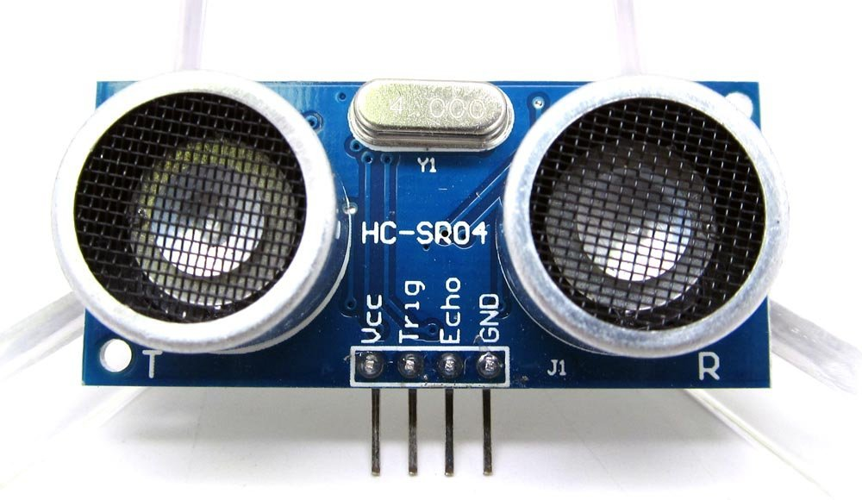
Ultrasonic module
Ultrasonic ranging module HC - SR04 provides 2cm - 400cm non-contact measurement function, the ranging accuracy can reach to 3mm
The modules includes ultrasonic transmitters, receiver and control circuit.

Slide 15
Ultrasonic module
The basic principle of work:
Using IO trigger for at least 10us high level signal
The Module automatically sends eight 40 kHz and detect whether there is a pulse signal back
) IF the signal back, through high level , time of high output IO duration is the time from sending ultrasonic to returning. Test distance = (high level time×velocity of sound (340M/S) / 2

Slide 16
code

Slide 17
return ((duration/2) / 74);
// Calculates distance in inches and sends it to function call
(** for centimeters (cm) divide by 58 **)

Slide 18
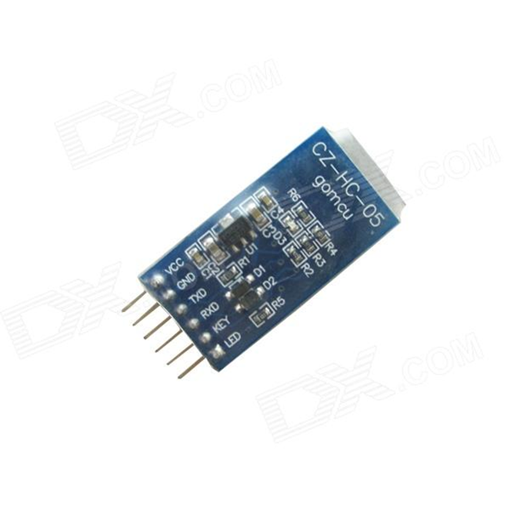
Bluetooth module
HC‐05 module is an easy to use Bluetooth SPP (Serial Port Protocol) module, designed for transparent wireless serial connection setup.
The HC-05 Bluetooth Module can be used in a Master or Slave configuration, making it a great solution for wireless communication

Slide 19
Laser diode

Slide 20
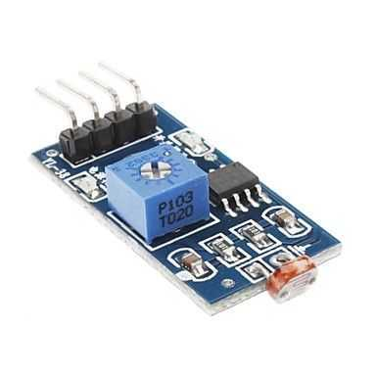
Ldr
LDR sensor module is used to detect the intensity of light. It is associated with both analog output pin and digital output pin labelled as AO and DO respectively on the board.
When there is light, the resistance of LDR will become low according to the intensity of light.
The greater the intensity of light, the lower the resistance of LDR.
The sensor has a potentiometer knob that can be adjusted to change the sensitivity of LDR towards light.

Slide 21
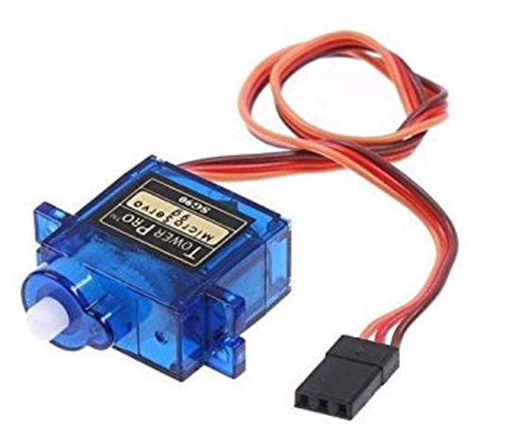
Servo motor
The servo motor is most commonly used for high technology devices in the industrial application like automation technology.
It is a self contained electrical device, that rotate parts of a machine with high efficiency and great precision.
The output shaft of this motor can be moved to a particular angle.

Slide 22
Let’s join all modules

Slide 23
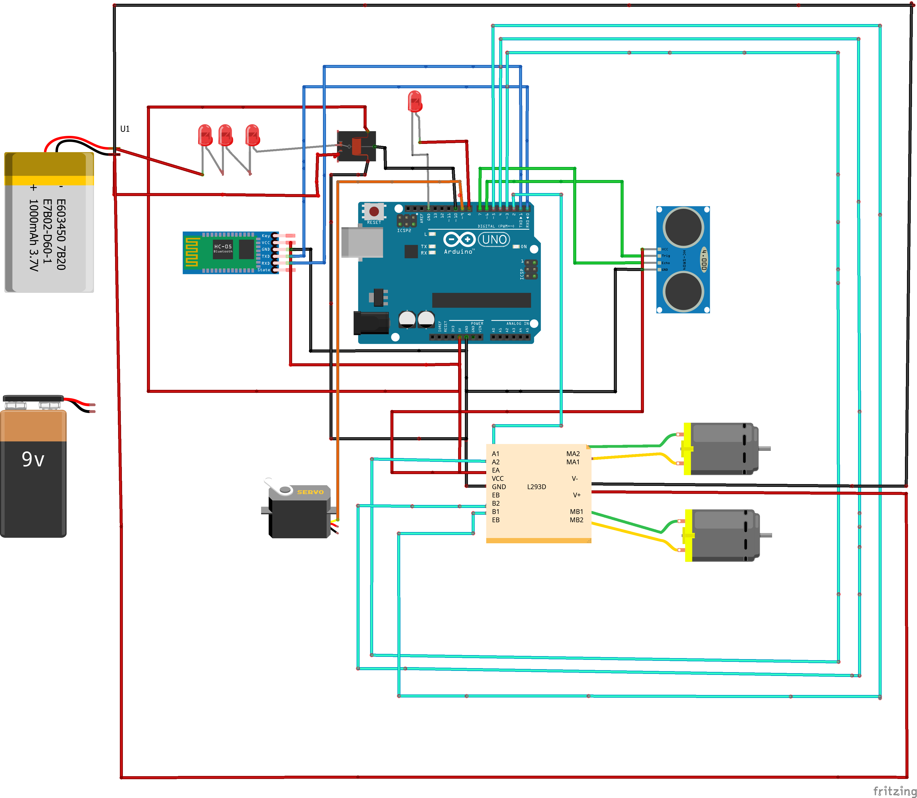

Slide 24
That’s all folks! Hope you had a good time!

