Slide 1





LEGION
Diet + Workouts in One System

Slide 2










Contents
01
02
03
04
05
06
07
Opportunity & Problem
Our Solution & Product
Diet Module (Inputs → Outputs → Tracking)
Workouts Module (Inputs → Outputs → Muscle Targeting)
Differentiation & Benefits
Product Walkthrough Mockups
Go-To-Market & Ask

Slide 3








The Problem
Nutrition Tracking
Training Logging
Progress Understanding
Calories tracking
Sets and reps
What changed?
Macros management
Weight progression
Why did it change?
Daily intake logging
Volume tracking
Connecting the dots
Friction Points
Re-entering body/goal info in different apps
No single weekly story across diet + training
Hard to connect intake to performance and body change
Fragmented tracking reduces consistency and results

Slide 4






Our Solution
Diet Module
Workouts Module
Two-part structure
Macros + Calorie Balance
Part A: Diet Module (macros + calorie balance)
Volume + Performance
Part B: Workouts Module (training volume + performance)
Unified weekly view
What you ate (totals + breakdown)
Weekly Outcomes
What you lifted (volume + bests)
What changed (kg gained/lost)
Unified Performance Narrative
Diet drives the plan; Workouts prove the execution

Slide 5

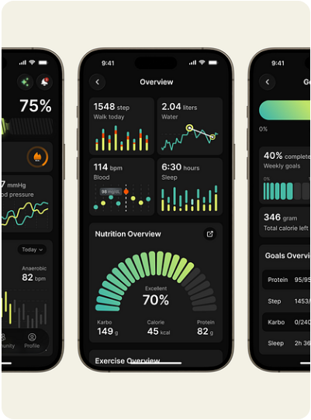



Product Overview
Live Tracking
Dashboard at a Glance
Today’s calorie needed vs. consumed
Macro snapshot (protein, carbs, fibre, fats)
Workout status (planned vs. completed)
Quick access to weekly progress
Unified View

Slide 6





Diet Module — Inputs
Body + Goal + Intake
User inputs collected once
Body information: weight, height
Calories: needed vs. consumed
Goal selection: bulk, cut, maintain
Objective: lose weight, gain weight, body recomposition
Diet Engine
Design intent
Minimal steps, clear goal states
Personalized Output
Daily logging optimized for speed

Slide 7


Diet Module — Outputs
Macros breakdown in grams
Personalized targets for protein, carbs, fibre, and fats based on weight + goal.
Calorie surplus/deficit recommendation
Dynamic adjustments for bulk/cut phases to ensure optimal metabolic response.
Weight loss/gain targets
Milestones aligned to your selected objective for steady, sustainable progress.
Clear targets reduce guesswork and keep users on-plan

Slide 8
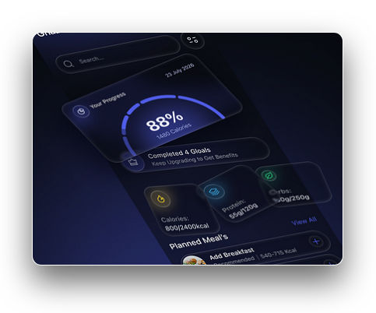





Diet Module — Weekly Tracking
Weekly tracking captured automatically
Total calories consumed
Total protein, carbs, fibre, fats
Kilograms gained or lost
Visualizations supported
Pie charts for daily consumption
Daily Pie
Weekly Pie
Pie charts for weekly breakdown

Slide 9


Workouts Module — Inputs
Add workouts with custom names
Set number of sets
Manual entry for reps per set
Checkbox for set completion
Flexible enough for any program; structured enough for tracking

Slide 10



Workouts Module — Outputs
Highest volume of the day
Highest weight lifted in the week
Total volume lifted in the week
Performance outputs derived from logged sets/reps/weights
Track peak strength milestones across all exercises
Aggregate workload to measure progressive overload
Weekly review helps users:
Spot progress
Identify weak days/exercises

Slide 11



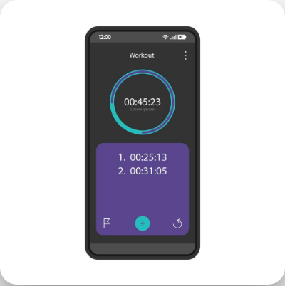


Workouts Module — Flow Features
Redo workouts (repeat a previous session)
Timer: start, pause, resume, end
Total workout time display
Outcome
SESSION INTERFACE
•
More consistent sessions
•
Less app switching

Slide 12


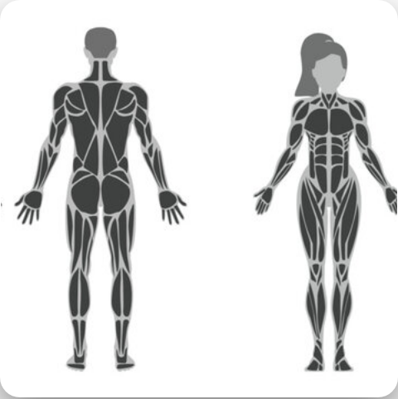


Muscle Targeting Visualization
Graph shows which muscle parts are affected by workouts
Supported muscle groups for breakdown:
Back
Legs
Biceps
Triceps
Chest
Shoulders

Slide 13























Muscle Breakdown Detail
Back
Triceps
lower back
upper back
middle back
upper lats
long head
medial head
lateral head
lower lats
traps
Chest
Legs
upper chest
middle chest
lower chest
quads
hamstrings
calves
Shoulders
Biceps
front delts
lateral delts
rear delts
long head
short head
brachialis
Fine-Grained Coaching Layer | Muscle Targeting Data

Slide 14







Differentiation
Compared to single-focus apps
Nutrition-only apps miss training context
Workout-only apps miss intake context
DIET TARGETS
Our advantage is the dual-loop
Diet targets guide intake
WORKOUT ACTIONS
Workout performance validates execution
Weekly outcomes connect actions to results
WEEKLY OUTCOMES
One system that links targets → actions → outcomes

Slide 15


Thank You
Seeking investor partners to build the Diet + Workouts system
.

