Slide 1
DEVOPS CAPSTONE PROJECT
QueueDesk
Support ticket tracker
Guna Sai Kumar
React, FastAPI and PostgreSQL
QueueDesk
01
Notes:
Project repository: https://github.com/chinna-328/Devops-capstone-project
Presenter: Guna Sai Kumar.
Introduce QueueDesk as a support ticket tracker. The project includes a working local Docker stack, automated validation, and infrastructure configuration. AWS deployment and live monitoring remain pending.

Slide 2
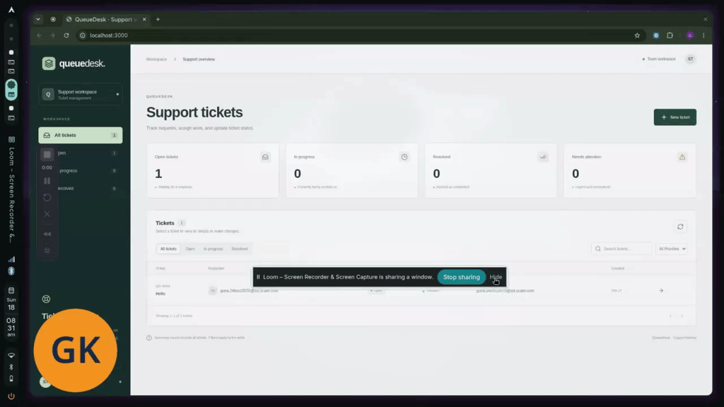
Support ticket workflow
Ticket details
Title, description, requester and assignee
Ticket status
Open, in progress and resolved
Search the queue and filter by status or priority.
Local demo recording
QueueDesk
02
Notes:
Sources: https://github.com/chinna-328/Devops-capstone-project/blob/main/frontend/src/App.jsx and frontend/src/components/TicketDialog.jsx.
Image: thumbnail from the user-provided Loom recording, https://www.loom.com/share/e109ef51b28045adabcc391b8813617a. The image shows the local application.
Demonstrate creation, assignment, priority changes, search, filtering and deletion using sample data.

Slide 3
Application architecture
Component | Responsibility
React frontend | Ticket list, forms, search and filters
Nginx | Serves the frontend and proxies /api requests
FastAPI backend | Validates requests and handles ticket operations
PostgreSQL | Stores tickets in a persistent database
Alembic | Applies schema migrations before application startup
Docker Compose coordinates service startup and readiness.
QueueDesk
03
Notes:
Sources: https://github.com/chinna-328/Devops-capstone-project/blob/main/docker-compose.yml, backend/app/main.py, backend/app/models.py, frontend/nginx.conf and backend/alembic/versions/0001_tickets.py.
The frontend sends API calls through Nginx. FastAPI uses SQLAlchemy to access PostgreSQL. The migration service finishes before the backend starts.

Slide 4
REST API and database
Method | Endpoint | Operation
GET | /api/tickets | List, search and filter
GET | /api/tickets/{id} | Read one ticket
POST | /api/tickets | Create a ticket
PUT | /api/tickets/{id} | Update ticket details
DELETE | /api/tickets/{id} | Delete a ticket
SQLAlchemy defines the ticket model. Alembic manages schema changes.
QueueDesk
04
Notes:
Sources: https://github.com/chinna-328/Devops-capstone-project/blob/main/backend/app/main.py, backend/app/models.py, backend/app/schemas.py and backend/alembic/versions/0001_tickets.py.
Additional endpoints include GET /api/tickets/stats, GET /health, GET /ready and GET /metrics.
The ticket model includes a primary key, timestamps, assignee, requester, priority and status. Swagger UI is available at /docs.

Slide 5
Local deployment
BACKEND_PORT=18001 docker compose up --build -d --wait
docker compose ps -a
Service | Expected result
Frontend | Healthy at http://localhost:3000
Backend | Healthy with API docs at http://localhost:18001/docs
PostgreSQL | Healthy with data in the postgres-data volume
Migration | Exited (0) after alembic upgrade head
Shutdown: docker compose down
QueueDesk
05
Notes:
Source: https://github.com/chinna-328/Devops-capstone-project/blob/main/docker-compose.yml.
Run from the repository root. BACKEND_PORT=18001 matches the demonstrated local setup. The frontend normally uses port 3000 and the backend defaults to 8000 without this override.
The user reported healthy PostgreSQL, backend and frontend containers and a migration service with exit code 0. docker compose down retains the named database volume.

Slide 6
Testing and health checks
18
API coverage
CRUD, invalid inputs, missing tickets, filters and pagination
backend tests passed
Database coverage
Isolated test databases and migration upgrade/downgrade
/health checks the process
/ready checks database access and the migrated table
QueueDesk
06
Notes:
Sources: https://github.com/chinna-328/Devops-capstone-project/blob/main/backend/tests/test_api.py, backend/tests/test_migrations.py, backend/tests/conftest.py and evidence/validation.txt.
The recorded verification reports 18 tests passing with SQLite and PostgreSQL, including the replacement Alpine backend image. The user also supplied successful /health and /ready responses. These are verified local/test results, not AWS availability measurements.

Slide 7
CI and container security
Stage | What runs
1 Validate | Pytest, Ruff, frontend build, Helm and Terraform checks
2 Build | Separate frontend and backend container images
3 Scan | Trivy scans both images and blocks HIGH/CRITICAL findings
4 Publish | GHCR images tagged with the full Git commit SHA
Last verified run: tests, scans and publication succeeded.
The AWS deployment job remains disabled until infrastructure is ready.
QueueDesk
07
Notes:
Sources: https://github.com/chinna-328/Devops-capstone-project/blob/main/.github/workflows/ci-cd.yml and https://github.com/chinna-328/Devops-capstone-project/actions/runs/39039931989.
Last verified successful run: 39039931989. The test job and build-scan-publish job succeeded. The AWS deploy job was skipped. The workflow publishes both images with full commit SHA tags only after both Trivy scans pass.
Local scan evidence in docs/troubleshooting.md and evidence/validation.txt records 44 HIGH findings in the original Debian backend base and zero HIGH/CRITICAL findings in the Alpine replacement on October 17, 2026. This is a historical scan result, not a permanent security guarantee.

Slide 8
AWS infrastructure
Terraform configuration ready. Cloud deployment pending.
Networking
Compute
VPC across two availability zones, public and private subnets, one NAT gateway
EKS with a managed node group and two private worker nodes
AWS access
Cluster services
IAM roles, GitHub OIDC and EKS access configuration
EBS CSI for persistent storage and Metrics Server for resource metrics
QueueDesk
08
Notes:
Sources: https://github.com/chinna-328/Devops-capstone-project/blob/main/terraform/network.tf, terraform/main.tf, terraform/github.tf, terraform/alb.tf and terraform/terraform.tfvars.example.
These resources are defined in Terraform. No successful real AWS plan, apply or destroy has been demonstrated in this project session. The configured default region is ap-south-1. Desired nodes are two t3.large instances. Apply creates billable resources. Destroy evidence remains required by the course rubric. Avoid implying deployment completion.

Slide 9
Kubernetes and Helm
Resource | Configured behavior
Deployments | Two frontend replicas and two backend replicas
Ingress | Routes / to the frontend and /api to the backend
PostgreSQL PVC | Persists database files on gp3 storage in AWS
Migration Job | Runs Alembic before the application release
Backend HPA | Scales between 2 and 6 replicas using CPU metrics
Helm chart validation passed. Cluster installation remains pending.
QueueDesk
09
Notes:
Sources: https://github.com/chinna-328/Devops-capstone-project/blob/main/helm/queuedesk/values.yaml, helm/queuedesk/values-aws.yaml and helm/queuedesk/templates/.
Configured design only: frontend and backend deployments start at two replicas, PostgreSQL uses a PVC, migrations run as a Helm job, and the backend HPA ranges from two to six replicas. The ALB Ingress routes /api to the backend and / to the frontend. Actual EKS installation, ingress access and scaling evidence remain pending.

Slide 10
Monitoring and troubleshooting
Application metrics
Prometheus and Grafana
/metrics exposes HTTP request counts and latency measurements
Helm values, ServiceMonitor and an application dashboard are included
Image pull failure
Service routing failure
Inspect Pod events, image tags and registry access
Compare Service selectors, Pod labels and EndpointSlices
Live dashboards and failure recovery demonstrations remain pending.
QueueDesk
10
Notes:
Sources: https://github.com/chinna-328/Devops-capstone-project/blob/main/monitoring/dashboard-configmap.yaml, monitoring/prometheus-values.yaml, monitoring/grafana-values.yaml, helm/queuedesk/templates/servicemonitor.yaml and docs/troubleshooting.md.
Local /metrics output was verified. Prometheus scraping and populated Grafana panels in a real cluster have not been demonstrated. Failure lab manifests exist in troubleshooting/, but their execution and recovery evidence remain pending.
Discuss ImagePullBackOff by checking image tags and registry access, then Service selector mismatches through Pod labels and EndpointSlices.

Slide 11
Project status
Area | Current result
Application and Docker | Working local stack and ticket API
Tests and container security | Passing tests and successful scan/publication workflow
Terraform and Helm | Configuration complete, real deployment pending
Live monitoring and scaling | Configuration included, runtime evidence pending
Final submission | Demo recording available, remaining evidence to collect
Next milestone: a verified AWS deployment with screenshots and cleanup.
QueueDesk
11
Notes:
Sources: https://github.com/chinna-328/Devops-capstone-project, evidence/validation.txt, docs/submission.md and https://github.com/chinna-328/Devops-capstone-project/actions/runs/39039931989.
Implementation and execution are separate. The app and local container workflow work. The last verified GitHub run passed the test and image publication jobs. AWS deployment is incomplete, and live monitoring, scaling, troubleshooting demonstrations and destroy evidence are pending.
The repository has four commits at the last local inspection. The rubric asks for at least ten meaningful commits and supporting screenshots. The Loom recording is user-provided demo evidence. Do not claim full rubric completion.

Slide 12
Demo recording
QueueDesk walkthrough
Watch the demo on Loom
https://www.loom.com/share/e109ef51b28045adabcc391b8813617a
Project repository
github.com/chinna-328/Devops-capstone-project
QueueDesk
12
Notes:
Recording supplied by the user: https://www.loom.com/share/e109ef51b28045adabcc391b8813617a
Loom oEmbed metadata title: QueueDesk · Support workspace - 18 October 2026.
Project repository: https://github.com/chinna-328/Devops-capstone-project
This deck describes the repository and the recorded local demo. It does not assert that cloud deployment, live monitoring or the course submission are complete.

