Slide 1


Resume Project Challenge - 12
ELECTRIC VEHICLE SALES ANALYSIS
Presented by
Chinnam naidu Mudila
Notes:
Hello all, welcome to the presentation of Electric vehicle sales analysis, this presentation is a part of Code basics Resume project Challenge 12, I will be sharing the insights of Analysis on Electric Vehicle market in India. So lets get started.

Slide 2
Problem Statement
Goal
Getting Familiar with Data
Primary and Secondary Questions with Output Visualization and Insights
Agenda
Notes:
In this presentation , I will discuss about problem statement, goal , Data, Primary and secondary questions with output visualizations and their Insights
.

Slide 3

Motors
Problem Statement
AtliQ Motors, a leading EV manufacturer from USA, with a 25% market share in North America's electric and hybrid vehicle segment, plans to expand into India, where their current market share is less than 2%, they aim to introduce their bestselling models in India. Bruce Haryali, the chief of AtliQ Motors India, has tasked the data analytics team to conduct a detailed market study on India's EVs.

Slide 4
Motors
Goal
As a Data Analyst at AtliQ Motors India, my goal is to analyze electric vehicle sales data to address both primary and secondary research questions, design a dashboard and present the insights from the analysis to the Chief, Bruce Haryali

Slide 5
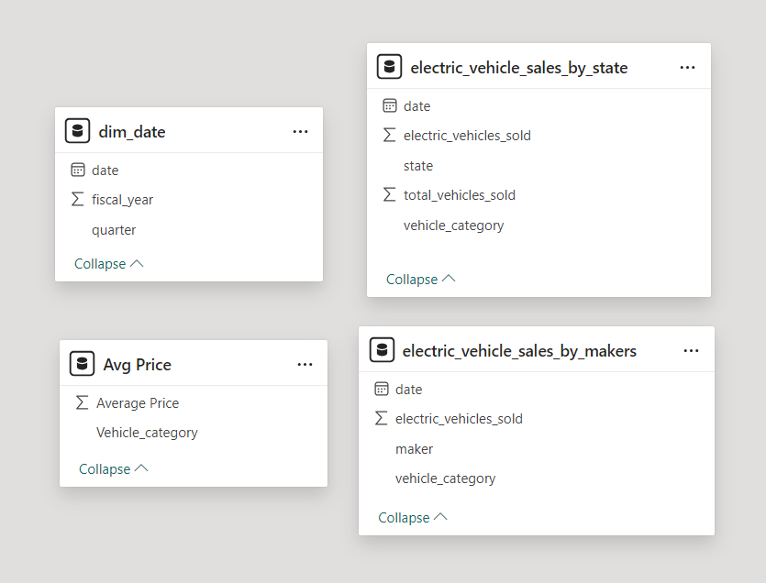
Getting Familiar with Data
The input data includes state-wise and manufacturer-wise electric vehicle sales for the fiscal years 2022 to 2024, along with a dimension table containing details such as vehicle categories and their average unit price.

Slide 6

Primary and Secondary Questions with Output Visualizations and Insights
Notes:
Moving forward to the important section,

Slide 7
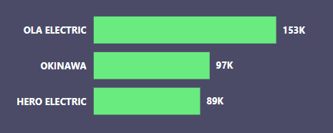
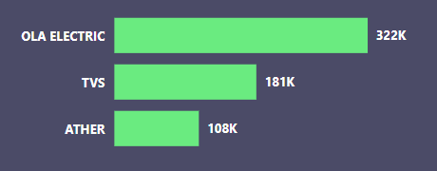
Primary research
1. List the top 3 and bottom 3 makers for the fiscal years 2023 and 2024 in terms of the number of 2-wheelers sold.
Top 3 makers in fiscal year 2023
Top 3 makers in fiscal year 2024
Ola Electric has the highest 2 wheeler EV sales for both fiscal years 2023 and 2024.

Slide 8
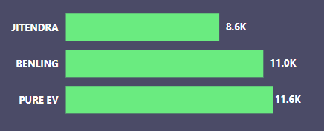
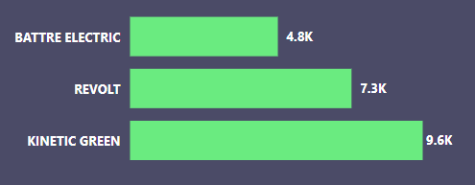
1. List the top 3 and bottom 3 makers for the fiscal years 2023 and 2024 in terms of the number of 2-wheelers sold.
Bottom 3 makers in fiscal year 2023
Bottom 3 makers in fiscal year 2024

Slide 9
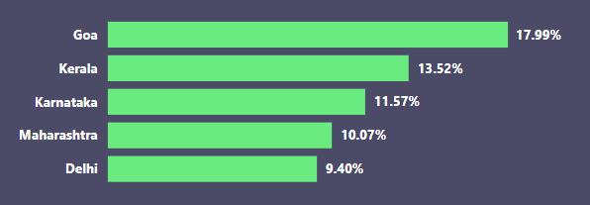
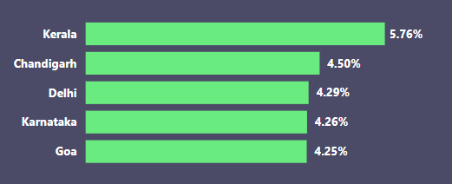
2. Identify the top 5 states with the highest penetration rate in 2-wheeler and 4-wheeler EV sales in FY 2024.
Top 5 states in penetration rate for 2-wheeler EV
Top 5 states in penetration rate for 4-wheeler EV

Slide 10
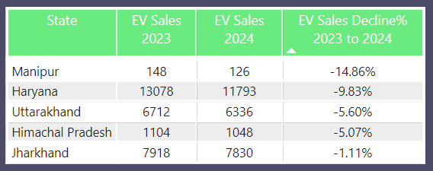
3. List the states with negative penetration (decline) in EV sales from 2022 to 2024?

Slide 11
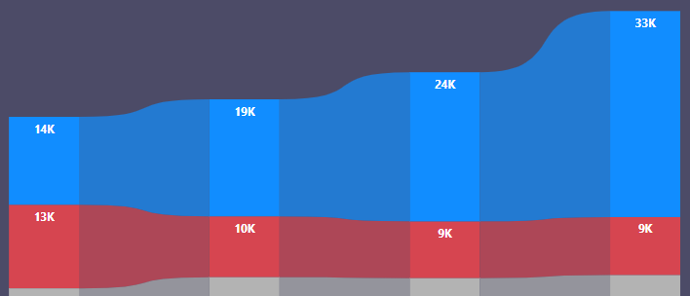
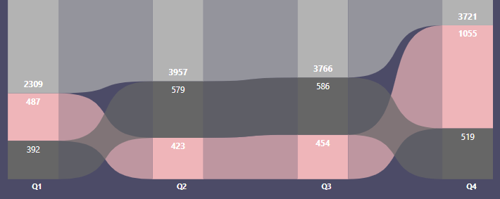
4. What are the quarterly trends based on sales volume for the top 5 EV makers (4-wheelers) from 2022 to 2024?
Tata Motors
Mahindra
MG Motor
BYD India
Hyundai Motor
Tata Motors records the highest sales among the top 5 4-wheeler EV makers.
Notes:
Among the top 5 $ wheeler EV makers , tata motors is in the first position

Slide 12
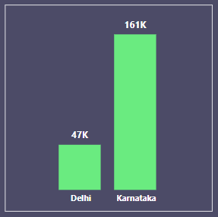
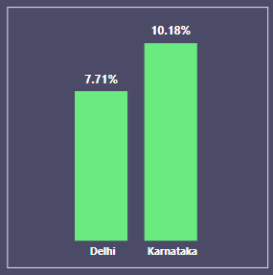
5. How do the EV sales and penetration rates in Delhi compare to Karnataka for 2024?
2024 EV sales comparison
2024 Penetration rate comparison
Karnataka has higher EV sales and Penetration rate, compared to Delhi

Slide 13
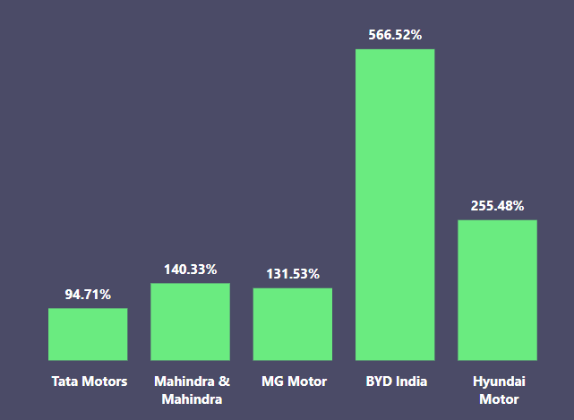
6. List down the compounded annual growth rate (CAGR) in 4-wheeler units for the top 5 makers from 2022 to 2024.
Among the top 5 makers , BYD India records the highest CAGR in 4-wheeler units from 2022 to 2024.

Slide 14
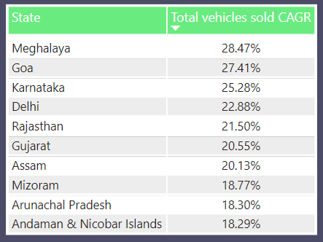
7. List down the top 10 states that had the highest compounded annual growth rate (CAGR) from 2022 to 2024 in total vehicles sold.
Among these states, Meghalaya has the highest CAGR in total vehicles sold

Slide 15
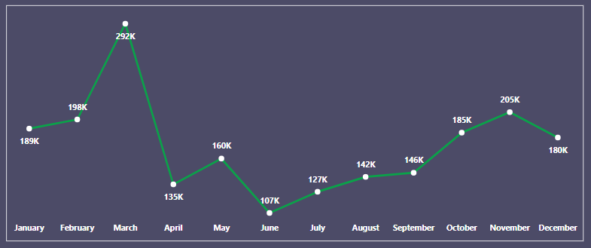
8. What are the peak and low season months for EV sales based on the data from 2022 to 2024?
March is the peak season month for EV sales.
June Is the low season month for EV sales.

Slide 16
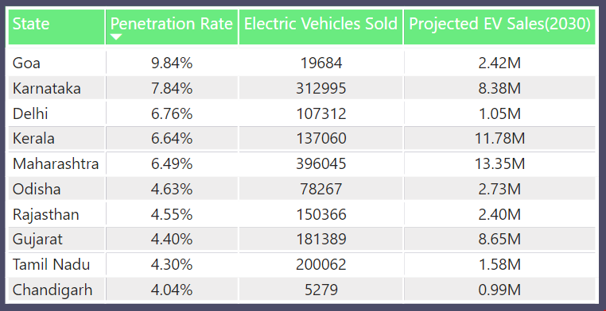
9. What is the projected number of EV sales (including 2-wheelers and 4- wheelers) for the top 10 states by penetration rate in 2030, based on the compounded annual growth rate (CAGR) from previous years?
Goa having higher penetration rate with lower projected EV sales.
Maharashtra and Kerala are having higher projected EV sales.

Slide 17
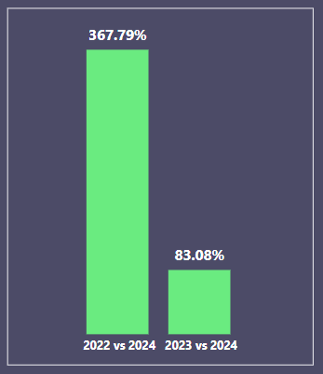
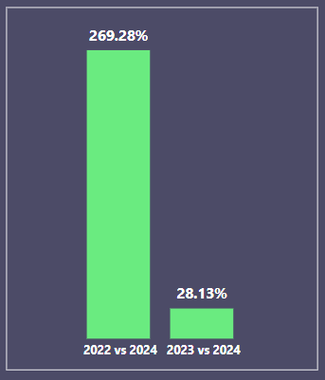
10. Estimate the revenue growth rate of 4-wheeler and 2-wheelers EVs in India for 2022 vs 2024 and 2023 vs 2024.
Revenue Growth Rate of 4-wheelers
Revenue Growth Rate of 2-wheelers
Revenue growth rate of 4-wheelers is higher than the revenue growth rate of 2-wheelers.

Slide 18

Secondary research
What are the primary reasons for customers choosing 4-wheeler EVs in 2023 and 2024
Cost Savings:
EVs have lower fuel and maintenance costs compared to traditional vehicles, making them an economically attractive choice over the long term.

Slide 19

Cost Savings:
EVs have lower fuel and maintenance costs compared to traditional vehicles, making them an economically attractive choice over the long term.
Environmental concerns:
Growing concerns about climate change and the environment are driving many consumers to choose EVs over traditional internal combustion engine (ICE) vehicles to reduce their carbon footprint and contribute to cleaner air

Slide 20

Cost Savings:
EVs have lower fuel and maintenance costs compared to traditional vehicles, making them an economically attractive choice over the long term.
Environmental concerns:
Growing concerns about climate change and the environment are driving many consumers to choose EVs over traditional internal combustion engine (ICE) vehicles to reduce their carbon footprint and contribute to cleaner air
Government Incentives and Policies:
Governments are offering financial incentives such as subsidies, tax breaks, and rebates to encourage the purchase of EVs. Many regions are also implementing stricter emissions regulations and planning to phase out ICE vehicles, making EVs a more appealing option.

Slide 21
2. How do government incentives and subsidies impact the adoption rates of 2-wheelers and 4-wheelers? Which states in India provided most subsidies?
Impact of Government Incentives and Subsidies on EV Adoption Rates:
Reduction in Upfront Cost
Expansion of Charging Infrastructure
Lower Total Cost of Ownership
Notes:
Reduction in Upfront Cost
Purchase subsidies, rebates, or tax credits directly lower the initial purchase price of EVs, making them more affordable and accessible to a broader range of consumers. This is particularly important for 2-wheelers, where even a small subsidy can significantly reduce the overall cost, and for 4-wheelers, which require larger subsidies to compete with traditional vehicles.
2. Expansion of Charging Infrastructure
Investments in building and expanding public charging infrastructure make owning and operating an EV more convenient, especially for 4-wheelers. Adequate charging facilities alleviate concerns over range anxiety, a common barrier to EV adoption, and enhance consumer confidence in switching from conventional vehicles to EVs.
3. Lower Total Cost of Ownership
Incentives like reduced registration fees, road taxes, and exemptions from congestion charges lower the ongoing costs associated with owning an EV. This makes them more attractive over time, especially to cost-sensitive consumers, thus driving adoption rates for both 2-wheelers and 4-wheelers.

Slide 22
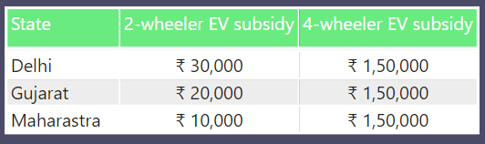
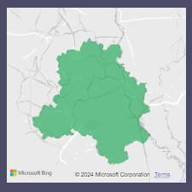
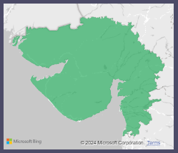
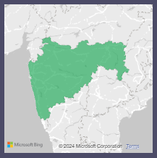
States in India Providing the Most Subsidies:
Delhi
Gujarat
Maharashtra
Notes:
Delhi:
Additional Benefits: Road tax exemptions, registration fee waivers, and incentives for charging infrastructure.
Maharashtra:
Additional Benefits: Scrappage incentives for old vehicles and support for charging infrastructure.
Gujarat:
Additional Benefits: Support for EV manufacturing and charging infrastructure development.

Slide 23
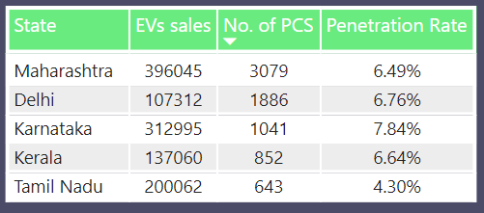
3. How does the availability of charging stations infrastructure correlate with the EV sales and penetration rates in the top 5 states?

Slide 24
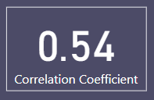
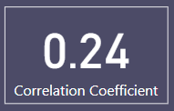
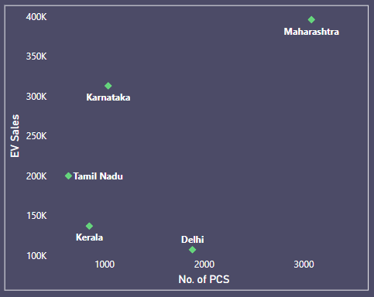
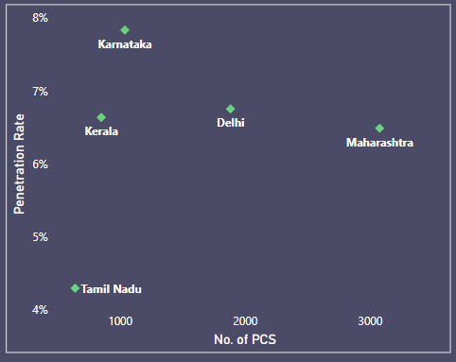
The correlation coefficient 0.54 between No. of PCS and EV sales indicates a positive correlation as the No of EVs sold increases the No. of Public Charging Stations also Increase.
The correlation coefficient 0.24 between No. of PCS and Penetration rate indicates a weak positive correlation.

Slide 25

4. Who should be the brand ambassador if AtliQ Motors launches their EV/Hybrid vehicles in India and why?
Motors
Notes:
Virat Kohli:
As the former captain of the Indian cricket team and a widely admired personality, Virat Kohli represents energy, dynamism, and a youthful spirit. He also has a huge fan following across India, which could help attract a younger audience interested in new technologies.

Slide 26
5. Which state of India is ideal to start the manufacturing unit?
Gujarat
Subsidies and Incentives
Ease of doing Business
Stable Governance
Notes:
Gujarat is the ideal state for starting an EV manufacturing unit due to its attractive subsidies and incentives, ease of doing business, and stable governance. The state offers substantial capital subsidies, interest subsidies on term loans, exemptions from electricity duty, and 100% reimbursement on stamp duty, significantly lowering initial investment and operational costs. Additionally, Gujarat consistently ranks high on the Ease of Doing Business index, supported by a well-developed industrial infrastructure, streamlined regulatory processes, and a strong supply of skilled labor. Its stable governance and pro-business environment further promote industrial growth, with policies designed to encourage both domestic and foreign investment.

Slide 27
6. top 3 recommendations for AtliQ Motors.
Focus on 2-Wheeler EVs:
prioritizing the launch of new 2-wheeler models will allow AtliQ Motors to tap into the growing demand and capture a larger market share. Offering a range of models entry-level to premium can address various consumer needs and price points.
Target Key Regional Markets:
launching new models in regions with high market share and revenue, with targeted marketing and strong local partnerships will maximize reach and sales, promoting the benefits of EVs in the regions with high penetration rate and offering incentives or promotional deals can attract eco-conscious consumers.
Expand Charging Infrastructure:
Partnering with local businesses and charging network providers to expand charging infrastructure, combined with offering convenient home charging solutions, This can improve accessibility and convenience, supporting increased EV sales.

Slide 28
THANK YOU

