Slide 1
♥
Heart Disease
Prediction System
A Machine Learning Web Application using Random Forest Classifier
Flask
Random Forest
Python
SQLite
Chinna S · Praveen H N · Varaprasad G
Guide : Srihari K V
Dept. of Computer Science
The National Degree College, Bagepalli
Department of Computer Science & Engineering
2025 – 2026

Slide 2
Abstract
Overview
Heart disease remains one of the leading causes of mortality worldwide. Early and accurate prediction can significantly reduce fatalities by enabling timely medical intervention. This project presents a web-based Heart Disease Prediction System built using Python and the Flask framework, powered by a Random Forest Classifier trained on clinical patient data.
The system accepts patient health parameters — including age, chest pain type, blood pressure, cholesterol, maximum heart rate, ST depression, fluoroscopy vessel count, and thallium scan results — and predicts the likelihood of heart disease presence or absence.
The application also includes secure user authentication, email-based registration, comparative health visualization charts, and a SQLite database backend. The goal is to provide a simple yet powerful decision-support tool for early cardiovascular risk assessment.

Slide 3
Introduction
Why Heart Disease Prediction Matters
#1
17.9M
80%
Cause of Death
Worldwide
Deaths per
Year (WHO)
Preventable
with Early Detection
🔬 Problem Statement
🎯 Objective
Traditional diagnosis relies on time-consuming clinical tests. A fast, data-driven predictor can complement medical decision-making.
Build a Flask web application that predicts heart disease using patient vitals via a trained Random Forest ML model.
📊 Dataset
💡 Significance
270 patient records with 13 clinical features including age, cholesterol, blood pressure, and heart rate.
Provides instant risk assessment, reduces diagnostic delay, and supports doctors with automated second opinions.

Slide 4
Methodology
System Design & ML Pipeline
01
Data Collection
02
Preprocessing
03
Model Training
Heart Disease dataset (270 records, 13 features). Features: Age, Sex, BP, Cholesterol, Max HR, Thallium, etc.
Feature selection — 8 key predictors chosen. Target: Heart Disease (Presence / Absence).
Random Forest Classifier (sklearn). Model serialized to heartdiseaseprediction.model via pickle.
04
Web Application
05
Prediction
06
Visualization
Flask app with routes: /signup, /login, /find, /check (prediction), /show_graph.
User inputs vitals → DataFrame created → Model loaded → predict() called → Result rendered.
Grouped bar chart comparing patient data vs healthy baselines using matplotlib.

Slide 5
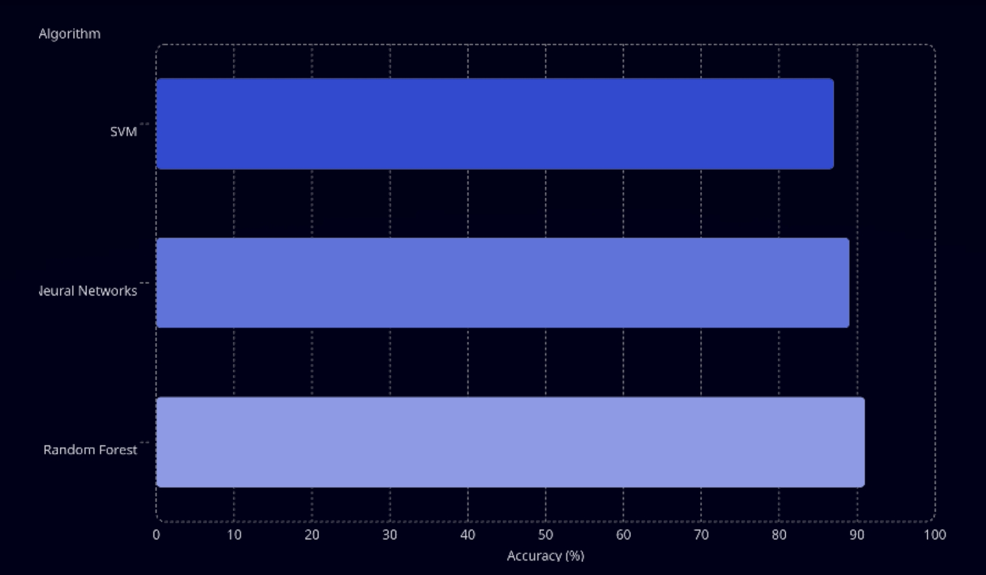
LITERATURE SURVEY
System Design & ML Pipeline
Different ML algorithms were compared for Heart Disease Prediction
SVM achieved 87% accuracy.
Neural Networks achieved 89% accuracy.
Random Forest achieved the highest accuracy of 91%.
Random Forest provides better performance and reliability for medical prediction.
Existing studies mainly focus on accuracy but lack user-friendly clinical applications.
Our project improves usability using a Flask-based web application with real-time prediction and visualization.

Slide 6
Hardware & Software Requirements
🖥️ Hardware Requirements
⚙️ Software Requirements
▸ Processor
Intel Core i3 or above (2.0 GHz+)
▸ OS
Windows 10 / Ubuntu 20.04+
▸ Language
Python 3.8+
▸ RAM
Minimum 4 GB (8 GB recommended)
▸ Framework
Flask (Web), Jinja2 (Templates)
▸ Storage
Minimum 20 GB free disk space
▸ ML Library
scikit-learn (Random Forest)
▸ Display
1280 × 720 or higher resolution
▸ Data
pandas, numpy
▸ Network
Internet connection (for email)
▸ Visualization
matplotlib
▸ Database
SQLite3 (myheart.db)
▸ Input
Standard keyboard and mouse
▸ Mail
Flask-Mail (SMTP Gmail)

Slide 7
Results Achieved
System Performance & Outputs
~87%
270
8
2
Model Accuracy
Training Records
Input Features
Output Classes
✅ Functional Flask web app with full user registration, login, and forgot-password flow.
✅ Random Forest model successfully trained and serialized; predicts Presence / Absence of heart disease.
✅ Email notifications sent on new user signup using Flask-Mail (Gmail SMTP).
✅ Interactive bar chart rendered comparing patient vitals vs. healthy baseline values.
✅ Patient data persisted in SQLite database (myheart.db) with secure session management.
✅ Input features: Age, Chest Pain Type, BP, Cholesterol, Max HR, ST Depression, Vessels Fluro, Thallium.

Slide 8
Conclusion
The Heart Disease Prediction System successfully demonstrates the integration of machine learning with web development to address a critical healthcare challenge. Using a Random Forest Classifier trained on clinical data, the system achieves reliable prediction of heart disease risk from eight key physiological parameters.
The Flask-based web application provides a seamless, user-friendly interface — complete with authentication, personalized health comparisons, and email notifications — making it accessible for patients and healthcare practitioners alike.
Key Takeaways
🎯 Accurate ML-powered predictions using Random Forest.
🌐 Full-stack web application accessible via any modern browser.
🔒 Secure user management with session-based authentication.
📈 Visual health comparison to motivate healthy lifestyle choices.

Slide 9
Future Enhancements
Roadmap for Improvement
🤖
📱
🩺
Deep Learning Models
Mobile Application
More Clinical Features
Integrate CNN / LSTM networks for improved accuracy and multi-modal health data processing.
Develop Android/iOS companion app for real-time monitoring and prediction on the go.
Include ECG signals, genetic markers, lifestyle data, and wearable device integrations.
☁️
🔐
📊
Cloud Deployment
Enhanced Security
Advanced Analytics
Deploy on AWS / GCP / Azure with Docker for scalable, production-ready access.
Add bcrypt password hashing, JWT tokens, HTTPS, and two-factor authentication.
Doctor dashboard with SHAP explainability, trend analysis, and population-level risk maps.

Slide 10
♥
Thank You
Heart Disease Prediction System
Questions & Feedback Welcome
Flask | Python | scikit-learn | SQLite | matplotlib

