Slide 1

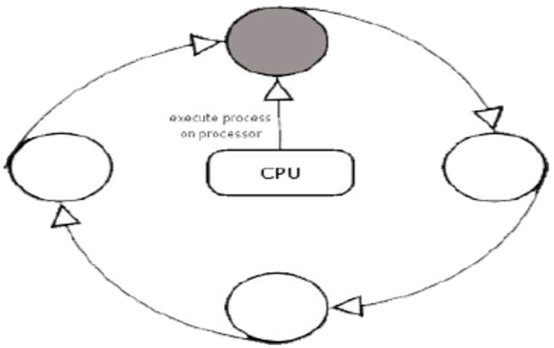
ROUND ROBIN SCHEDULING

Slide 2
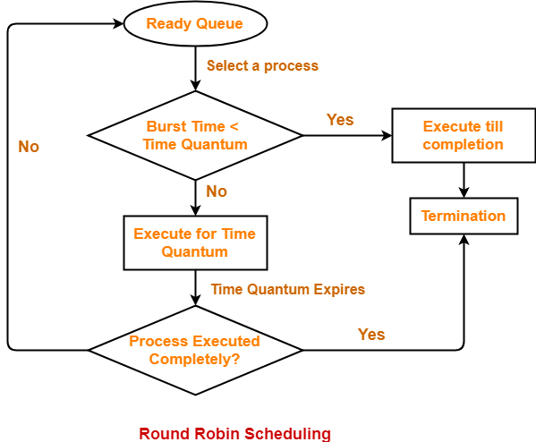
ALGORITHM -

Slide 3
Inputs: Number of tasks (n) , arrival_time[n] , burst_time[n] , time_quantum (quantum)
for i in range(n):
remaining_burst_time[i] = burst_time[i]
current_time = 0 #To start counting the time.
while True:
complete = True #To check whether all the tasks are completed or not.
for i in range(n):
if (arrival_time[i] <= current_time): #Did the task i arrive? If yes, proceed for scheduling.
if (remaining_burst_time[i] > 0): #If task is still not completed...
complete = False
if (remaining_burst_time[i] > quantum): #If the remaining burst time exceeds the quantum time...
current_time += quantum #Schedule the task until quantum time expires. Eventually, increment the current time.
remaining_burst_time[i] -= quantum #Update the remaining burst time.
else: #If the remaining burst time is less than quantum time...
current_time += remaining_burst_time[i] #Complete the task and update the current time.
waiting_time[i] = current_time - burst_time[i] - arrival_time[i] #Calculate the waiting time.
remaining_burst_time[i] = 0 #Task is completed. Hence, remaining burst time = 0.
turn_around_time[i] = burst_time[i] + waiting_time[i] #It is the response time.
else:
continue #If the task i did not arrive, check the next one.
if (complete == True): #If this is not True, it means some tasks are still remaininig.
break

Slide 4
Consider this example -
Task | Arrival_Time | Burst_Time
A | 0 | 11
B | 7 | 12
C | 11 | 3
D | 13 | 11
E | 13 | 6
Time quantum = 4

Slide 5
Task | Arrival_Time | Burst_Time | Remaining_Time | Waiting_Time | Turn_Around_Time
A | 0 | 11 | 11
B | 7 | 12 | 12
C | 11 | 3 | 3
D | 13 | 11 | 11
E | 13 | 6 | 6
A
0

Slide 6
Task | Arrival_Time | Burst_Time | Remaining_Time | Waiting_Time | Turn_Around_Time
A | 0 | 11 | 7
B | 7 | 12 | 12
C | 11 | 3 | 3
D | 13 | 11 | 11
E | 13 | 6 | 6
A
A
0
4

Slide 7
Task | Arrival_Time | Burst_Time | Remaining_Time | Waiting_Time | Turn_Around_Time
A | 0 | 11 | 3
B | 7 | 12 | 12
C | 11 | 3 | 3
D | 13 | 11 | 11
E | 13 | 6 | 6
A
A
B
0
4
8

Slide 8
Task | Arrival_Time | Burst_Time | Remaining_Time | Waiting_Time | Turn_Around_Time
A | 0 | 11 | 3
B | 7 | 12 | 8
C | 11 | 3 | 3
D | 13 | 11 | 11
E | 13 | 6 | 6
A
A
B
C
0
4
8
12

Slide 9
Task | Arrival_Time | Burst_Time | Remaining_Time | Waiting_Time | Turn_Around_Time
A | 0 | 11 | 3
B | 7 | 12 | 8
C | 11 | 3 | 0
D | 13 | 11 | 11
E | 13 | 6 | 6
A
A
B
C
D
0
4
8
12
15

Slide 10
Task | Arrival_Time | Burst_Time | Remaining_Time | Waiting_Time | Turn_Around_Time
A | 0 | 11 | 3
B | 7 | 12 | 8
C | 11 | 3 | 0
D | 13 | 11 | 7
E | 13 | 6 | 6
A
A
B
C
D
E
0
4
8
12
15
19

Slide 11
Task | Arrival_Time | Burst_Time | Remaining_Time | Waiting_Time | Turn_Around_Time
A | 0 | 11 | 3
B | 7 | 12 | 8
C | 11 | 3 | 0
D | 13 | 11 | 7
E | 13 | 6 | 2
A
A
B
C
D
E
A
0
4
8
12
15
19
23

Slide 12
Task | Arrival_Time | Burst_Time | Remaining_Time | Waiting_Time | Turn_Around_Time
A | 0 | 11 | 0
B | 7 | 12 | 8
C | 11 | 3 | 0
D | 13 | 11 | 7
E | 13 | 6 | 2
A
A
B
C
D
E
A
B
0
4
8
12
15
19
23
26

Slide 13
Task | Arrival_Time | Burst_Time | Remaining_Time | Waiting_Time | Turn_Around_Time
A | 0 | 11 | 0
B | 7 | 12 | 4
C | 11 | 3 | 0
D | 13 | 11 | 7
E | 13 | 6 | 2
A
A
B
C
D
E
A
B
D
0
4
8
12
15
19
23
26
30

Slide 14
Task | Arrival_Time | Burst_Time | Remaining_Time | Waiting_Time | Turn_Around_Time
A | 0 | 11 | 0
B | 7 | 12 | 4
C | 11 | 3 | 0
D | 13 | 11 | 3
E | 13 | 6 | 2
A
A
B
C
D
E
A
B
D
E
0
4
8
12
15
19
23
26
30
34

Slide 15
Task | Arrival_Time | Burst_Time | Remaining_Time | Waiting_Time | Turn_Around_Time
A | 0 | 11 | 0
B | 7 | 12 | 4
C | 11 | 3 | 0
D | 13 | 11 | 3
E | 13 | 6 | 0
A
A
B
C
D
E
A
B
D
E
B
0
4
8
12
15
19
23
26
30
34
36

Slide 16
Task | Arrival_Time | Burst_Time | Remaining_Time | Waiting_Time | Turn_Around_Time
A | 0 | 11 | 0
B | 7 | 12 | 0
C | 11 | 3 | 0
D | 13 | 11 | 3
E | 13 | 6 | 0
A
A
B
C
D
E
A
B
D
E
B
D
0
4
8
12
15
19
23
26
30
34
36
40

Slide 17
Task | Arrival_Time | Burst_Time | Remaining_Time | Waiting_Time | Turn_Around_Time
A | 0 | 11 | 0
B | 7 | 12 | 0
C | 11 | 3 | 0
D | 13 | 11 | 0
E | 13 | 6 | 0
A
A
B
C
D
E
A
B
D
E
B
D
0
4
8
12
15
19
23
26
30
34
36
40
43

Slide 18
Task | Arrival_Time | Burst_Time | Remaining_Time | Waiting_Time | Turn_Around_Time
A | 0 | 11 | 0 | 15 | 26
B | 7 | 12 | 0 | 21 | 33
C | 11 | 3 | 0 | 1 | 4
D | 13 | 11 | 0 | 19 | 30
E | 13 | 6 | 0 | 17 | 23
A
A
B
C
D
E
A
B
D
E
B
D
0
4
8
12
15
19
23
26
30
34
36
40
43
Average waiting time = (15+21+1+19+17)/5 = 14.6
Average turn-around time = (26+33+4+30+23)/5 = 23.2

