Slide 1
Support vector machine
Shahnawaz Sayyed
01 DEC 2020

Slide 2

AGENDA
01
02
03
What is Machine Learning
Why Support Vector Machine
What is Support Vector Machine
04
05
06
Understanding of Support Vector Machine
Advantage and Disadvantage of Support Vector Machine
Implementation of SVM in Python

Slide 3
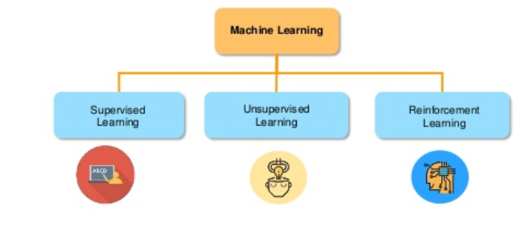
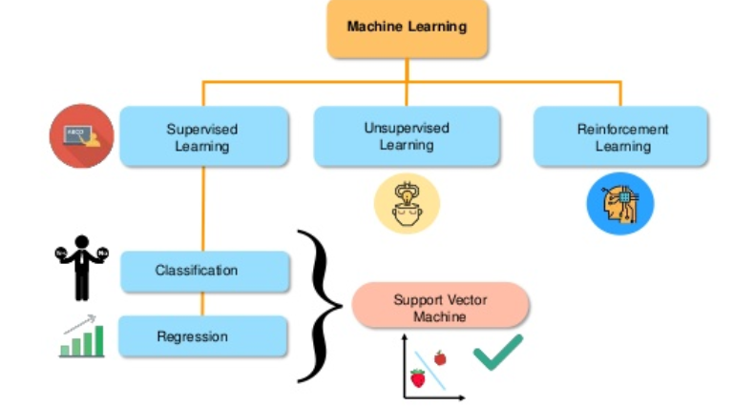
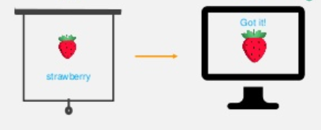
What is machine learning
Machine learning model learns from the past input data and makes the prediction as output

Slide 4
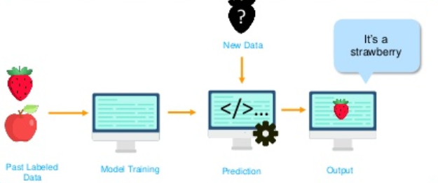
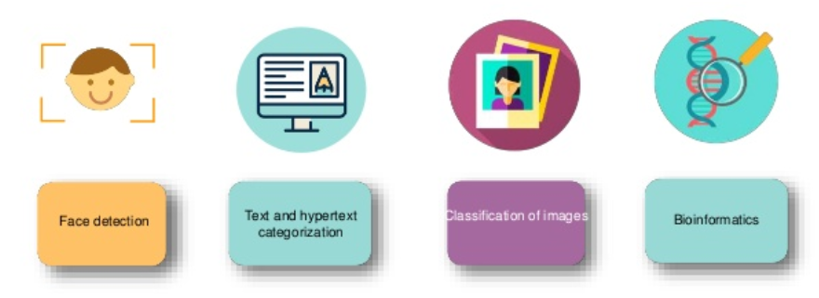
Why support vector machine
SVM is a supervised learning method that looks at data and sorts it into one of the two categories
Various challenges in the different business domain where we can use SVM as a robust technique
Why we are not build a model to predict an unknown data?
This is Support Vector Machine
But how does prediction works?

Slide 5
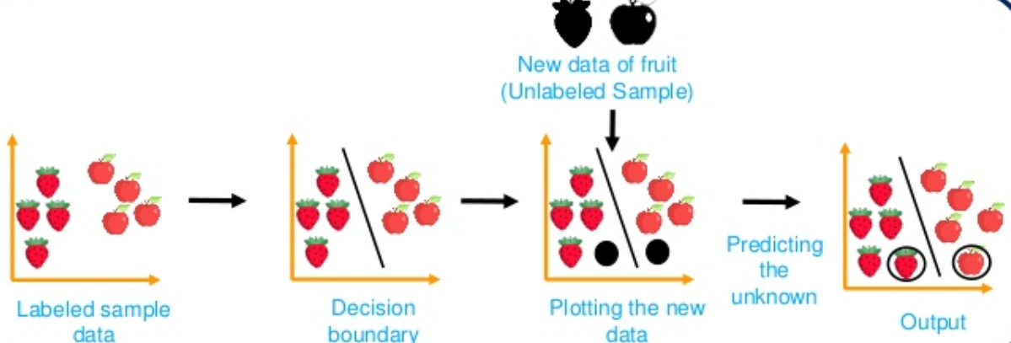
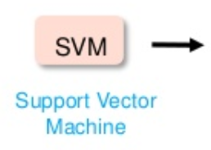
Why support vector machine
New Data points
Support vector machine will classify any new data/element into one of the two classes

Slide 6

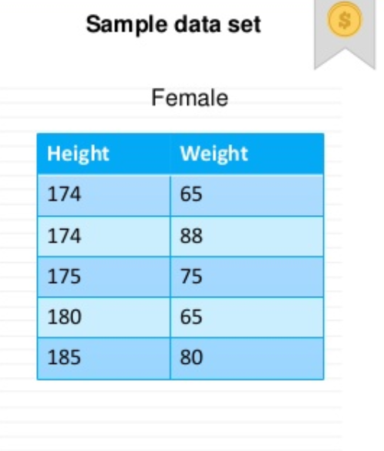
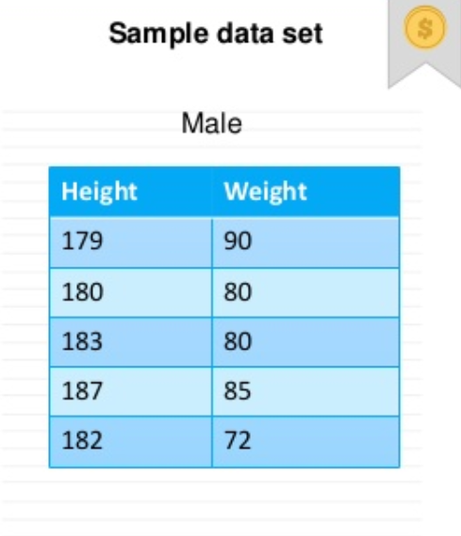
What Support vector machine
Support Vector Machine(SVM) is a supervised classification method that separates data using hyperplane. It will work for both Regression and Classification problem
Lets understand SVM with an example. We will classify Male and Female by using Height and weight for an individual.
With the help of this example, we will going to learn below concept related to SVM
Decision boundary
Distance Margin
Hyperplane
Support Vector
Linear Separable
Non Linear Separable

Slide 7
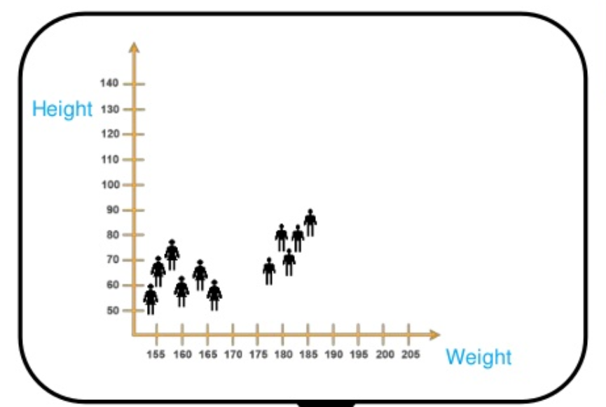

What Support vector machine
Support Vector Machine(SVM) is a supervised classification method that separates data using hyperplane. It will work for both Regression and Classification problem
Lets add a New data point and figure out if it’s a male or Female?
New Data Point
When we plot the data we can see clear separation between two classes, Male and Female

Slide 8
What Support vector machine
Support Vector Machine(SVM) is a supervised classification method that separates data using hyperplane. It will work for both Regression and Classification problem
So for this task we need to split our data first
Unknown value
Line 1
Line 2
A decision boundary is required in order to classify the new unknown variable
Decision boundary
But to predict the gender of the new data point we should split the data in best possible way.
Which line would be the best decision boundary? Line 1 or Line 2?

Slide 9
What Support vector machine
Support Vector Machine(SVM) is a supervised classification method that separates data using hyperplane. It will work for both Regression and Classification problem
But why do we say this line is the best split?
Line 1
The best line is selected by computing the maximum space from equidistant support vectors
Maximum space
Then we would say this line is the best split of data

Slide 10
What Support vector machine
While the other line doesn’t has the maximum space that separate two classes
Line 1
Line 2
Minimum space

Slide 11
What Support vector machine
Margin is a gap between the two lines on the closest class points. This is calculated as the perpendicular distance from the line to support vectors or closest points. A margin should be maximum between two classes.
Distance Margin
Hyperplane
Hyperplane: As we can see in the diagram, it is a decision plane or space which is divided between a set of objects having different classes..
Support Vectors
Support vectors are the data points, which are closest to the hyperplane.
That’s why this line is the best split the data

Slide 12
SVM Maths intuition
m=-1
C or b=0
Y=W^{T}.X+0
Y=w^{T}.x+b
Always be -ve
X2
(4,4)
-1
0
4,4
Marginal plane
m=-1
C or b=0
Y=W^{T}.X+0
(-4,4)
= -4 -ve Value
X1
Y=w^{T}.x
Equation of Hyperplane:
w^{T}.x+b=0
-1
0
-4,0
Always be +ve
w^{T}.x+b= -1
w^{T}.x+b=0
Slope=-1
w^{T}.x+b=+1
= 4 +ve Value

Slide 13
SVM Maths intuition
Y=w^{T}.x+b
Always be -ve
w^{T}.x1+b= -1
What is the difference between x1 and x2?
X2
(-4,4)
w^{T}.x2+b= 1
Marginal plane
(-)
(-)
(-)
Now we need to remove W
w^{T}(x2-X1) = 2
This is called optimization function
(-4,4)
X1
w^{T}
X2
X1
(x2-X1) = 2
W
W
Slope=-1
Always be +ve
w^{T}.x+b= -1
we need to Maximize this distance..
2
1 w^{T}.x1+b>=1
Max
w^{T}.x+b=0
W
-1 w^{T}.x1+b<=-1
w^{T}.x+b=+1
Condition of optimization of margin
Optimization Function= Yi*w^{T}.x1+b>=1

Slide 14
SVM Maths intuition
Y= w^{T}.x+b
Always be -ve
w^{T}.x1+b= -1
What is the difference between x1 and x2?
X2
(-4,4)
w^{T}.x2+b= 1
Marginal plane
(-)
(-)
(-)
Now we need to remove W
w^{T}(x2-X1) = 2
(-4,4)
X1
X2
X1
(w,b) =
min
W
+ Ci ∑£i
Value of the error
Slope=-1
2
Always be +ve
How many errors?
w^{T}.x+b= -1
w.x+b=0
w^{T}.x+b=+1
Regularization is done by doing hyperparameter tuning.
Parameter Tuning: For linear SVM C (Cost Parameter)
For Non-linear SVM gamma
This equation is called Linear SVM equation

Slide 15
What Support vector machine
Here D+ is the shortest distance to the closest positive point
Distance Margin
And D- is the shortest distance to the closest negative point
Sum of D+ and D- is called the distance margin
Optimal Hyperplane
From the distance margin we can get an optimal hyperplane
D+
D-
Based on the hyperplane we can say that, new data points belongs to male gender
If we select hyperplane having low margin then there is a high chance of misclassification
This method is also called as Linear Support Vector Machine(LSVM)

Slide 16
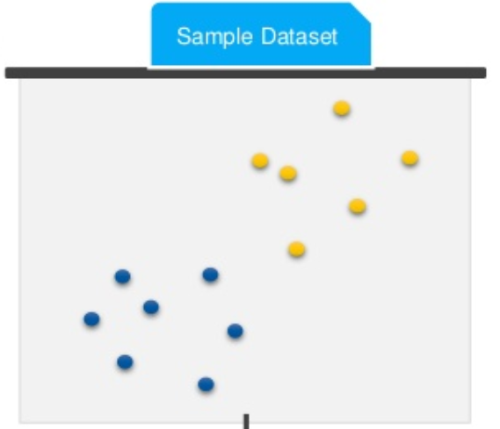
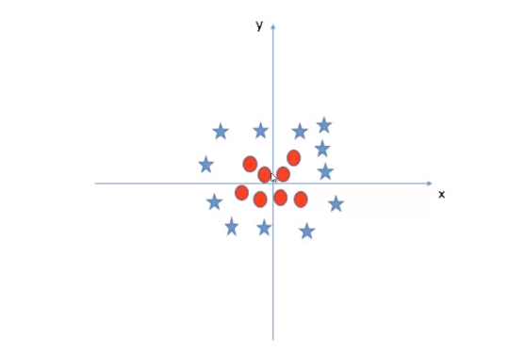
Understanding of Support vector machine
What if our data is not like this?
But if it looks like this?
What if our 2-Dimentional data looks like in the given graph?
This data can not be separated into 2 classes using the hyperplane.
Here we cant use Hyperplane?

Slide 17
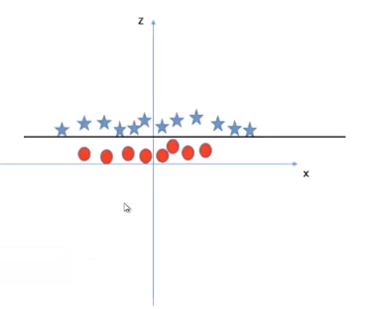


Understanding of Support vector machine
What is Kernel
Kernel is a method to make SVM run in case of non separable data points. The kernel function transform the data into higher dimensional feature to make it possible to perform the linear separation. We can say that non linear function is learned by a support vector machine in a higher dimensional feature space.
Kernel
Sample 2D Plot
Input
Output
Sample 3D Plot

Slide 18
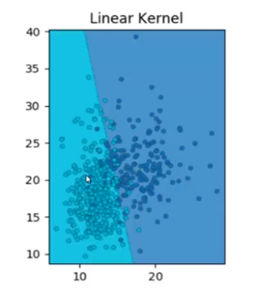

Understanding of Support vector machine
Different type of Kernels
1. Linear: u'*v
2. Polynomial: (gamma*u'*v + coef0)^degree
3. Radial basis (RBF) : exp(-gamma*|u-v|^2)
1. Linear Kernel
A linear kernel can be used as normal dot product any two given observations. The product between two vectors is the sum of the multiplication of each pair of input values.
Decision boundary is straight line
In real/practical example data is rarely ever linearly separable
Linear kernel not used frequently in SVM because data is not linearly separable in real world example

Slide 19
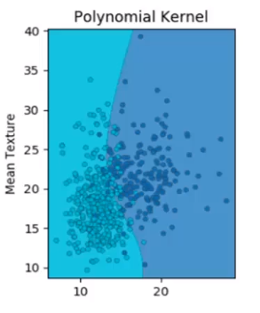

Understanding of Support vector machine
Different type of Kernels
1. Linear: u'*v
2. Polynomial: (gamma*u'*v + coef0)^degree
3. Radial basis (RBF) : exp(-gamma*|u-v|^2)
2. Polynomial Kernel
It has in non uniform in nature due to non polynomial function of the base feature.
RBF kernel classified data well by isolating them, but this kernel is prone to overfitting and it can captured noise.
A polynomial kernel is a more generalized form of the linear kernel. The polynomial kernel can distinguish curved or nonlinear input space.
Where d is the degree of the polynomial. d=1 is similar to the linear transformation. The degree needs to be manually specified in the learning algorithm.

Slide 20
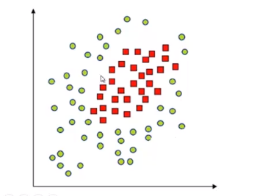
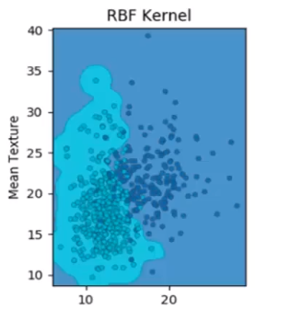

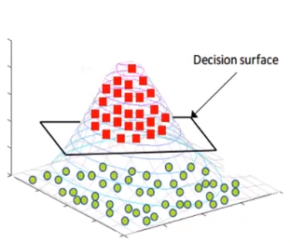
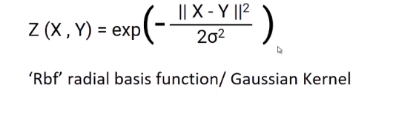
Understanding of Support vector machine
Different type of Kernels
3. Radial Basis Function
The Radial basis function kernel is a popular kernel function commonly used in support vector machine classification. RBF can map an input space in infinite dimensional space.
Kernel
It has circular bounded region due to rounded base of the gaussian kernel
RBF kernel classified data well by isolating them, but this kernel is prone to overfitting and it can captured noise.

Slide 21
Advantage and disadvantage of svm
Advantages of SVM
1.SVM performs well in case of non-linear separable data using kernel trick.
2.It works well in high dimensional space (i.e. large number of predictors)
3.It works well in case of text or image classification.
4.It does not suffer multicollinearity problem
Disadvantages of SVM
It takes a lot of time on large sized data sets
It does not directly return probability estimates.
The linear kernel is almost similar to logistic regression in case of linear separable data.

Slide 22
Tuning Parameter of SVM
Linear Kernel SVM:
There is only one parameter in linear kernel - Cost (C). It implies misclassification cost on training data.
A large C gives you low bias and high variance. Low bias because you penalize the cost of misclassification a lot. Large C makes the cost of misclassification high, thus forcing the algorithm to explain the input data stricter and potentially overfit.
A small C gives you higher bias and lower variance. Small C makes the cost of misclassification low, thus allowing more of them for the sake of wider "cushion"
Non-Linear Kernel (Radial)
Two parameters for fine tuning in radial kernel - Cost and Gamma
Gamma explains how far the influence of a single training example reaches. When gamma is very small, the model is too constrained and cannot capture the complexity or “shape” of the data.
The goal is to find the balance between "not too strict" and "not too loose". Cross-validation and resampling, along with grid search, are good ways to finding the best C.

Slide 23
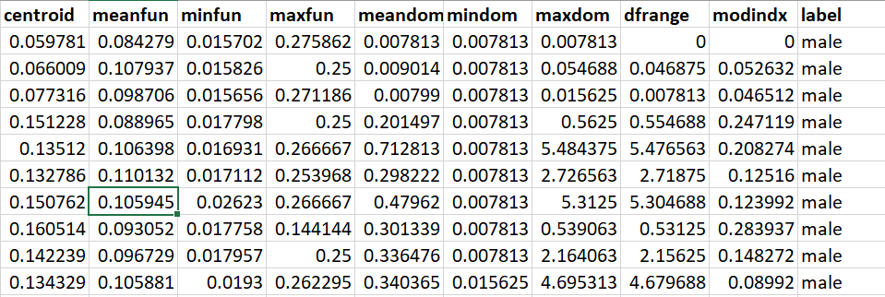
Implementation of svm in python
Objective: To identify the Gender based on recognition of voice and speech Analysis
Target variable

Slide 24
Implementation of svm in python
Data dictionary:
meanfreq: mean frequency (in kHz)
sd: standard deviation of frequency
median: median frequency (in kHz)
Q25: first quantile (in kHz)
Q75: third quantile (in kHz)
IQR: interquantile range (in kHz)
skew: skewness (see note in specprop description)
kurt: kurtosis (see note in specprop description)
sp.ent: spectral entropy
sfm: spectral flatness
mode: mode frequency
centroid: frequency centroid (see specprop)
peakf: peak frequency (frequency with highest
energy)
meanfun: average of fundamental frequency
measured across acoustic signal
minfun: minimum fundamental frequency measured across acoustic signal
maxfun: maximum fundamental frequency measured across acoustic signal
meandom: average of dominant frequency measured across acoustic signal
mindom: minimum of dominant frequency measured across acoustic signal
maxdom: maximum of dominant frequency measured across acoustic signal
dfrange: range of dominant frequency measured across acoustic signal
modindx: modulation index. Calculated as the accumulated absolute difference between adjacent measurements of fundamental frequencies divided by the frequency range
label: male or female

Slide 25
THANK YOU

