Slide 1
Cost of Capital
Ashok Banerjee

Slide 2
Cost of capital
The cost of capital is the return that must be provided for the use of an investor’s funds.
Cost of Debt:
  Direct Approach.
  Weighted Average Method.
  IRR Approach.
Cost of Equity: CAPM
  What is the risk-free rate?
    Logic of using a long-term rate.
  What is your equity beta?
  How much is the equity risk premium (ERP)?

Slide 3
Estimation of Beta
Market Portfolio - Portfolio of all assets in the economy. In practice, a broad stock market index, such as the S&P Composite, is used to represent the market.
Beta - Sensitivity of a stock’s return to the return on the market portfolio.
Notes:
3

Slide 4
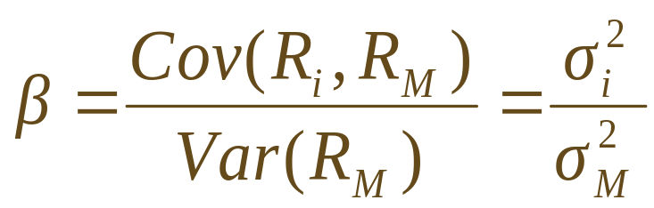
Estimation of Beta
Problems
  Betas may vary over time.
  The sample size may be inadequate.
  Betas are influenced by changing financial leverage and business risk.
Solutions
  Problems 1 and 2 can be moderated by more sophisticated statistical techniques.
  Problem 3 can be lessened by adjusting for changes in business and financial risk.
  Look at average beta estimates of comparable firms in the industry.

Slide 5
Stability of Beta
Most analysts argue that betas are generally stable for firms remaining in the same industry.
That is not to say that a firm’s beta cannot change.
  Changes in product line
  Changes in technology
  Deregulation
  Changes in financial leverage

Slide 6
Using an Industry Beta
It is frequently argued that one can better estimate a firm’s beta by involving the whole industry.
If you believe that the operations of the firm are similar to the operations of the rest of the industry, you should use the industry beta.
If you believe that the operations of the firm are fundamentally different from the operations of the rest of the industry, you should use the firm’s beta.
Do not forget about adjustments for financial leverage.

Slide 7
Determinants of Beta
Business Risk
  Cyclicality of Revenues
  Operating Leverage
Financial Risk
  Financial Leverage

Slide 8
Cyclicality of Revenues
Highly cyclical stocks have higher betas.
  Empirical evidence suggests that retailers and automotive firms fluctuate with the business cycle.
  Transportation firms and utilities are less dependent upon the business cycle.
Note that cyclicality is not the same as variability—stocks with high standard deviations need not have high betas.
  Movie studios have revenues that are variable, depending upon whether they produce “hits” or “flops,” but their revenues may not be especially dependent upon the business cycle.

Slide 9
Operating Leverage
The degree of operating leverage measures how sensitive a firm (or project) is to its fixed costs.
Operating leverage increases as fixed costs rise and variable costs fall.
Operating leverage magnifies the effect of cyclicality on beta.
The degree of operating leverage is given by:
Δ EBIT
Sales
DOL =
×
EBIT
Δ Sales

Slide 10
Financial Leverage and Beta
Operating leverage refers to the sensitivity to the firm’s fixed costs of production.
Financial leverage is the sensitivity to a firm’s fixed costs of financing.
The relationship between the betas of the firm’s debt, equity, and assets is given by:
Debt
Equity
β_{Asset} =
× β_{Debt} +
× β_{Equity}
Debt + Equity
Debt + Equity
Financial leverage always increases the equity beta relative to the asset beta.

Slide 11
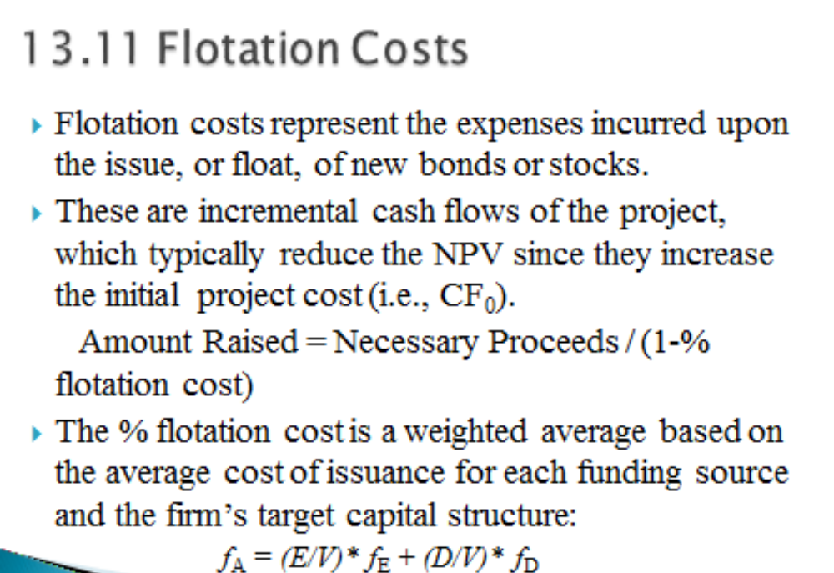

Slide 12
Problem
Longstreet Communications Inc. has the following capital structure, which it considers to be optimal:
  Debt 25%
  Preferred Stock 15%
  Equity 60%
LCI’s tax rate is 40% and investors expect earnings and dividend to grow at a constant rate of 9% in the future. LCI paid a dividend of Rs. 3.60 per share last year, and its stock currently sells at a price of Rs.60 per share. Treasury bonds yield 11%, expected equity risk premium is 3%, and LCI’s beta is 1.51
New 11%preferred stock could be sold at Rs. 100 with 5% floatation cost.
Debt could be sold at an interest rate of 12%.
What’s the WACC of LCI?

Slide 13
Reducing the Cost of Capital
What is Liquidity?
Liquidity, Expected Returns and the Cost of Capital
Liquidity and Adverse Selection
What the Corporation Can Do

Slide 14
What is Liquidity?
The idea that the expected return on a stock and the firm’s cost of capital are positively related to risk is fundamental.
Recently, a number of academics have argued that the expected return on a stock and the firm’s cost of capital are negatively related to the liquidity of the firm’s shares as well.
The trading costs of holding a firm’s shares include brokerage fees, the bid-ask spread and market impact costs.

Slide 15
Liquidity, Expected Returns and the Cost of Capital
The cost of trading an illiquid stock reduces the total return that an investor receives.
Investors will thus demand a high expected return when investing in stocks with high trading costs.
This high expected return implies a high cost of capital to the firm.

Slide 16
Liquidity and the Cost of Capital
Cost of Capital
Liquidity
An increase in liquidity (i.e., a reduction in trading costs) lowers a firm’s cost of capital.

Slide 17
Liquidity and Adverse Selection
There are a number of factors that determine the liquidity of a stock.
One of these factors is adverse selection.
This refers to the notion that traders with better information can take advantage of specialists and other traders who have less information.
The greater the heterogeneity of information, the wider the bid-ask spreads, and the higher the required return on equity.

Slide 18
What the Corporation Can Do
The corporation has an incentive to lower trading costs since this would result in a lower cost of capital.
A stock split would increase the liquidity of the shares.
A stock split would also reduce the adverse selection costs, thereby lowering bid-ask spreads.
This idea is a new one, and empirical evidence is trickling in.
The incidence of no trading decreases and liquidity risk is lower following splits, implying a decline in latent trading costs and a reduced cost of equity capital. (Lin et al, JFE Volume 93, Issue 3, September 2009, Pages 474-489)

Slide 19
What the Corporation Can Do
Companies can also facilitate stock purchases to influence cost of capital.
How?
Companies can also disclose more information, especially to security analysts to narrow the gap between informed and uninformed traders. This should reduce spreads.

Slide 20
Variable WACC
Calculate WACC using existing structure.
Estimate the cost of debt at the new debt ratio.
Estimate the new cost of equity
Recalculate the WACC at the new financing weights.

Slide 21
Example
Consider Grand Sport, Inc., which is currently all-equity financed and has a beta of 0.90.
The firm has decided to lever up to a capital structure of 1 part debt to 1 part equity.
Since the firm will remain in the same industry, its asset beta should remain 0.90.
However, assuming a zero beta for its debt, its equity beta would become twice as large:
1
β_{Asset} = 0.90 =
× β_{Equity}
1 + 1
β_{Equity} =
2 × 0.90 = 1.80

Slide 22
The Firm versus the Project
Any project’s cost of capital depends on the use to which the capital is being put—not the source.
Therefore, it depends on the risk of the project and not the risk of the company.
Notes:
16
This relation is consistent with the separation principle discussed in a prior chapter.

Slide 23
Capital Budgeting & Project Risk
Suppose the Conglomerate Company has a cost of capital, based on the CAPM, of 17%. The risk-free rate is 4%, the market risk premium is 10%, and the firm’s beta is 1.3.
17% = 4% + 1.3 × 10%
This is a breakdown of the company’s investment projects:
1/3 Automotive Retailer β = 2.0
1/3 Computer Hard Drive Manufacturer β = 1.3
1/3 Electric Utility β = 0.6
average β of assets = 1.3
When evaluating a new electrical generation investment, which cost of capital should be used?
Notes:
17

Slide 24
Problem
A company has the following capital structure (market value basis):
  12% Debt Rs. 500 million
  Equity Rs. 1200 million
Levered beta of equity 1.10. Risk free rate 8%. Risk premium 8%. Find out WACC
The company proposes to change the capital structure to 1:1 (Debt: Equity).
Corporate tax rate 30%. Will there be any change in WACC (assume that the company can raise additional debt at the same rate)

