Slide 1
Value Maximisation and Firm Objective
Ashok Banerjee

Slide 2
Shareholder Vs. Stakeholder Theory
U.S. experience
Japan’s experience
Shift in Corporate vision of Indian firms.

Slide 3
BP-AMOCO’s Vision
To create long-term shareholder value from a distinctive set of investment opportunities, which are:
  biased towards the upstream
  capable of producing returns which are both secure and highly competitive over the long-term

Slide 4
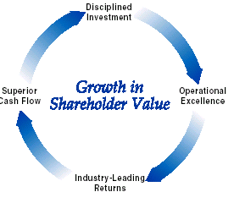
ExxonMobil: Vision
Long-term growth in shareholder value is our core and fundamental objective

Slide 5
Xerox’s Corporate Goals
To deliver maximum customer satisfaction.
To aim for enhanced Employee motivation and satisfaction.
To increase market share.
To improve its Return on Assets.

Slide 6
RIL’s Vision in 1980-81
…..the Company a multi product and well diversified Company resulting in a complete change in the face of the Company and imparting a future improvement to the net worth of equity.

Slide 7
RIL’s Vision in 1997-98
In the light of anticipated robust growth in the Indian economy, and our earnings growth forecast, we will endeavour to double the value of Reliance in the next five years. We plan to achieve this goal through focused growth, capital efficiency and a single minded emphasis on shareholder value.
We have set ourselves the targets of achieving a 20% compounded growth in earnings per share and a return of 20% on shareholders’ funds over the next 5 years.

Slide 8
RIL’s vision in 2017-18
We consider stakeholders as partners in our success, and we remain committed to maximising stakeholders’ value, be it shareholders, employees, suppliers, customers, investors, communities or policy makers.

Slide 9
Shared Value- Porter (HBR, 2011)
The concept of shared value can be defined as policies and operating practices that enhance the competitiveness of a company while simultaneously advancing the economic and social conditions in the communities in which it operates.
The concept of shared value blurs the line between for-profit and nonprofit organizations. New kinds of hybrid enterprises are rapidly appearing.
Revolution Foods, a four-year-old venture-capital-backed U.S. start-up, provides 60,000 fresh, healthful, and nutritious meals to students daily—and does so at a higher gross margin than traditional competitors.
Shared value does not mean redistribution of value.

Slide 10
Issues in Corporate Restructuring
Identify the best option for restructuring a company faced with a particular problem, challenge, or opportunity;
Use financial valuation and credit analysis to measure the potential value gains available through restructuring;
Manage the complicated accounting, tax, legal, and regulatory challenges that stand in the way of a restructuring;
Design an optimal negotiation strategy for dealing with the firm's stakeholders to ensure the ultimate success of a restructuring; and
Execute decisively a restructuring plan.

Slide 11
Essence of Corporate Restructuring
The principal purpose of any restructuring exercise is to achieve corporate objectives and unlock value. Three essential steps in corporate restructuring:
  Internal Restructuring
  External Restructuring.
  Making managers owners.

Slide 12
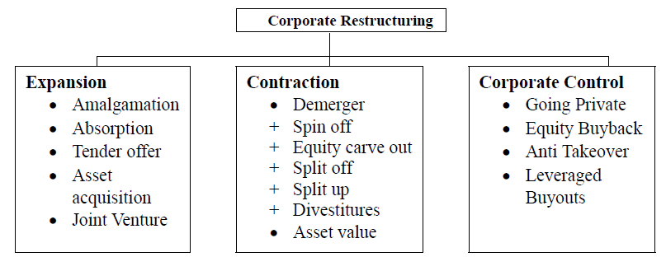
(External) Corporate Restructuring

Slide 13
Asset Restructuring

Slide 14
Asset Restructuring: Definition
Asset restructuring involves actions undertaken to realign the asset side of the balance sheet.
Whereas, recapitalization involves realignment of the liability side of the balance sheet.
Asset restructuring is a change in the nature of business accomplished by total or partial disposition of some of the assets held by the company and the possible acquisition of others.

Slide 15
Diversification Discount
The first step in embarking upon a potential asset restructuring plan is to acknowledge the source of negative synergies or grasping the diversification discount.
Empirical studies report that the observed market value of a diversified firm is, on average, about 15 per cent less than the sum of the implied market values of its divisions, as proxied by the stand-alone market values of single-segment firms in those industries.
The diversified conglomerate constitutes an internal capital market in which capital is allocated internally across lines of business by corporate headquarters.
In contrast, a stand-alone firm depends on external debt and equity markets for its capital investments and is subject to the discipline of these markets.

Slide 16
Factors behind diversification discount
The information hypothesis: the inability of markets to correctly evaluate conglomerate structures with unrelated businesses, leading to possible undervaluation of the parent firm.
The inefficient management hypothesis: the inability of managers to efficiently manage unrelated businesses from a lack of focus on core competency.
The inefficient investment hypothesis: the distortion of investment allocations within the firm arising from agency problems between corporate headquarters and business units, and competition among the units for resources

Slide 17
Modes of asset disposition
Complete disposition:
  By direct private sales (including slump sale)
  Initial public offerings (IPOs)
  Spin-offs
  Split-offs
  Split-ups/ sell offs
Partial disposition:
  Carve outs
  Tracking stocks

Slide 18
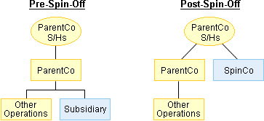
Corporate Spin off

Slide 19
Spin off: Strategic Rationale
Unlocking hidden value – Establish a public market valuation for undervalued assets and create a pure-play entity that is transparent and easier to value
Undiversification – Divest non-core businesses and sharpen strategic focus when direct sale to a strategic or financial buyer is either not compelling or not possible
Institutional sponsorship – Promote equity research coverage and ownership by sophisticated institutional investors, either of which tend to validate SpinCo as a standalone business
Public currency – Create a public currency for acquisitions and stock-based compensation programs
Motivating management – Improve performance by better aligning management incentives with SpinCo's performance (using SpinCo, rather than ParentCo, stock-based awards), creating direct accountability to public shareholders, and increasing transparency into management performance
Eliminating dissynergies – Reduce bureaucracy and give SpinCo management complete autonomy
Anti-trust – Break up a business in response to anti-trust concerns
Corporate defense – Divest "crown jewel" assets to make a hostile takeover of ParentCo less attractive.

Slide 20
Spin-offs: capital market implications
Institutional investors committed to specific investment styles (e.g. value, growth, large-cap, etc.) or subject to certain fiduciary restrictions may need to realign their holdings with their investment objectives following a spin-off by one of their portfolio companies.
On the other hand, spin-offs are commonly executed in response to shareholder pressure to divest a subsidiary, perhaps because the hypothetical sum-of-the-parts valuation exceeds the current value of the consolidated enterprise. In these cases, the parent and/or new subsidiary stock may experience upward pricing pressure following a spin-off that mitigates downward pressure due to shareholder rotation.

Slide 21
Spin-offs: Implementation Issues
Allocation of overhead costs between the spin-off and the remaining parent.
Allocation of pre-spinoff debt between the de-merged units: It makes economic sense to allocate more debt to the unit with the higher debt capacity i.e., to the more mature unit with higher cash generating capacity and higher tangible assets which serve as collateral for debt.
Allocation of people and corporate resources

Slide 22
Spin-offs: Indian Examples
Gulf Oil Corporation Ltd. (GOCL):
  Demerged its lubricant business to Gulf Oil Lubricants India Limited (GOLIL) effective April 2014.
  According to the scheme, for every two existing shares (face value Rs 2) in GOCL, shareholders would receive a share of each of the two companies of the same face value (Rs 2 each).
  At the time of the merger of Gulf Oil India Ltd with IDL Industries Ltd in 2002, the turnover of the lubricants business was Rs 51.58 crore. Since the merger, the business has been growing at a CAGR (compounded annual growth rate) of 30 per cent; for 2012-13, the turnover was Rs 970.87 crore.

Slide 23
Spin-offs: Indian Examples
COMPANY NAME | STATUS | SHARE PRICE (BSE & NSE) On 31st Dec,2014 | SHARE PRICE (BSE & NSE) On 31st July,2015
GOCL | LISTED | 153.45 | 163.50
GOLIL | LISTED | 513.70 | 480.60
GOCL share price as on 31 March 2014 Rs. 108.75

Slide 24
Split-offs
In a split-off, the parent company offers its shareholders the opportunity to exchange their ParentCo shares for new shares of a subsidiary (SplitCo).
This tender offer often includes a premium to encourage existing ParentCo shareholders to accept the offer. For example, ParentCo might offer its shareholders $11.00 worth of SplitCo stock in exchange for $10.00 of ParentCo stock (a 10% premium).

Slide 25
Split-ups
The term “split-up” is defined as the division of a company into two or more publicly traded, comparatively substantial entities through one or more transactions.
A study ( Finegan, 1998 ) found that the average short-term excess return for companies announcing large corporate splitups during the 1990s was 5.9 percent, the 90-day excess return 8.3 percent, and the one-year return 31.6 percent.

Slide 26
Sell-offs
It is the outright sale of a division or subsidiary that does not fit into the company's core strategy.
The sale to a higher valued user raises cash and is taxable.
For example, Dominion Resources, a utility holding company, sold its natural gas and oil exploration assets earlier this year for about USD8.5 billion to increase focus on its core competency.

Slide 27
Equity carve out
In an equity carve-out, also known as an IPO carve-out or a subsidiary IPO, the parent company (ParentCo) sells a portion or all of its interest in a subsidiary (SubCo) to the public in an initial public offering.
The carve-out creates a new legal entity with its own management team and board of directors, and provides a cash infusion with proceeds distributed to the parent, subsidiary, or both.

Slide 28
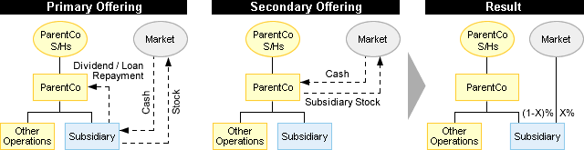
Equity carve Out: Transaction Structure

Slide 29
Equity carve out
Similar to monetization techniques employed in spin-offs and split-offs, ParentCo may push down debt to SubCo prior to the IPO, and/or extract a special tax-free dividend from SubCo.
Cash proceeds from the stock sale might be distributed to ParentCo to pay down debt, to SubCo for growth capital, and/or used by SubCo to repay an intercompany loan from ParentCo.

Slide 30
Spin off Vs. Equity carve out
Spin-off separates the divisions of a multi-division firm completely so that there can no longer be any internal transfers between the divisions and each division trades as a stand-alone entity after the spin-off.
In contrast, the parent in an equity carve-out maintains a controlling interest in the carved out subsidiary so that some residual cross-subsidization and investment inefficiency may persist even after the divestiture.

Slide 31
Financial Restructuring
Ashok Banerjee

Slide 32
Cleaning up the Balance Sheet
Involves writing off losses
Writing down useless assets:
  To eliminate any questionable asset values on the balance sheet by writing down assets to a more conservative but realistic valuation
Writing up asset-class
Bring on board off balance sheet liabilities.
Balance sheet restructuring are of two types:
  Asset restructuring
  Recapitalization

Slide 33
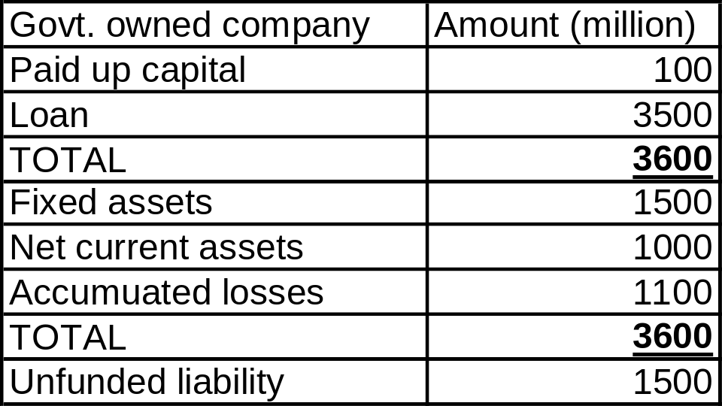
Cleaning up balance sheet
The unfunded liability is also not provided for. The above entity would be divested. How to clean up the balance sheet before divestment?

Slide 34
De-leveraging balance sheet
De-leveraging with equity infusion may be the best course of action for companies that have become over-levered and are flirting with financial distress.
Since summer of 2007, financial institutions in the U.S. and Europe have collectively raised over $240 bn in new equity and equity-linked capital.
Companies with leverage ratios and CDS spread in the top quartile of their industries, and interest coverage ratios, liquidity and credit rating at the bottom quartile would benefit the most in re-equitizing the balance sheet.
Cutting the dividend is equivalent to requiring current shareholders to reinvest their dividend payments in new equity. Relying on existing shareholders to provide equity avoids diluting their ownership stake. But dividend cut does send a negative signal to investors about the company’s financial health.

Slide 35
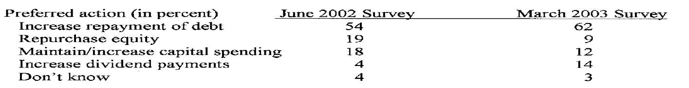
Merril Lynch’s Monthly Fund Manager Survey: June 2002 & March 2003
Question asked: What you most like to see companies do with their cash flows at the current time?

Slide 36
Methods of Financial Restructuring
Debt Restructuring
  Strategy-driven
  Crisis-driven
Equity Restructuring
  Special dividend
  Share buyback
  Stock splits
  Bonus shares

Slide 37
Special Dividend-Signal?
A sizeable one-time dividend could create an impression that a company did not foresee healthy growth prospects in its core businesses and thus was seeking to return cash to the shareholders.
For instance in 2000, the market appeared to take a jaundiced view of the decision by P&G Hygiene and Healthcare to distribute a one-time dividend of Rs 40 per share. The stock trading at Rs 500 at the time of the announcement dropped precipitously to Rs 380 levels, soon after it went ex-dividend.
Given the company's limited product portfolio, the markets appear to have interpreted the dividend as signalling poor growth prospects for the company.

Slide 38
Dividend Vs. Stock Repurchase: factors influencing choice
Undervaluation of the firm
Management Compensation
Taxation impact
Capital structure adjustment (gravitating towards target capital structure).
Information Asymmetry theory (Miller and Rock, 1985; Brennan and Thakor, 1990)
  Corporations will make small payouts through dividends, intermediate payouts through open market repurchases, and large payouts through tender offer repurchases.
Why some investors prefer cash dividend/ Behavioral finance (Shefrin and Statman, 1984): self-control theory (Thaler and Shefrin,1981)-investors may want dividend because of self control. Prospect theory (Kahneman and Tversky, 1979): the sale of stock causes more regrets. Regret aversion can induce a preference for dividends through the use of rule like ‘finance consumption out of dividends, not capital’.

Slide 39
WHY DOES A FIRM BUY BACK SHARES?
Signaling Effect-
  Cash flow signaling
  Market Undervaluation
  Investment in own shares
Agency Costs- Overinvestment problem (Jensen 1986)
  Distribution of free cash flows
Leverage Effect-
  More Levered Capital Structure
  Debt disciplines management
Takeover Defense-
  Get rid of dissatisfied shareholders
  Consolidate control
  Repurchase can increase the lowest price for which the stock is available
Capital market allocation

Slide 40
Share repurchase and need for external finance
It is accepted that when shares are undervalued, firms repurchase shares.
Also, there is a negative reaction to equity offerings.
Undervalued companies that expect to raise more equity in the not too distant future could reap significant benefits from eliminating undervaluation of shares by offering to buy back shares before issuing new ones.
A financing strategy of seasoned equity offerings preceded by repurchases could represent an effective way for listed companies to limit the information costs associated with raising outside equity.

Slide 41
Share repurchase: regulatory environment in India
Companies Act, 2013:
  Sources of funds for buy back-
    Free reserves
    Securities Premium
    Proceeds of any shares or other specified securities
Two types:
  Buy-back up to 10% of total paid up capital plus free reserves approved by Board (Board approved buy-back)
  Buy-back approved by shareholders in the general meeting up to 25% of total paid up capital plus free reserves (General body approved buy-back)

Slide 42
Share repurchase: regulatory environment in India
Debt-equity ratio post-buy back not to exceed 2:1.
Every buy back should be completed within 12 months of passing a special resolution to this effect.
Special resolution is not necessary if the buy back percentage does not exceed 10%.

Slide 43
Share Buy-back: SEBI Regulations
Buy-back offer from the open market shall not be made for 15% or more of the paid up capital and free reserves of the company.
In case of tender offers and offers through book building, even promoters can participate.
In case of buy back of shares through stock exchanges, promoters or persons in control of the company are not allowed to participate.
Before opening of the buy-back offer, the company shall create an escrow account towards security and shall deposit 25 % of the amount earmarked for the buy-back in such escrow account.
A company shall not raise further capital for a period of six months from the closure of buy-back offer.

Slide 44
Another example: Akzo Nobel India
Announced in May 2018 of 1.12 million shares (about 2.4% of the paid up capital) at a price of Rs. 2100 per share.
Fixed price tender-offer at a total cost of Rs. 2352 million.
Buyback price is at a premium of 15%
Almost 25% of the paid up capital and free reserves
Main reason for buyback is return of free cash to shareholders
Promoters not participating in the buyback
Promoters holding went up from 72.9% to 74.8%
Present share price (11 July 2018) Rs. 1878.45

Slide 45
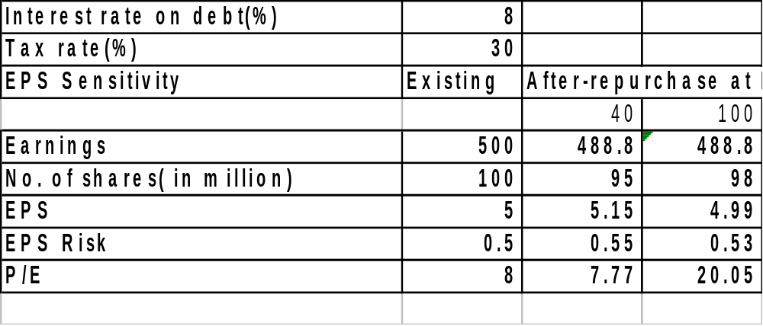
Sensitivity of EPS impact of share repurchase to share price

Slide 46
EPS Sensitivity | Existing | After-repurchase at Rs.
 |  | 40 | 100 | 200
Earnings | 500 | 488.8 | 488.8 | 488.8
No. of shares( in million) | 100 | 95 | 98 | 99
EPS | 5 | 5.15 | 4.99 | 4.94
EPS Risk | 0.5 | 0.55 | 0.53 | 0.53
P/E | 8 | 7.77 | 20.05 | 40.51

Slide 47
Share buy-back: Case of Britannia Industries
Operates in bakery industry.
One of the largest players in the biscuit market in the country with the sale of over 250,000 tonnes of biscuits in FY 2003.
Current Debt-Equity ratio 0.42.
Intended to buy back (third round) a maximum of up to 2.5 million shares at a price not exceeding Rs.650 per share payable in cash for an aggregate amount not exceeding Rs.780 million.
The buy back size represents 20.09% of the aggregate of the Company’s paid up capital and free reserves as on 31 March, 2003 and 9.5% of the paid up equity capital.
Mode of buy back: from the open market through stock exchanges using the electronic facilities of the BSE and NSE.

Slide 48
Britannia Industries: Rationale for buy back
The Company currently has substantial reserves that are deployed in financial assets that yield below the desired rate of return for the shareholders.
The Company believes that it would keep generating enough cash flows to meet the requirement of the present business.
Hence, the Company intends to return surplus cash to its shareholders.
This offers a reasonably fair exit opportunity to those shareholders who so desire, in a manner that does not substantially impact the market price of the Company’s share to the detriment of the continuing shareholders.
However, the Company does not anticipate any significant change in the earnings from its business, except to the extent of loss in investment income on the amount utilised for funding the buy back.

Slide 49
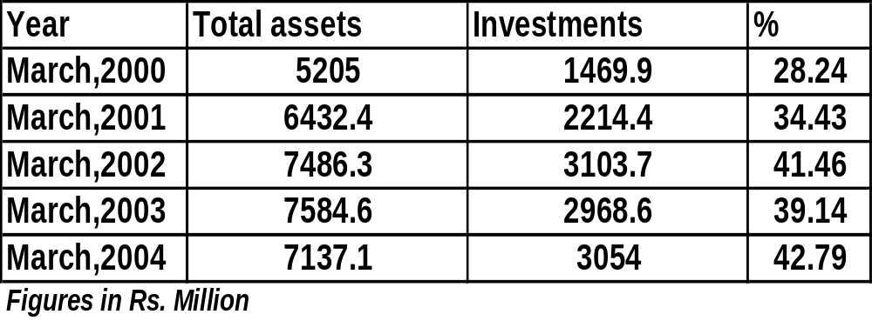
Britannia Industries: Rationale for buy back

Slide 50
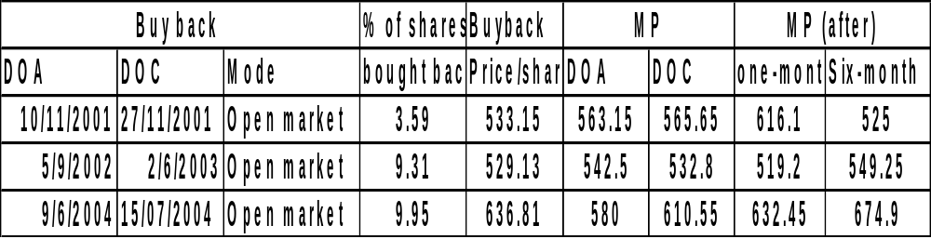
Share buy-back: Case of Britannia Industries
Post-buy back | Promoters'
 | Holding(%)
First buy back | 45.34
Second buy back | 48.48
Third buy back | 50.96

Slide 51
Why do firms split stock?
According to the signalling hypothesis (Brennan and Copeland, 1988), stock splits are associated with positive announcement excess returns because managers use stock splits to convey favourable private information about their firms' future prospects.
Empirically, there is little evidence that split announcements provide informational content about a firm's improved future profitability in the long run.
Stock split return anomaly is related to market underreaction to information- financial analysts tend to underestimate splitting firms' earnings

Slide 52
Why do firms split stock?
Alternatively, the trading range hypothesis suggests that there is an “optimal” trading range and that splits realign share prices to this range.
Realigning share price could draw more attention to a stock and hence increase the liquidity of the stock with an enlarged clientele and reduced trading cost.
Indeed, the survey research by Baker and Powell (1992) reports that moving the stock price into a better trading range and improving the stock's liquidity are the primary motives for managers to undertake a split.
In addition, management prefer to bring more small investors, investors who tend not to exercise too much control, into the firm to create a more controllable ownership mix.

Slide 53
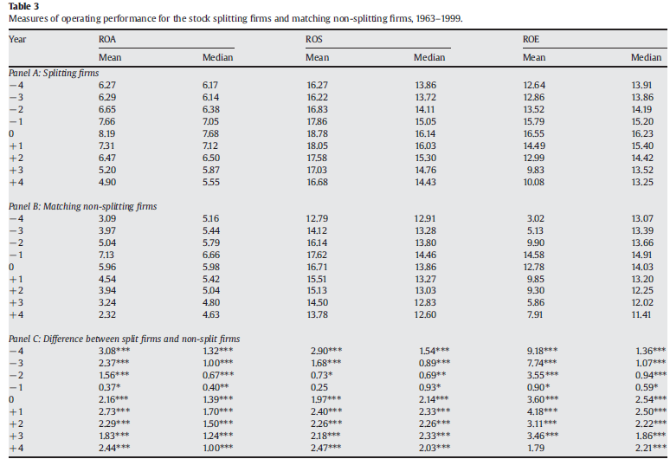

Slide 54
Stock split and liquidity
The empirical literature suggests an enlarged ownership base after split, more analysts following the stock, and improved trading liquidity.
The finance literature suggests a strong relation between stock split and market liquidity.
To assess the change in liquidity upon stock splits, two indicators may be used: turnover ratio and Amihud’s illiquidity measure.
Turnover ratio is calculated as the average of the daily ratio of trading volume (in shares) to shares outstanding
Amihud has developed a measure of illiquidity.

Slide 55
