Slide 1
High Availability (HA) Distributed File Storage
Group name: Gryffindor
Group Members:
ARJITH CHALASANI JITENDRA NEELAM URMILA JYOTHULA CHINNA BALAJI YALLA NITISH NAGABHAIRAVA PRANEEL REDDY PADALA SURYA TEJA BOLLIMPALLI SRI GANESH SAI GUNNAM SRI KASYAP KAPPAGANTULA SIRISHA MANASWINI BHAMIDI RAGHUVINAYAK RAO MEDISETTI MAHAMMAD SUHAIL ATCHUKATLA

Slide 2
Description of the project
The main concept of this project is to develop a secure file storage to the company SecureFile in the form of a distributed file storage system with high availability to the customers.
When a user uploads a file, the file is stored in a randomly chosen server. In this we are creating replicas for the file uploaded by the user
If a user accesses the file from one of the servers that does not have the files, it is redirected to the origin server.
The recipient must acknowledge the reception of the message. If a recipient fails to do this multiple times in a row then the server is marked as down and Users are not allowed to access files on failed or down servers
Administer has to fix that server manually and has to put that server bac online
Each user defines by a namespace on the server by assigning a unique root folder to each user .This way two users can upload identical files without conflict.
The owner can decide which other users can have access to a owned file as well as delete the file. An editor can read as well as modify but can not delete the file.
The admin server is used for storing server, file and user data in an SQL database

Slide 3
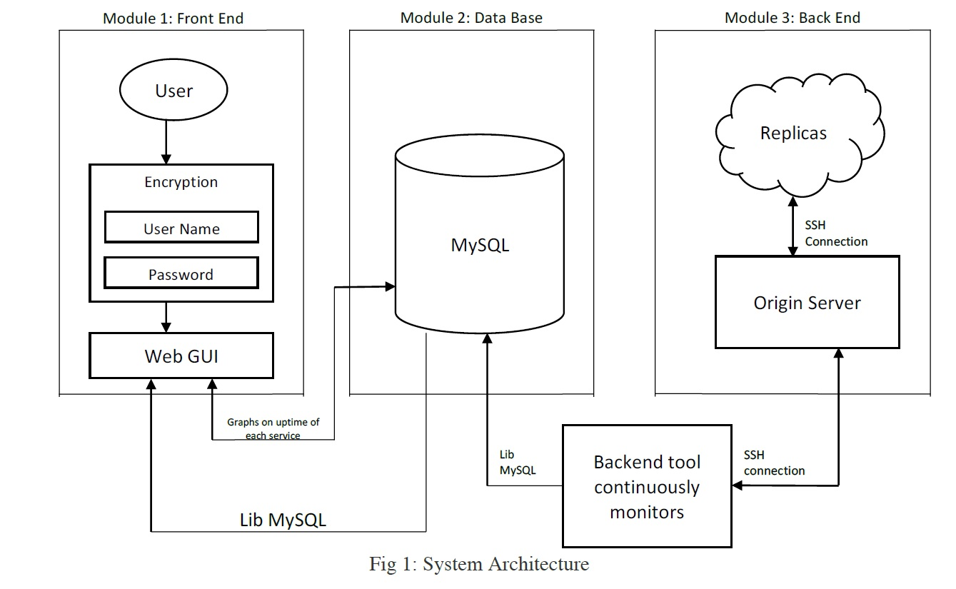
System Architecture
The system Architecture can be determined in three sections they are the front end, database and the back end of the system

Slide 4
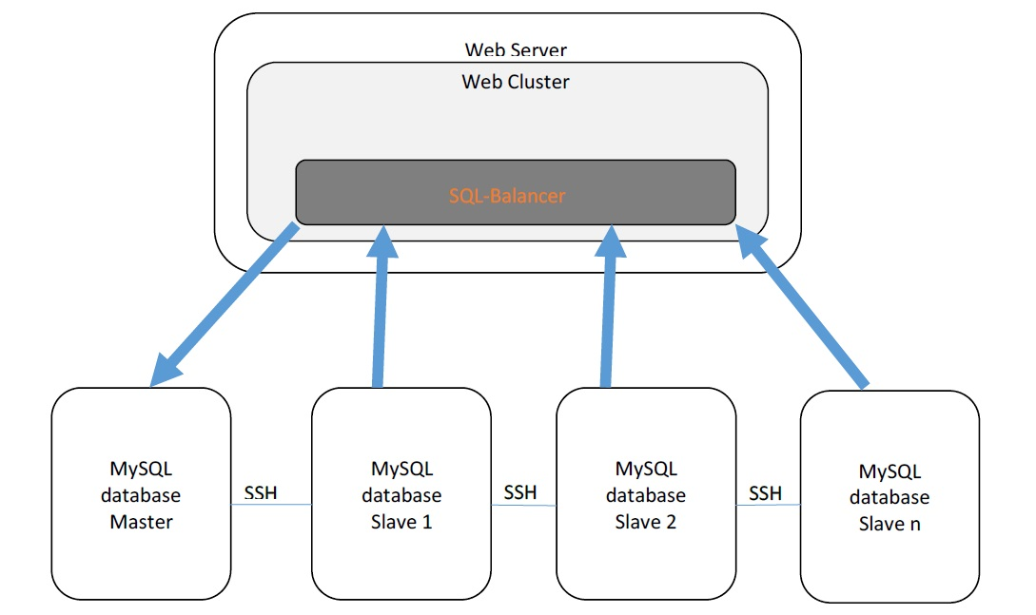
Replication Connection
Cluster:
Cluster and users are connected and registered with SSL connection.
Cluster connects the master users to the master database and for the slave users slave database is randomly selected.
The cluster is connected to master and slave using SSH connection.
Master and Slave:
Master database can be accessed only by the master users.
Master database also consists the files present in the slave database.
Slaves and masters are connected with SSH connection.

Slide 5
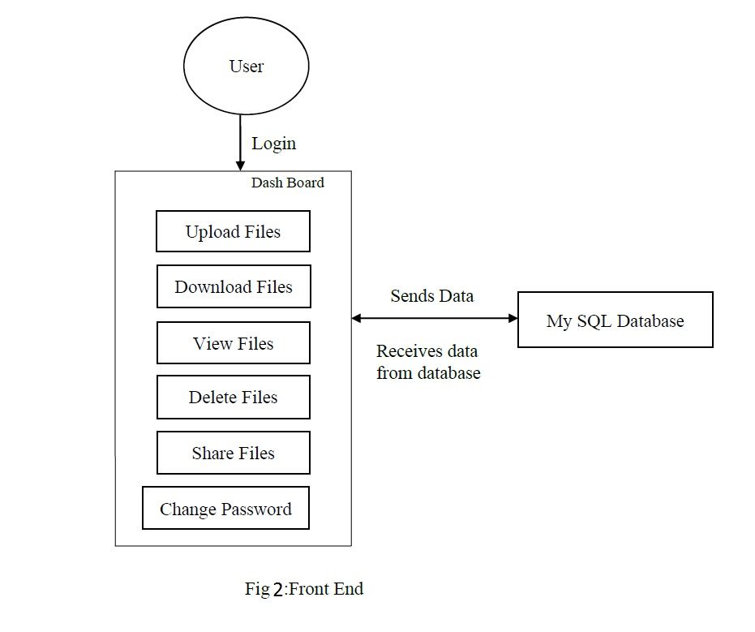
Front End
In this we described the web interface of the tool. First, the user needs to register into the server. Customer receives the conformation mail from the admin server and then customer can login into the server by using registered user name and password
The information of the user is stored in the MySQL database.

Slide 6
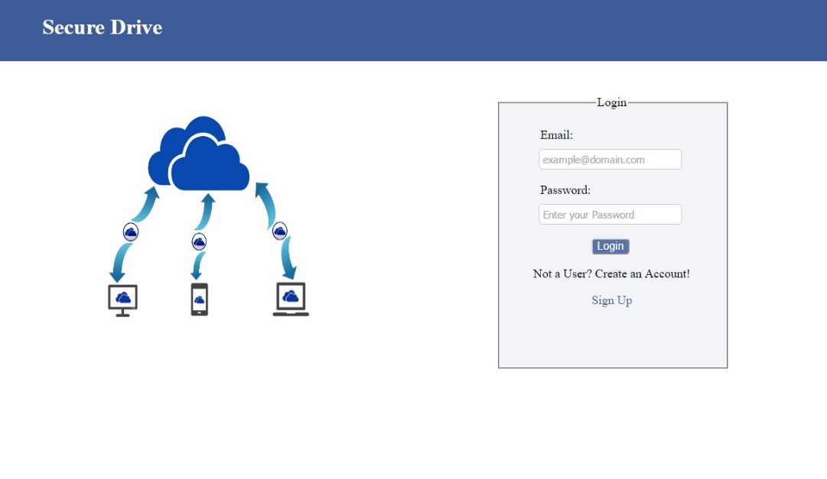
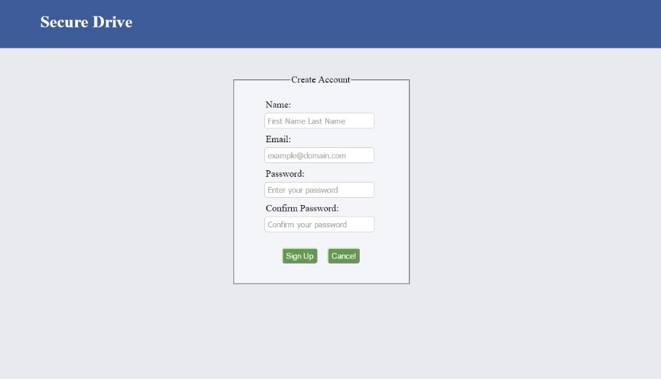
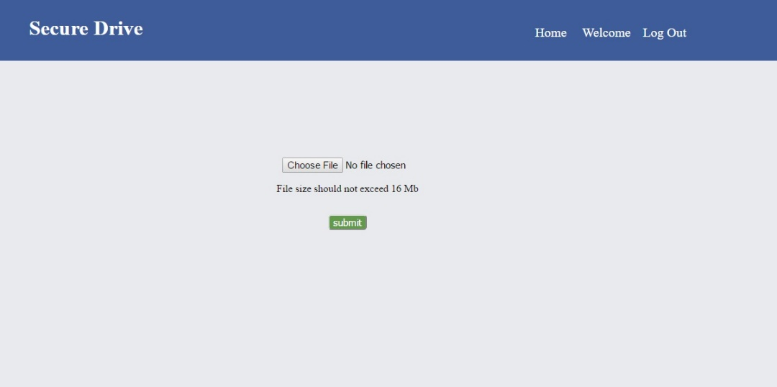
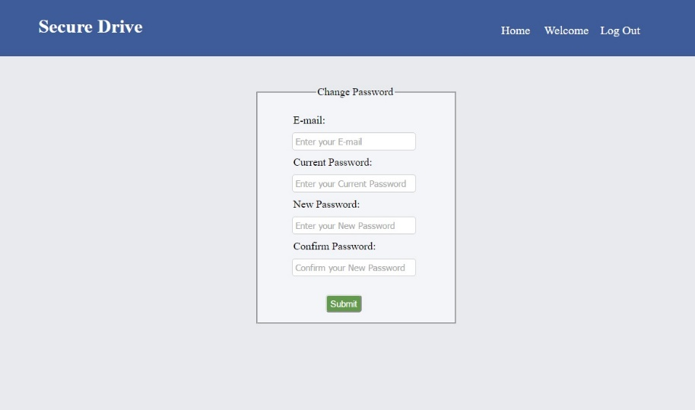
Graphical User Interface

Slide 7
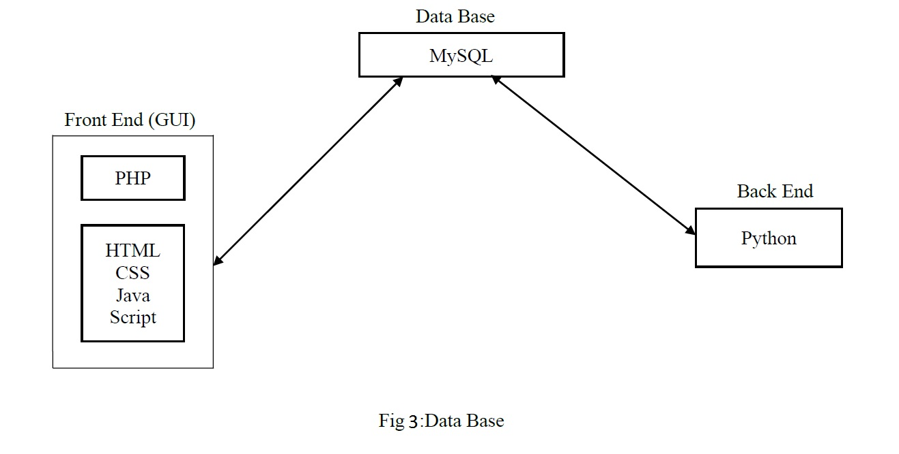
Data Base
The MySQL database contains user’s information, data status and uptime information inserted into their respective service tables
In the MySQL database we create a data slot for each customer. Through front end the user can access into user’s login account and through backend the user can access user’s files.

Slide 8
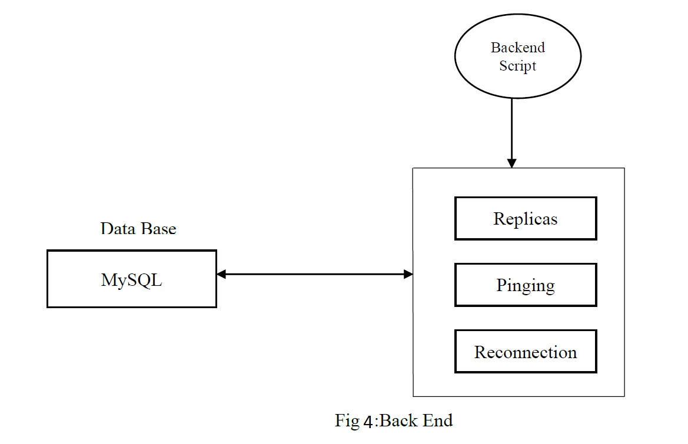
Back End
For backend programming we use Python, which is used to connect the servers.
We use the back end for the creation of replicas of the files
Backend is also use to ping the servers constantly, if the ping is lost or server is down it sends a message to database and in the database it is stored if the connection is lost.

Slide 9
Challenges Faced
Technical Problems faced in project programming :
Sftp server creation.
Programming a cluster
Creation of ssl links between users and cluster.
Mysql remote connections using ssh.
Group Challenges :
This is the first time developing such a software program so initially lag in knowledge of server communication but we overcome by dividing the work between group members.

Slide 10
Git Lab
Git lab is used to upload all the files in the storage space and we can also update the code.
In this gitlab is present where we store the files and these files can be replaced, delete and merge. These files can be downloaded by any member in the group.
The gitlab supports many files we store different files in different places in the git lab a separate place for bin where the deleted files are stored. Libraries are also present to share data. The check ins and check outs of the members can be checked over the graphs the commits committed by the members are also seen through it.
In a group the task is divided among all the members and an individual coding language is divided among different members the code developed by individual developer are uploaded into the git lab and these codes can be seen by the rest of the developers in the group if they want to develop it they can replace them.

Slide 11
Lectures And discussions
Through lessons and topics discussed during the lectures we get familiar with version management which helped in gitlab
We learned how to plan properly for the completion of project
We learned how to overcome Risks occurred during project
We learned about Quality Control, Progress Tracking and Project Organization

Slide 12
Suggestions

Slide 13
THANK YOU! ☺

