Slide 1

TEAM MEMBERS:
Ch Mallikarjuna Rao
D Sai Dhanush
E Vamsi Vijaya Sai Suraj Chowdary
N Bhagya Sri

Slide 2


Slide 3


Slide 4
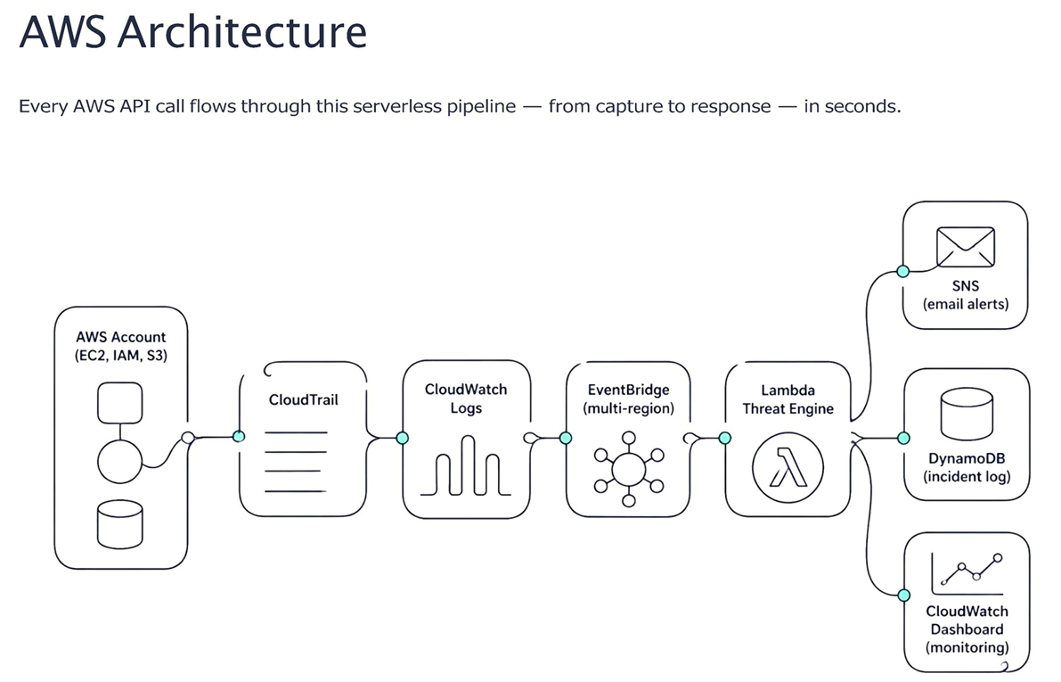

Slide 5
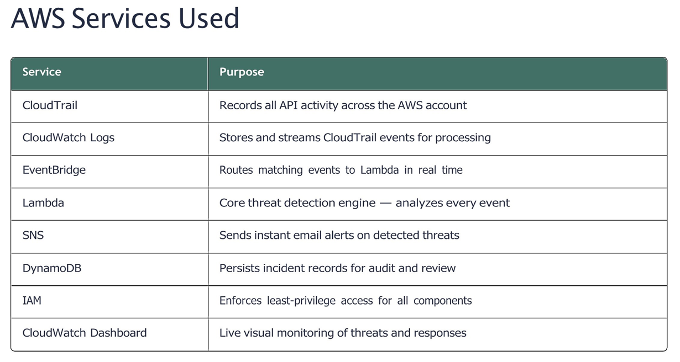

Slide 6
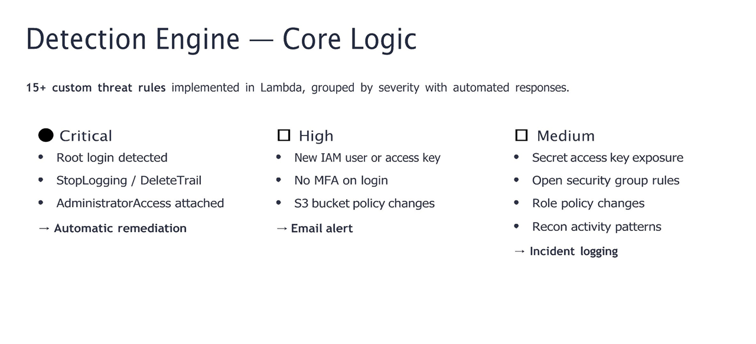

Slide 7
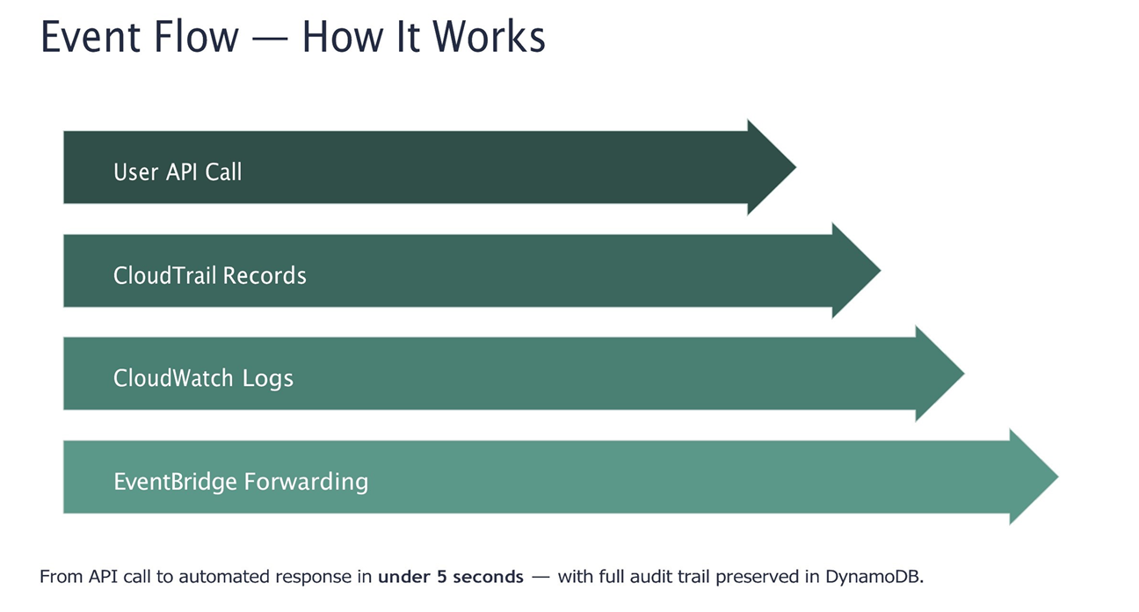

Slide 8
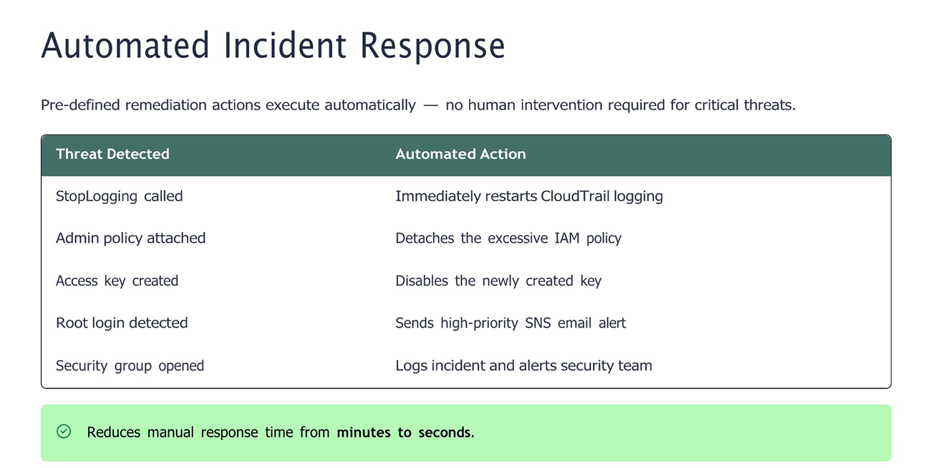

Slide 9
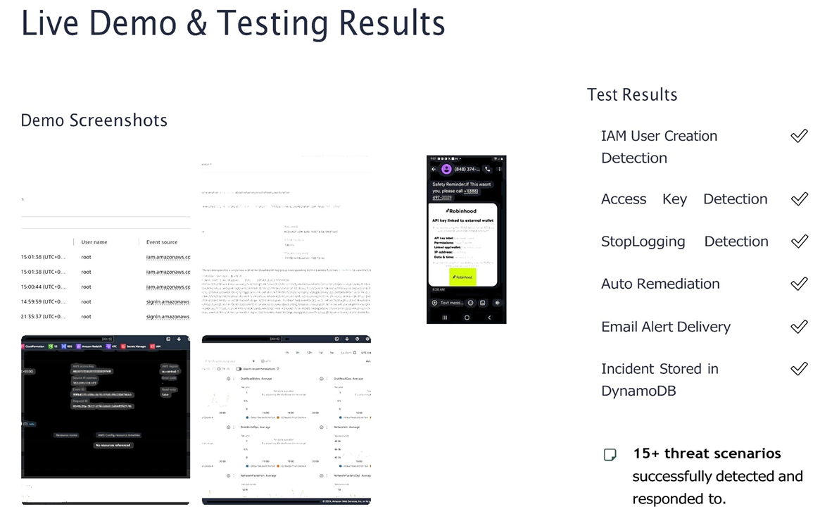

Slide 10
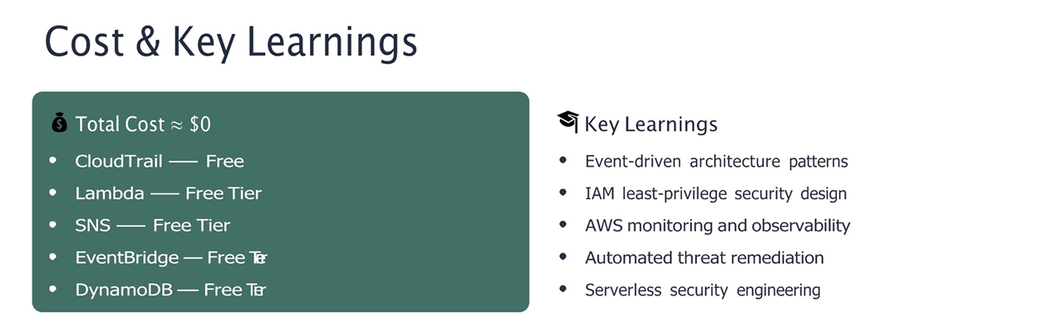


Slide 11


