Slide 1
Emerging AI topics
LLM LangChain API (Image Captioning)
Ravi Chinnamanaidu and Allana Nelson

Slide 2
Requirements:
To build the LLM dashboard to demonstrate the LLM Langchain API to interact with various API providers as openlibrary.org, opentdb.org, wikipedia.org, nasa.gov and other websites.
The LLM dashboard built using the getBootStrap API to provide interface for getting user questions and provide the answers from LLM.
The Python library Flask is used to run the python engine to support both GET and POST transactions.
The models that are used by the interface
Hugging Face
LangChain
OpenAI
The other technologies that are used GPT and Image Processing, PyTorch.
GitHub URL:
https://github.com/chinnamanaidu/langchain_llm_finalproject

Slide 3
Emerging AI Topics:
Intro LangChain
Langchain Recipe interface
Open API Langchain
Resume Reader
Open API Text Database Langchain
Wikipedia Questions
NASA Questions
Advanced AI Topics:
Prompt Templates
Quote Generator
Data Parsers
Picture Captioning:
IMG folder

Slide 4
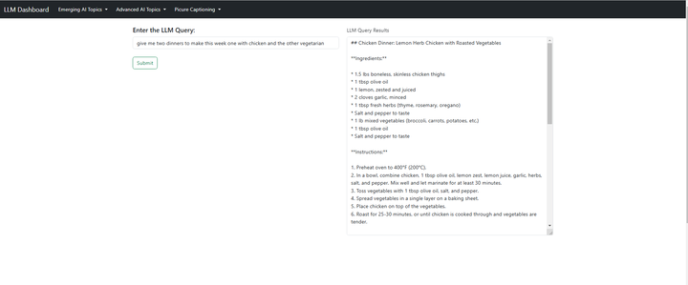
LLM Langchain Intro ( common questions to chatgoogle Gen AI)

Slide 5
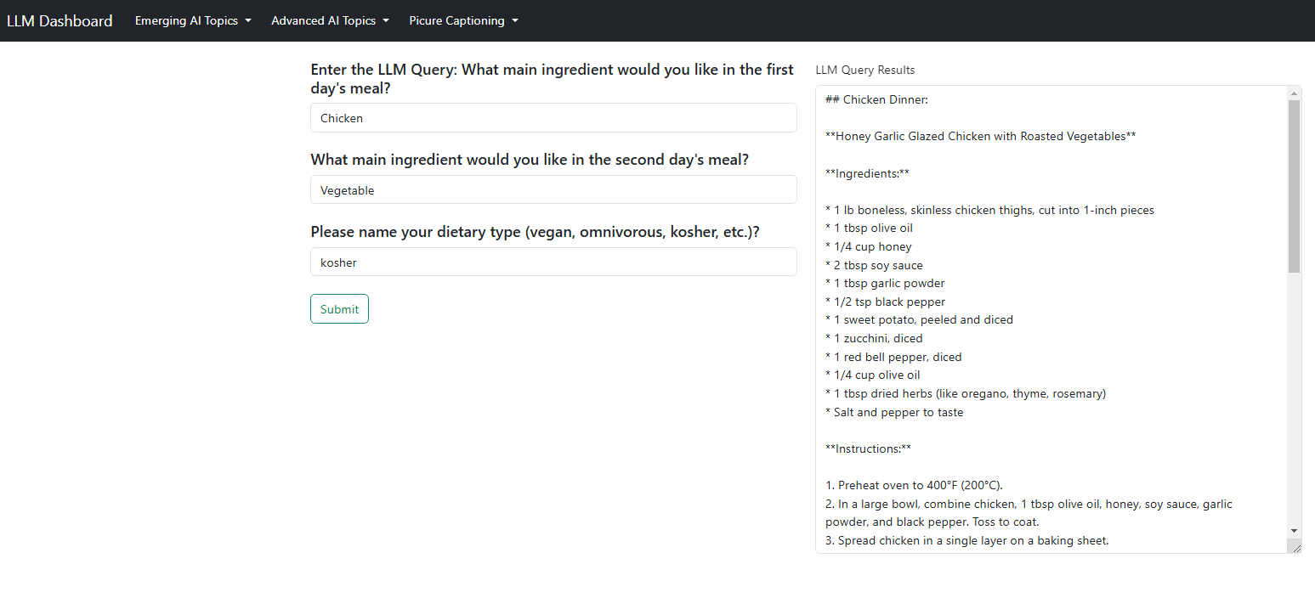
LLM Langchain interactive( common questions to chatgoogle Gen AI)

Slide 6
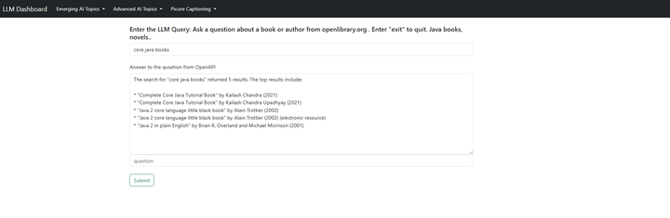
LLM OpenLibrary ORG

Slide 7
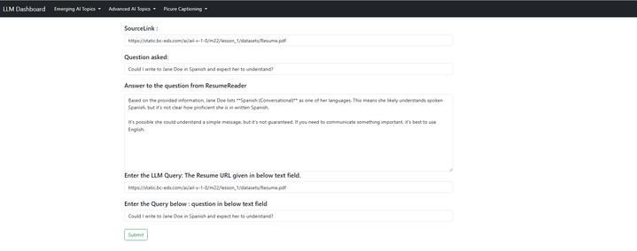
LLM Resume Reader

Slide 8
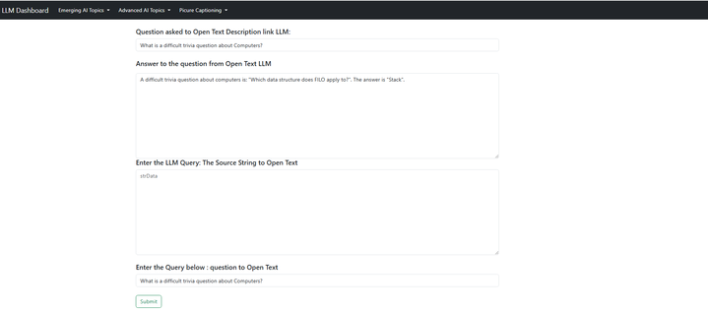
LLM Open Text Description Database questions:

Slide 9
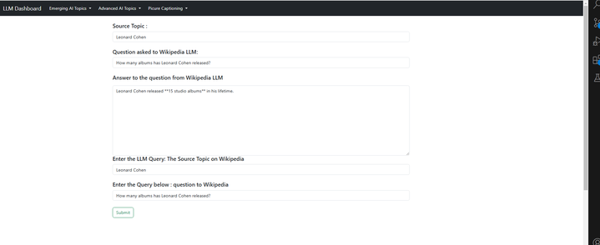
LLM Wikipedia Questions

Slide 10
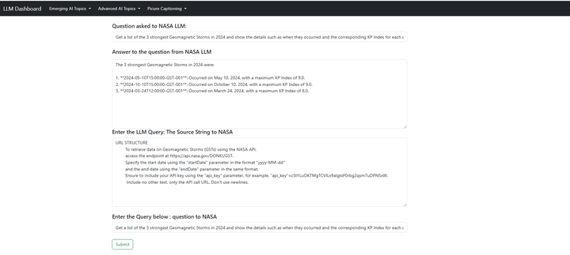
LLM NASA Questions:

Slide 11
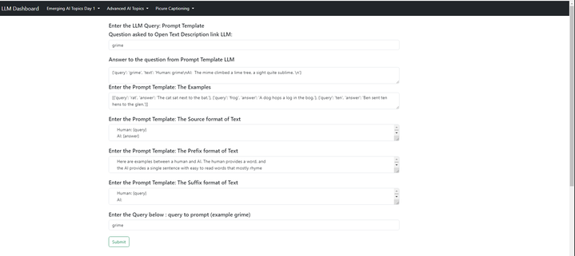
LLM Prompt Template:

Slide 12
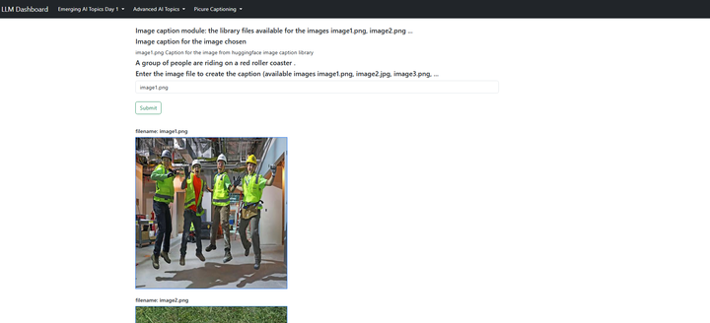
Hugging face Image Captioning

Slide 13
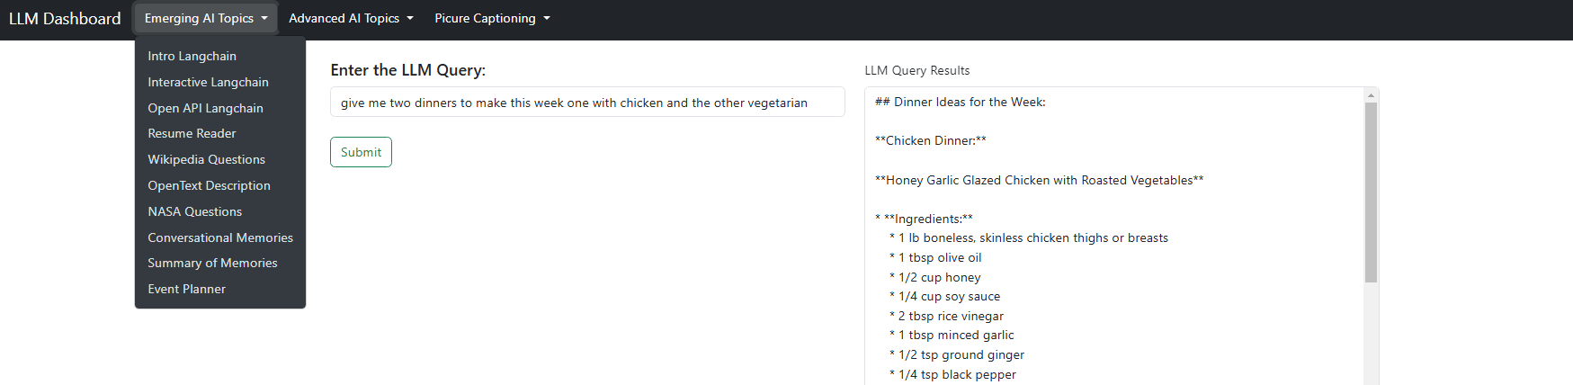
Dashboard Dropdowns

Slide 14
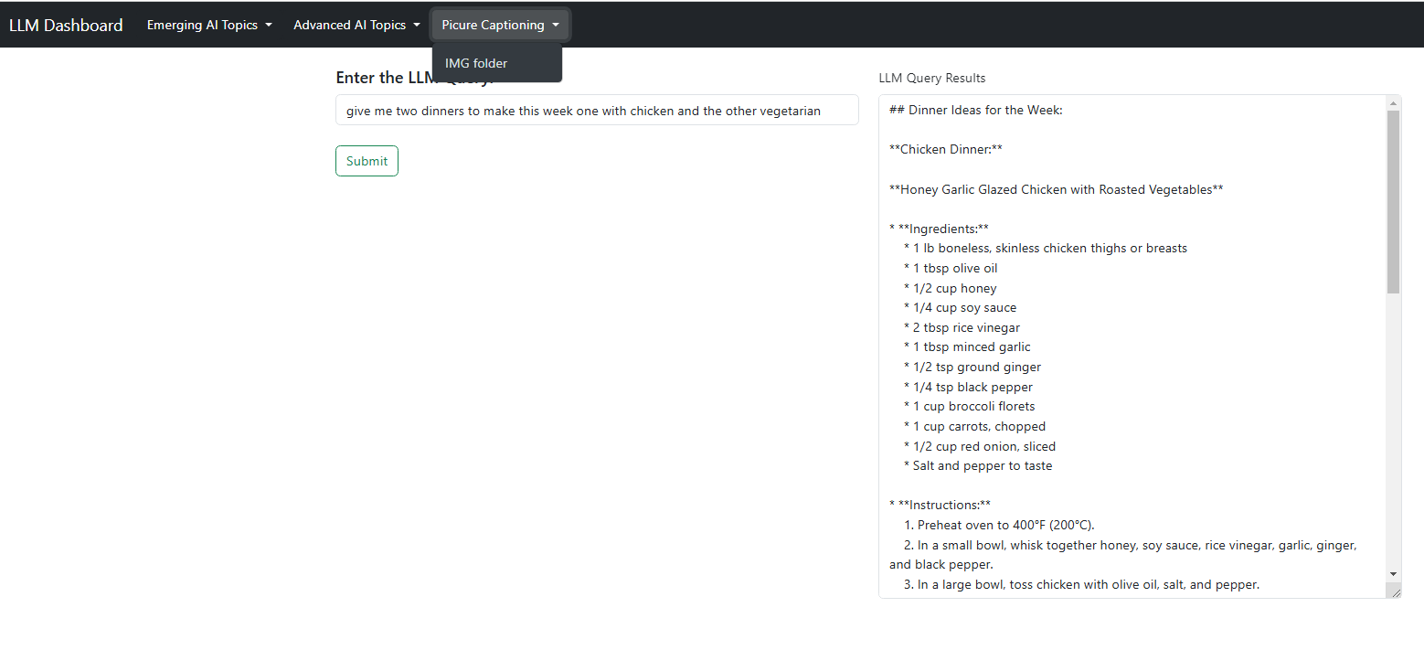
Dashboard Dropdowns

Slide 15
Dashboard Dropdowns

