Slide 1

Progress of Women and People of Color in Professional and Management Positions, 2010 - 2030
Ravi Chinnamanaidu, Ashni Dattani, Michal Fineman, Alexandra Zelcer 9/18/2020
Notes:
Our team set out to examine data from the Bureau of Labor Statistics regarding employment of women and People of Color in higher level positions. We wanted to see how these populations were represented in professional and managerial jobs and how that representation had changed over the last ten years, how we could expect it to change in the next ten or eleven years, and whether we could figure out any of the factors that might affect that rate of change.

Slide 2
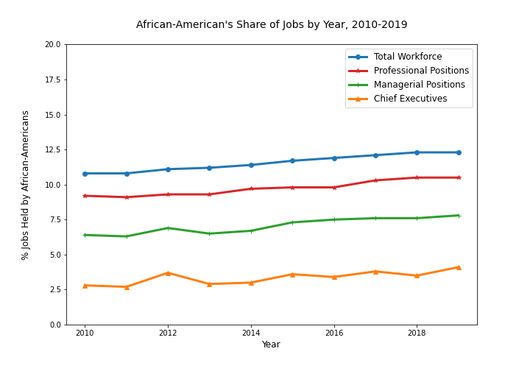
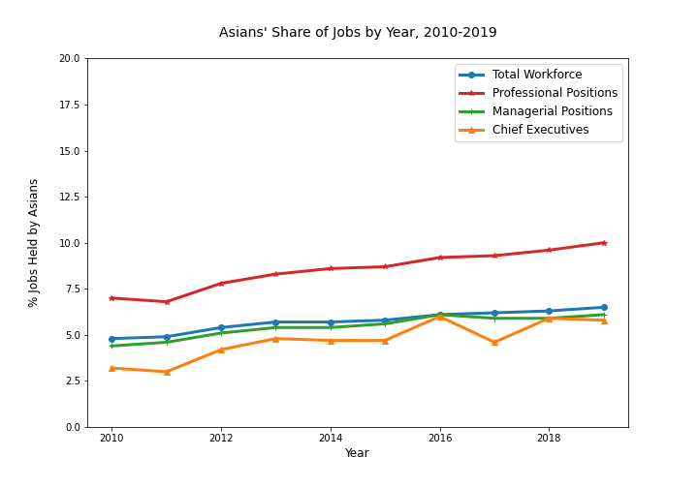
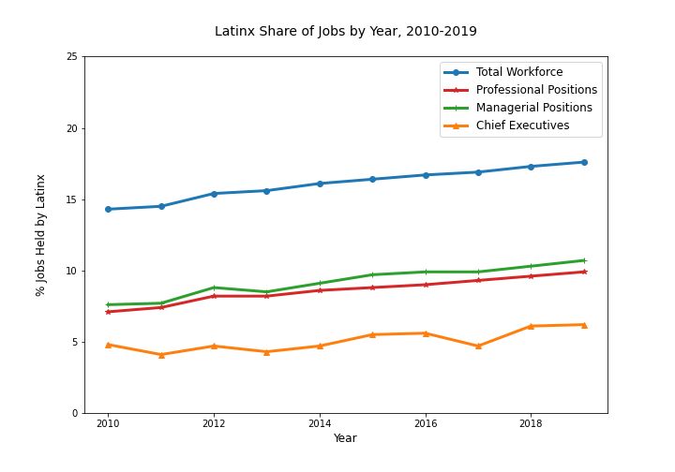
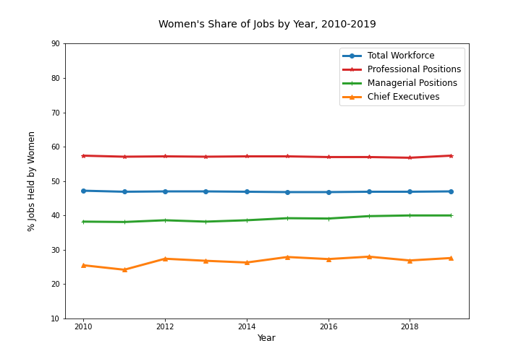
Representation over past ten years
Notes:
These charts show each population group’s share of jobs in the total workforce and their share of professional, managerial, and chief executive positions. Over the past ten years representation of African-americans, latinx, and Asians has generally gone up at least slightly, while movement among women has been flatter. But the real story is between the lines—literally, the space between the lines. For example, we can see that latinx workers’ share of managerial and professional jobs has gone up in the past ten years. But so has their share of the workforce as a whole. If all things were truly equal, we would expect that latinx workers would be represented in managerial ranks in the same proportion as they are in the workforce but there ‘s a big gap between those two lines, so clearly they’re not.

Slide 3
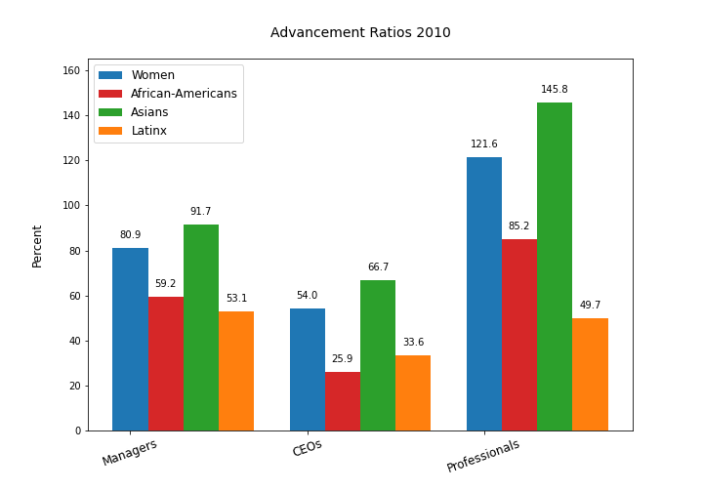
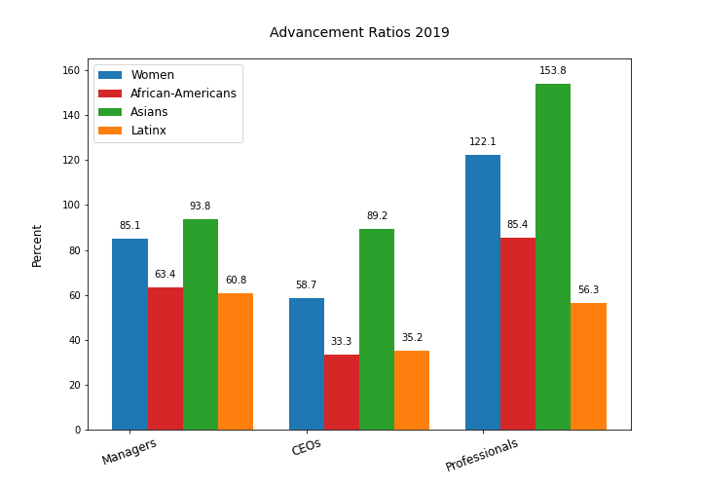
Advancement Ratios
Notes:
So, we looked at what we’re calling advancement ratios—the comparison of share of a particular job category, like managers or professionals, to the population group’s share of the total workforce. If a group’s share of a job category is at parity with their share of the workforce, the ratio is 100%. These charts for advancement ratios in 2010 and for ten years later show that in most cases women and people of color hold higher level jobs at considerably lower levels than their share of the workforce.

Slide 4
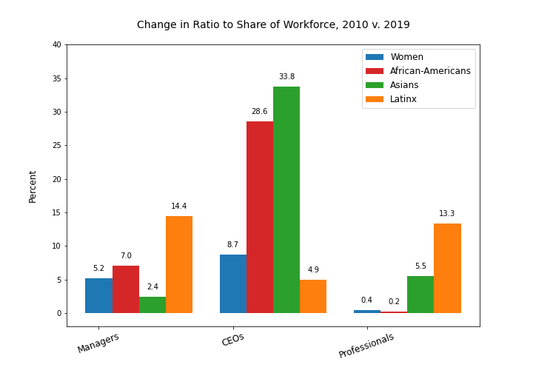
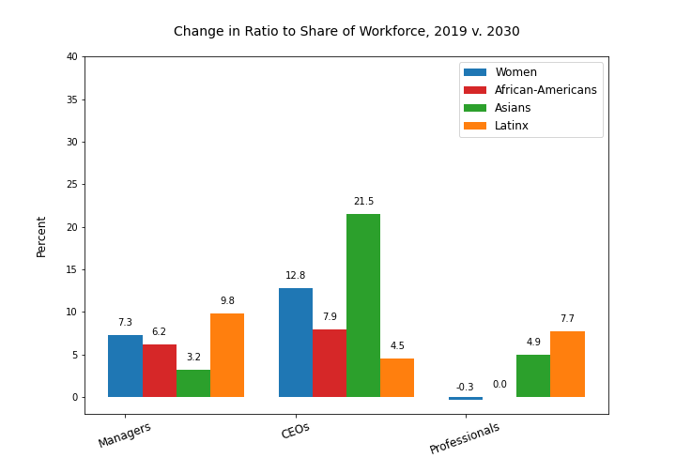
Change in Advancement Ratios 2010 to 2030
Notes:
To see how much the gap has closed during the past ten years, we charted the change in advancement ratio from 2010 to 2019. We were also interested to see what the future would look like if these trends continued so we ran linear regression analyses to predict what representation of each group would be in 2030 and then calculated the advancement ratios and expected change between now and then, which is what you’re seeing on the right. Our model predicts slower progress in a number of categories over the next 11 years than in the past ten.
One note about these analyses: throughout this study we have been interested in the share of jobs held by different demographic groups, so we’ve been dealing with percentages. There is some question about whether linear regression can be run legitimately on percentages, and we didn’t have time to study the question thoroughly. So for the purposes of the exercise, we went ahead with them.
Assuming, then, that—as these charts suggest—progress of women and some people of color into higher level positions is slowing, we wanted to know what would need to change in order to speed it up.

Slide 5
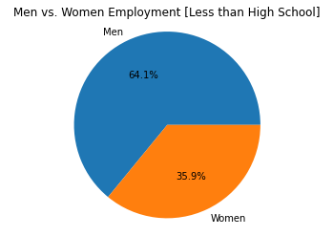
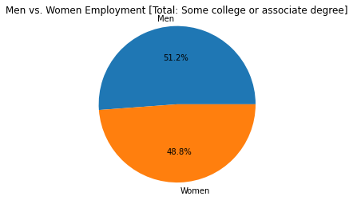
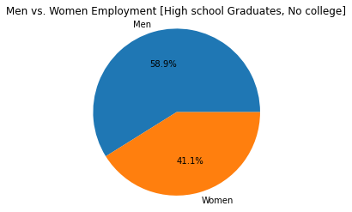
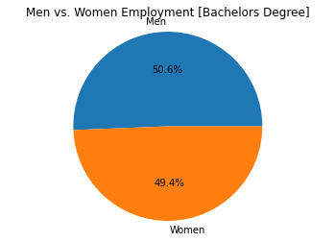
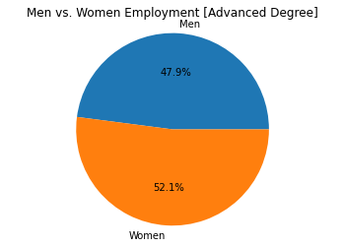
Education levels for male & female workers, 2019
Notes:
One thing we looked at was education. We don’t have data on the education level of people who hold professional and managerial jobs, but we do know, as illustrated here, that women in the workforce are just about as likely as men to hold bachelor’s degrees and more likely than men to hold advanced degrees. While 47% of the workforce are women, 49% of those holding bachelors degrees are women and 52.1% of workers with advanced degrees are women. So it does not seem likely that lack of education is holding women back.

Slide 6
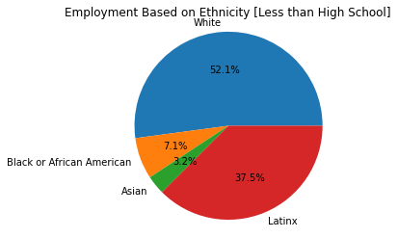
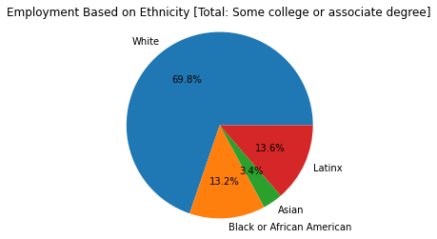
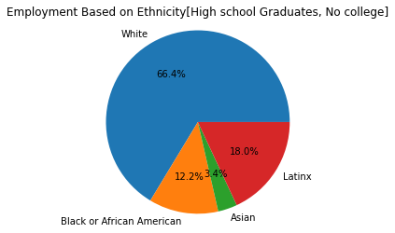
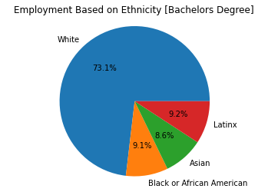
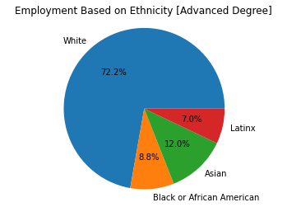
Education levels for POC, 2019
Notes:
Overall, you can see that white workers’ share of educational credentials increases as you go up in education level, while that of African-Americans and Latinx decreases. We know from our previous slides that, on the whole, the share of jobs for people of these ethnicities also decreases as you go up the ladder. We cannot say that this phenomenon is actually causing poc to be underrepresented in higher level jobs, but it is perhaps an area that should be studied in greater detail.

