Slide 1

Progress of Women and People of Color in Professional and Management Positions, 2010 - 2030
Ravi Chinnamanaidu, Ashni Dattani, Michal Fineman, Alexandra Zelcer 9/18/2020
Notes:
Our team set out to examine data from the Bureau of Labor Statistics regarding employment of women and People of Color in higher level positions. We wanted to see how these populations were represented in professional and managerial jobs and how that representation had changed over the last ten years, how we could expect it to change in the next ten or eleven years, and whether we could figure out any of the factors that might affect that rate of change.

Slide 2
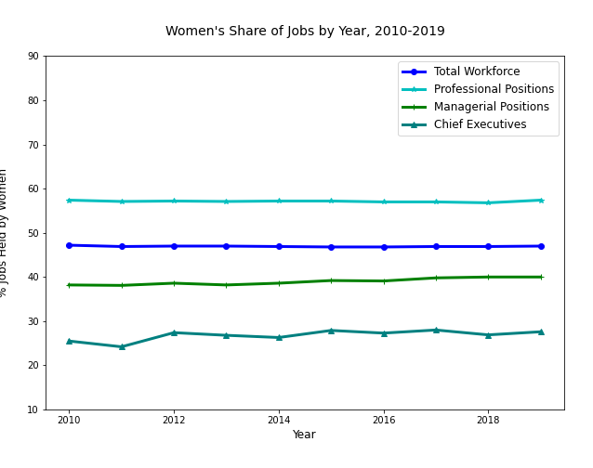
Advancement ratios (job category/total workforce
CEOs/Total 58.7
Managers/Total 85.1
Professionals/Total 122.1
Notes:
This and the next few slides show each populations share of jobs in each job category over time. So here, the bright blue line is total workforce. Women’s share of the total workforce has remained at about 47%, give or take a fraction, for the past ten years. Women’s share of the other job categories has similarly remained pretty steady over that time, with slight upticks in professional positions (the aqua line) and managerial positions(the green line). But the real story in these numbers is the space between the lines. All things being equal, we’d expect that if women make up 47% of the workforce, they ought to hold 47% of professional, managerial, and ceo positions. But clearly they don’t. The relationship between their share of the workforce and their share of a specific job category we’re calling the “advancement ratio”. A ratio below 100 means women hold less than their expected share of jobs in that job category; over 100 means they hold more than their share. So we can see that women are over-represented in professional positions, but they are not making it into managerial and ceo positions in the proportions we’d expect if nothing else were going on.

Slide 3
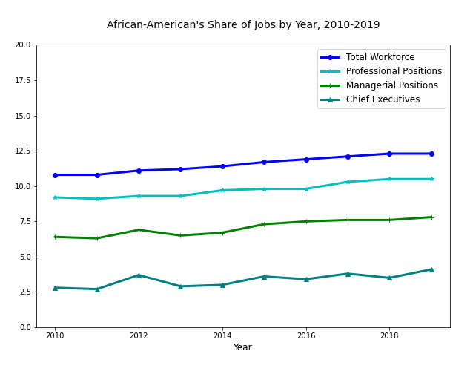
Advancement ratios (job category/total workforce
CEOs/Total 33.3
Managers/Total 63.4
Professionals/Total 85.4
Notes:
We see a similar trend among African-Americans, but somewhat more pronounced. While African-Americans share of jobs in each category has gone up a bit over the past ten years, so has their share of the workforce, their advancement ratios, representing their share of each job level compared to their share of the workforce, remain well under 100% in each category.

Slide 4
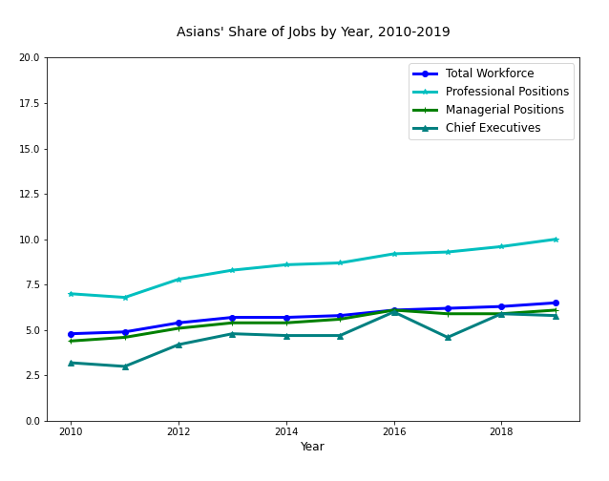
Advancement ratios (job category/total workforce
CEOs/Total 89.2
Managers/Total 93.8
Professionals/Total 153.8
Notes:
The picture for Asians shows that they are disproportionately represented in professional positions, but they do not hold managerial or ceo jobs in proportion to their presence in the workforce.

Slide 5
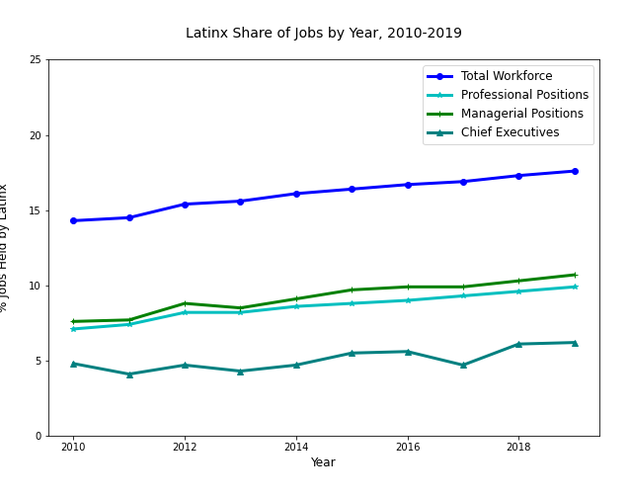
Advancement ratios (job category/total workforce
CEOs/Total 35.2
Managers/Total 60.8
Professionals/Total 56.3
Notes:
Latinx workers have seen their share of all jobs go up as their share of the workforce rises, but, again, they are underrepresented by quite a bit in the higher level job categories.

Slide 6
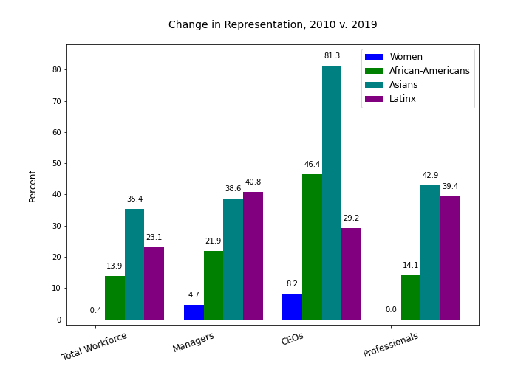
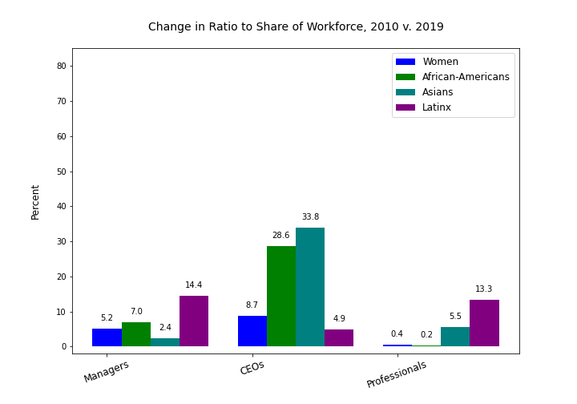
Change in Representation, 2010 v. 2019
Notes:
So as we look at what has happened over time, and what we expect to happen in the future, we are not so interested in the raw change numbers, which can be misleading, but in the change in advancement ratios. These two slides show what I mean. For example, on the left we see that African Americans have seen about a 14% increase in their representation in professional jobs. However, their representation in the total workforce has also increased by nearly the same. The chart on the right shows that so the change in their advancement ratio is really only 0.2%

