Slide 1
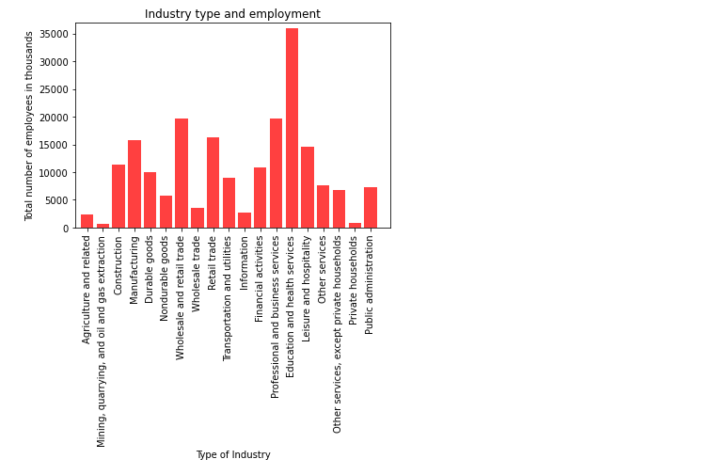
This is total number of employed persons across industries

Slide 2
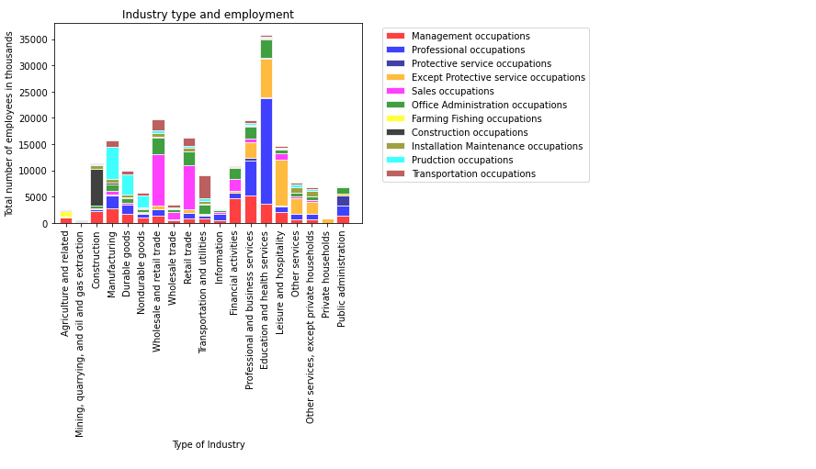
The different job levels in industries and total employed

Slide 3
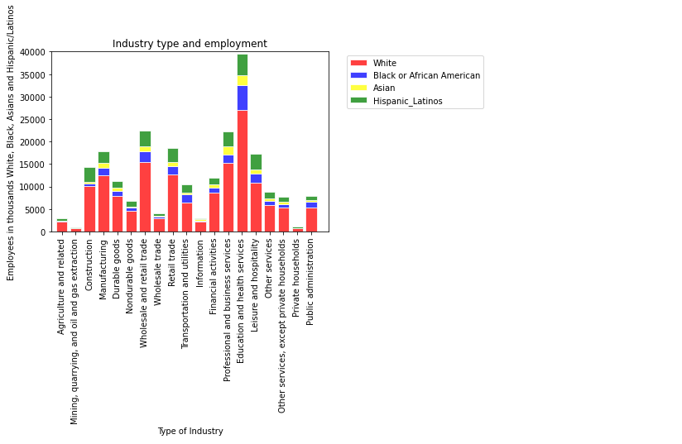
The total employed across ethnicity in different industries

Slide 4
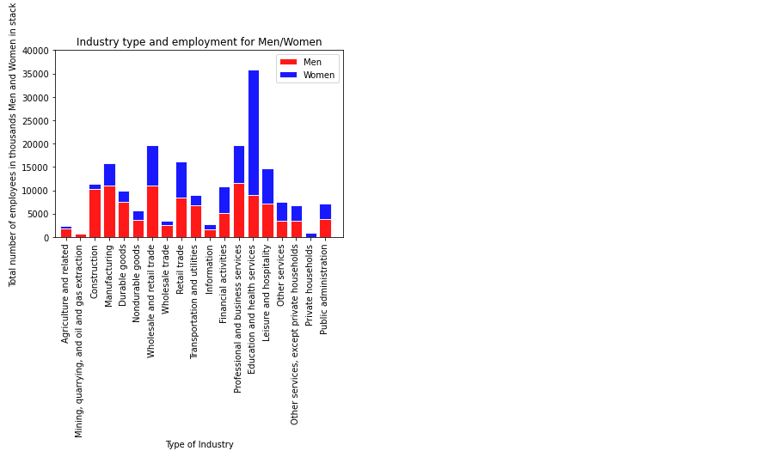
The employment held by genders across industries

Slide 5
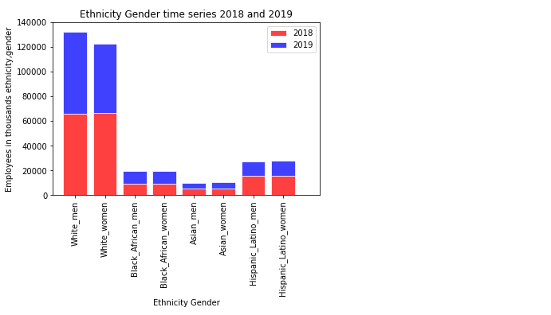
The total employed in 2018 and 2019 across genders

Slide 6
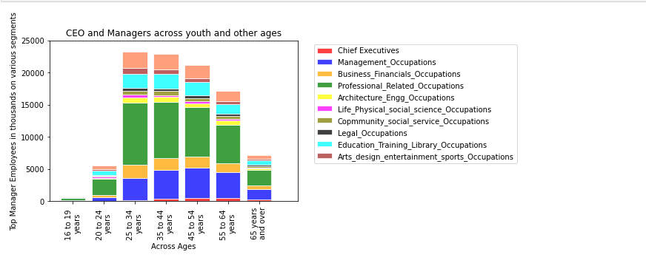
The CEO and Manager level jobs held by different age groups

Slide 7
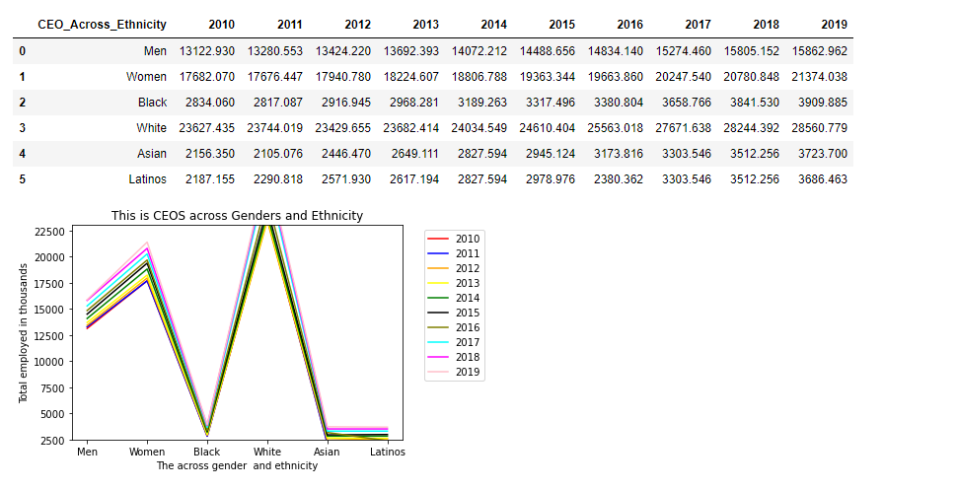
The CEOS across ethnicity from 2010 to 2019

Slide 8
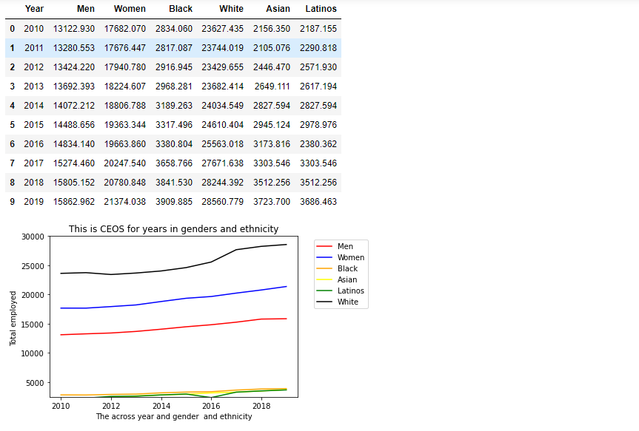
The CEOS across genders and ethnicity from 2010 to 2019

Slide 9
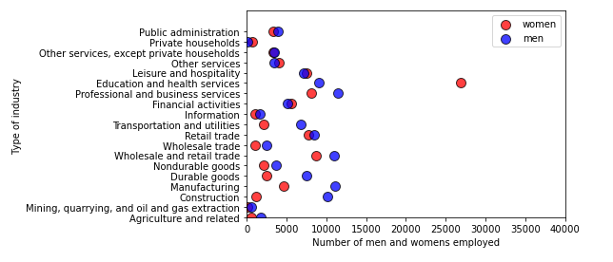
This is scattered plot across men/women and industries

Slide 10
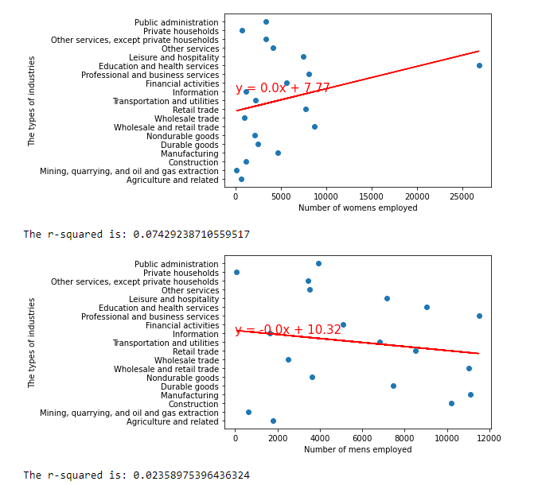
This is scattered plot across men/women and industries

