Slide 1
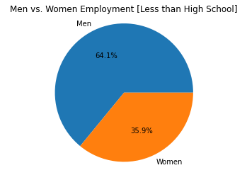
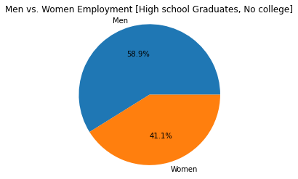
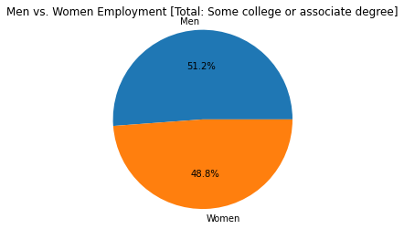
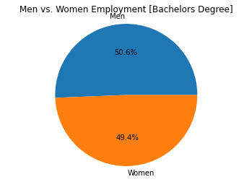
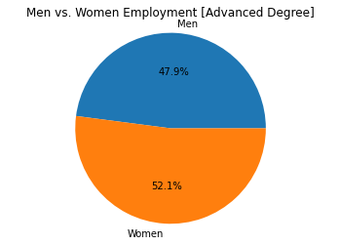
Percentages of Employment Based on Education Level for Men and Women in 2019
Notes:
As you increase education level, the number of women in the population who are employed increases. When you get to advanced degrees, there are more women who are employed than men.

Slide 2
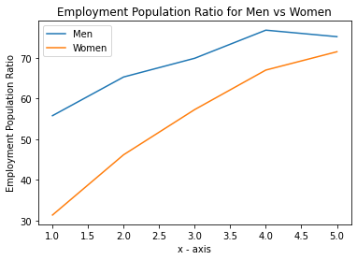
Comparison of the Employment Population Ratio for Men and Women in 2019
* Employment population ratio is the number of employed people compared to the total Civilian Noninstitutional Population.
* Civilian Noninstitutional Population refers to people 16 years of age and older residing in the 50 States and the District of Columbia who are not inmates of institutions (penal, mental facilities, homes for the aged), and who are not on active duty in the Armed Forces.
Notes:
This graph shows that there is a big gap in the employment ratio between men and women at a lower education level. As you increase education levels, this gap decreases significantly.

Slide 3
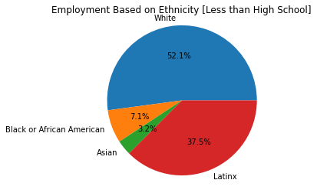
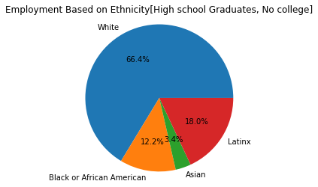
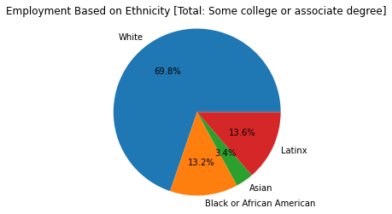
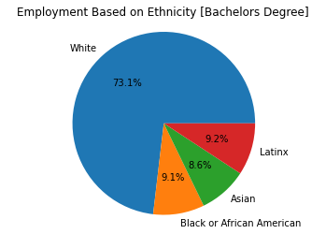
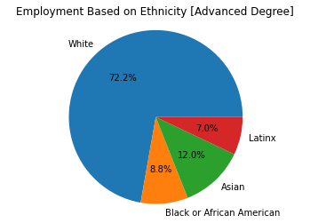
Percentages of Employment Based on Education Level for Different Ethnicities in 2019
Notes:
As you go higher in education level, the Latinx population decreases in employees, White and Asian ethnicities increase, and overall, Black or African Americans employment decreases as you increase education level.

Slide 4
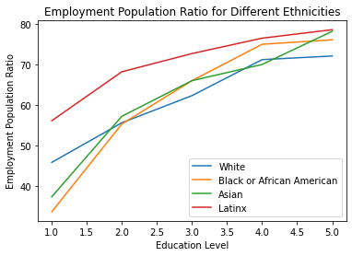
Comparison of the Employment Population Ratio for Different Ethnicities in 2019
* Employment population ratio is the number of employed people compared to the total Civilian Noninstitutional Population.
* Civilian Noninstitutional Population refers to people 16 years of age and older residing in the 50 States and the District of Columbia who are not inmates of institutions (penal, mental facilities, homes for the aged), and who are not on active duty in the Armed Forces.
Notes:
This graph shows that the employment ratio for Latinx is always the highest. This means that a greater proportion of this population is working compared to other ethnicities. Black or African American and Asin populations have the most growth in employment population as education level increase. The white population has the smallest change over time and at the highest education level, this population has the smallest employment population ratio.

Slide 5
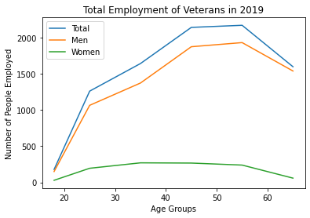
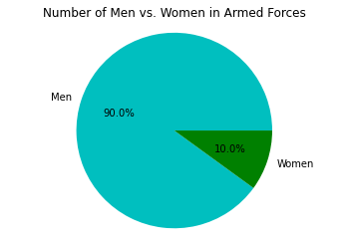
Veteran Employment by Age for Men and Women in 2019
Notes:
The ratio of men to women in the armed forces is 9:1.
Correlation between military service, age, and employment. There are a considerably more men in the armed forces compared to women so the trend line for women employment is lower. However, over time, the employment for men increases a lot while employment for women does not show a lot of change from its starting point.

Slide 6
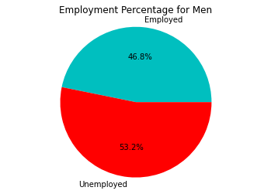
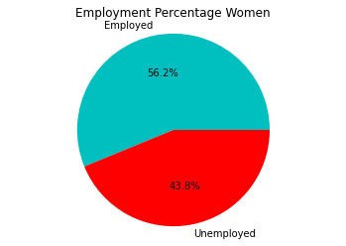
Veteran Employment Percentages for Men and Women in 2019
Total Veteran men, 18 years and over employed in the Civilian Labor Force: 7,926
Total Veteran women, 18 years and over employed in the Civilian Labor Force: 1,060
Notes:
These graphs show the percent of the Civilian Noninstitutional Population that is employed in the Civil labor force, for men and women.
There are a considerably more men in the armed forces compared to women so even though there is a higher percentage of unemployment for men, there are still many more veteran men who are employed in the Civil Labor Force than women.

