Slide 1
Progress of Women and People of Color in Professional and Management Positions, 2010 - 2030
Ravi Chinnamanaidu, Ashni Dattani, Michal Fineman, Alexandra Zelcer

Slide 2
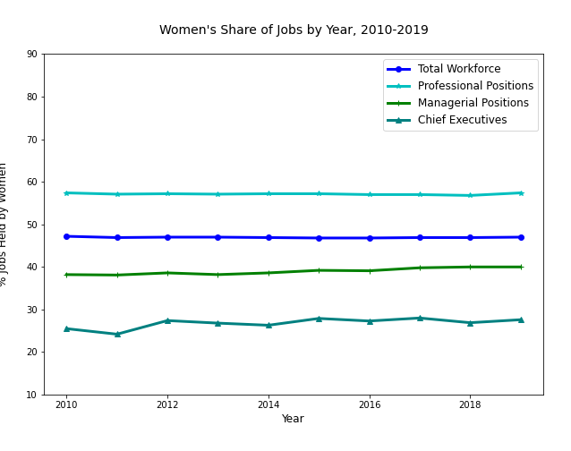
Flat progress for women since 2010
Expected representation, 2030:
Total workforce: 46.7%
(resquared 0.22)
Management: 42.6%
(rsquared 0.89)
CEOs: 30.9%
(rsquared 0.46)
Professional: 56.8%
(rsquared 0.11)
Notes:
For the past ten years, women have held about 47% of the workforce. For the same period, their share of professional jobs has remained steady at about 57%. But even though they are overrepresented in professional jobs, they are not being promoted into managerial jobs in equal numbers—their share of management jobs has rised just 2 percentage points in the past ten years,. Based on our regression analysis, if nothing else changes, we can predict with some confidence that 11 years from now, they will hold 42.6% of managerial jobs.

Slide 3
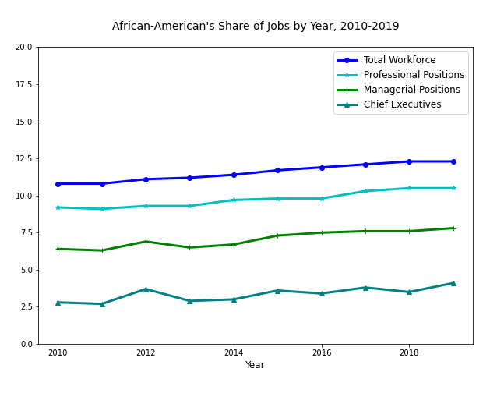
Slight ten-year gains for African-Americans
Expected representation, 2030:
Total workforce: 14.5%
(resquared 0.98)
Management: 9.8%
(rsquared 0.88)
CEOs: % 5.2
(rsquared 0.59)
Professional: 12.4%
(rsquared 0.93)
Notes:
The lines over the past ten years show a little more relative gain for African americans, both in their share of the total workforce and their representation in higher level jobs.

Slide 4
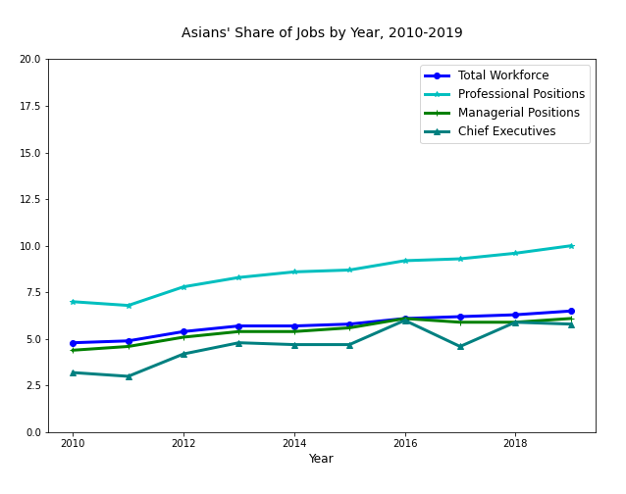
Asians hitting glass ceiling
Expected representation, 2030:
Total workforce: 8.6%
(resquared 0.95)
Management: 8.3%
(rsquared 0.88)
CEOs: 9.3%
(rsquared 0.75)
Professional: 13.9%
(rsquared 0.95)
Notes:
While Asians, are over represented in professional positions compared to their proportion in the total workforce, their share of managerial positions is only just about keeping pace with their overall representation in the work force. If we assume that professional positions are feeders for the management jobs, than we would expect to see more Asians breaking into the manarial ranks.

Slide 5
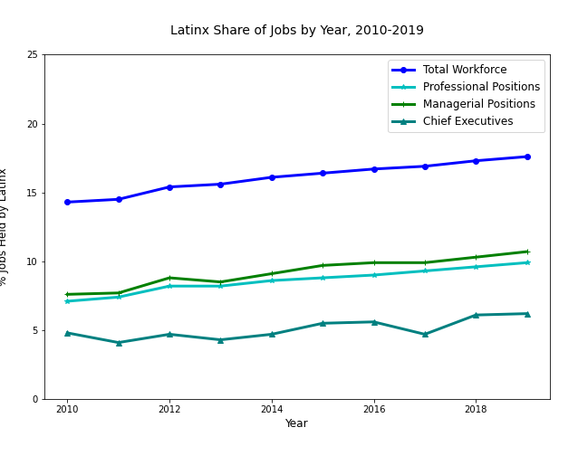
Latinx keep pace with workforce gains
Expected representation, 2030:
Total workforce: 21.8%
(resquared 0.98)
Management: 14.52%
(rsquared 0.95)
CEOs: 8.0%
(rsquared 0.62)
Professional: 13.2%
(rsquared 0.97)
Notes:
Over the past ten years, Latinx representation in higher level jobs has more or less kept pace with their increased representation in the workforce, but no more.

Slide 6
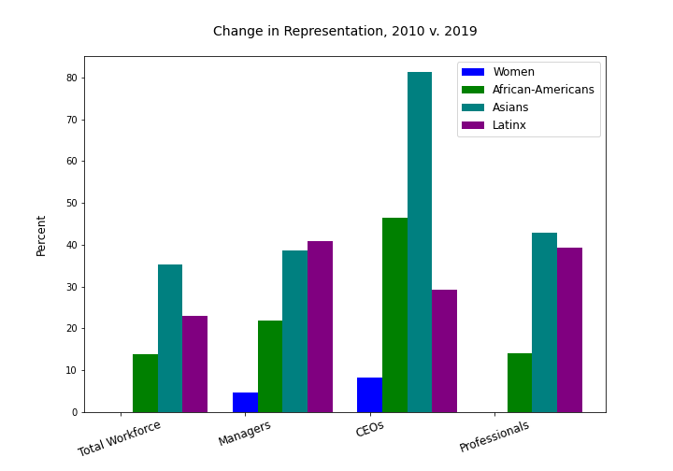
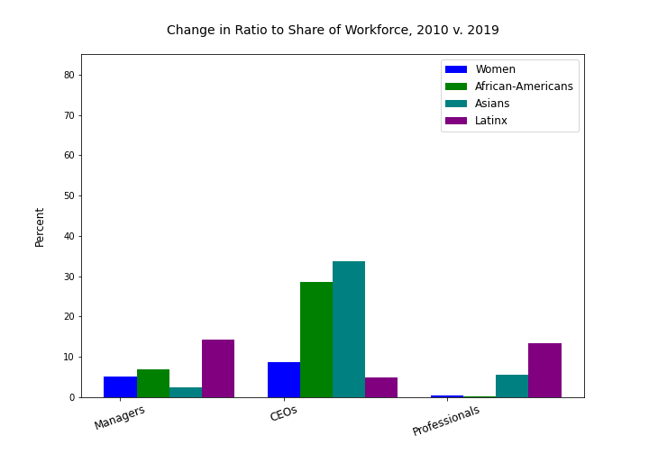
Notes:
And that leads us to the real story in these numbers. To see the whole story, it’s important to look at the trends for each demographic group in comparison to their representation in the workforce as a whole and in the job level below to see to what degree people are able to move from one level to the next. These two slides show what I mean. On the left, we have a chart show the change in representation over the past ten years for each population in each job category. For example we what looks like very healthy gains for all populations managerial jobss: from about a 5% increase for women to 40% increase for Latinx. But we have to remember that for the three ethnic group categories, their share of the workforce has also been increasing. So how much of this change in representation is real gain? To get a sense of that, we looked at how the ratio between higher level jobs compared to the total workforce has changed in ten years, and we can see that advances were much more modest. We know from the line charts above that in most cases, women and people of color hold disproportionately fewer professional and managerial jobs than their numbers in the workforce would lead one to expect, all other factors being equal. For example, on the left chart we see that over the past ten years, the African-American’s have gained professional , but compared to their share of the total workforce, the gains are really negligible.

