Slide 1

Progress of Women and People of Color in Professional and Management Positions, 2010 - 2030
Ravi Chinnamanaidu, Ashni Dattani, Michal Fineman, Alexandra Zelcer 9/18/2020
Notes:
Our team set out to examine data from the Bureau of Labor Statistics regarding employment of women and People of Color in higher level positions. We wanted to see how these populations were represented in professional and managerial jobs and how that representation had changed over the last ten years, how we could expect it to change in the next ten or eleven years, and whether we could figure out any of the factors that might affect that rate of change.

Slide 2
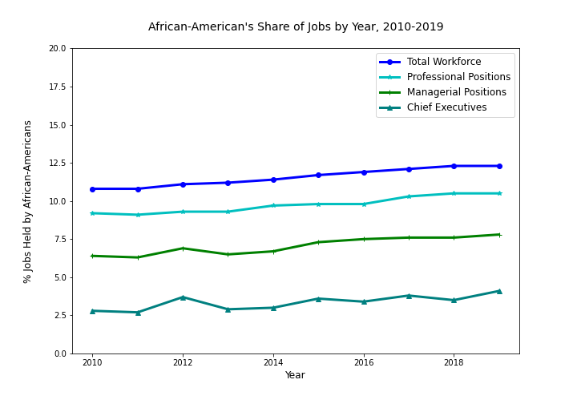
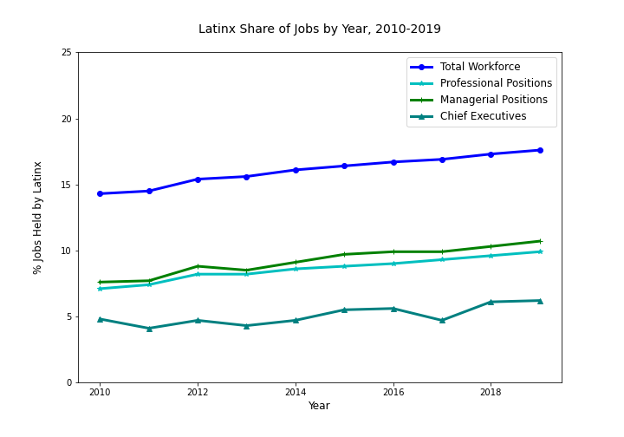
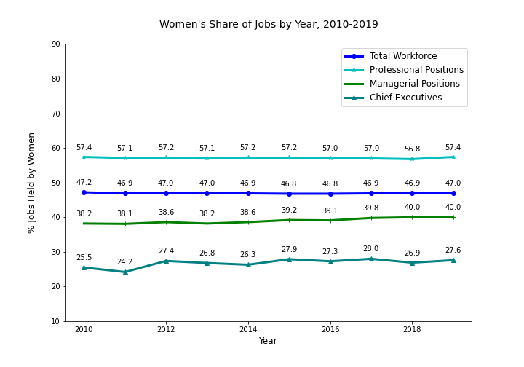
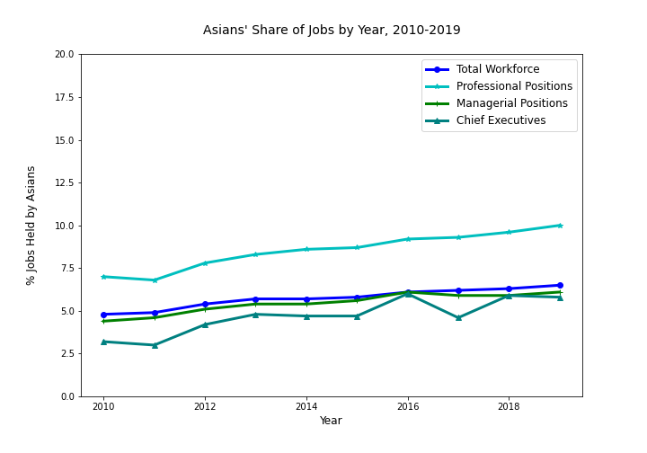
Representation over past ten years
Notes:
One way to look at the data—the most usual way—is simply to look at the change in representation over time—has it gone up or down. In these charts the blue line is share of the total workforce, the aqua line is percentage of professional jobs held by people in the population group, the green line is managerial positions, and the teal line is ceos. They show us that over the past tend years representation of African-americans, latinx, and Asians as generally gone up at least slightly, while movement among women has been flatter.
But the real story isn’t how much the lines go up; the real story is between the lines—literally, the space between the lines. Look for example at the charts for latinx workers. We can see from the green and acqua lines that their share of managerial and professional jobs has gone up in the past ten years. But so has their share of the workforce as a whole. If all things were truly equal, we would expect that latinx workers would be represented in managerial ranks in the same proportion as they are in the workforce but there ‘s a big gap between those two lines, so clearly they’re not. And is the gap getting any smaller?

Slide 3
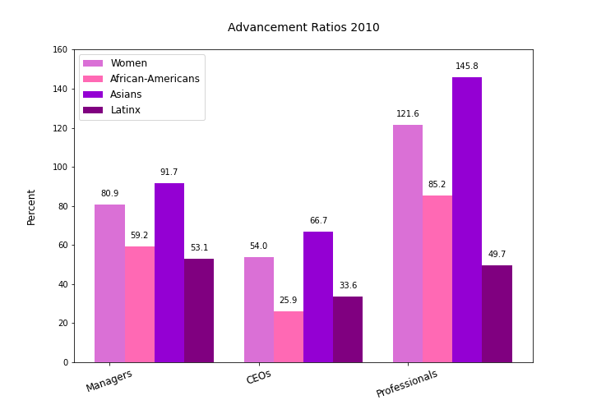
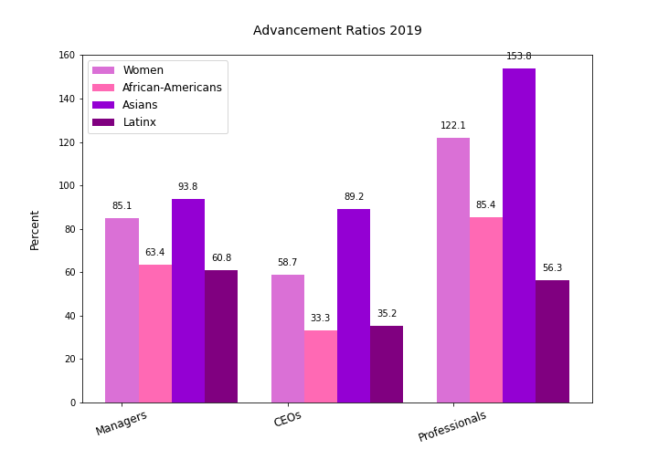
Advancement Ratios
Notes:
To get a sense of that, we looked at what we’re calling advancement ratios—the comparison of share of a particular job category, like managers or professionals, to the population group’s share of the total workforce. If a group’s share of a job category is at parity with their share of the workforce, the ratio is 100%. These charts for advancement ratios in 2010 and ten years later show that in most cases women and people of color hold higher level jobs at considerably lower levels than their share of the workforce.
So are we making any progress?

Slide 4
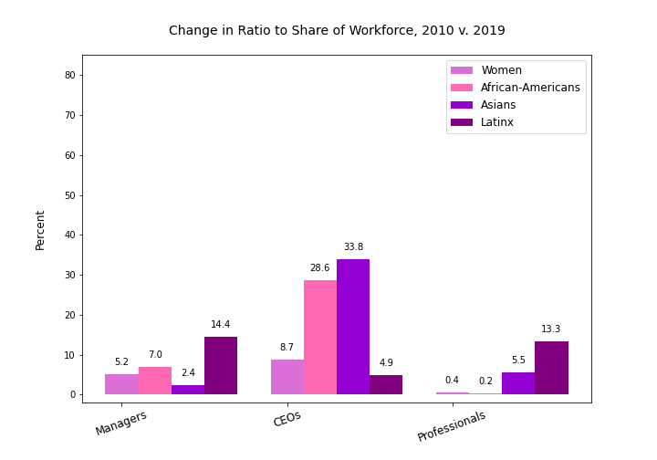
Change in Advancement Ratios, 2010 v. 2019
Notes:
To look at that we determined the change in advancement ratios over time. In the ten year period between 2010 and 2019, we see almost no gains among women and African-Americans in professional positions (although women were over represented in that category anyway, so it’s not of great concern). Gains for women, African americans and Asians in managerial jobs were quite low for a ten year period, although Latinx have made some inroads.

Slide 5
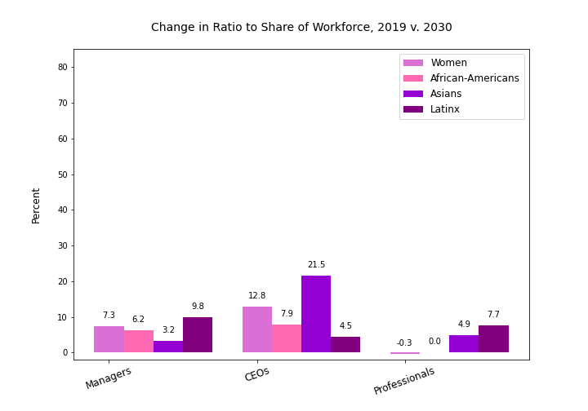
Change in Advancement Ratios, 2019 v. 2030
Notes:
We were interested to see what the future would look like if these trends continued so we ran linear regression analyses to predict what representation of each group would be in 2030 and then calculated the advancement ratios and expected change between now and then, which is what you’re seeing here. We put the chart from the previous slide side by side with the chart showing predicted future change in advancement ratios, and we can see that progress is expected to be slower in a number of categories over the next 11 years than in the past ten.
One note about the linear regressional analyses: throughtout this study we have been interested in the share of jobs held by different demographic groups, so we’ve been dealing with percentages rather than raw numbers. There is some question about whether linear regression can be run legitimately on percentages, and we didn’t have time to study the question thoroughly. So for the purposes of the exercise, we went ahead with them.
Assuming, then, that—as these charts suggest—progress of women and people of color into higher level positions will continue to be slow, we wanted to know what would need to change in order to speed it up.

