Slide 1

FPGA Based System Design
Alavala Chinnapa Reddy

Slide 2
Contents
Classification of IC’s
Why we need FPGA?
Programmable logic device
What is an FPGA?
Components of FPGA
Modern FPGA Architecture
Programming Technology
FPGA design Process
FPGA design Examples

Slide 3
Classification of IC’s
IC
IC
IC
IC
IC
IC
IC
ASIC
PLD
ASIC
ASIC
ASIC
ASIC
ASIC
SPLD
CPLD
FPGA
PROM
PAL
PLA

Slide 4
Why we need to use FPGA?
Once after the fabrication of VLSI chips, we cannot do any alteration to design.
If there is any bug in the design, the fabricated chip is a Waste.
It’s a wastage of money, time, man power.
If it is working properly in FPGA, we can think about converting into a hardware.

Slide 5
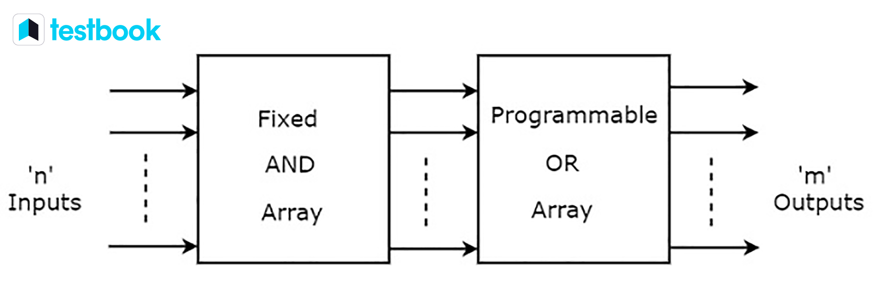
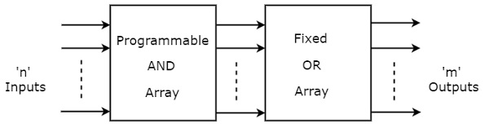
Programmable logic device(PLD)
Programmable Read-Only Memory
Programmable Array Logic

Slide 6
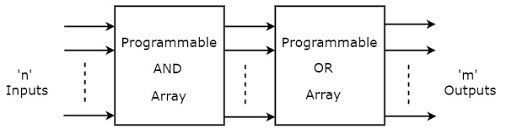
Programmable logic device(PLD)
Programmable Logic Array

Slide 7
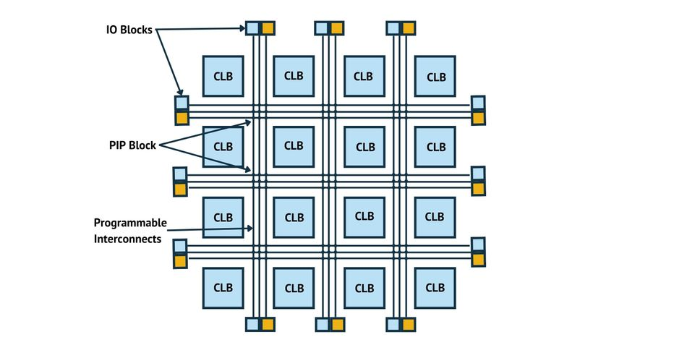
What is an FPGA
Field Programmable Gate Array(FPGA)
Gate Array – composed of array of logic gates
Field Programmable – FPGAs are programmable and reprogrammable after manufacture
Fig. 1 : Internal Structure of an FPGA

Slide 8
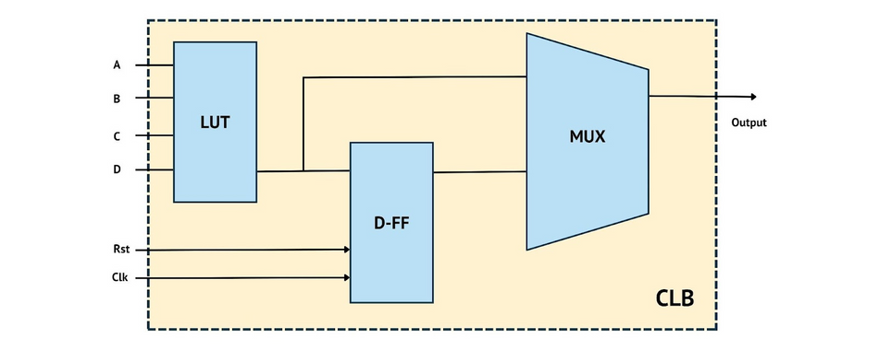
Components of an FPGA
Configurable Logic Blocks (CLBs): These are the basic building blocks of an FPGA, containing Look-Up Tables (LUTs), flip-flops, and sometimes dedicated arithmetic units. CLBs can be configured to perform various combinational and sequential logic functions.
Fig. 2 : Block diagram of configurable logic block

Slide 9
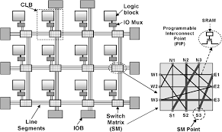
Components of an FPGA
Programmable Interconnect Points ( PIPs): These are the programmable switches and wiring resources that connect CLBs and other components within the FPGA. PIPs allow for flexible routing and interconnection of signals between different elements on the chip. Deep down, transistors are the basic building blocks of FPGAs, forming both CLBs and PIPs.
Fig. 3 : programmable interconnect points

Slide 10
Components of an FPGA
Input/Output Blocks (IOBs): These are the interface points between the FPGA and external devices or other components on the board. IOBs are configurable to support various signaling standards and protocols, enabling the FPGA to communicate with a wide range of peripherals.
Block RAM (BRAM): This is the on-chip memory available on an FPGA, used for storing data and implementing memory functions. BRAMs are faster than off-chip memory and can be accessed with lower latency.

Slide 11
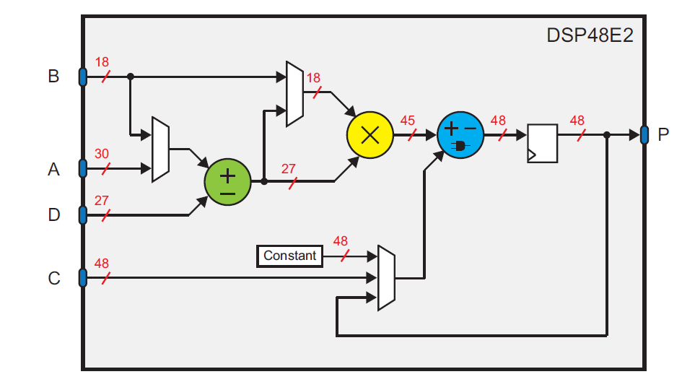
Components of an FPGA
Digital Signal Processing (DSP) Blocks: These are specialized hardware blocks dedicated to performing arithmetic operations, such as multiplication and accumulation, at high speeds. DSP blocks are commonly used in signal processing and filtering applications.
Fig. 4 : Block diagram of DSP48E2 Slice

Slide 12
Components of an FPGA
Clock management resources: These include Phase-Locked Loops (PLLs) and Digital Clock Managers (DCMs) used to generate, distribute, and manage clock signals within the FPGA. These resources help maintain precise timing and synchronization across the device.
Configuration memory: This is the flash memory that stores the configuration bitstream, which programs the FPGA to implement the desired digital circuit. The bitstream is loaded into the FPGA at startup or when reprogramming is required.

Slide 13
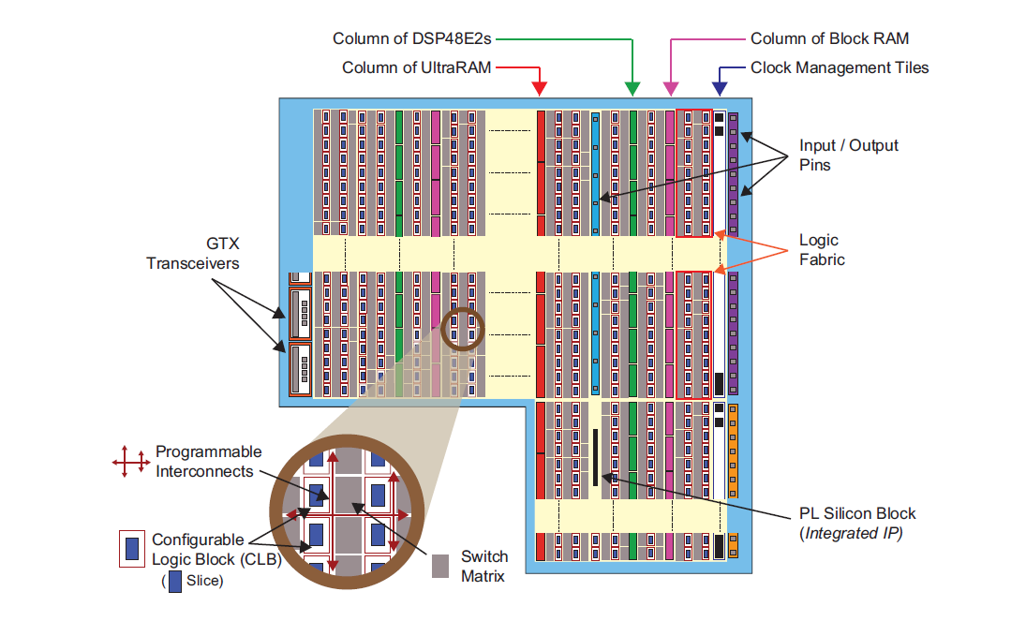
Modern FPGA Architecture
Fig. 5 : Ultra Scale+ Layout

Slide 14
FPGA Programming Technologies
SRAM Based: SRAM cells control the logic and interconnect configuration of the FPGA. Volatile, needs reconfiguring on power up. Most common approach used by major vendors.
Antifuse: One time programmable connections between logic blocks. Used in some lower cost FPGAs. Permanent once programmed.
Flash/EEPROM: Flash or EEPROM cells used for configuration cells. Allows reprogramming but nonvolatile so retains configuration on power loss.
JTAG Interface: Joint Test Action Group

Slide 15
FPGA Design Process
Design entry: Designers create a high-level representation of the desired digital circuit using an HDL like VHDL or Verilog.
RTL design and simulation: The HDL code is translated into an RTL representation, which is then simulated to verify functionality and performance.
Synthesis: The RTL design is converted into a gate-level netlist, a representation of the digital circuit using gates and flip-flops.
Implementation: The gate-level netlist is mapped to the FPGA's resources, including CLBs, DSP slices, and programmable interconnects. This step includes place-and-route and bitstream generation.

Slide 16
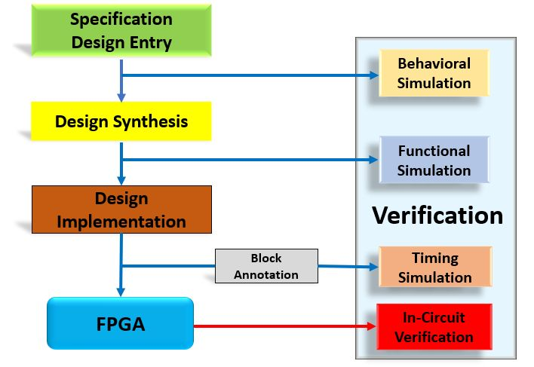
FPGA Design Process
Testing and debugging: FPGA devices are tested and debugged with simulation tools, testbench, or target hardware to ensure correct functionality and performance.
Fig. 5 : FPGA Design Flow

Slide 17
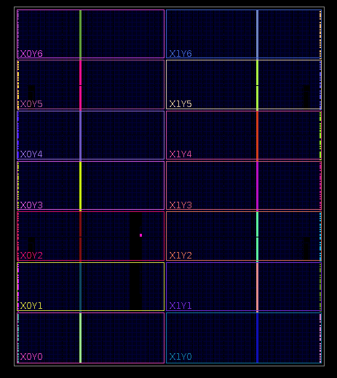
FPGA Design Examples
Thermostat
Verilog code
Fig. 6 : Device of thermostat

Slide 18
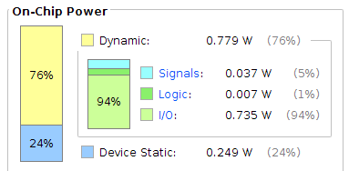
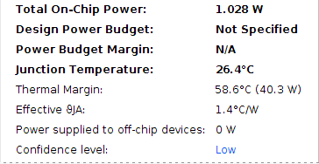
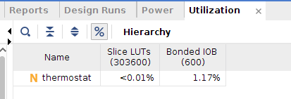
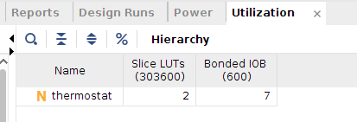
FPGA Design Examples
Thermostat – power and utilization

Slide 19
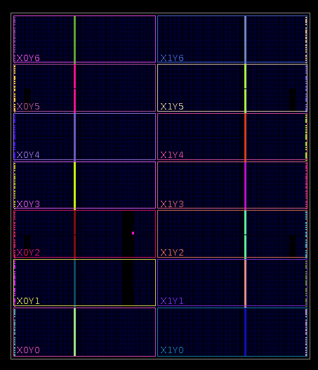
FPGA Design Examples
Decade_counter
Verilog code
Fig. 7 : Device of Decade_counter

Slide 20
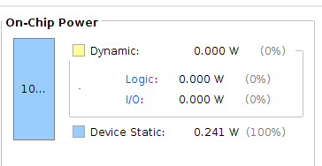
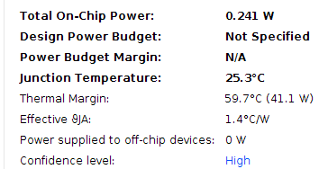
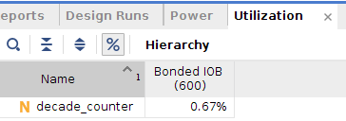
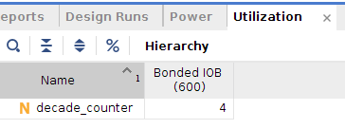
FPGA Design Examples
Decade_counter - power and utilization

Slide 21
FPGA Design Examples
FSM
Verilog code
Fig. 8 : Device of FSM

Slide 22
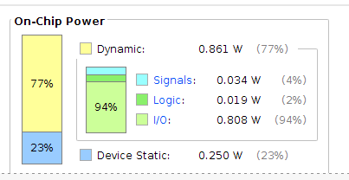
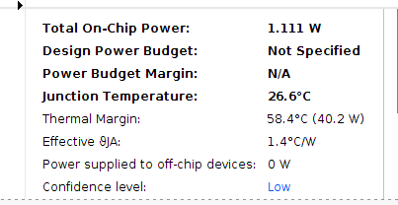
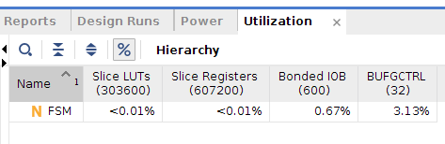
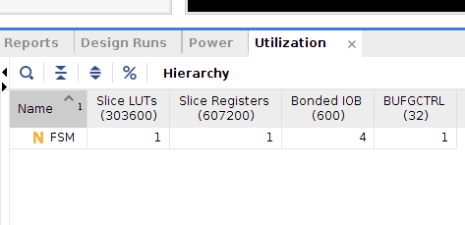
FPGA Design Examples
FSM – power and utilization

Slide 23
Comparison
Parameter | Thermostat | Decade_counter | FSM
Total on-chip Power | 1.028 W | 0.241 W | 1.111 W
Junction Temperature | 26.4 degree Celsius | 25.3 degree Celsius | 26.6 degree Celsius
Slice LUTs | 2 | 0 | 1
Slice Registers | 0 | 0 | 1
Bonded IOB | 7 | 4 | 4
BUFGCTRL | 0 | 0 | 1

Slide 24
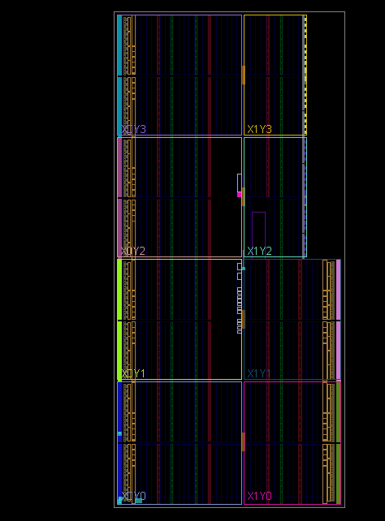
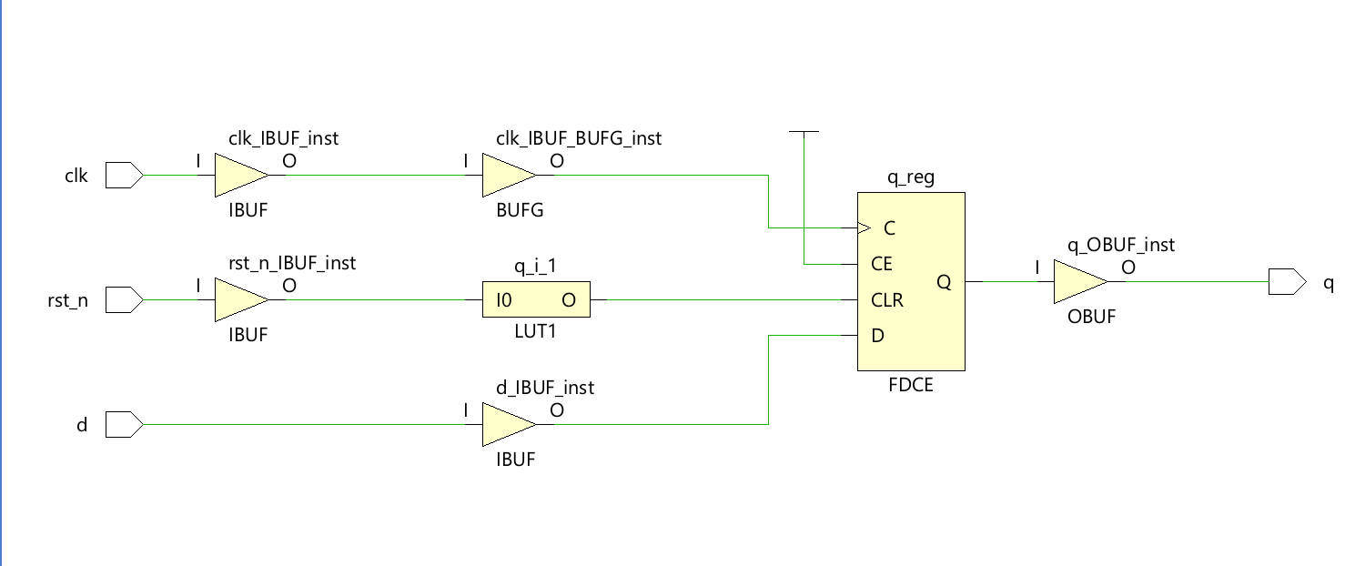
FPGA Design Examples
D flipflop
Verilog Code
Verilog tb Code

Slide 25
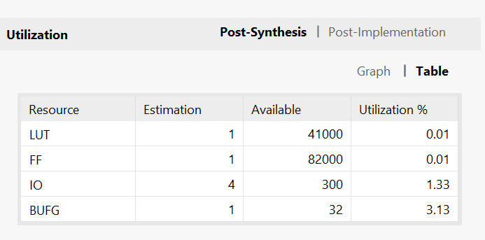
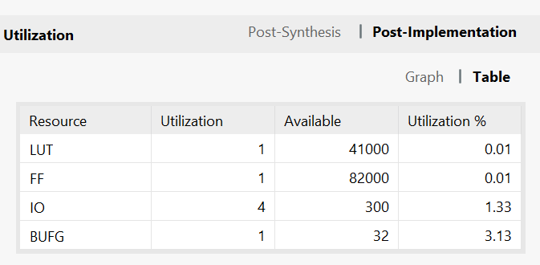
FPGA Design Examples
D flipflop – Utilization Report

Slide 26
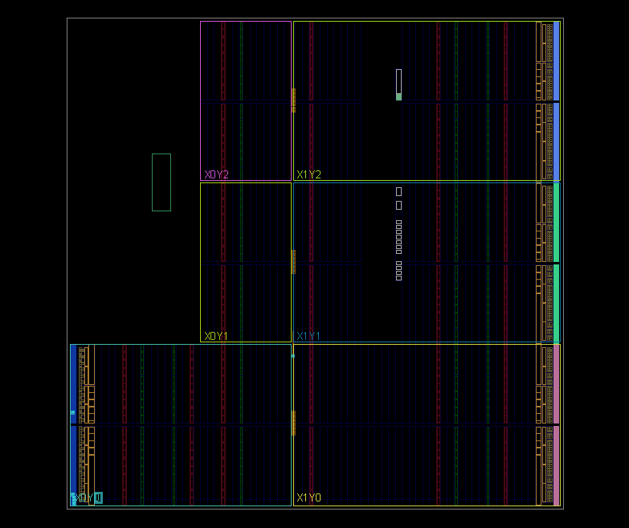
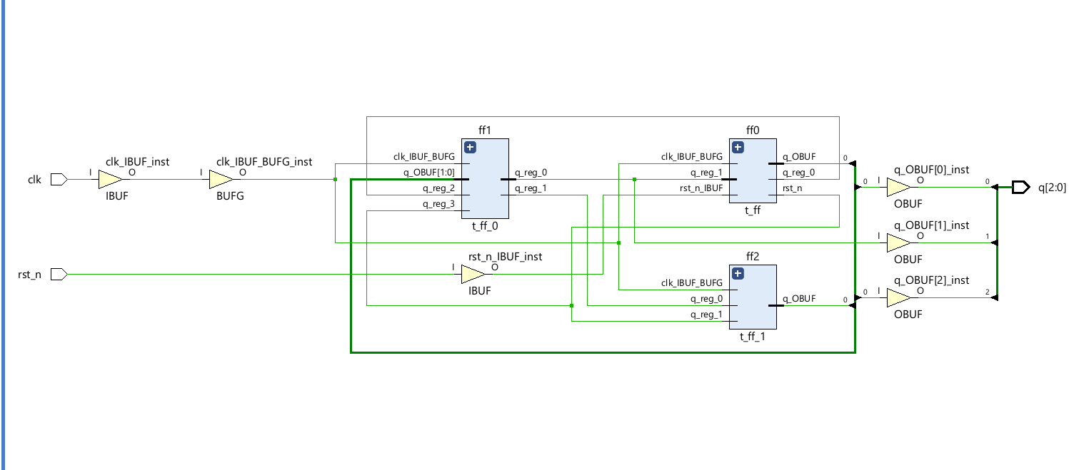
FPGA Design Examples
Counter
Verilog Code
Verilog tb Code

Slide 27
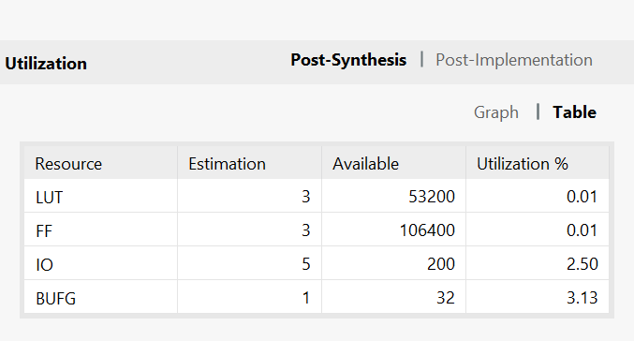
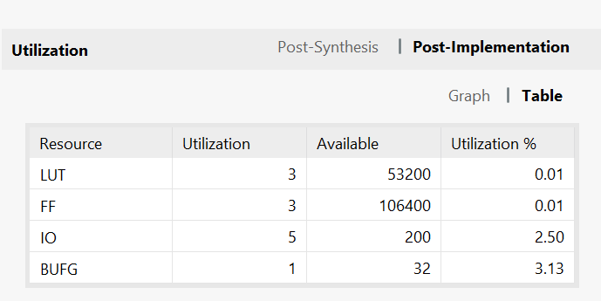
FPGA Design Examples
Counter – Utilization Report

Slide 28
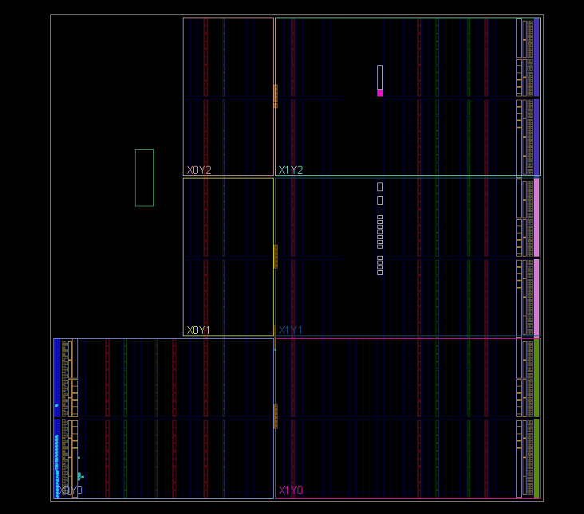
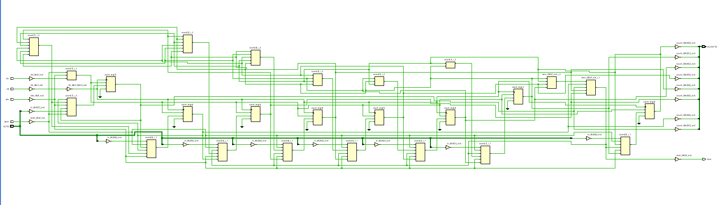
FPGA Design Examples
Problem statement
Down counter
Verilog Code
Verilog tb Code

Slide 29
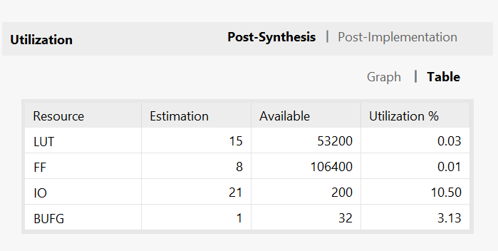
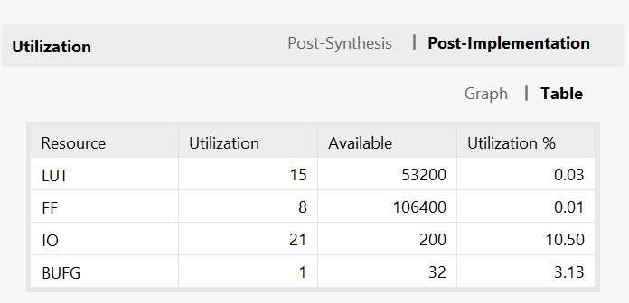
FPGA Design Examples
Down counter – Utilization Report

Slide 30
FPGA Advantages
Flexibility and Rapid Prototyping
Parallelism and Customization
Reconfigurability
Security

Slide 31
FPGA Disadvantages
Cost and Size
Design complexity
Power consumption

Slide 32
Thank You

