Slide 2


Slide 3

Notes:
As today's digital world becomes increasingly competitive, what are some of the relevant skills needed to succeed? While the list is certainly endless, skills like Artificial Intelligence (AI) and Machine Learning (ML), data analytics, big data, SEO, and cybersecurity overlap. No matter who answers that question, AI and Data Analytics will always list at the core.

Slide 4
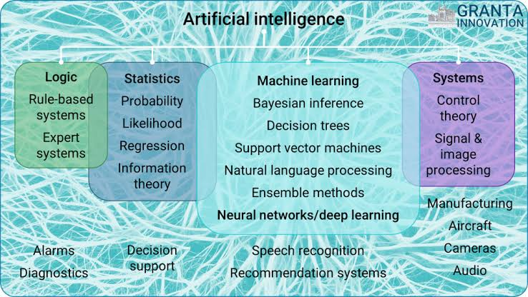

Slide 5



Slide 6
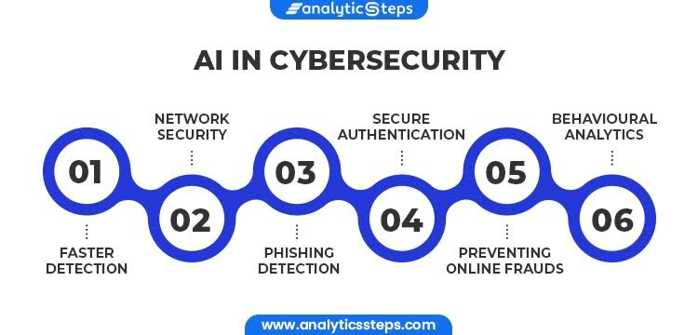
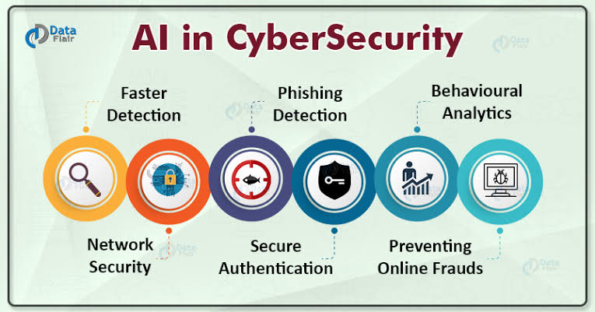

Slide 7
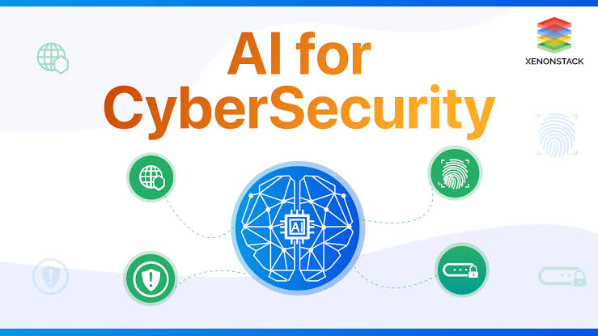

Slide 8
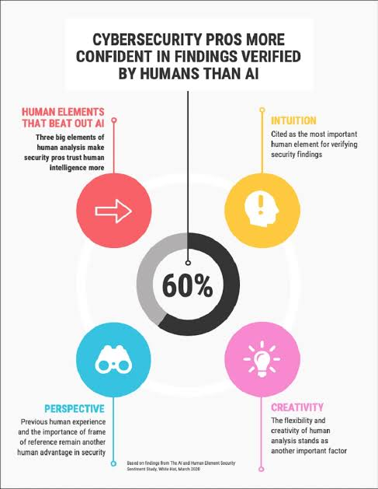

Slide 9



Slide 10



Slide 11
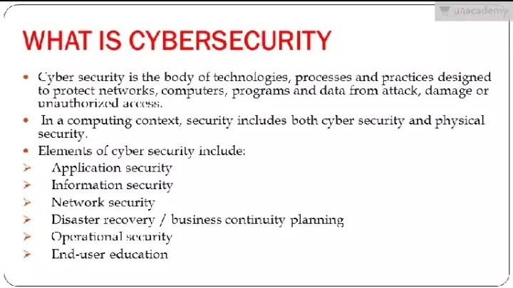

Slide 12
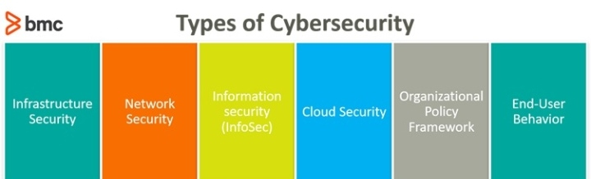


Slide 13
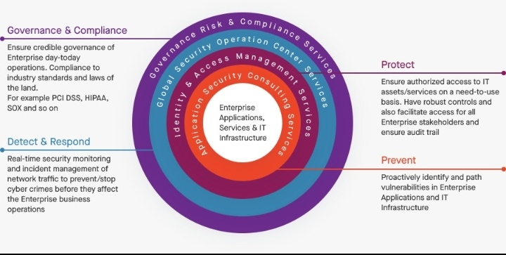

Slide 14


Slide 15


Slide 16
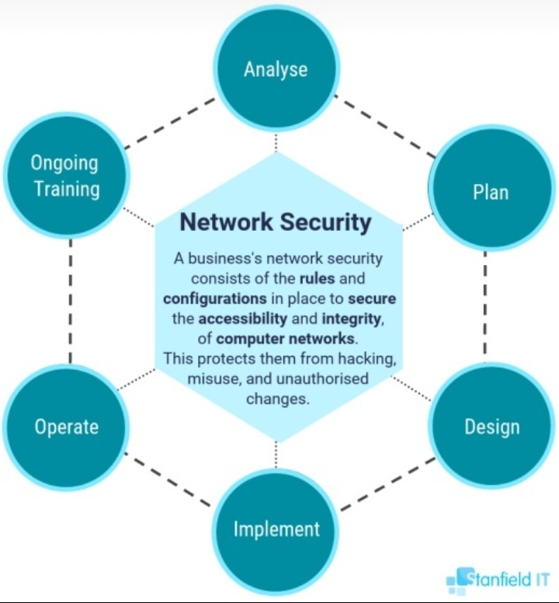

Slide 17



Slide 18
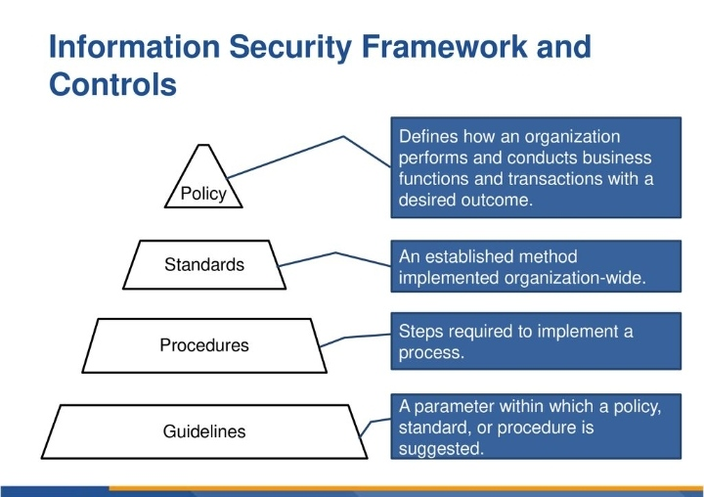

Slide 19


Slide 20



Slide 21


Slide 22
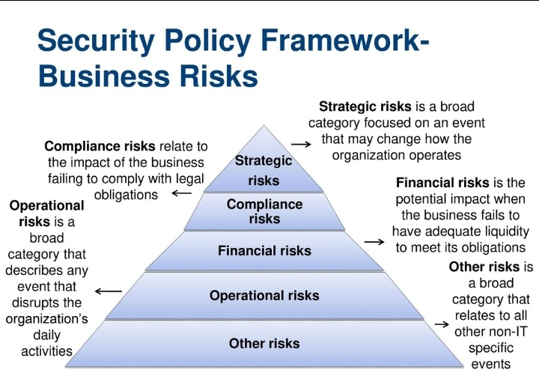

Slide 23
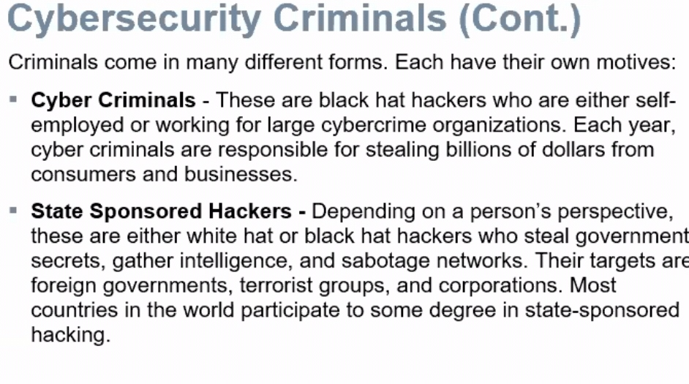

Slide 24


Slide 25


Slide 26
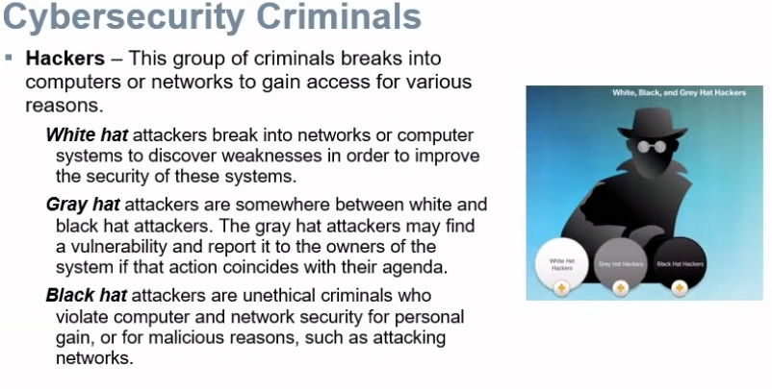

Slide 27


Slide 28
