Slide 1

SWARNANDHRA COLLEGE OF ENGINEERING AND TECHNOLOGY
(Autonomous)
Accredited by NAAC with ‘A’ Grade Approved by AICTE & Permanently Affiliated to JNTUK, Kakinada Seetharampuram , Narsapur-534280, West Godavari District, AP
DEPARTMENT OF
ARTIFICAL INTELLIGENCE AND MACHINE LEARNING
“E CLASS”
Under the esteemed guidance of:
Dr.M.Sridhar(M.Tech,Ph.D)
Professor
Presented by:
G.R.N.G.Bhavani (20A21A6119)
K.Thrivalya (20A21A6131)
M.Charan Tej (20A21A6139)
T.Chinna Siva Krishna (20A21A6154)

Slide 2
CONTENTS:
❖ Problem Statement
❖ Abstract
❖ Existing System
❖ Proposed System
❖ Modules In The System
❖ Project Requirements
❖ Advantages
❖ Sequence Diagram
❖ Architecture Diagram
❖ Conclusion
❖ Output Screenshots

Slide 3
Problem Statement:
Our core challenge lies in creating a platform that grants administrators complete control, facilitating smooth organization, updating, and maintenance of essential data

Slide 4
ABSTRACT:
eClass is an web application which is mainly focusing on student progress report. Our project consists of two phases of views admin view and client view
➢ Admin view resembles the organizer phase. It has a dashboard with complete rights on the entire software to make use crud operations on any functionality.providing an overview of key metrics and activities within the system.The admin view serves as the organizer phase, implying that administrators can organize, update, and maintain the entire system.
➢ Client view resembles the student phase. The student phase can seek information provided by the admin phase. The student can override the information provided by the organizer phase. This could include viewing their progress reports, course details, announcements, and any other relevant data.This suggests a level of autonomy for students to update or modify their own data within the system.

Slide 5
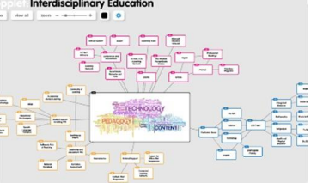
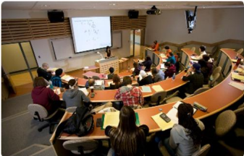

Existing System:
Challenges: Manual Processes: Technological limitations:
The existing system lacks real-time Manual data entry and cumbersome The current system may be
updates and comprehensive data reporting procedures result in outdated technology and
analysis, leading to potential inefficiencies and a lack of scalability hindering the ability to adopt
inaccuracies and delays in the current system. features and customization
in reporting.
l

Slide 6

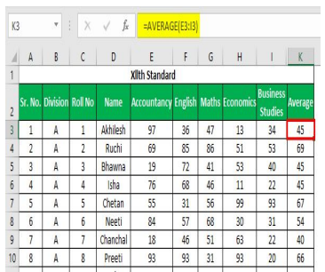

PROPOSED SYSTEM:
Attendance Management Marks Management Classrooms System System (uploading pdfs & syllabus)
Implement an attendance tracking and Marks management system in Uploading PDFS and other study
allowing instructors to mark attendance E-class that allows instructors to materials directly to E - Class
manually or automatically. Input and manage Students mark’s room,allowing for easy access
Provide students with access to their for Assignments,Exams and other by students
attendance records for self-monitoring. Assessments.

Slide 7


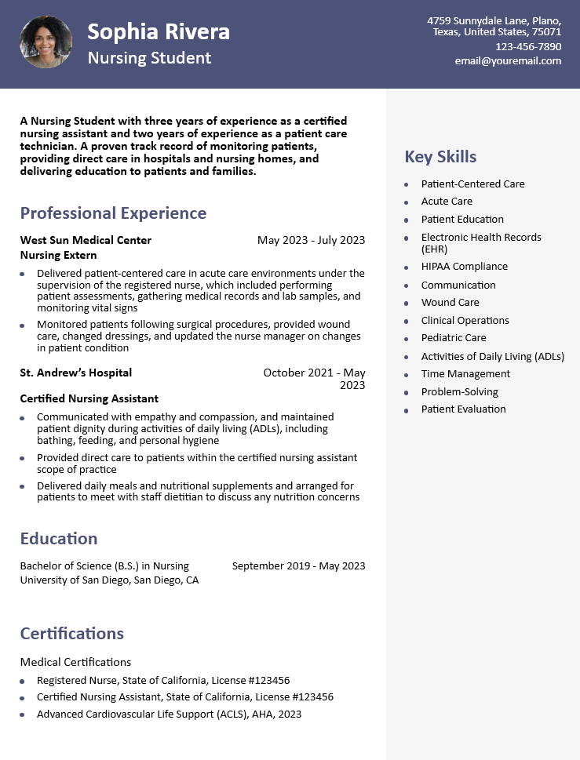
CHATBOT facial Recognition Resume Builder
Develop the chatbot to provide quick Facial Recognition in E-Class serves as The E-Class platform serves as a
answers to frequently asked questions a means to access the portal by utilizing tool for resume creation in a
About E-Class functionalities,course facial recognition technology in the app. professional and structured format.
Information,deadlines and other
relevant topics.

Slide 8
Modules in the System:
1. Announcements: 2. Assignment Submission:
Teachers can post important updates, A module where student can submit
Announcements,and notifications for their assignments online, and teachers
Students to see . can provide feedback and grades.
3. Attendance Tracking: 4. Content Sharing:
A module to track and manage A space for teachers to upload and share
Student attendance for virtual course materials ,lecture notes and
or in-person classes. Multimedia content.

Slide 9
Advantages:
1.User-friendly interface:making it easy for administrators and students to navigate and use the application.
2.Data Security:Implements security measures to ensure the protection of sensitive student data, maintaining privacy and compliance with data protection regulations.
3.Time-Saving:Streamlines administrative tasks and processes, saving time for educators and administrators, allowing them to focus more on student engagement and support.
4.Assessment and feedback: eClass offers various tools for creating and administering Assessments,including quizzes,exams,and assignments.It also provides features for providing
Feedback and grading submissions. Promoting continuous improvement and accountability

Slide 10
Project Requirements:
Techstack Software's Required
➢Bootstrap ➢OS
➢PHP ➢Browser
➢JavaScript ➢PHPMyadmin[local Database]
➢Jquery ➢Apache [local server]
➢Ajax ➢Infinity Free [global server]
➢Mysql

Slide 11
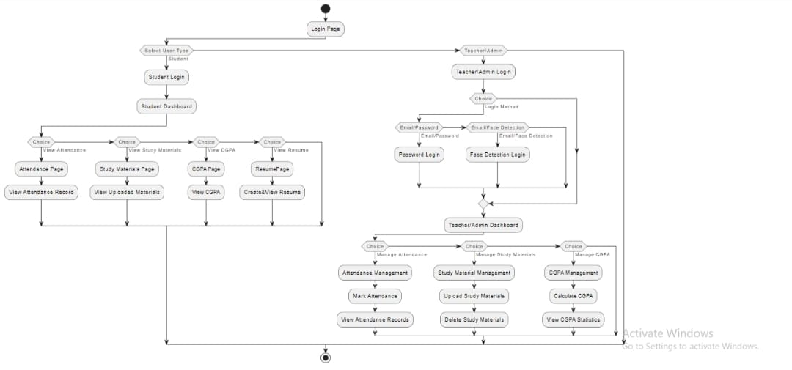
Sequence Diagram:

Slide 12
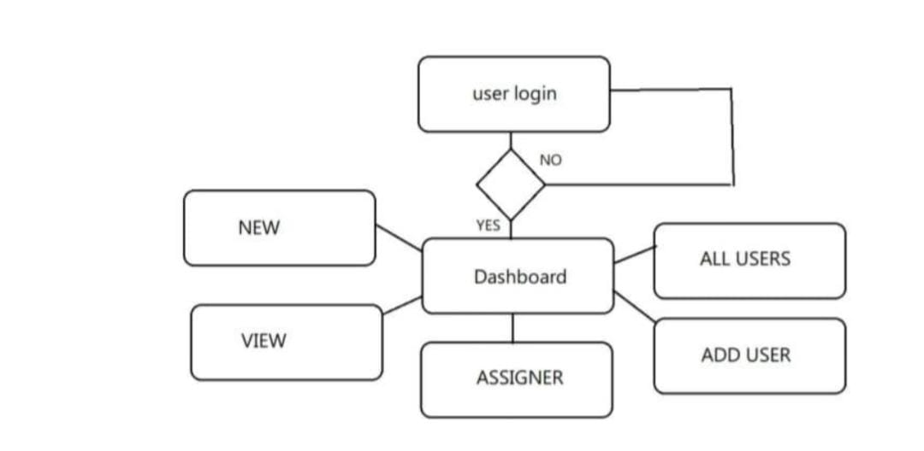
Architecture Diagram:

Slide 13
Conclusion:
In conclusion,the implementation of an e-class system represents a paradigm shift in educational management.It emcompasses various functionalities,including attendance tracking,grading mechanisms,PDF uploads,teacher managements tools,and CGPA calculation features.This enhanced connectivity promotes active participation and facilitates timely feedback,ultimately enriching the learning process.

Slide 14

Of our project:
Administration:
• Accessing data of a student by faculty is easy with reg no.
• Faculty can give notification to entire class.
• Creating a classroom and organizing it (units, ques. papers, etc…)
Student:
• Can see the complete progress report.
• It can be accessed from anywhere.
• Auto-generating of resume, based on data provided.

Slide 15
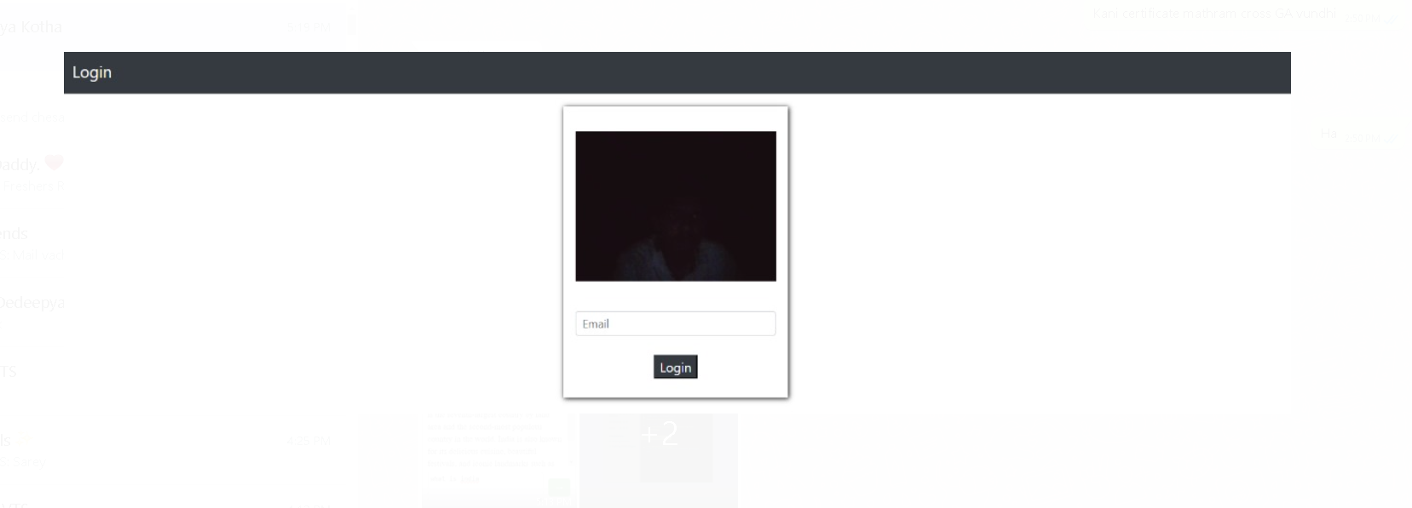
OUTPUT SCREEN:(Facial Recognition):

Slide 16
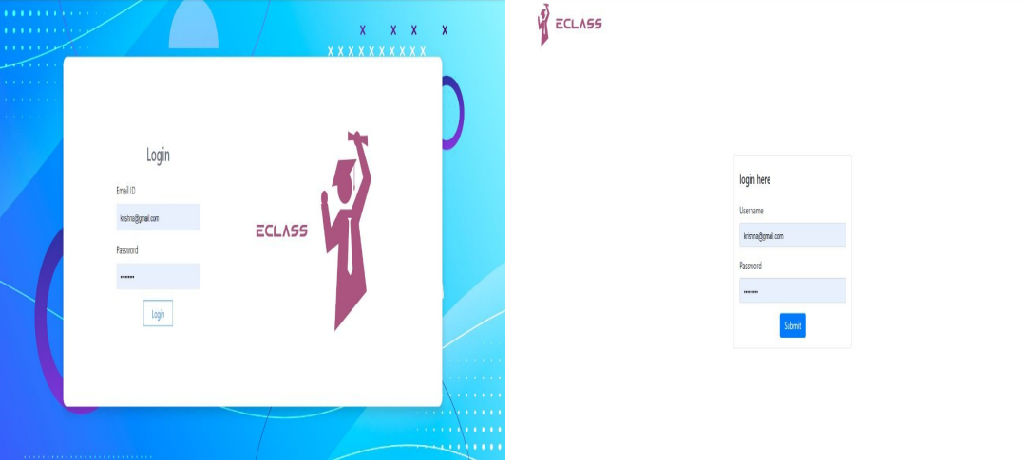
OUTPUT SCREEN:(Login Page Of Admin And Student)

Slide 17
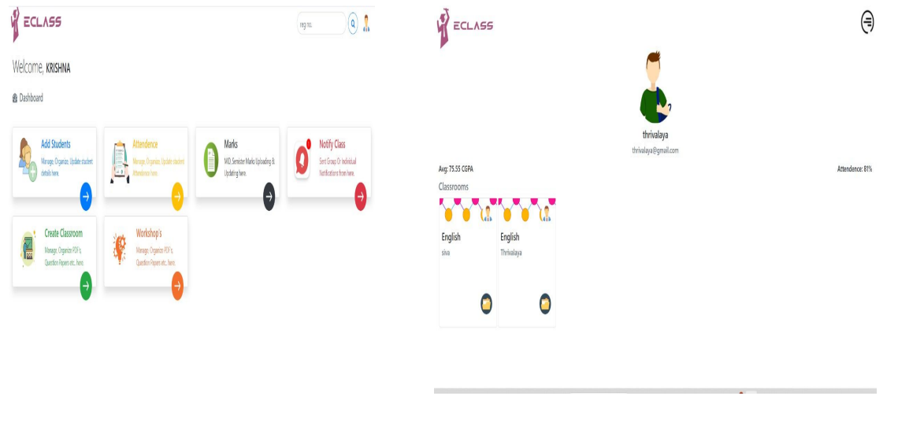
OUTPUT SCREEN:(Dashboard Of Admin And Student)

Slide 18
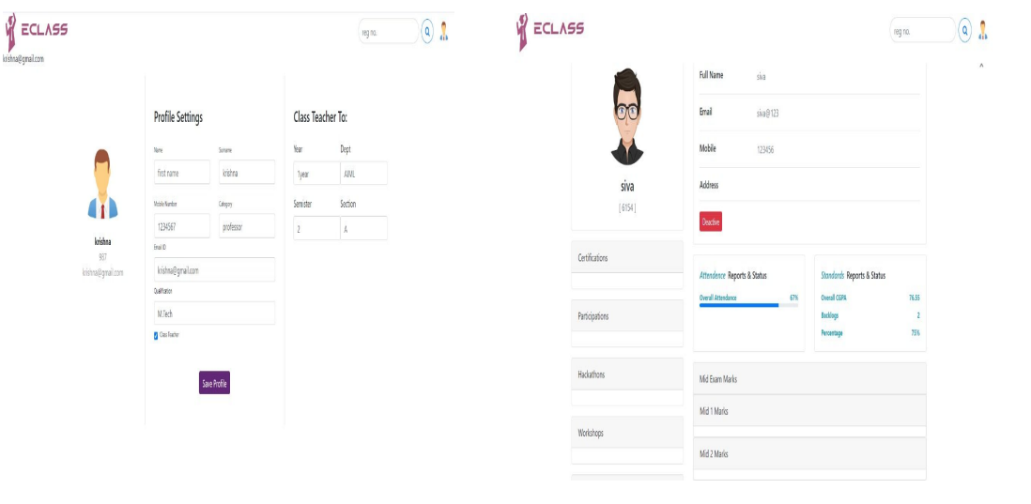
OUTPUT SCREEN:(Admin’s And Student Profile)

Slide 19
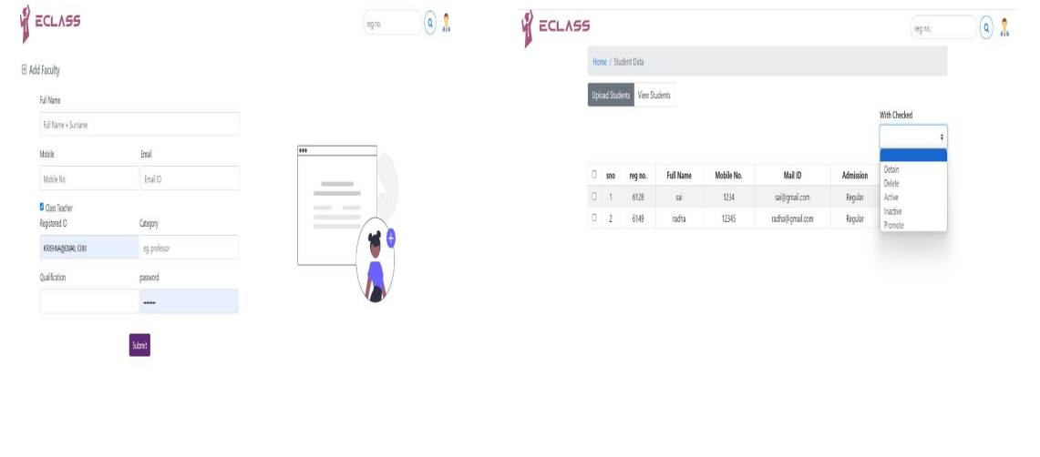
OUTPUT SCREEN:(Adding Teachers And Adding Student)

Slide 20

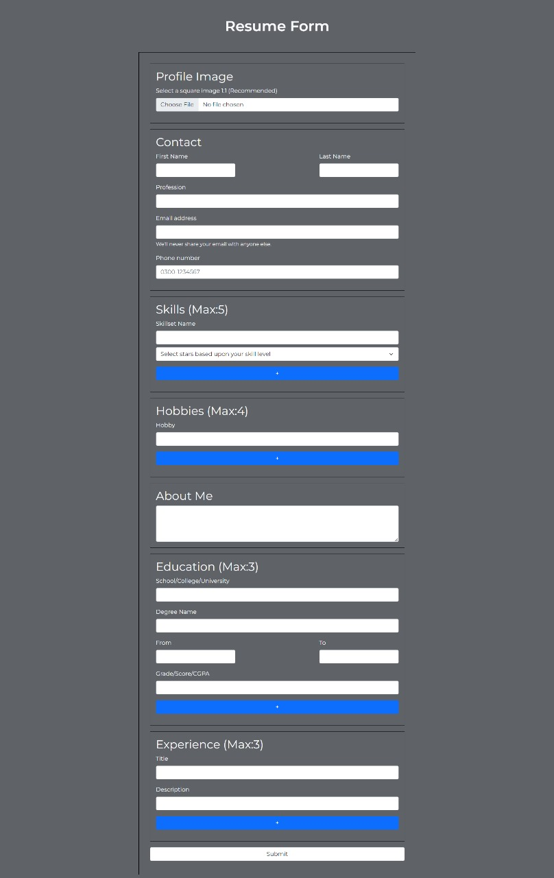
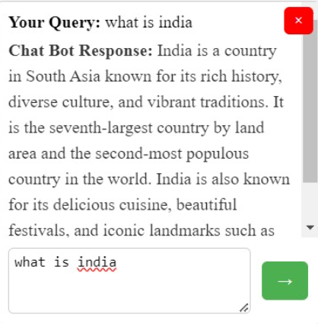
OUTPUT SCREEN:(Chatbot And Resume Builder)

Slide 21
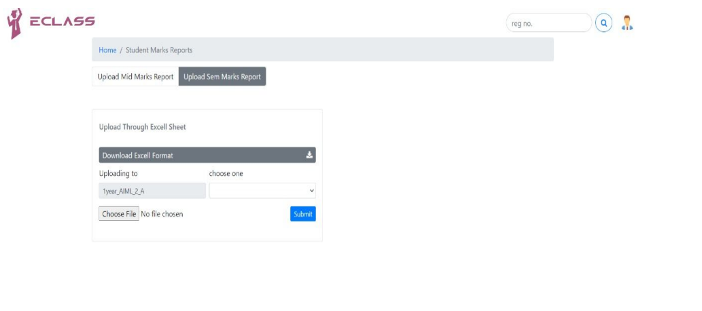
OUTPUT SCREEN:(Uploading Student Marks)

Slide 22


