Slide 1
Feedback Management System
Group Number 2
Mentor – Tanmaya Acharya
Notes:
Add instructor notes here.

Slide 2
Objectives
Project Understanding
Approach used
Project Execution
Modules
Learning
Best Practices
Opportunity for improvement
Demo and Code Walkthrough
Q&A
Notes:
Add instructor notes here.

Slide 3
Project Understanding
The project aims at developing a feedback management system that can be accessed throughout the organization and this is a web based application that can be accessed over the web.
This is an integrated system that comprises of 3 factors: Training Admin, Co-coordinator and Participant.

Slide 4
Project Understanding (Continued)
Admin can maintain Faculty Skillset, Course information and can view the Feedback report.
Co-coordinator can maintain Training Program, Participant Enrollment and can view Feedback report.
Participant is allowed to enter Feedback report for his or her completed training program.

Slide 5
Approach used :
Front End & Web Components
* HTML/JavaScript
* Servlets
* JSP
Business Logic Components & Services
* java Beans
Application Servers
* WildFly
Database
* Oracle 10g

Slide 6
Project Execution
Training Admin Module
Co-coordinator Module
Participant Module

Slide 7
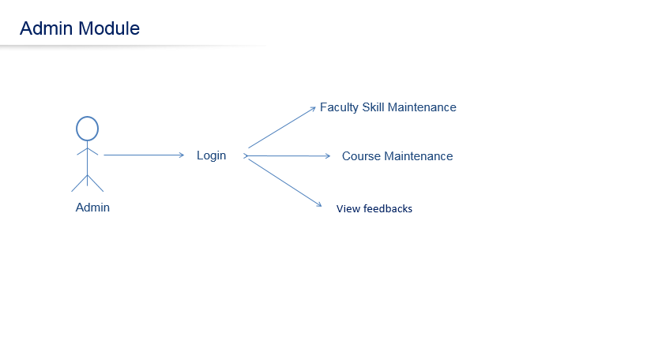
Modules

Slide 8
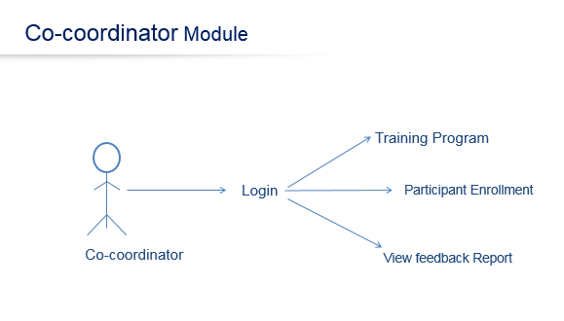
Modules

Slide 9
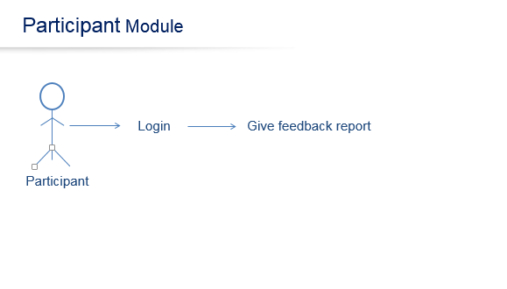
Modules

Slide 10
Modules
Login
Faculty Skill Maintenance
Course Maintenance
Training Program Maintenance
Participant Enrollment
Feedback Entry
View Feedback Report

Slide 11
Modules
Login
It is common for all the users.
i.e. Admin, Co-coordinator and Participant.
Basic Functionality of Login Module is as follows:
1. Taking login credentials from the user.
2. If the credentials are wrong, it shows appropriate message.
3. If login is successful, user will be navigated to their pages based
on his/her role.

Slide 12
Modules
Faculty Skill Maintenance
This should maintain information of faculties based on their skills.
This displays the faculty skill set.
Course Maintenance
This should maintain course details like course id, course name and duration.
Training Program Maintenance
This should allow the maintenance of Training program details like
Training ID,
Training course,
faculty scheduled for the course,
start date and end date.

Slide 13
Modules
Participant Enrollment
This should allow enrolling the participants to the different training programs.
Feedback Entry
This should allow the participants to enter the feedback for his/her
completed training program.
View Feedback Report
This should be available to Training admin and Co-coordinators.
This should display list of all feedback reports of faculties.
This should display feedback based on a particular faculty id.

Slide 14
Learning
  Technical Learning:
  It lead to the implementation and skill enhancement related to technical fields such as java 8.0,Spring 4.0,JSP-Servlets.
  The practical implementation helped us in furnishing the technical skills and to work on our weak areas.

Slide 15
Learning
  Non - Technical learning:
  There are several traits that lead to development of skills as:
  Team work: It taught us to work in a team efficiently , communicate with team members efficiently as well as to understand each others aspect efficiently.
  Work in time constraint : It taught us to work for a project/task in a time constraint i.e. to define and schedule our tasks according to time constraint, how to divide the task, etc.

Slide 16
Best Practices
Spring 4.0 annotations reduced the compilation errors.
All the variables are initialized before they are used.
The for each loop is used for iteration purpose .
The proper naming conventions are used.
No Deprecated Methods are used.

Slide 17
Opportunity for improvement
Keeping in view of time constraint, the project made by our team should be improved in certain aspects:
Feedback report could be displayed using appropriate graphs and pie charts.
Round – trip feature for giving feedback.

Slide 18
Q & A

Slide 19
Thank You…

