Slide 1
Understanding Floats and Position in CSS
Dan Hahn
AppNexus
Jan 18, 2013

Slide 2
What will be covered
Basic use of float
Clearing a float
Stacking a float
Basic Layout
Flexible Layout
How positions work
Static
Relative
Absolute
Fixed
Nesting positions
A few examples

Slide 3
Basic of Floats
Elements can only be floated to the left or right.
A floated element will move to the extreme right or left.
The content after the floated element will wrap around the element. If an element is floated to the left the content will wrap to the right.
Both inline and block elements can be floated.
Floated elements are pulled out of the flow of the document.
When floated the element will be as wide as the content determines.
A width may be need to limit how wide the element is.
If an element is floated it will no longer effect the height of its parent. (more on this in a bit)

Slide 4
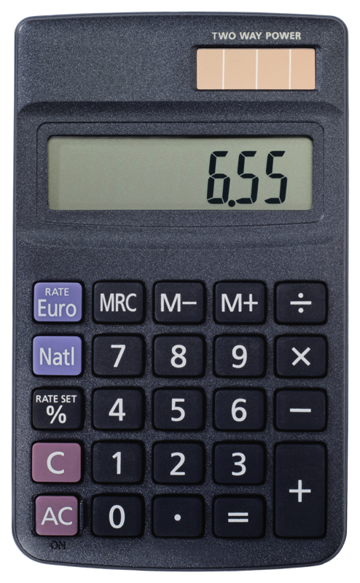
Example of Basic Float
<p>
<img src=“image.gif” style=“float: right”>
Post-ironic delectus pitchfork cray. Semiotics velit pariatur butcher, tempor blue bottle before they sold out narwhal
</p>
Post-ironic delectus
pitchfork cray.
Semiotics velit pariatur
butcher, tempor blue
bottle before they sold
out narwhal
Note how the image overflows the box. This happens when a floated element is larger than the content in the parent element.

Slide 5
Clearing a Float
When an element is floated the content after the element will wrap around the element.
Clear will instruct an element to no longer wrap.
Block Elements are the best elements to clear.
Clear has 3 values left, right or both
clear: left; will clear a float: left;
clear: right; will clear a float: right;
clear: both; will clear a float: left; or float: right;

Slide 6
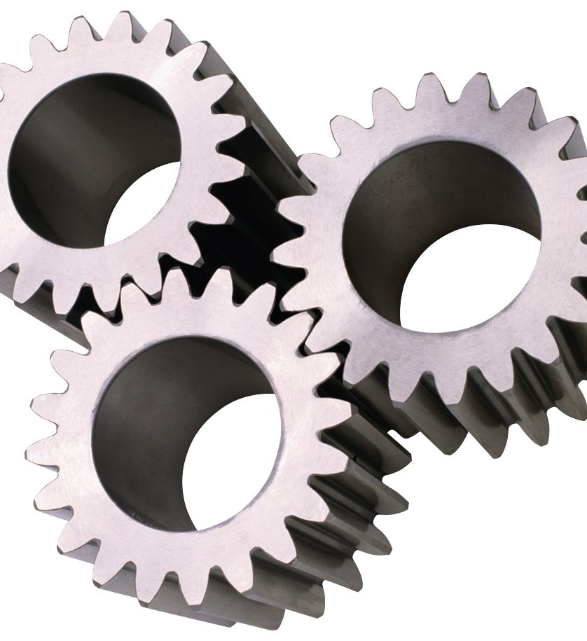
Example of Clear
<div style="float:left">
<img src="image.gif" alt="">
</div>
<p>Post-ironic delectus pitchfork cray. Semiotics velit pariatur butcher, tempor blue bottle</p>
<h2 style="clear">Next Section</h2>
Post-ironic delectus pitchfork cray. Semiotics velit pariatur butcher, tempor blue bottle before they sold out
Next Section
Note how the box now is the same size as the content. The cleared content “pins” the content below the floated element extending the parent element.

Slide 7
Stacking Floats
When two or more elements are floated next to each other in the same direction they will stack.
They stack in the direction they are floated.
They will stack until the parent elements width is met when they will wrap to the next line.
If the heights of the elements are all the same this will create a grid.
Use margin to control the space between floated elements.
When all the content in a an element is floated that element does not have a height.
Float vs. inline-block
They are not the same.
There are advantages and disadvantages to each.

Slide 8
Example of Stacking
<style>
ul {background: red;}
</style>
<ul>
<li>item 1</li>
<li>item 2</li>
<li>item 3</li>
</ul>
item 1
item 2
item 3

Slide 9
Example of Stacking (cont)
<style>
ul {background: red;}
li {float: left;}
</style>
<ul>
<li>item 1</li>
<li>item 2</li>
<li>item 3</li>
</ul>
item 1 item 2 item 3
Notice that the red background on the <ul> is no longer showing. This has to do with the fact that all the <li> tags are floated.

Slide 10
Fixing the height issue
The issue is when all the content is floated within an element (<ul>) it no longer has any content to give it a height.
Remember that floated content is no longer part of the document flow.
The five ways to fix the issue
Set the height of the element using the css height.
Set the parent element to position: absolute;
Set the parent’s overflow to hidden.
Add another element after the last floated element and clear it.
Invoke the :after pseudo element on the parent element and clear it.
Each has its advantages and disadvantages.

Slide 11
Adding a height
Good
Not So Good
It is straight forward.
It works.
What is the height anyways?
Hard to manage.
ul {
height: 25px;
}

Slide 12
Position: absolute;
Good
Not So Good
It works.
z-index issues.
Absolute elements are only as wide as the content.
Setting width: 100% has issues.
ul {
position: absolute;
}

Slide 13
Overflow: hidden;
Good
Not So Good
Older browser support.
Hard to remember since there is no real connection to floats.
Content that you want to flow out of the element will be cut off.
ul {
overflow: hidden;
}

Slide 14
Adding an element
Good
Not So Good
Older browser support
Adding unused mark up to fix a display issue.
Have to change HTML markup.
Not a best practice.
<ul>
<li>item 1</li>
<li>item 2</li>
<li class=“clear-fix”></li>
</ul>
.clear-fix {
clear: both;
}

Slide 15
:after pseudo element
Good
Not So Good
No unneeded markup.
Makes sense.
One of the best practice.
Easy to retrofit elements.
Lack of IE6 and IE7 Support.
.clear-fix {
clear: both;
}

Slide 16
Setting up a basic Layout
Floats can be used to set up simple fixed width layout.
<style type="text/css">
div {width: 800px;}
div:after{content:""; display: block; clear: both;}
article, aside{float: left;}
article {width: 600px;}
aside {width: 200px;}
</style>
<div>
<article></article>
<aside></aside>
</div>

Slide 17
Basic of Position
Position will pull an element out of the normal flow of the document.
Position values:
static – default for all elements.
Puts element back in the flow.
relative – pulls the element from the flow and saves its dimensions within the view.
Elements can be moved relative to the original position.
A space will be kept as if they element was still in that spot.
absolute – pulls the element from the flow but the dimensions are not saved.
When the element is moved it is moved to the extreme edge of the parent document.
If the parent element is set to position relative that is now the parent document.
fixed – like absolute but the element will not move when the document scrolls.

Slide 18
Nested Position
By default all elements that are positioned absolute will be move to the top left corner when a value top: 0; and left: 0;
If a element above the element is set to position: absolute or position: relative that element becomes the new document and that element would be the top left corner of the element and not the document.
<style type="text/css">
div {position: relative;}
article{position: absolute;top: 0; left: 0;}
</style>
<div>
<article></article>
</div>
div
article

Slide 19
Example time!
Clear Fix
Simple Layout
Position
Nested Position
Fixed Position
All examples can be found here
https://github.com/danhahn/app-talk

Slide 20
Interested in learning more about AppNexus?
Visit our Website:
careers.appnexus.com
Apply via PennLink for technical summer internships
by January 23rd

Slide 21
Questions?

