Slide 1

OBJECT ORIENTED PYTHON PROGRAMMING project CSE - 343
Submitted by:
Name : Satya Diresh
Section : K19SD
Batch : b-tech computer science & engineering.

Slide 2
ABOUT PYTHON
Python is an interpreted, object-oriented, high-level programming
language with dynamic semantics.
Python is a programming language that lets you work quickly and
integrate systems more effectively.
Its high-level built in data structures, combined with dynamic typing
and dynamic binding, make it very attractive for Rapid Application
Development.

Slide 3
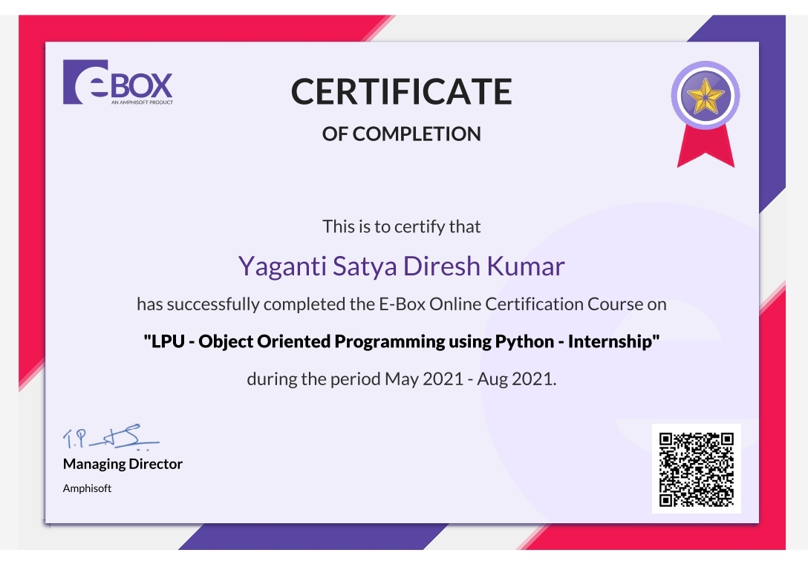

Slide 4
PROJECT SYNOPSIS OF KIDS LEARNING GAME
INTRODUCTION of project :
In this game player has to enter colour of the word that appears on the screen and hence the score increases by one, the total time to play this game is 30 seconds. Colours used in this game are Red, Blue, Green, Pink, Black, Yellow Orange, White, Purple and Brown.
ANALYSIS AND DESIGN:
Let’s try to make a game using Tkinter python. In this game player has to enter colour of the word that appears on the screen and hence the score increases by one, the total time to play this game is 30 seconds. Colours used in this game are Red, Blue, Green, Pink, Black, Yellow, Orange, White, Purple and Brown. Interface will display name of different colours in different colours. Player has to identify the colour and enter the correct colour name to win the game.

Slide 5
we are going to build a colour game in Tkinter python. If you don’t know what this colour game is then let me explain. Colour game is simple and easy to play. In this game, different colour names will be displayed with different text colours. Here in this game, the role of a player is to enter the correct colour of the word which is displayed on the screen. Each time when the player enters the correct colour the score will be incremented by one. And the game duration will be 30 seconds.
I will create a window inside which I have placed some description of the game and how to play the game. Then I have placed some labels which display the current score, words with different colours and count down timer. And entry box to enter the colour name.
Two buttons are placed at the bottom of the window namely start and reset. The start button is used to start the game and the reset button will reset the game so that players can start the game from the beginning.

Slide 6
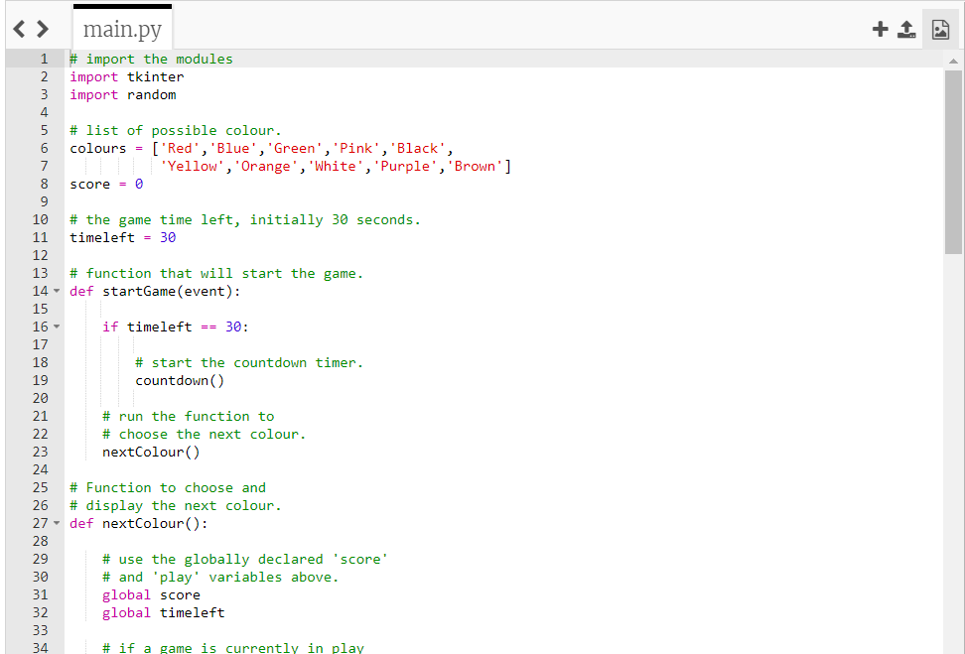
CODE

Slide 7
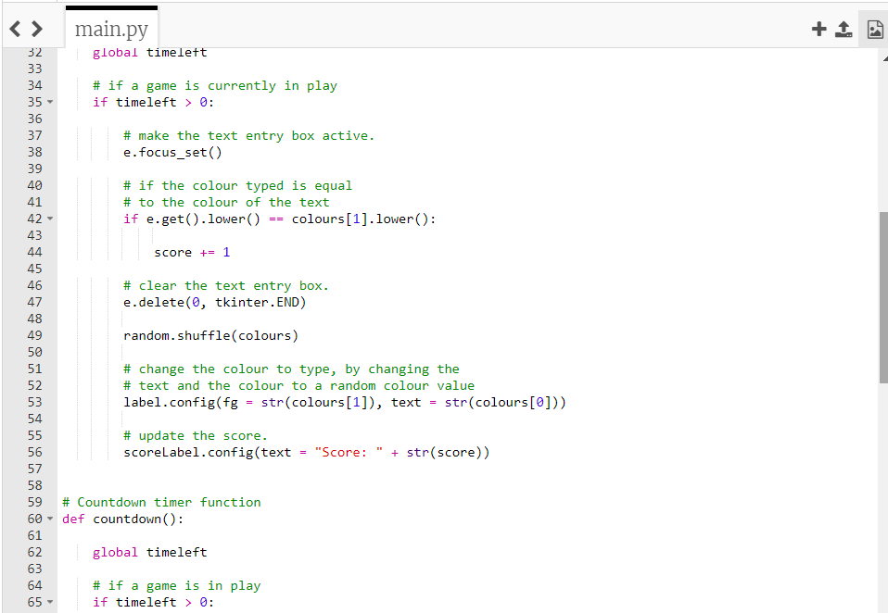

Slide 8
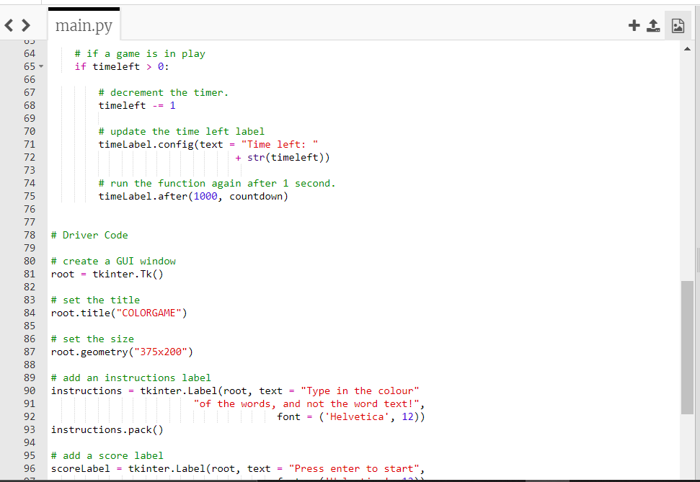

Slide 9
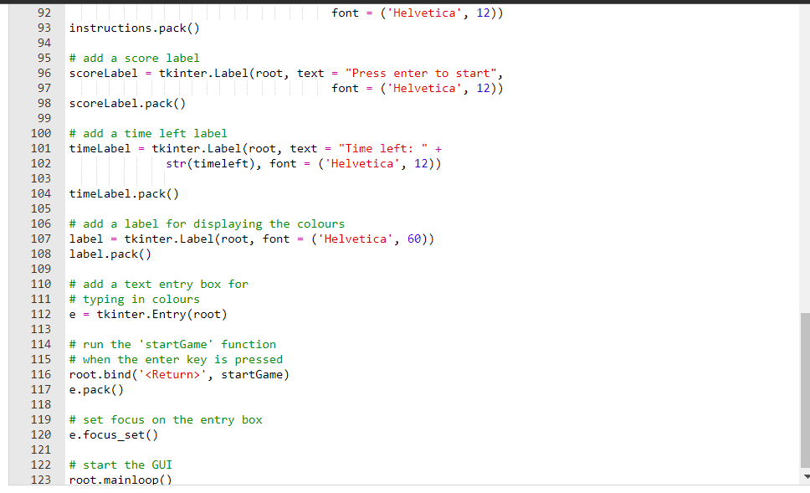

Slide 10
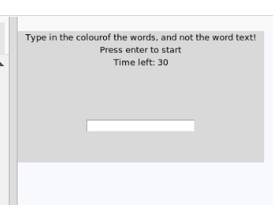
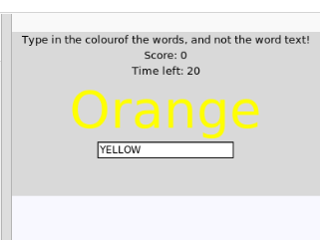
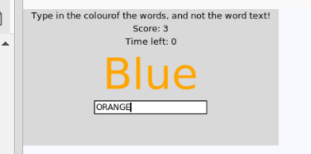
OUTPUTS:
We have to press enter to start
While entering colour
AFTER SCORE INCRESES

Slide 11
When the player clicks on the start button, the startGame() function will be called. this function first checks whether the timer is equal to 30 or not. Previously I have set timer variable to 30. if the timer variable is equal to 30 then another function startCountDown() will be called to start counting from 30 to 0.
After calling the startCountDown() function a random color from the colors list will be fetched and shown to the user with a different text color. startCountDown() function will just count from 30 to 0 and when the counter hits 0 it will display a message “Game Over!!!” to the player.
And have written another function called displayNextWord(). The purpose of this function is to display a new word every time the player submits his answer and increment the score if the player enters the correct answer. And repeat this process until the timer gets to zero.

Slide 12
CONCLUSION:
Tkinter python is excellent for small, quick GUI applications, and since it runs on more platforms than any other Python GUI toolkit, it is a good choice where probability is the prime concern. Obviously we haven’t been able to give Tkinter the depth of discussion it warrants, but its fair to say that almost anything that can be done.

