Slide 1

Rumor Spreading on Facebook
Chinmay Patwardhan
Tyler Nisonoff

Slide 2
Relevance
Facebook and Twitter: well defined social networks
2008: President’s Obama’s birthplace
2013: Chinese government’s response to Bitcoin
2014: Wayne Knight’s alleged death

Slide 3
Overview
Population size is constant
SIR model hybrid
Partition population into three categories:
Ignorants
Spreaders
Stiflers

Slide 4
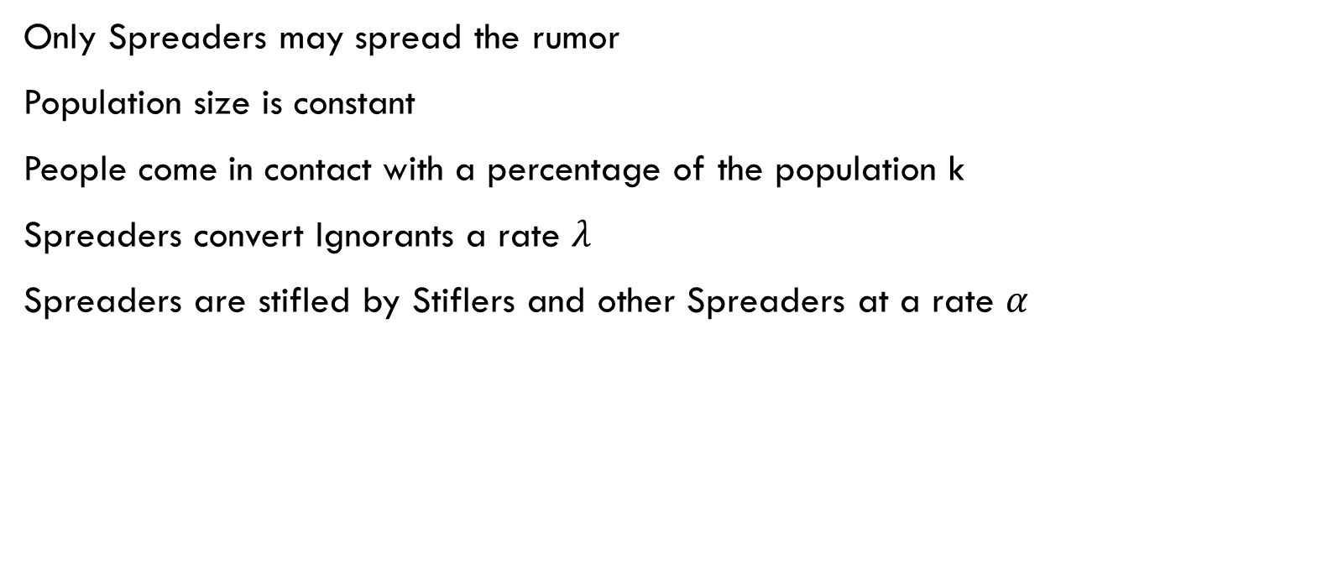
Model 1 Assumptions
Only Spreaders may spread the rumor
Population size is constant
People come in contact with a percentage of the population k
Spreaders convert Ignorants a rate $λ$
Spreaders are stifled by Stiflers and other Spreaders at a rate $α$

Slide 5

Model 1 Equations
$$N=I+S+R$$
$$\frac{dI}{dt}=−λkIS$$
$$\frac{dS}{dt}=λkIS−αkS(S+R)$$
$$\frac{dR}{dt}=αkS(S+R)$$

Slide 6

Simplified Equations
$$N−I=S+R$$
$$\frac{dI}{dt}=−λkIS$$
$$\frac{dS}{dt}=λkIS−αkS(N−I)$$

Slide 7
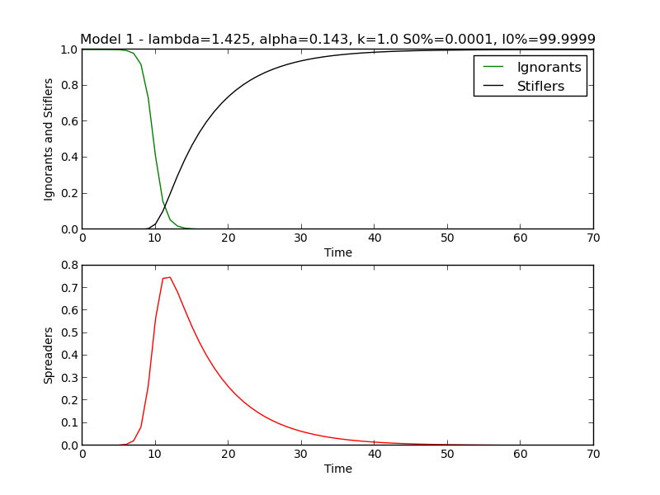

Slide 8

Model 2 Assumptions
All Model 1 assumptions are included
Spreaders may also spontaneously become Stiflers at a rate $δ$
Boredom
External stifling

Slide 9

Model 2 Equations
$$N=I+S+R$$
$$\frac{dI}{dt}=−λkIS$$
$$\frac{dS}{dt}=λkIS−αkS\left(S+R\right)−δS$$
$$\frac{dR}{dt}=αkS\left(S+R\right)+δS$$

Slide 10

Simplified Equations
$$N−I=S+R$$
$$\frac{dI}{dt}=−λkIS$$
$$\frac{dS}{dt}=λkIS−αkS\left(N−I\right)−δS$$

Slide 11
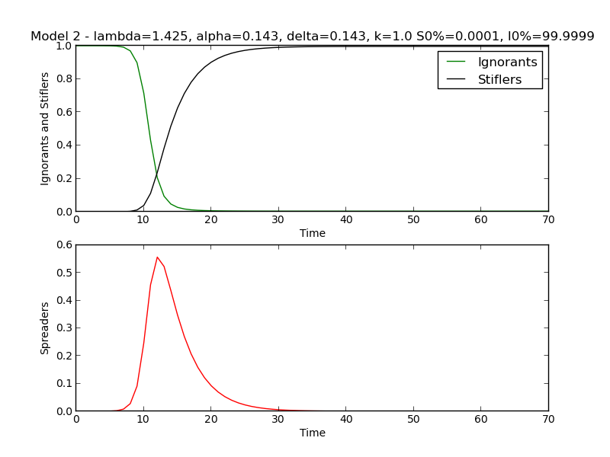

Slide 12
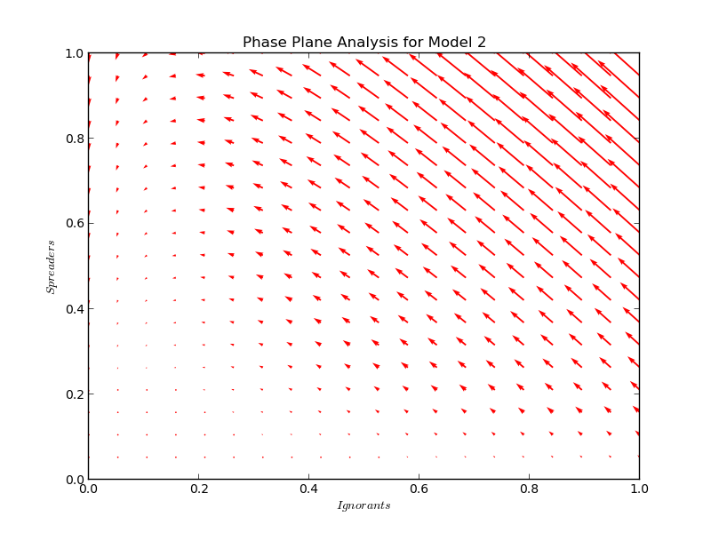

Slide 13
Agent-Based Model
More realistic than an ODE solution
Uses integer-valued populations
May be based on actual network graphs
Implicitly introduces network attributes as parameters
Size of network
Density of network

Slide 14
Data from Stanford Network Analysis Project (SNAP)
Graph | Size | Average Friends Per Node
0 | 334 | 17.08
107 | 1035 | 53.69
348 | 225 | 30.36
414 | 161 | 24.41
686 | 169 | 21.59
698 | 62 | 10.68
1684 | 787 | 37.64
1912 | 748 | 82.28
3437 | 535 | 19.99
3980 | 53 | 7.47

Slide 15
Data from Stanford Network Analysis Project (SNAP)
Graph | Size | Average Friends Per Node
0 | 334 | 17.08
107 | 1035 | 53.69
348 | 225 | 30.36
414 | 161 | 24.41
686 | 169 | 21.59
698 | 62 | 10.68
1684 | 787 | 37.64
1912 | 748 | 82.28
3437 | 535 | 19.99
3980 | 53 | 7.47
Training
SHD
LHD
LLD

Slide 16
Algorithm
Make sets of the initial Ignorants, Spreaders, and Stiflers
For each hour in 48 hours:
Allow spreaders to spread to some of their friends
Allow spreaders to be stifled by some of their friends
Update the sets of Ignorants, Spreaders, and Stiflers
Repeat 10 times and average the results

Slide 17
Parameters
spreadChance: chance of a spread
stifleChance: chance of a stifle
numSpreaders: initial number of Spreaders
contactFraction: average fraction of friends a node interacts within an hour*
spontaneousStifleChance: chance of a spontaneous stifle

Slide 18
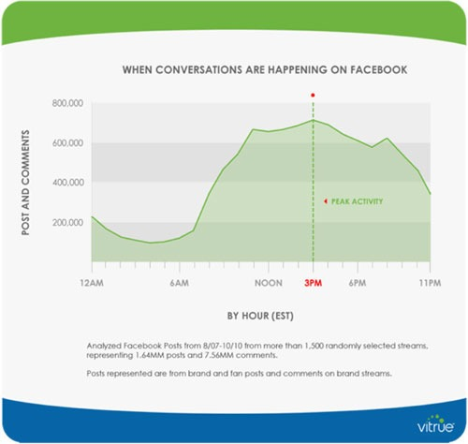

Slide 19
Chosen Parameters for Training Data
Parameter | spreadChance | stifleChance | numSpreaders | contactFraction | spontaneousStifleChance
Values | .1, .5, 1 | .01, .1, .5 | 1, 5, 25 | .01, .1, 1 | 0, .1, .5

Slide 20
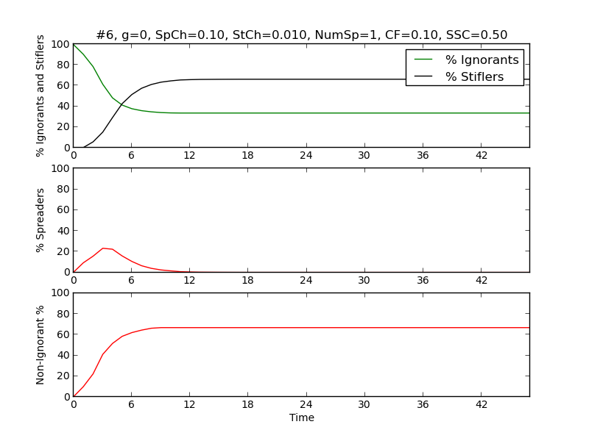
Results (243 Graphs)

Slide 21
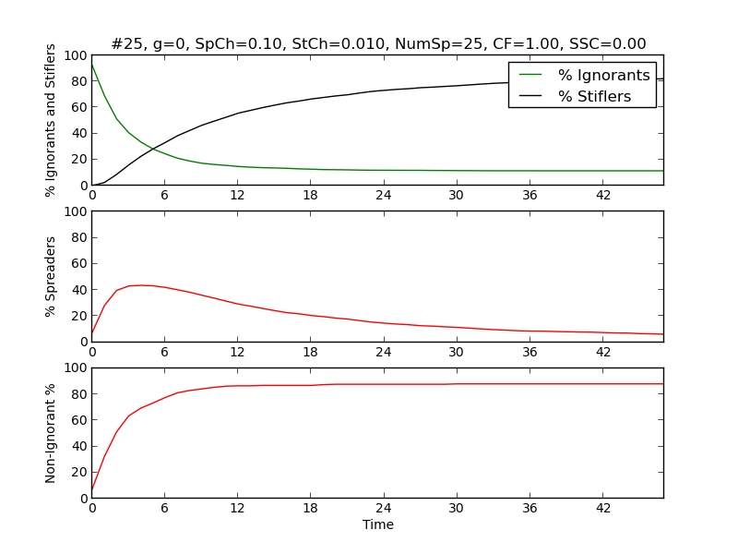
More Results

Slide 22
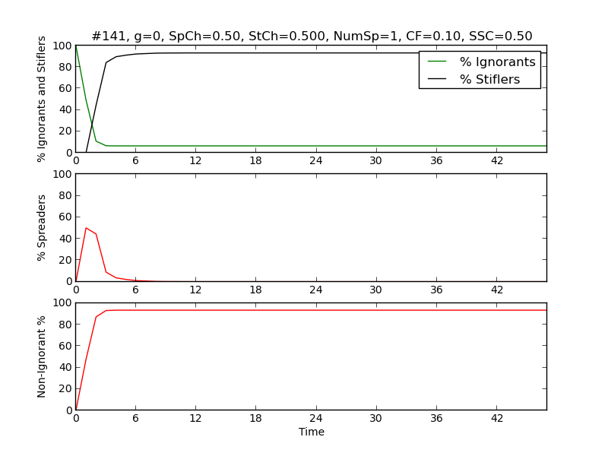
Even More Results

Slide 23
…Summary of Results
Spread Chance has high impact
Stifle Chance has medium impact
Num Spreaders has almost zero impact
Contact Fraction has medium impact
Spontaneous Stifle Chance has low impact

Slide 24
New Parameters for SHD, LLD, and LHD
Parameter | spreadChance | stifleChance | numSpreaders | contactFraction | spontaneousStifleChance
Values | .1, .5 | .001, .1 | 1, 25 | .05, .5 | 0, .2

Slide 25
Results
96 more graphs (32 for each of the 3 networks)
Automated statistics on peak Spreader Percentage and Percent Yield
Human-measured statistics on duration

Slide 26
Lots of Big Data
Graph # | SHD Time | LLD Time | LHD Time | SHD Yield % | LLD Yield % | LHD Yield % | SHD Peak SP % | LLD Peak SP % | LHD Peak SP %
1 | 9 | 8 | 6 | 92 | 86 | 97 | 72 | 74 | 96
2 | 10 | 6 | 6 | 24 | 72 | 95 | 17 | 42 | 64
3 | 12 | 9 | 6 | 98 | 99 | 100 | 84 | 86 | 80
4 | 14 | 8 | 6 | 79 | 95 | 98 | 45 | 60 | 66
5 | 12 | 9 | 6 | 88 | 95 | 98 | 83 | 74 | 75
6 | 8 | 8 | 4 | 72 | 74 | 94 | 41 | 40 | 63
7 | 6 | 10 | 4 | 98 | 99 | 100 | 89 | 85 | 78
8 | 6 | 6 | 5 | 93 | 93 | 98 | 56 | 53 | 64
9 | 2 | 6 | 3 | 9 | 56 | 85 | 10 | 24 | 42
10 | 1 | 6 | 3 | 13 | 54 | 86 | 10 | 19 | 42
11 | 6 | 8 | 4 | 42 | 68 | 91 | 12 | 23 | 43
12 | 8 | 6 | 5 | 27 | 66 | 89 | 14 | 22 | 42
13 | 1 | 4 | 6 | 53 | 52 | 87 | 47 | 25 | 38
14 | 2 | 5 | 4 | 52 | 52 | 87 | 40 | 22 | 38
15 | 3 | 4 | 4 | 81 | 74 | 89 | 40 | 23 | 38
16 | 3 | 4 | 3 | 85 | 72 | 90 | 40 | 24 | 39
17 | 6 | 2 | 3 | 98 | 97 | 99 | 89 | 93 | 92
18 | 6 | 2 | 2 | 79 | 93 | 100 | 64 | 76 | 84
19 | 3 | 3 | 2 | 98 | 99 | 100 | 97 | 96 | 95
20 | 3 | 2 | 2 | 98 | 100 | 100 | 82 | 85 | 85
21 | 6 | 3 | 2 | 98 | 97 | 98 | 96 | 93 | 91
22 | 3 | 3 | 2 | 95 | 99 | 98 | 73 | 78 | 76
23 | 3 | 2 | 2 | 98 | 100 | 100 | 97 | 96 | 92
24 | 2 | 2 | 2 | 98 | 100 | 100 | 83 | 82 | 77
25 | 2 | 3 | 2 | 74 | 90 | 98 | 67 | 66 | 58
26 | 3 | 3 | 2 | 69 | 88 | 99 | 52 | 60 | 55
27 | 3 | 3 | 2 | 98 | 99 | 100 | 57 | 59 | 52
28 | 3 | 3 | 2 | 95 | 99 | 100 | 53 | 56 | 53
29 | 2 | 3 | 2 | 85 | 88 | 100 | 75 | 62 | 75
30 | 1 | 2 | 2 | 85 | 90 | 97 | 67 | 63 | 76
31 | 3 | 2 | 2 | 96 | 98 | 100 | 67 | 40 | 75
32 | 2 | 2 | 2 | 96 | 98 | 99 | 65 | 45 | 75

Slide 27

Now what? …Taylor Expansion?

Slide 28
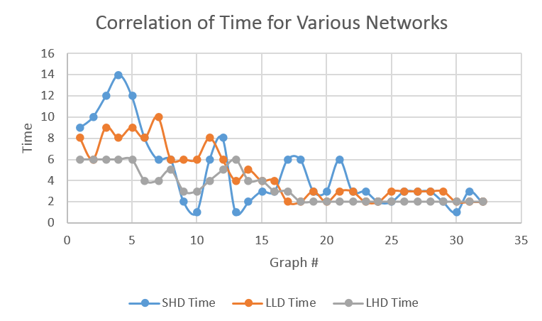

Slide 29
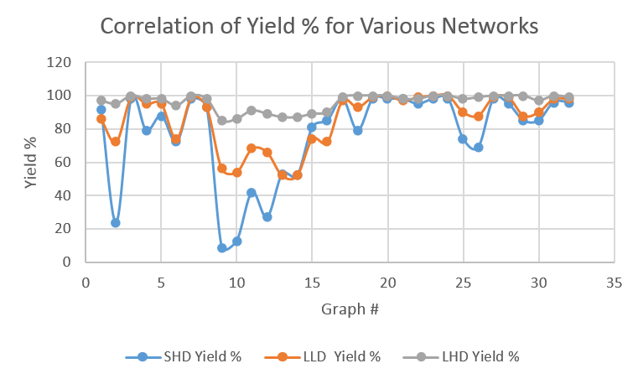

Slide 30
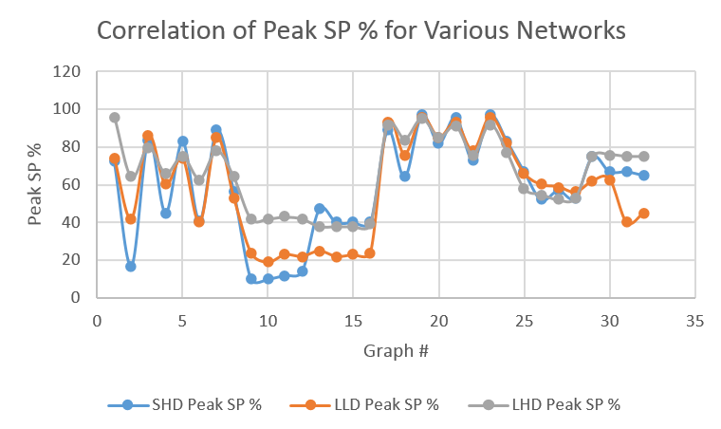

Slide 31
Conclusion
Similar patterns in different types of networks
So what?

