Slide 1

HACK4 TEAM "TRIPLE T"
TELLING TOOL TALES
Optimize Royal Navy Fleet Air Arm's aircraft availability by efficiently managing tools, minimizing losses, and saving resources through effective measures against missing tools.

Slide 2

HACKING FOR MOD
Total number of interviews: 20
Problem Sponsor: CPO Nick Astill
Industry Mentor: LT CDR Thomas Blacburn
Notes:
You should design your own unique branding for these slide decks. You could include:
A logo;
Unique team name;
Background imagery.
This slide should always include the number of beneficiaries you have spoken to that week and the total number you have spoken to for the duration of the module.

Slide 3
PROBLEM STATEMENT
Royal Navy Fleet Air Arm Tool Controller needs a more efficient method of managing their tools
and equipment in order to save significant time and resource and ensure greater aircraft
availability across the Fleet Air Arm.
Notes:
Talk the class through the key changes you have made to your problem and a top-level overview of the reasons why you made these changes.
Remember to build a narrative around your problem and learn how to make your peers and the teaching team care about it.

Slide 4






RNAS Culdrose Current Tool Check-in/Out Process
Step Two
Step Three
Toolbox checked out. Currently in use for aircraft maintenance.
Change of shift without checking toolbox in for the next shift to checkout.
Step One
Step Four
Toolbox content thoroughly checked and confirmed complete before checkout.
Toolbox is checked back in at the end of the day..
© COMMON MISSION PROJECT 2024

Slide 5
UPDATED PROBLEM STATEMENT
An efficient method of reducing the frequency of missing tools to the barest minimum, thereby encouraging management of tools and equipment to save significant time and resource and ensure greater aircraft availability across the Fleet Air Arm.
Notes:
Talk the class through the key changes you have made to your problem and a top-level overview of the reasons why you made these changes.
Remember to build a narrative around your problem and learn how to make your peers and the teaching team care about it.

Slide 6

Failure to Return Tools to Toolbox After Use.
Inter-Shift Tools Sharing Following Checkout.
The lack of a rigorous check-in procedure for shared toolboxes across shifts can cause tools to be lost or misplaced.
Absence of Inter-Shift Toolbox Inspection.
The absence of a systematic inspection process for toolboxes between shifts, ensuring all tools are accounted for, properly stored, and ready for use.
High pressure job at hand
Causes
© COMMON MISSION PROJECT 2024

Slide 7



Stakeholder Mapping
SENIOR LEADER
Air Engineer Officer
SABOTEUR
Organisation
BUY-IN/SUPPORT
Maintenance Engineers
Tool Controller
Chief petty officer
Able Rating
Air Engineer Officer
ACTION OFFICER
Chief Petty Officer– Nick Astill
BENEFICIARIES + USERS
Engineers, Pilots, Chief petty officer, Able Rating, Mechanical Supervisor
Warrant Officer
TECHNICAL EXPERTS
Senior Maintenance Rating - Adien Lagallez​
KEY PARTNERS
Problem Sponsors(CPO)
Industry Mentor(LT Thomas Black Born)
Military Adviser(LT Sean Parr )
Common mission project (Program lead Emma Pearson)
.

Slide 8
Mission Model Canvas
Key Partners Problem Sponsors(Air Engineer CPO) Industry Mentor(LT Thomas Black Born) Military Adviser(LT Sean Parr ) Common mission project (program lead Emma Pearson) | Key Activities Interviews. Process Analysis. Research. | Value Proposition Quicker fixes. Tertiary Improved working environment – All Beneficiaries Aircraft schedules are promptly met - Primary Cost efficiency - Secondary Better manpower allocations. - Primary and Secondary | Buy-in and Support Maintenance Engineers Tool Controller Chief petty Officer Able Rating Warrant Officer Air Engineer Officer | Beneficiaries PRIMARY Tool Controller Aircraft Engineer Leading Hand (Issue Office) Mechanical Supervisor SECONDARY Chief petty Officer Warrant Officer TERTIARY Able Rating (Issue Office) Port Watch Officer Starboard Watch Officer
 | Key Resources Interviewees. Visit to RNAS to observe the process. Visit to Yeovilton base. |  | Deployment Able Rating Chief Petty officer Issuing Officer Mechanical Supervisor Port Watch Officer
Mission Budget/Cost The financial Resources available to RNAS for maintenance. |  | Mission Achievement An efficient tool control procedure - Tertiary Beneficiaries More robust workforce - Secondary Beneficiaries Greater availability of naval aircraft – Primary Beneficiaries.
Notes:
Talk the class through the key changes you have made to your Mission Model Canvas in a top-level overview (your presentation is short and you will not have the time to over every detail of this - so, what are the key things your audience should know?). Highlighting changes offers a visual way to show the development of your thinking and the key changes week on week.
Colour code your beneficiaries and match these to the value proposition box

Slide 9
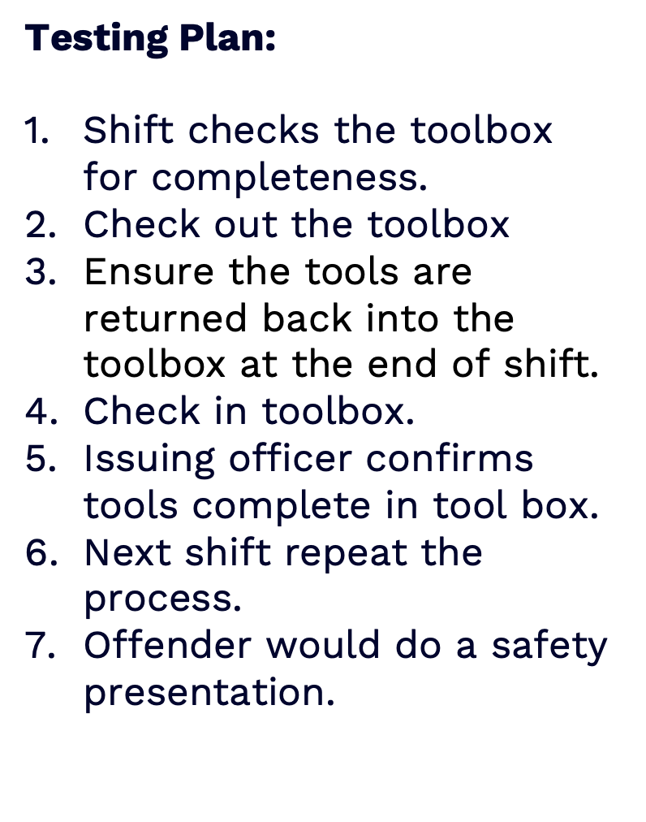
Minimum Viable Product (MVP)
Benefits:
Cost Effective.
Easy to implement.
Easy to maintain.
Reduces the frequency of missing tools.
Accountability
System
Notes:
Talk the class through what’s next. This might be an opportunity to:
Demonstrate an MVP and how you will test it and, OR;
Identify hypotheses you need to test, who you will test it with and what questions you will ask to test it.

Slide 10
Value Proposition Canvas
Value proposition: Tool Accountability
Beneficiary Jobs • Aircraft Maintenance Engineers/Technicians
Pains • Constant misplacement of tools. • Time wasted searching for tools. • The team's significant effort in tool searches. • Grounded aircraft make pilots miss out on flight trainings.
Gains Streamlined workflow in aircraft maintenance. Reduced stress of tool searches. Increased aircraft readiness. Easy Integration with existing system.
Products and Services Accountability Systems | Gain Creators Workflow optimization through streamlined tool management. Improved morale through readily available and accounted-for tools. Seamless integration with current processes. Aircraft delays eliminated.
 | Pain Relievers Accountability system to reduce lost tools significantly. Tool check-ins/check-outs after each shift to cut search time. Awareness on effects of lost tools.

Slide 11
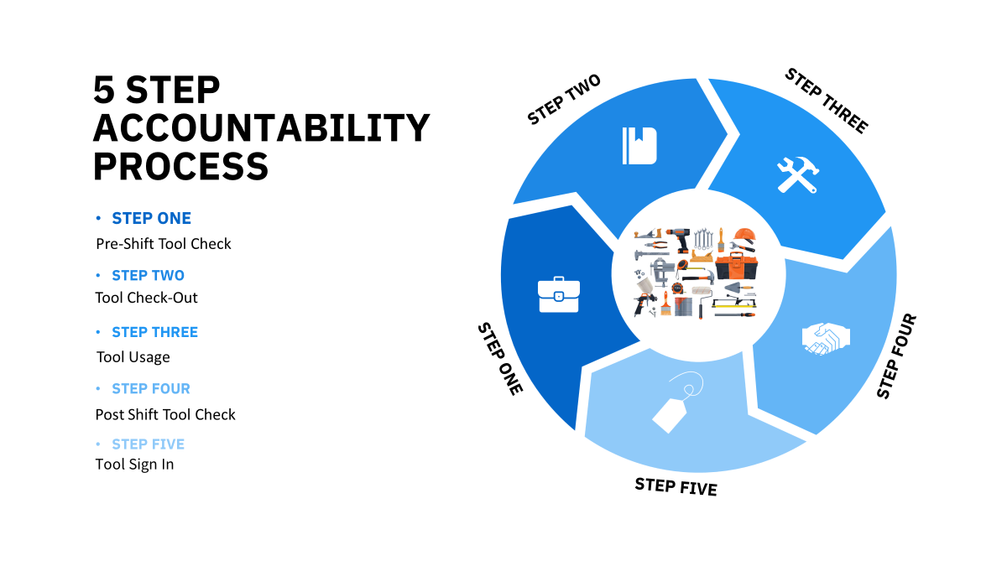
Notes:
Talk the class through the key changes you have made to your problem and a top-level overview of the reasons why you made these changes.
Remember to build a narrative around your problem and learn how to make your peers and the teaching team care about it.

Slide 12
Process Journey
Lost Tools Identified as significant issue
Information Gathering
Acccountability Issue Identified
Trial System – Currently ?
External Contacts/ Resources
Team Creation/ Visit to Culdrose RNAF
Weeks 4/5
2
MVP –Reflective Tape- Idea Created and further rejected.
Weeks 1-3.
1
Problem
Statement
Yeovilton Visit
3
Weeks 6/7
Discover trial system was a demo and too expensive.
Improve People processes
H&S Presentation
Final Presentation
4
Collate Findings.
DASA presentation
Potential Future Project for upgrade to paper system?

Slide 13






MVP - Presentation
Oh where oh where has that tool gone?!!
On this occasion it took ten man hours to look for the tool I misplaced
I am responsible
How did I make others feel?!
Be the change!
What behaviors should we adapt to help alleviate the problem within our current structure.
‘Team Triple T’ 2024 – University of Plymouth

Slide 14






Did you feel like this?
Maybe not so extreme, maybe worse!
dum de dum
hmm
Ho hum
Don’t be this one!
Not paying attention to your tools and leaving them behind.
REMEMBER YOUR PART
It’s the little things
Your mindfulness can save hours of
Everyone’s precious time! Don’t share between teams
Mindfulness costs nothing!!
Be this one!
Happy and going home and knows where all the tools are and I shouldn’t have to come back!
‘Team Triple T’ 2024 – University of Plymouth

Slide 15
Conclusion
In conclusion, our comprehensive fieldwork, including visits and interviews at RNAS Culdrose and Yeovilton, provided us with profound insights into the challenges faced by the Fleet Air Arm, particularly at RNAS Culdrose. Our in-depth analysis and comparison of the tool management systems revealed a significant gap in tool accountability when contrasted with the practices at RNAS Yeovilton. The core issue identified was the absence of a robust mechanism to ensure accountability for tools, leading to inefficiencies and operational delays. By proposing and implementing a tailored accountability system, informed by our findings and the successful practices at Yeovilton, we anticipate a transformative impact on the Fleet Air Arm's operations. This strategic intervention is expected to streamline tool management processes, significantly reduce resource wastage, and most critically, enhance the availability of aircraft. The adoption of this system promises not only to resolve the current operational inefficiencies but also to set a new standard for tool management within the Royal Navy, thereby supporting its mission with greater effectiveness and reliability.
Notes:
A good presentation is concise, engages the audience in a clear, compelling narrative and focuses primarily on the problem. Therefore, be careful not to use too many deep dive slides for one pitch.

Slide 16
THANK YOU!

