Slide 1
BUSINESS PRESENTATION
Dataset Inspection & Customer Churn Insights
Week One Assignment

Slide 2
1. Business Context
Business issue: customer churn reduces recurring revenue and customer lifetime value.
Objective: inspect the customer dataset, identify churn patterns and translate them into business actions.
Focus: customer profile, service usage, contracts, payment behaviour, charges and tenure.

Slide 3
2. Dataset Inspection
7,043 customer records across 21 fields.
Overall churn: 26.5% (1,869 customers).
No duplicate rows were identified.
11 TotalCharges values are missing and require validation.
Average monthly charge: $64.76; average total charge: $2,283.30.
The workbook combines raw data with analysis outputs; separating these layers is recommended for future reporting.

Slide 4
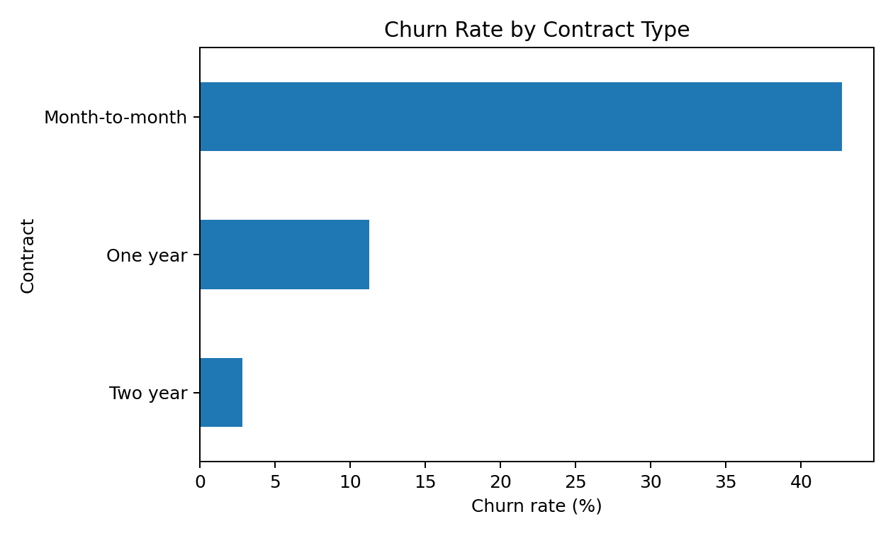
3. Headline Finding: Contract Type
Month-to-month churn: 42.7%
One-year churn: 11.3%
Two-year churn: 2.8%
Contract structure is the clearest retention lever in the dataset.

Slide 5
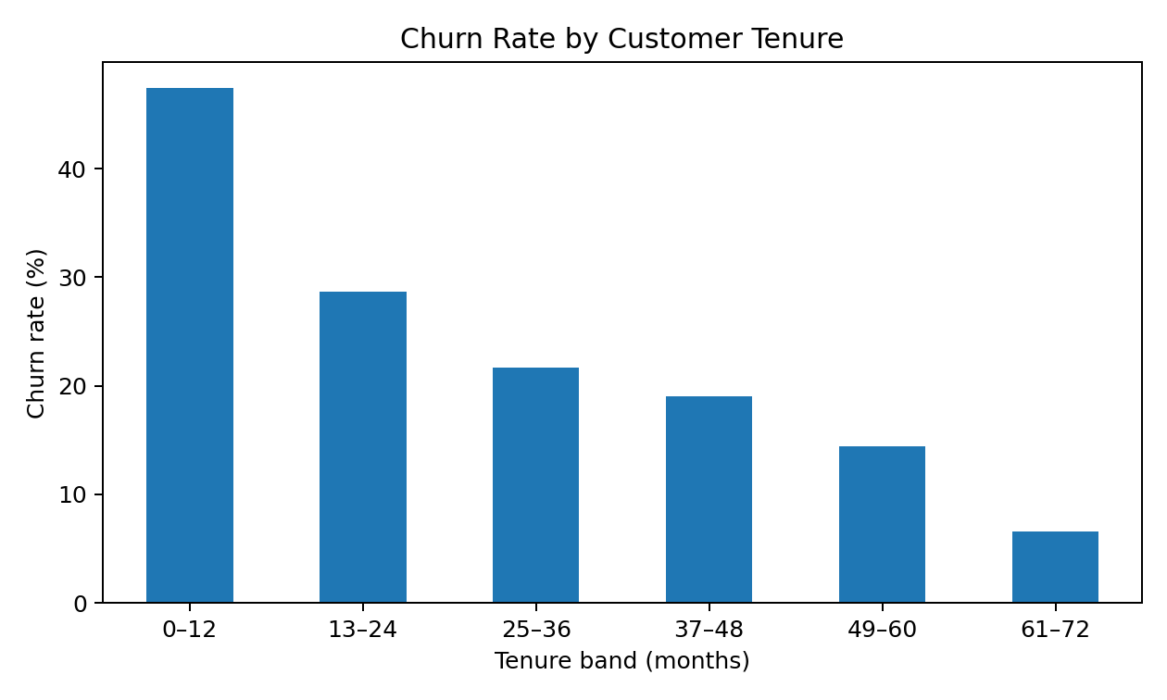
4. Churn Concentrates Early
First 12 months: 47.4% churn
61–72 months: 6.6% churn
Retention investment should be front-loaded into onboarding and the first year.
Longer tenure is associated with lower churn.

Slide 6
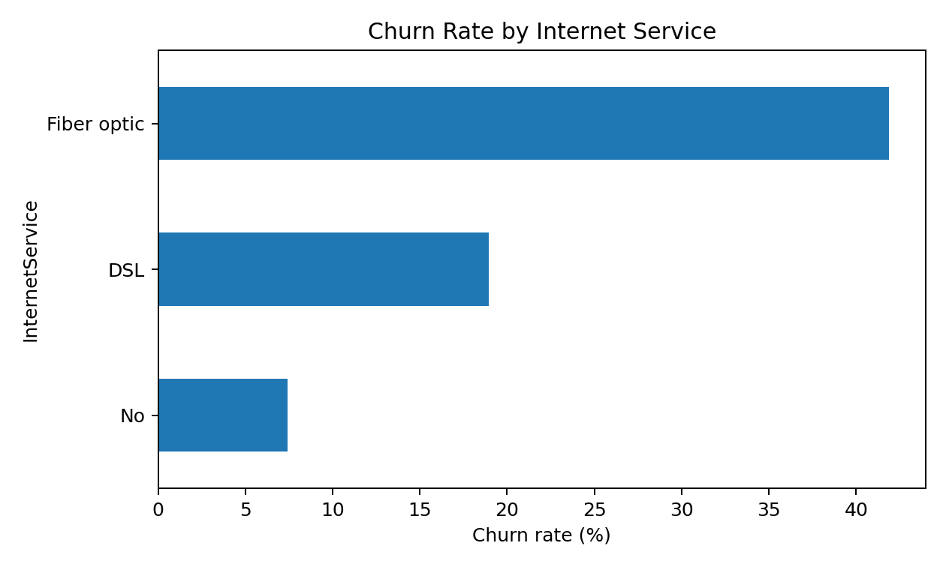
5. Service Segment Risk
Fibre-optic churn: 41.9%
DSL churn: 19.0%
No-internet-service churn: 7.4%
Premium fibre customers may represent a value, reliability or service-experience gap.

Slide 7
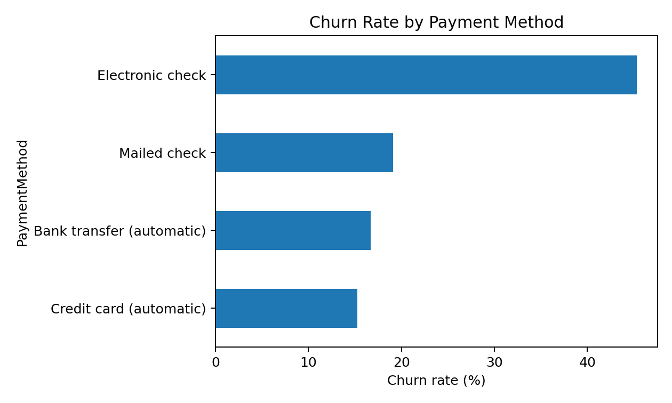
6. Payment Behaviour Matters
Electronic check: 45.3% churn
Automatic credit card: 15.2%
Automatic bank transfer: 16.7%
Encouraging automatic payments may reduce friction and improve retention.

Slide 8
7. Business Risks
Revenue concentration: higher-value fibre customers are also exposed to high churn.
Contract volatility: a large month-to-month customer base can leave with limited notice.
First-year risk: early churn reduces lifetime value and raises acquisition requirements.
Payment risk: electronic-check users are a high-risk behavioural segment.
Service-value risk: lack of add-on support services is associated with higher churn.

Slide 9
8. Recommended Actions
Target month-to-month customers for contract conversion with tailored offers.
Launch first-year retention checkpoints at months 1, 3, 6 and 12.
Audit fibre pricing, reliability, complaints and perceived value.
Promote automatic payment migration with simple incentives.
Use add-on bundles—security, support and protection—as retention tools.
Create a monthly churn dashboard with customer-risk segmentation.

Slide 10
9. Management Takeaway
Churn is not evenly distributed; it is concentrated in identifiable customer segments.
The strongest actionable signals are contract type, tenure, internet service and payment method.
The biggest opportunity is proactive retention—not waiting until customers are already leaving.
A targeted retention strategy can protect recurring revenue while improving customer experience.

