Slide 1
HealthConnect Clinic
Reducing Missed Appointments Through Data-Driven Insights
AnalystLab Africa Experience Lab | Data Analytics Track
Final Presentation - Week 8

Slide 2
The Problem
HealthConnect Clinic manages appointment-based healthcare services, but loses a significant share of its booked capacity to patients who simply don't attend. Understanding why - and which patients are most at risk - is the foundation for any operational fix.
51.2%
of completed appointments end in a no-show
Central project question:
5.3%
“How can HealthConnect Clinic use data to reduce missed appointments and improve the patient support experience?”
are cancelled in advance - no-shows are the real problem

Slide 3
The Data
5,000
fictional, anonymized appointment records spanning Jan 2025 to Jun 2026
0
duplicate appointment IDs or logical inconsistencies found
3
fields with missing values (distance, waiting time, reminder channel) - all explainable, none treated as errors
11
independent tests run in Week 7 to confirm every figure matches the raw data - all passed

Slide 4
Key Finding: Distance to Clinic
The strongest predictor of a missed appointment found across the entire project - confirmed independent of age group and appointment type.
21.3pp
spread from nearest to farthest band
70.0%
no-show rate for patients 30km+ away

Slide 5
Key Finding: Risk Factors Compound
Distance and prior no-show history don't just add together - patients with both factors show the highest risk of any segment identified.
Distance Band | First-Time | Repeat No-Show
0-5 km | 44.9% | 55.3%
10-20 km | 46.6% | 60.5%
20-30 km | 53.8% | 64.0%
30+ km | 64.1% | 77.4%
77.4%
no-show rate: 30km+ away AND a prior no-show (n=31)
This is the single highest-risk, most actionable patient segment identified - a clear candidate for manual confirmation calls rather than automated reminders alone.

Slide 6
Key Finding: Reminders Aren't Uniform
The same reminder produces very different results depending on appointment type - a blanket policy leaves value on the table.
11.8pp
reminder effect for Diagnostic Test appointments
3.6pp
reminder effect for General Consultation - far weaker

Slide 7
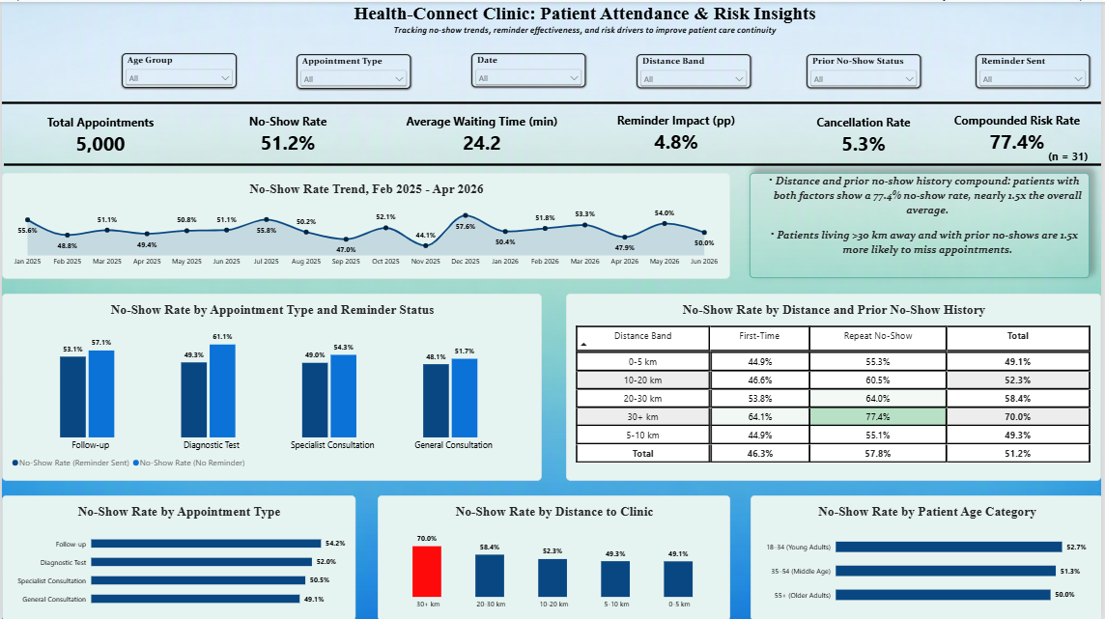
The Dashboard
Built in Power BI, independently tested in Week 7 - every value on this dashboard matches an independent recalculation from the raw data.

Slide 8
Recommendations
1
Prioritize guaranteed reminder coverage for Diagnostic Test appointments first - the largest return on reminder effort of any type.
2
Introduce a distance-based intervention (telehealth follow-up or transport support) for patients living 20km or more from the clinic.
3
Flag the compounded-risk segment (30km+ and prior no-show) for manual confirmation calls rather than automated reminders alone.
4
Continue sending reminders to patients with a no-show history - the effect is, if anything, slightly larger for this group.

Slide 9
Limitations & Cross-Track Contribution
Limitations
Cross-Track Contribution
Dataset is fictional and anonymized - findings need validation against real clinic data.
All relationships are correlational, not causal.
The compounded-risk finding rests on a small sample (n=31).
Missing values in distance and waiting time were left blank, not imputed.
Prepared a ranked feature handoff for Data Science: distance, prior no-show history, and reminder status by appointment type.
Independently re-verified every figure in that handoff in Week 7 - zero discrepancies.
Completed solo this placement - documented honestly as a prepared, self-verified handoff rather than a two-way exchange.

Slide 10
Thank You
Distance and appointment history are the strongest, independently-verified drivers of missed appointments at HealthConnect Clinic - and both point toward specific, actionable interventions.
HealthConnect Clinic Experience Lab | AnalystLab Africa | Data Analytics Track

