Slide 1
HUMAN RESOURCES ANALYSIS
Workforce Retention,
Performance & Turnover Findings
311 employees | 2006–2018 | Power BI analysis
Prepared for Human Resources Management • July 2026
BY: Onwuka Augustina Chinonye.

Slide 2
THE BUSINESS PROBLEM
We collect HR data but can't yet answer why people leave
Why employees leave the organization
1
Which departments experience the highest turnover
2
Whether compensation and engagement levels are competitive
3
How recruitment sources affect employee quality and retention
4
Which workforce trends require immediate managerial attention
5
HR Workforce Analytics
2

Slide 3
AIM & OBJECTIVES
Turning HR data into decisions HR can act on
Analyze workforce trends, performance, and retention patterns to generate actionable insight for talent management, employee satisfaction, and organizational performance.
01
02
03
04
Clean & prepare employee records
Analyze workforce demographics
Evaluate retention & turnover drivers
Assess performance across teams
05
06
07
08
Examine salary & compensation equity
Rate recruitment source effectiveness
Explore engagement & satisfaction
Generate strategic recommendations
HR Workforce Analytics
3

Slide 4
DATA & METHOD
From messy records to an analysis-ready dataset
DATASET
CLEANING & METHOD
Human Resources Data Set (Kaggle, rhuebner)
Removed 8 ID columns; trimmed duplicate position labels
Original size
311 rows × 36 columns
Fixed DOB parsing errors (two-digit year → correct century)
Cleaned size
311 rows × 30 columns
Preserved legitimate blanks (207 active employees)
Time span
Hires 2006–2018
Back-filled 8 missing Manager IDs from matching manager names
Active employees
207 (66.6%)
Terminated employees
104 (33.4%)
Standardized odd TermReason entries; removed duplicates
Departments covered
6
Engineered tenure, age bands & DAX KPI measures in Power BI
HR Workforce Analytics
4

Slide 5
WHERE WE STAND TODAY
The headline numbers
311
33.4%
66.6%
4.11 / 5
Total Employees
Attrition Rate
Retention Rate
Avg. Engagement Score
Attrition is not random . it is concentrated by department, by tenure stage, and by recruitment source. The rest of this deck walks through the evidence.
HR Workforce Analytics
5

Slide 6
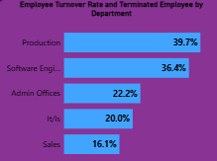
FINDING 1 · WHICH DEPARTMENTS EXPERIENCE THE HIGHEST EMPLOYEE TURNOVER RATES
Production drives most of the company’s turnover
WHY IT MATTERS
Production is 67% of the workforce (209 of 311 employees) and has the highest turnover rate at 39.7%.
Software Engineering is smaller (11 employees) but runs a close second at 36.4%.
A modest improvement in Production's turnover moves the whole-company number more than any other single intervention. The company should prioritize retention actions in Production first. That could include supervisor coaching, pay review, workload review, and targeted stay interviews.
HR Workforce Analytics
6

Slide 7
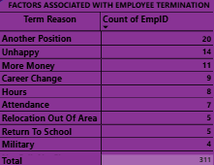
FINDING 2 · WHY EMPLOYEES LEAVE
Most exits are voluntary and opportunity-driven
WHY IT MATTERS
Most attrition is voluntary and opportunity-driven rather than performance-driven, meaning it is largely preventable through competitive pay, career pathing, and engagement rather than discipline.
Introduce structured stay interviews (one-on-one conversation) and career development programs that provide employees with opportunities for promotions, cross-functional transfers, job rotation and benchmark pay for roles where "more money“ and "another position" are recurring exit reasons.
40 of 104 terminations (Another Position + More Money + Career Change) are career-motivated moves, far more than performance-related exits (4).
HR Workforce Analytics
7

Slide 8
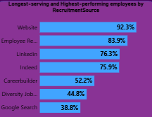
FINDING 3 · SOURCING QUALITY
Where you hire from predicts who stays
WHY IT MATTERS
Average performance is almost identical across every source (2.8–3.2 on a 4-point scale). But retention swings from 38.8% (Google Search) to 92.3% (Website) a 53-point gap for equally capable hires.
Since performance is similar across sources but retention is not, recruitment channel choice can significantly reduce attrition with a low-cost as referrals typically cost less per hire than paid channels.
Shift recruiting spend and effort toward Employee Referral and direct Website applications, and audit the sourcing/screening process used for Google Search and Diversity Job Fair candidates to understand why early attrition is higher there.
HR Workforce Analytics
8

Slide 9
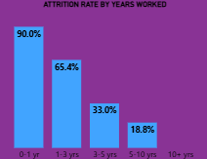
FINDING 4 · THE BIGGEST SIGNAL
Attrition risk is almost entirely a first-year problem
90%
Early tenure, particularly among employees with under 1 year of tenure is by far the highest-risk period for departure. “Tenure” not “satisfaction” not “pay” is the strongest predictor of who leaves in this dataset.
Invest unequally in first-year onboarding, 30/60/90-day check-ins, and early mentorship. A small improvement in first-year retention will have a much larger effect on overall attrition than efforts aimed at long-tenured staff.
HR Workforce Analytics
9

Slide 10
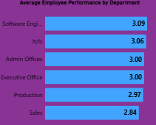
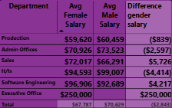
FINDING 5 · PERFORMANCE & PAY
Performance is consistent; pay gaps are department-specific
A moderate, department-dependent pay gap exists rather than a uniform, organization-wide one
The performance spread across departments is narrow, suggesting there is no single underperforming department.
HR Workforce Analytics
10

Slide 11
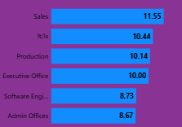
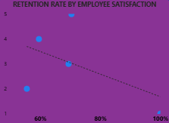
FINDING 6 & 7 · CONDUCT AND SENTIMENT
Sales Department shows the most conduct risk; satisfaction doesn't predict exits
AVG. ABSENCES BY DEPARTMENT (DAYS/YEAR)
Sales combines the lowest average performance score with the highest absenteeism and lateness
Relying on satisfaction scores alone as an early-warning system for attrition would miss the great majority of at-risk employees.
HR Workforce Analytics
11

Slide 12
FINDING 8 · MANAGEMENT
High performance and low turnover don't always travel together
Manager | Team Size | Avg. Performance | Turnover
Jennifer Zamora | 7 | 3.14 | 14.3%
Simon Roup | 17 | 3.12 | 47.1%
Janet King | 19 | 3.11 | 31.6%
Brian Champaigne | 8 | 3.00 | 0.0%
Webster Butler | 21 | 3.00 | 61.9%
Amy Dunn | 21 | 2.90 | 61.9%
John Smith | 14 | 2.71 | 21.4%
TAKEAWAY
Jennifer Zamora combines the strongest performance (3.14) with the lowest turnover (14.3%).
Webster Butler and Amy Dunn each lose 61.9% of turnover despite average performance which shows us that a retention issue, not a performance issue.
HR Workforce Analytics
12

Slide 13
PUTTING IT TOGETHER
Five patterns explain most of what's driving attrition
01
02
03
04
05
Scale
Timing
Sourcing
Sentiment
Pay
Production's size + highest average turnover make it the single biggest lever on company-wide attrition.
Attrition is concentrated in workers with 0-1year tenure (90%) which is not spread evenly across other tenure.
Recruitment channel predicts retention far more than it predicts performance.
Satisfaction & engagement scores do not predict who leaves, they can't be the early-warning system.
A modest, department-specific gender pay gap exists and needs a controlled audit.
HR Workforce Analytics
14

Slide 14
RECOMMENDATIONS
Eight actions, sequenced by impact vs. effort
Fix the first year tenure
Launch a Production retention plan
1
2
Structured onboarding with 30/60/90-day check-ins and assigned mentors.
Largest headcount and highest turnover. This is the single biggest lever available.
Rebalance recruiting spend
Coach high-turnover managers
3
4
Shift toward Employee Referral & Website; audit Google Search / Diversity Job Fair funnels to understand why early attrition is highest there.
Pair managers like Webster Butler & Amy Dunn that has high performance and high turnover rate with mentors like Jennifer Zamora.
Commission a pay-equity audit
Redesign the engagement survey
5
6
Investigate department-level gaps controlling for role, tenure & performance.
Current scores don't predict attrition, it capture more actionable drivers.
Review Sales workload & incentives
Operationalize the dashboard
7
8
Lowest performance + highest absenteeism warrants a combined review.
Assign ownership of KPI cards so findings are monitored, not just reported once.
HR Workforce Analytics
15

Slide 15
OUR RECOMMENDATION TO THE COMPANY
Treat the first 12 months of employment as the top retention priority and fund it accordingly.
The data is unambiguous: 90% of attrition risk sits in year one, and it is concentrated in Production and in specific recruitment channels. It is not spread evenly across tenure, satisfaction, or pay. Every dollar spent improving early-tenure onboarding, Production retention, and sourcing mix will outperform broad, undifferentiated HR spending.
Approve a structured first-year onboarding program with named ownership
Fund a targeted Production retention initiative
Rebalance recruiting budget toward Referral & Website sourcing
Re-run this analysis quarterly using the live Power BI dashboard
HR Workforce Analytics
16

Slide 16
Thank You
Questions & Discussion
Full findings, methodology and data notes are documented in the companion HR Analytics Report.

