Slide 1
fedora
for developers
Presented by:
Adrian “Chino” Soliard
Fedora ambassador

Slide 2
fedora for software developers
fedora workstation
Today's Programming Languages
Developers
Today's Technologies
Some tools
Joining all that

Slide 3

fedora workstation

Slide 4
fedora workstation – what?
Since F21: Fedora.Next
  Workstation (or client, desktop)
  Server
  Cloud (minimal, for private and public clouds)
Aimed to providing a platform for software development (from students to corporations)

Slide 5
fedora workstation – why?
Smartphones, tablets, phablets, etc., etc.
Cloud computing (PaaS, IaaS, SaaS)
What kind of user will be using Pcs soon?

Slide 6
fedora workstation – who?
CAD professionals (Engineers, Architects, etc.)
Graphics Designers
(some) Gamers
Calculists
...
Software developers
Slowly, PCs will be replaced with gadgets

Slide 7
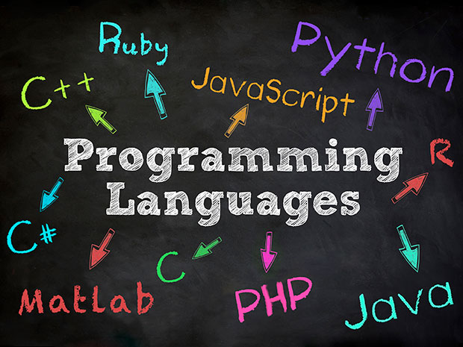

Slide 8
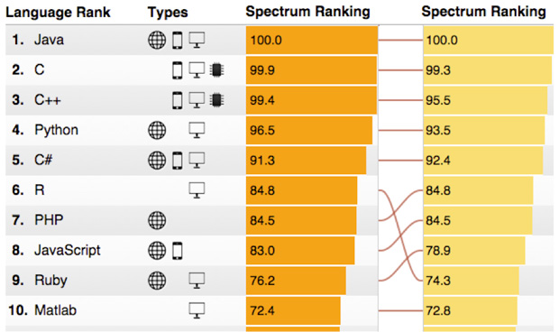
Top ten 2015 (IEEE Spectrum)
Taken from: http://spectrum.ieee.org/computing/software/the-2015-top-ten-programming-languages

Slide 9
Dev – Enterprise environment
Enterprise C/C++ Developer
  Maintenance work
  Large, old, code bases
  Often fat client guis on windows (lots) or linux (few)
Enterprise Java Developer
  Probably the bulk of enterprise developers
  New apps & maintenance
  Favor IDEs and graphical debuggers
Enterprise PHP Developer
  Mostly maintenance work
  On the left side of the sophistication curve
  Favor IDEs and graphical debuggers
Client-side Application Developer
  C# / VB / VB.net
  C/C++
  Python (linux)
Credits: Langdon White – Fedora for developers @Flock2014

Slide 10
Dev – Small shop
Small Shop PHP Developer (often Consultancy)
  Usually more cutting edge
  Looking for debuggers
  Right side of sophistication curve
  May favor IDEs (as they often come from enterprise)
Small Shop Ruby Developer (often Consultancy)
  Very cutting edge
  Favor sophisticated text editors
  Looking for CI/CD support
  Very UI/UX focused
Web App Python Developer
  Bit of a unicorn
  Increasing
Small Shop Java Developer (often Consultancy)
  Similar to Small Shop PHP Developers, shop may have both
  Debuggers & IDEs
Web App Ruby Developer
  Similar to the consultancy model
  Probably very strongly in favor of CI/CD
Web App PHP Developer
  More similar to ruby consultancy
  CI/CD
  Still leaning towards IDEs and graphical debuggers
Credits: Langdon White – Fedora for developers @Flock2014

Slide 11
Dev – Special
HPC-style C/C++/Python Developer (actual HPC, Hedge Funds, etc)
  Experiments with languages? (e.g. Go)
  Highly parallized applications with many application updates deployed to many servers
Casual programmer (scientists, researchers)
  Python (mostly)
Java Mobile Developer
Multi-target Mobile Developer
Objective-C / iOS Developer
Credits: Langdon White – Fedora for developers @Flock2014

Slide 12

Java
Today's most used language for client-server
Published by Sun (1995)
Objetc Oriented
GNU GPL licenced
WORA (write once, run anywhere)
JVM, JRE, JDK, Servlets, JSP

Slide 13
JavaScript (JS)
Interpreted language
One of the three essential tech for web content
Published in 1995
Objetc Oriented
Oracle Corp trademark

Slide 14

Python
First implementation in 1989
2.0 released on 2000; 3.0 released on 2008
Python 2.x is legacy, Python 3.x is the present and future of the language
GNU GPL licenced
Cares about code readability
Interpreted language

Slide 15

PHP
Since 1994
Server-side scripting language
Designed for web development
PHP licence (and Zend engine licence)
Interpreted language

Slide 16

Ruby
Interpreted language
Published in 1995
Based on Pearl and Python languages
Object Oriented
Ruby Licence, GPL, 2-clause BSD
RubyGems

Slide 17
Developers
are people, too...

Slide 18
Developers are people, too
Developers...
Hate wasting time
Worries about breaking the system
Love performance
Get happy when things works well

Slide 19
Today's technologies

Slide 20

WildFly (JBoss)
Java applications server
Written in Java
Implements Java EE
Runs in multiple platforms
LGPL Licence
JBoss product (Red Hat)

Slide 21

Hibernate ORM
Framework for objetcs persistence in databases
LGPL Licence
Maintained by Jboss (Red Hat inc.)
Also:
  Hibernate Search
  Hibernate Validator
  More…

Slide 22

Node.js
Published for linux in 2009
Server-side and networking apps
built on Chrome's JavaScript runtime
MIT licence (and others)
Apps are written in JavaScript

Slide 23

Django
Web design framework
Written in python
MVC
Included ORM, and more...
BSD Licence

Slide 24

Ruby On Rails
Web design framework
Written in Ruby
MVC
ActiveRecord (ORM)
MIT Licence

Slide 25
There's more...
Maven
Flask (Python)
GTK
...

Slide 26

Docker
Automates the deployment of apps inside software containers
Since 2013
Apache licence 2.0

Slide 27
Some tools

Slide 28

Eclipse IDE
Actually, the universal IDE
Various languages
Also, a framewok for other apps
Eclipse Public Licence

Slide 29
Eclipse IDE
Java
Java EE
C/C++
PHP
And Python...

Slide 30

PyDev
Python IDE for Eclipse
Django integration
Code completion
Code analisys

Slide 31

VIM
Highly configurable text editor
Improved version of vi editor
VIM Licence

Slide 32
Joining all that

Slide 33
DevAssistant
Set up your development environment
Publish your code
You only have to code
GPL2
less configuration, more code

Slide 34
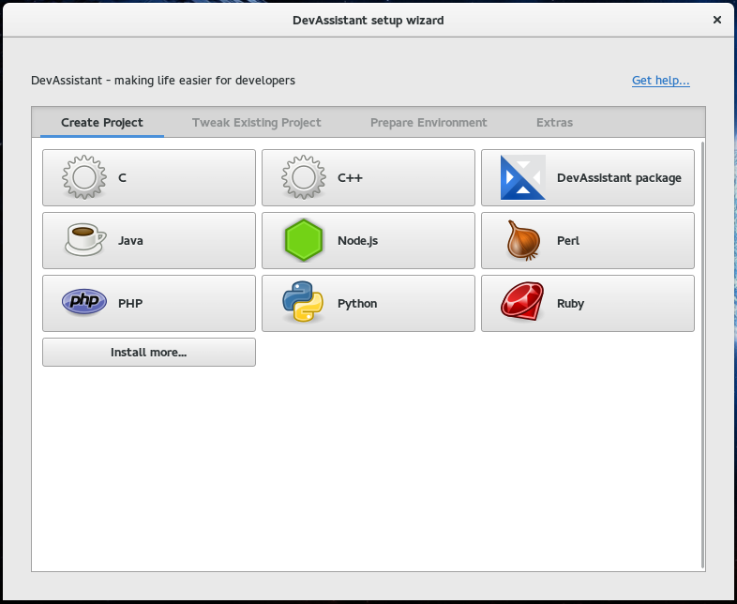
DevAssistant

Slide 35
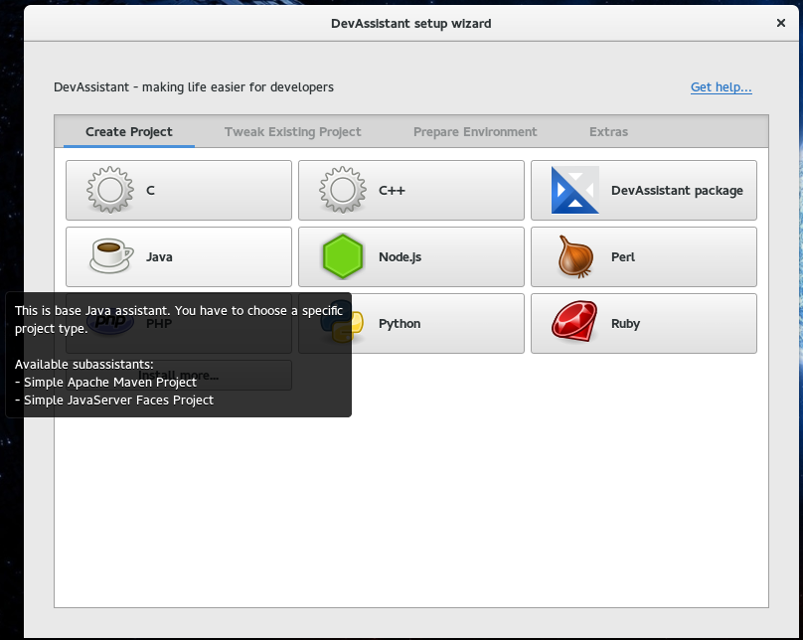
DevAssistant

Slide 36
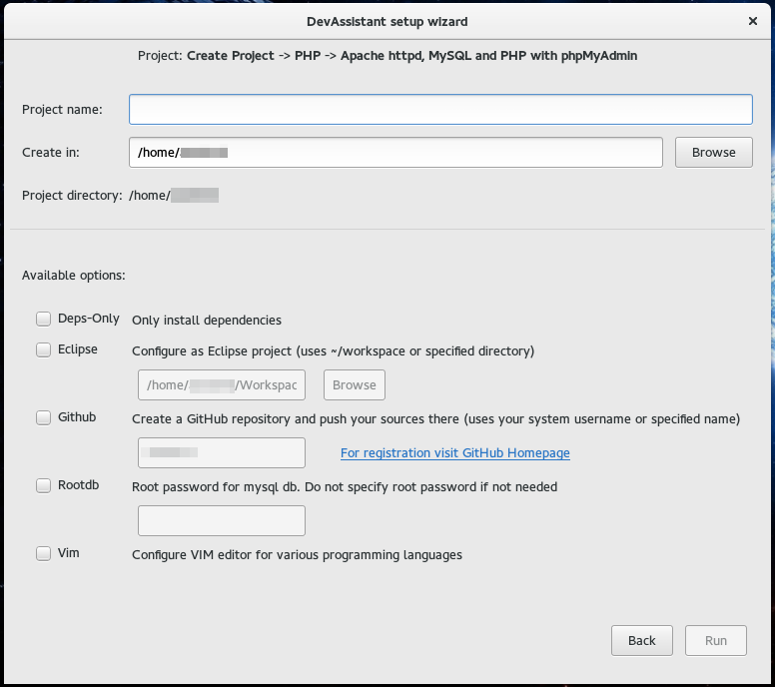
DevAssistant

Slide 37
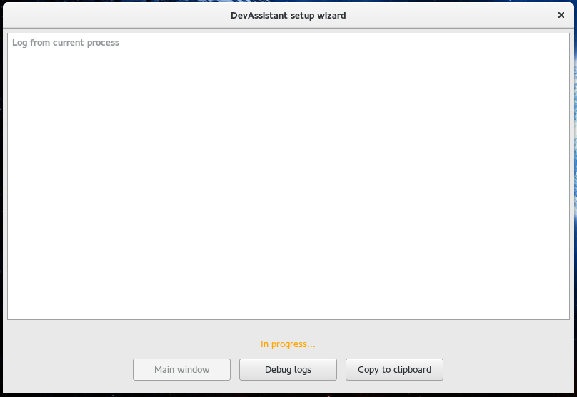
DevAssistant

Slide 38
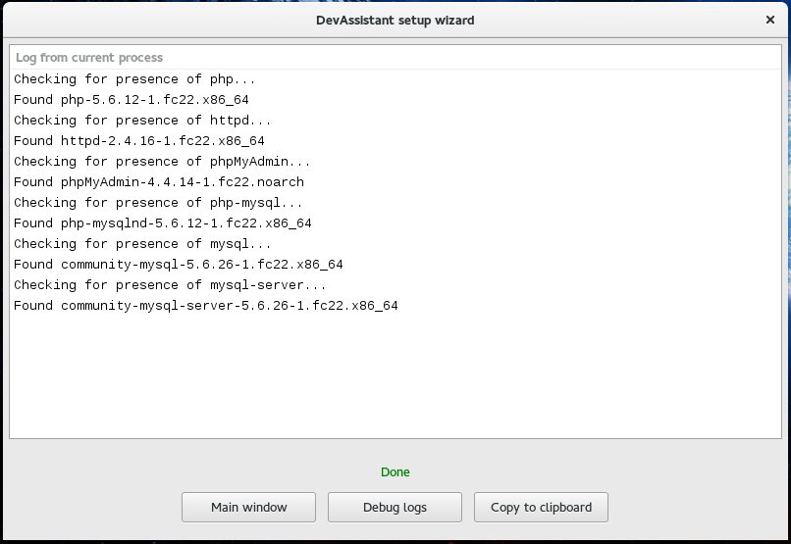
DevAssistant

Slide 39
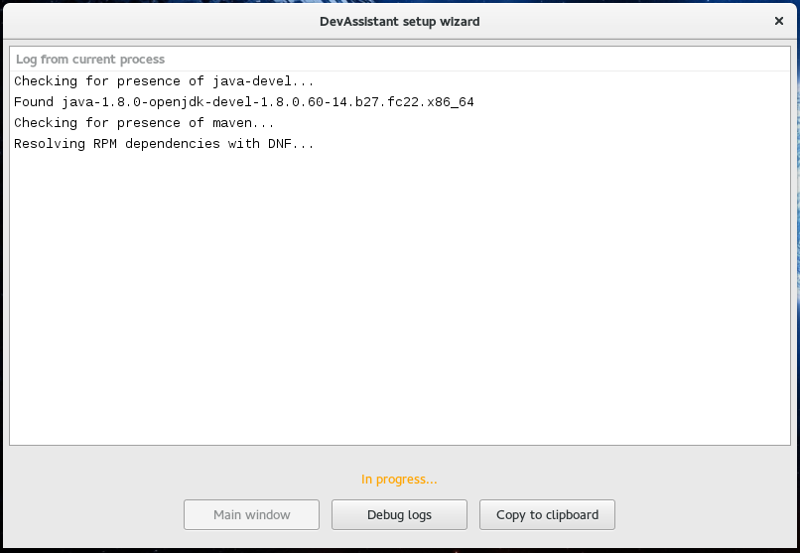
DevAssistant

Slide 40
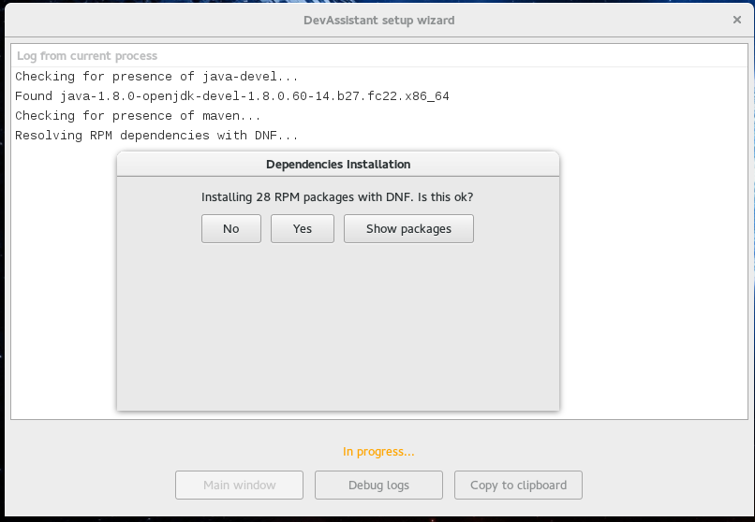
DevAssistant

Slide 41
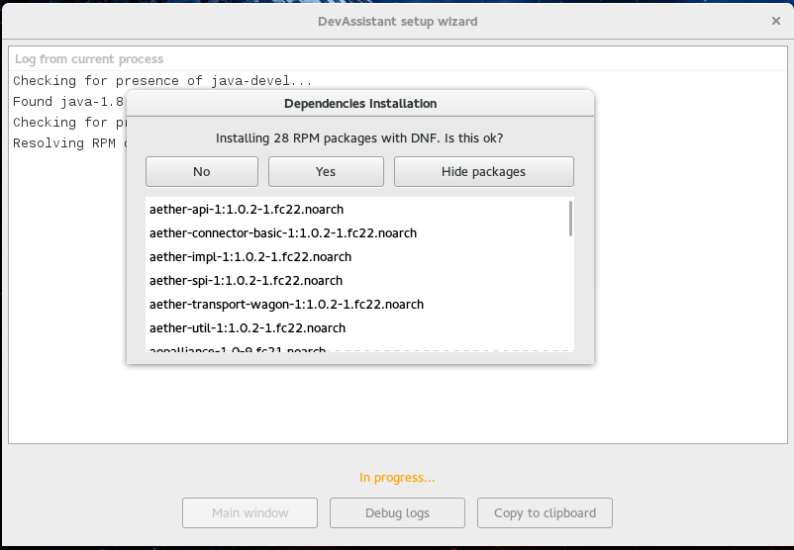
DevAssistant

Slide 42
Conclution
Fedora Workstation is aimed to developers, but can be used for all porpuses
Developers are people, too…
If you're developer, you've to try DevAssistant

Slide 43
Fedora loves Python

Slide 44
Fedora loves Python
Python is
In all Fedora infraestructure Software
Powering *.fedoraproject.org
  Turbo gears, Django, Flask
  Like, Koji, bodhi, pkgdb

Slide 45
Questions?
This presentation is licensed under a Creative Commons Attribution 4.0 International License.

Slide 46
Thanks!
Contact:
asoliard@fedoraproject.org
This presentation is licensed under a Creative Commons Attribution 4.0 International License.

