Slide 1
Hard Drive Reliability - Survival Analysis
Chinpei Tang (cptang@gmail.com)
Springboard Foundation of Data Science Capstone Project
November 11, 2016

Slide 2
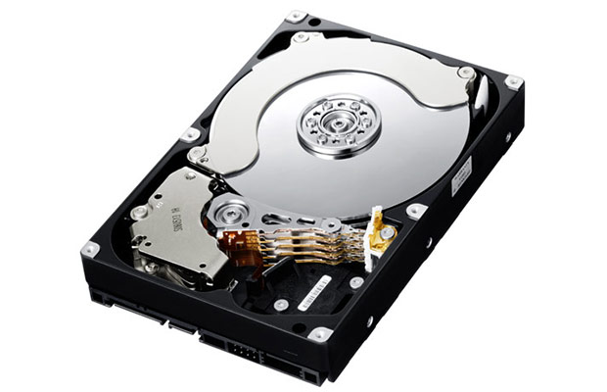
Introduction
Hard drive reliability details are important:
The data centers can also use the information to predict the risk and decide which types of hard drives they should choose to run data centers to ensure high uptime and low customer dissatisfaction.
The consumers can also use such data to make decision on which types of hard drives they should be purchasing to backup their valuable files and reducing the risk of losing them.
The hard drive manufacturers can use such information to focus on improving the key weaknesses.
The project aims at analyzing the trends of the survival period of hard drives of variety of hard drives available in the market.

Slide 3
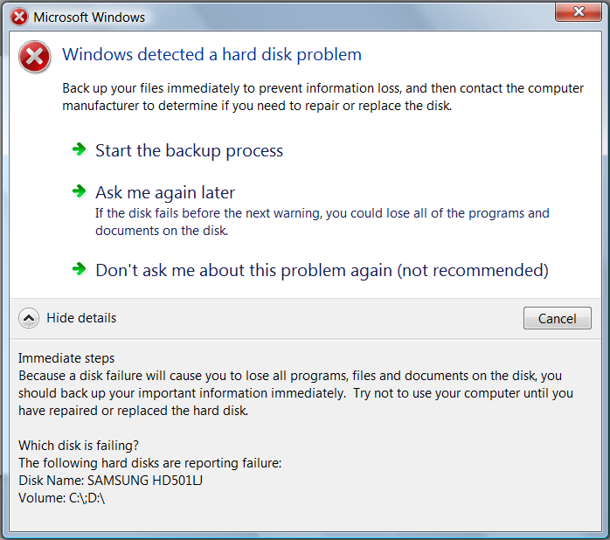
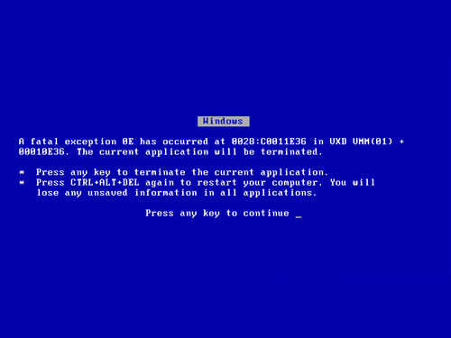
Hard Drive Failures
Predictable failures: resulting from slow processes such as mechanical wear and gradual degradation of storage surfaces. Monitoring can determine when such failures are becoming more likely.
Unpredictable failures: happening without warning and ranging from electronic components becoming defective to a sudden mechanical failure (which may be related to improper handling).

Slide 4
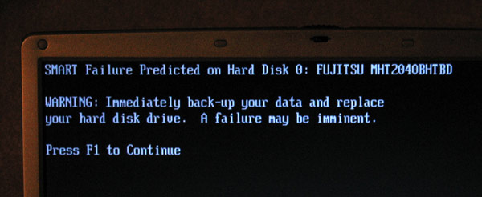
Project Goals
Understanding the failure rates of the hard drives based on its different manufacturer, models, and sizes. These may lead to the list of “high risk” hard drives that may be avoided for critical operations.
Estimate and predict the survival rates of the hard drives based on its different manufacturer and sizes. The data center can then proactively plan for the hard drive procurement and replacement to minimize inventory and maximize uptime.

Slide 5

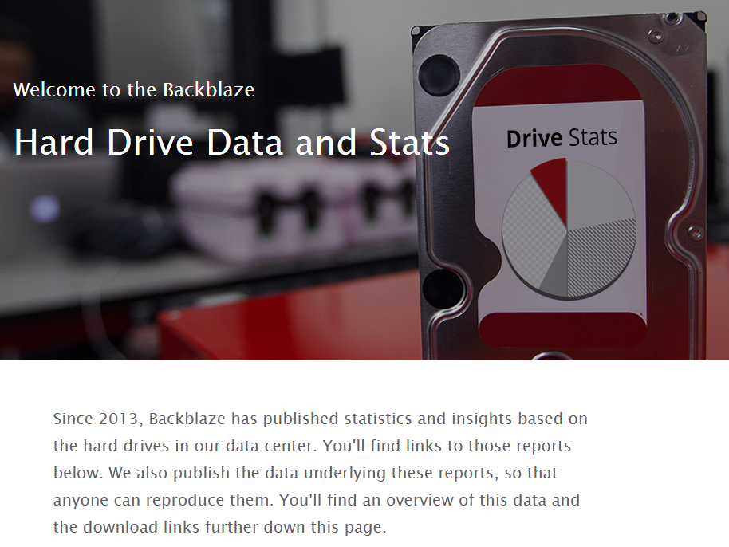
Backblaze Open Source Data
Backblaze is an online personal/business backup and cloud storage service provider, which consumes about 1000 hard drive per month.
The company wrote scripts to track the hard drive health information since 2013.
See more information: https://www.backblaze.com/blog/hard-drive-data-feb2015
The dataset is made open-source: https://www.backblaze.com/b2/hard-drive-test-data.html

Slide 6
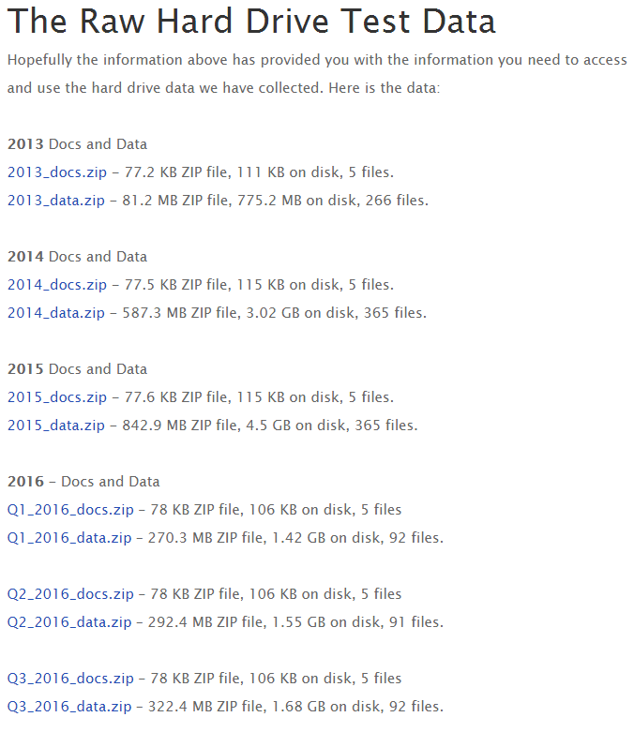
Backblaze Data Available
Data logged:
Date – The date of the file in yyyy-mm-dd.csv format.
Serial Number – The manufacturer-assigned serial number of the drive.
Model – The manufacturer-assigned model number of the drive.
Capacity – The drive capacity in bytes.
Failure – Contains a “0” if the drive is OK. Contains a “1” if this is the last day the drive was operational before failing.
2013-2014 SMART Stats – 80 columns of data, that are the Raw and Normalized values for 40 different SMART stats as reported by the given drive. Each value is the number reported by the drive.
2015-2016 SMART Stats – 90 columns of data, that are the Raw and Normalized values for 45 different SMART stats as reported by the given drive. Each value is the number reported by the drive.

Slide 7
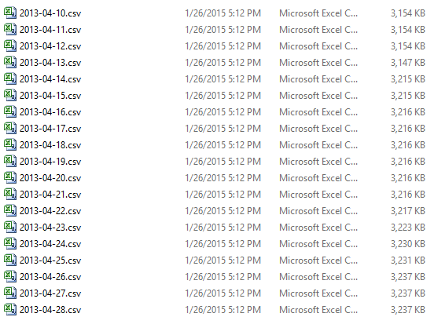
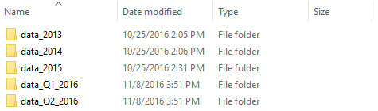
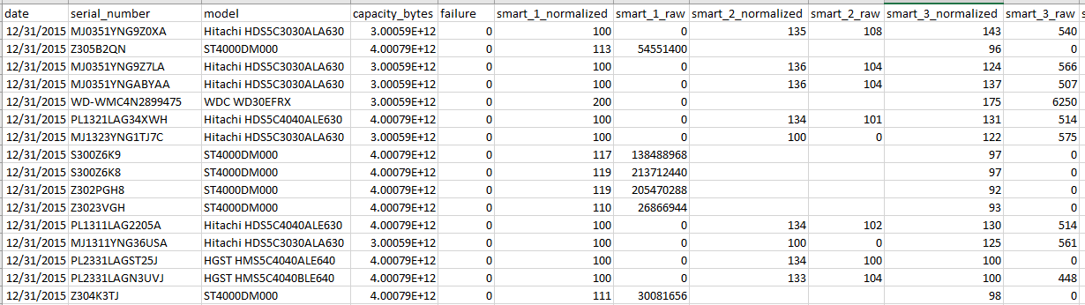
Data Organization
Data directories
In each directory, csv files of each day
Individual Hard Drive
identified by serial numbers
smart_255
Each csv files
1 if failed on this day

Slide 8
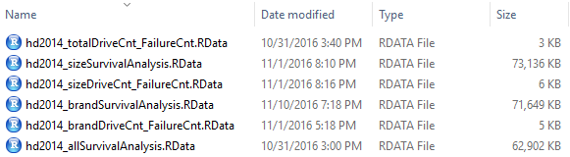
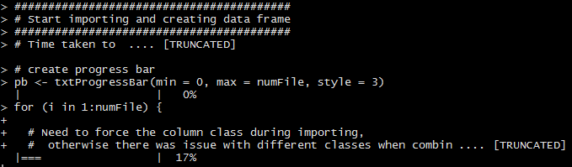
Major Challenges – Data Import
Huge amount of data:
Need to work to extract only relevant data to stay within the feasible size.
It is impossible to import all the available data into a huge data frame to perform analysis.
This is even impossible for just a year of data (the author spent quite some times to make the attempts but failed due to the limited available memory)
A script to explicitly import the data into RStudio, then save them to the RData file. Then the RData files will be loaded to perform the corresponding analysis.
Importing the data also takes significant amount of time
Use progress bar and beep when the importing is completed.
Missing data – some days of data with no info.

Slide 9
Example Errors
Reading all 2015 data warning & error
Error: cannot allocate vector of size 36.0 Mb
In addition: There were 28 warnings (use warnings() to see them)
Error: cannot allocate vector of size 64.0 Mb
In addition: Warning messages:
1: In structure(.Call(C_objectSize, x), class = "object_size") :
Reached total allocation of 8075Mb: see help(memory.size)
2: In structure(.Call(C_objectSize, x), class = "object_size") :
Reached total allocation of 8075Mb: see help(memory.size)
3: In structure(.Call(C_objectSize, x), class = "object_size") :
Reached total allocation of 8075Mb: see help(memory.size)
4: In structure(.Call(C_objectSize, x), class = "object_size") :
Reached total allocation of 8075Mb: see help(memory.size)
dplyr error
Warning messages:
1: In format.POSIXlt(as.POSIXlt(x), ...) :
Reached total allocation of 8075Mb: see help(memory.size)
2: In format.POSIXlt(as.POSIXlt(x), ...) :
Reached total allocation of 8075Mb: see help(memory.size)
3: In format.data.frame(x, digits = digits, na.encode = FALSE) :
Reached total allocation of 8075Mb: see help(memory.size)
4: In format.data.frame(x, digits = digits, na.encode = FALSE) :
Reached total allocation of 8075Mb: see help(memory.size)

Slide 10
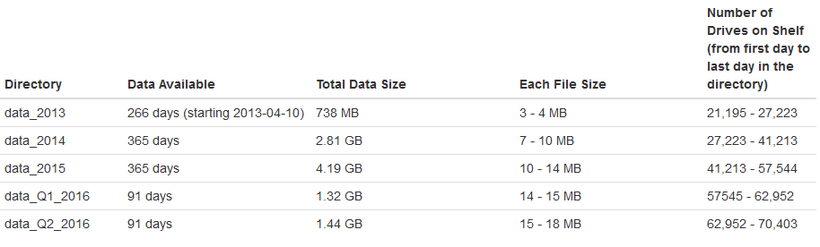
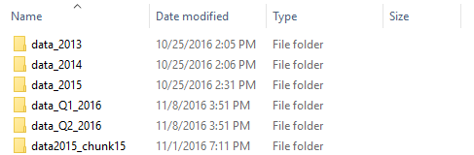
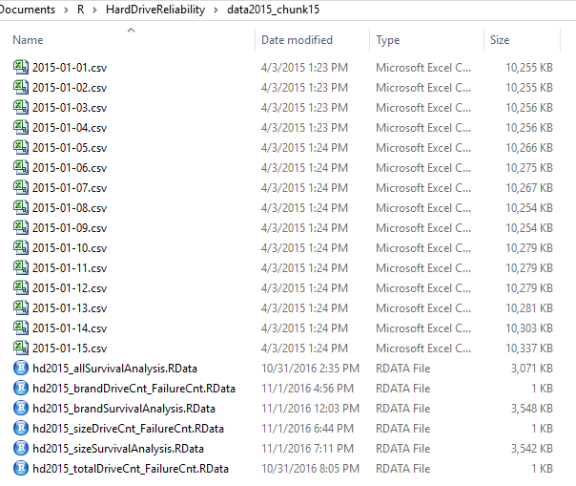
Overview of Data
“Production” Data
“Test” Data of 15 csv files to test script

Slide 11
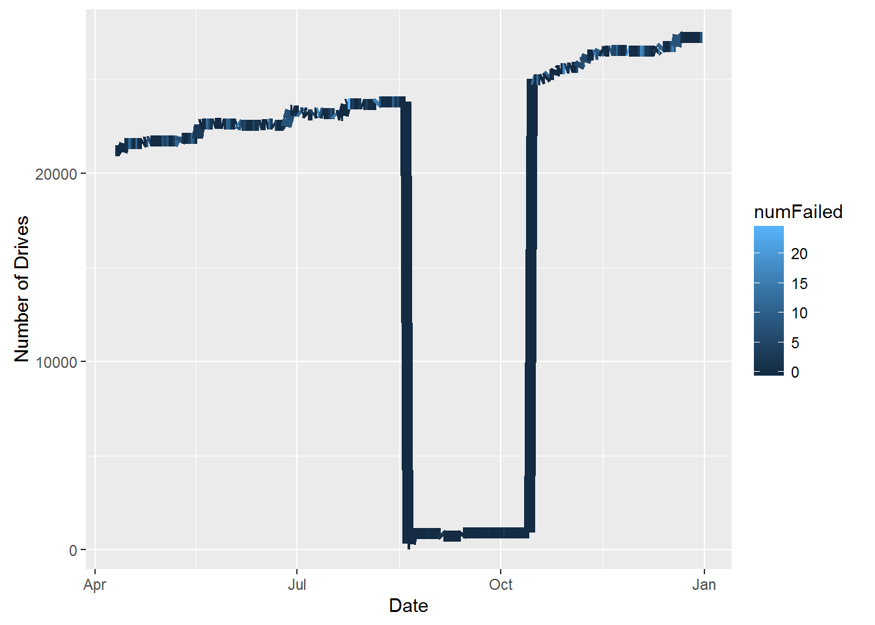
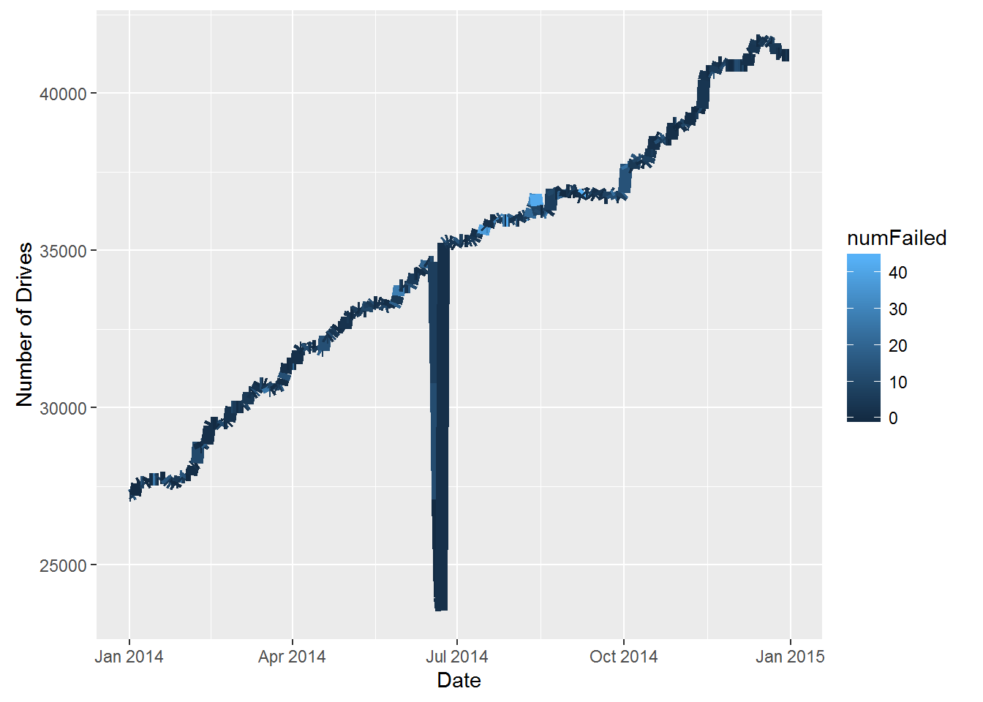
Number of Hard Drives Over Time
Year 2013 (from 2013-04-10 to 2013-12-31)
Year 2014 (from 2014-01-01 to 2014-12-31)

Slide 12
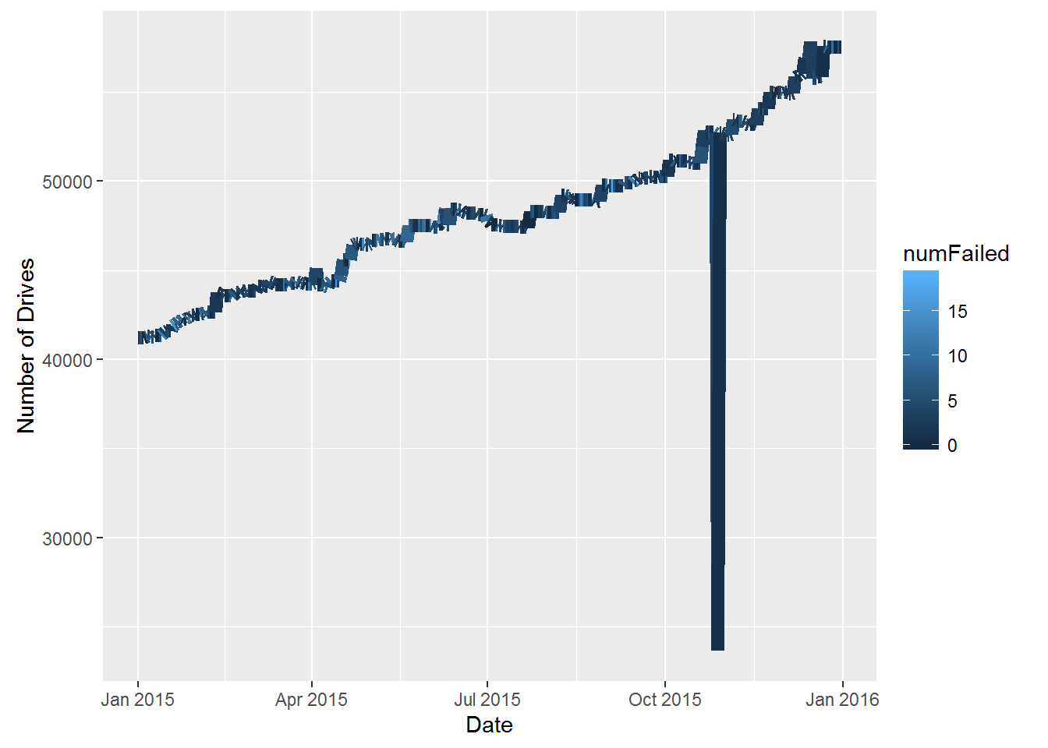
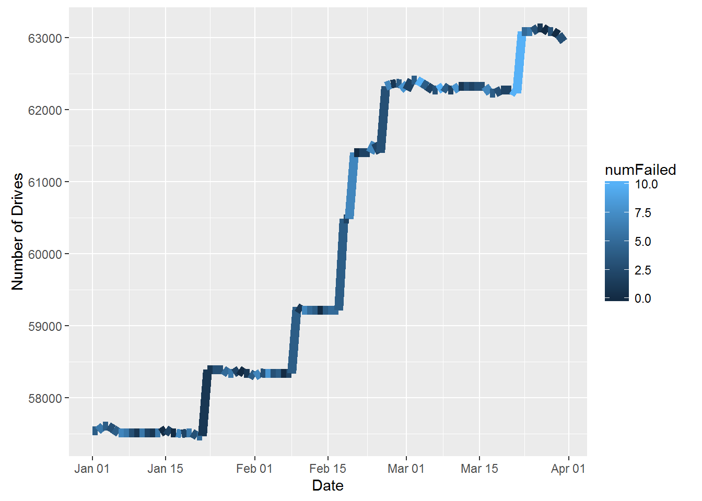
Number of Hard Drives Over Time
Year 2015 (from 2015-01-01 to 2015-12-31)
Q1 of Year 2016 (from 2016-01-01 to 2016-03-31)

Slide 13
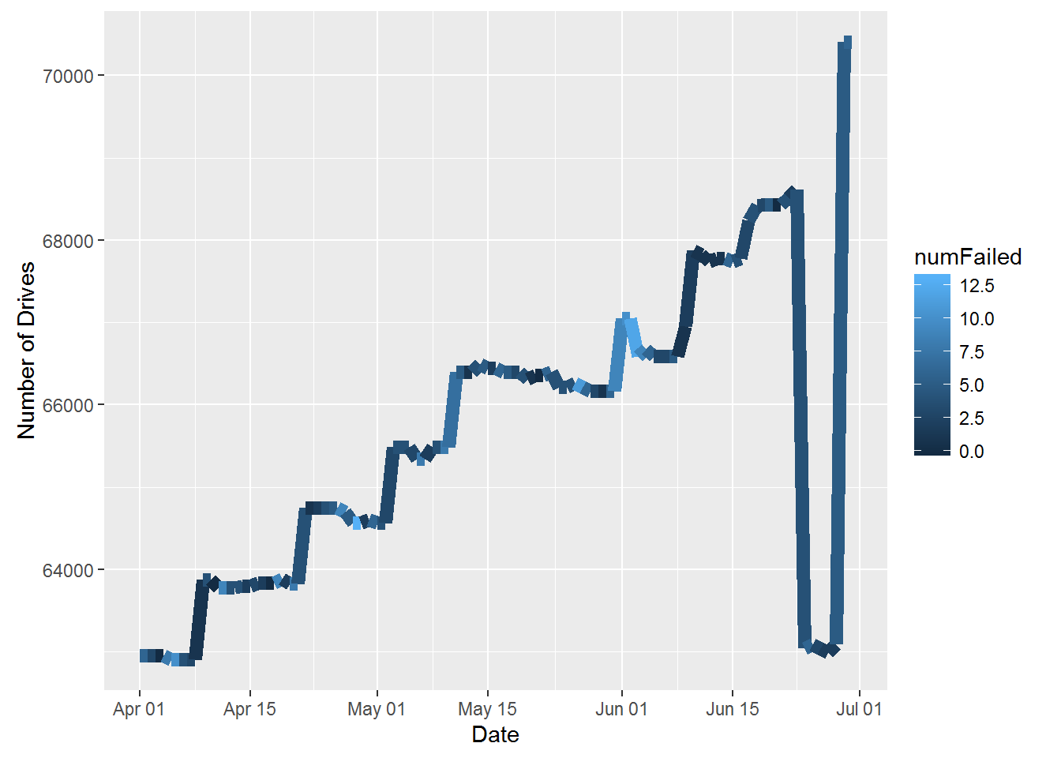
Number of Hard Drives Over Time
As can be noted from the above graphs, the data logged is not without issue.
There are a few files logged 0 kb, which means that there was no data on those particular days.
There are files also have sudden drop of the number of hard drives (some hard drives details are not logged), which may be due to the logging issue on those days.
Fortunately this is not imposing a huge issue since the sampling is assumed to be in a day, and we may just lose the data of some of the subjects (data is "censored" from the survival analysis point of view).
Q2 of Year 2016 (from 2016-04-01 to 2016-06-30)

Slide 14
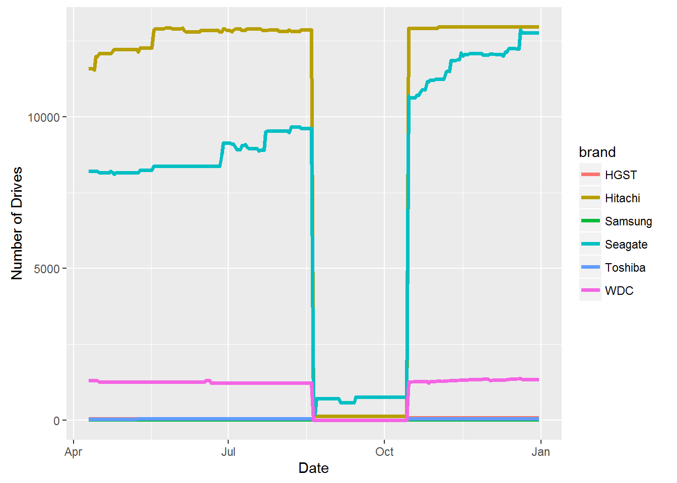






Number of Hard Drives of Different Brand/Manufacturer Over Time
Hard drive models:
"HGST"" -> "HGST"
"Hitachi" -> "Hitachi"
"SAMSUNG" -> "Samsung"
"TOSHIBA" -> "Toshiba"
"WDC" -> "Western Digital"
"^ST" -> "Seagate"
Most Hitachi
Increased installation
of Seagate
Year 2013 (from 2013-04-10 to 2013-12-31)

Slide 15
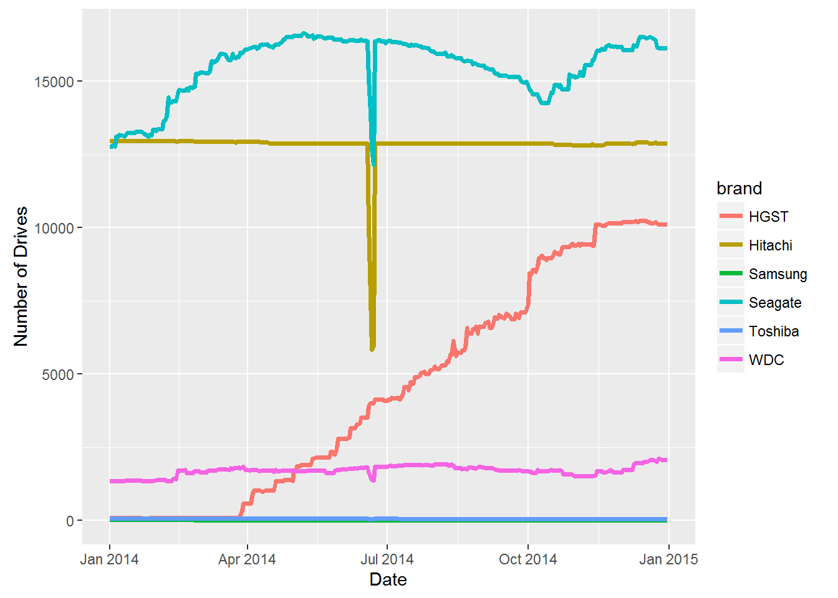
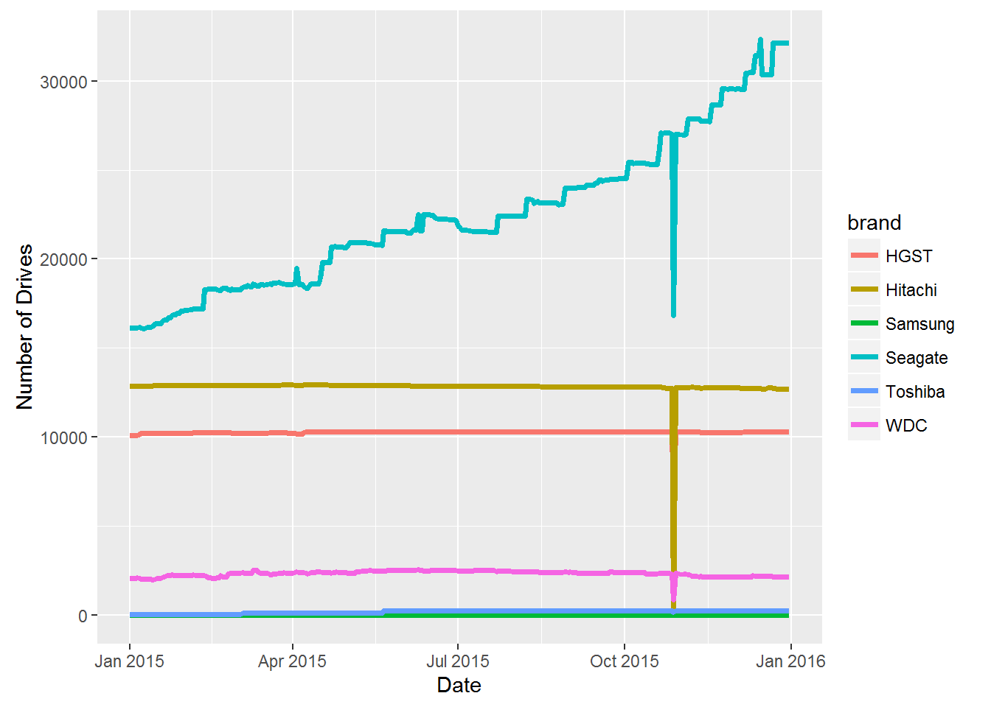
Number of Hard Drives of Different Brand/Manufacturer Over Time
Most Seagate
Increased installation
of Seagate
Increased installation
of HGST
Year 2014 (from 2014-01-01 to 2014-12-31)
Year 2015 (from 2015-01-01 to 2015-12-31)

Slide 16
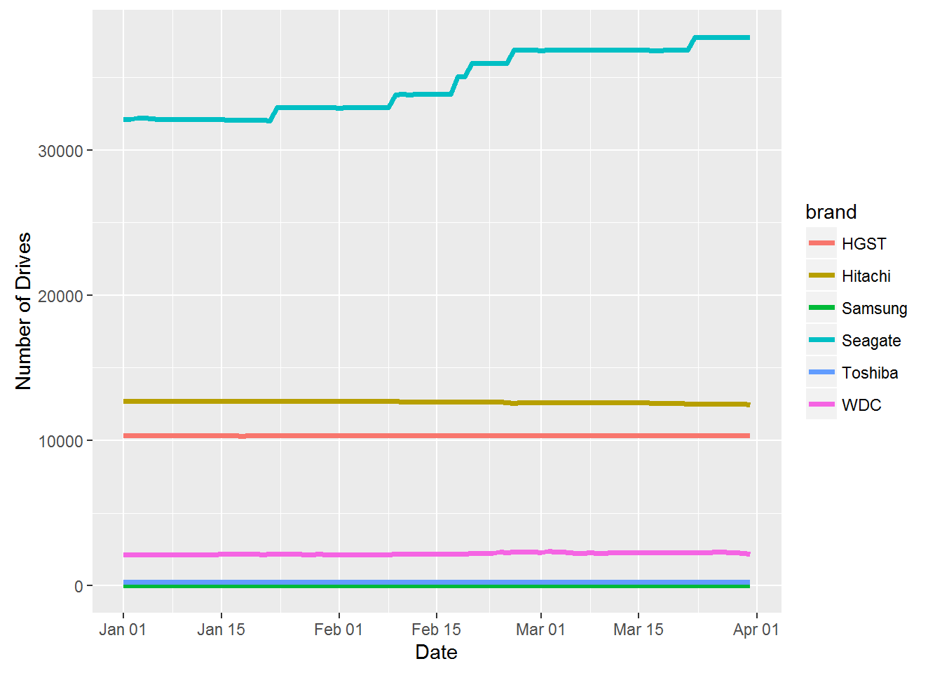
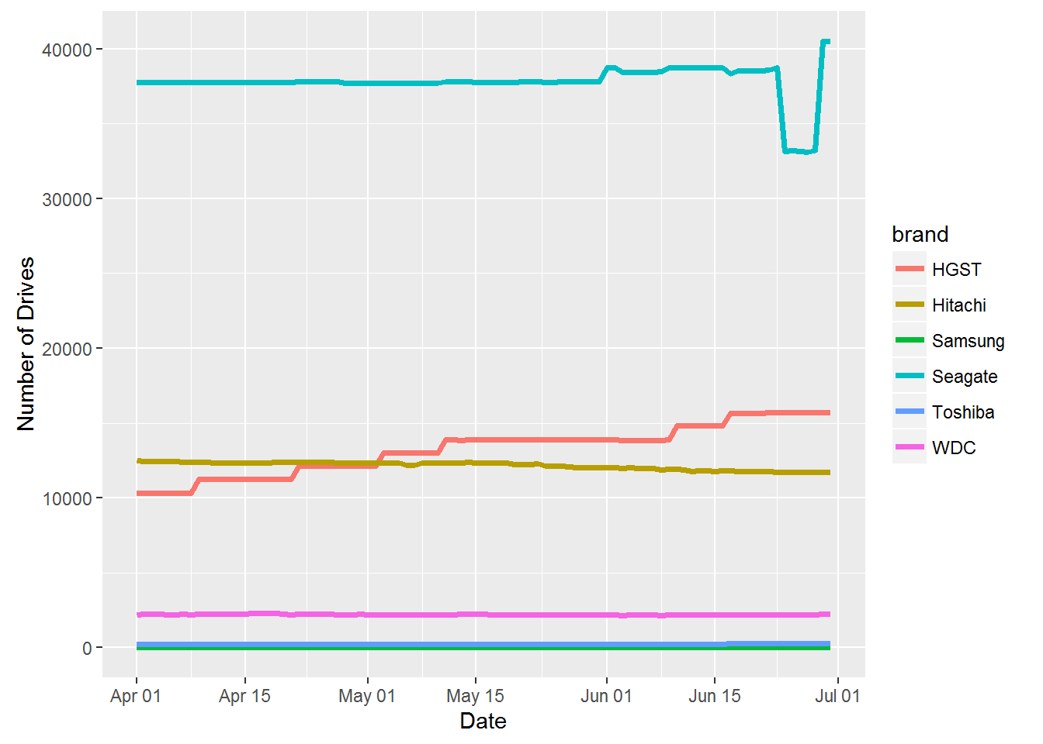
Number of Hard Drives of Different Brand/Manufacturer Over Time
Most Seagate
Most Seagate
Q1 of Year 2016 (from 2016-01-01 to 2016-03-31)
Q2 of Year 2016 (from 2016-04-01 to 2016-06-30)

Slide 17
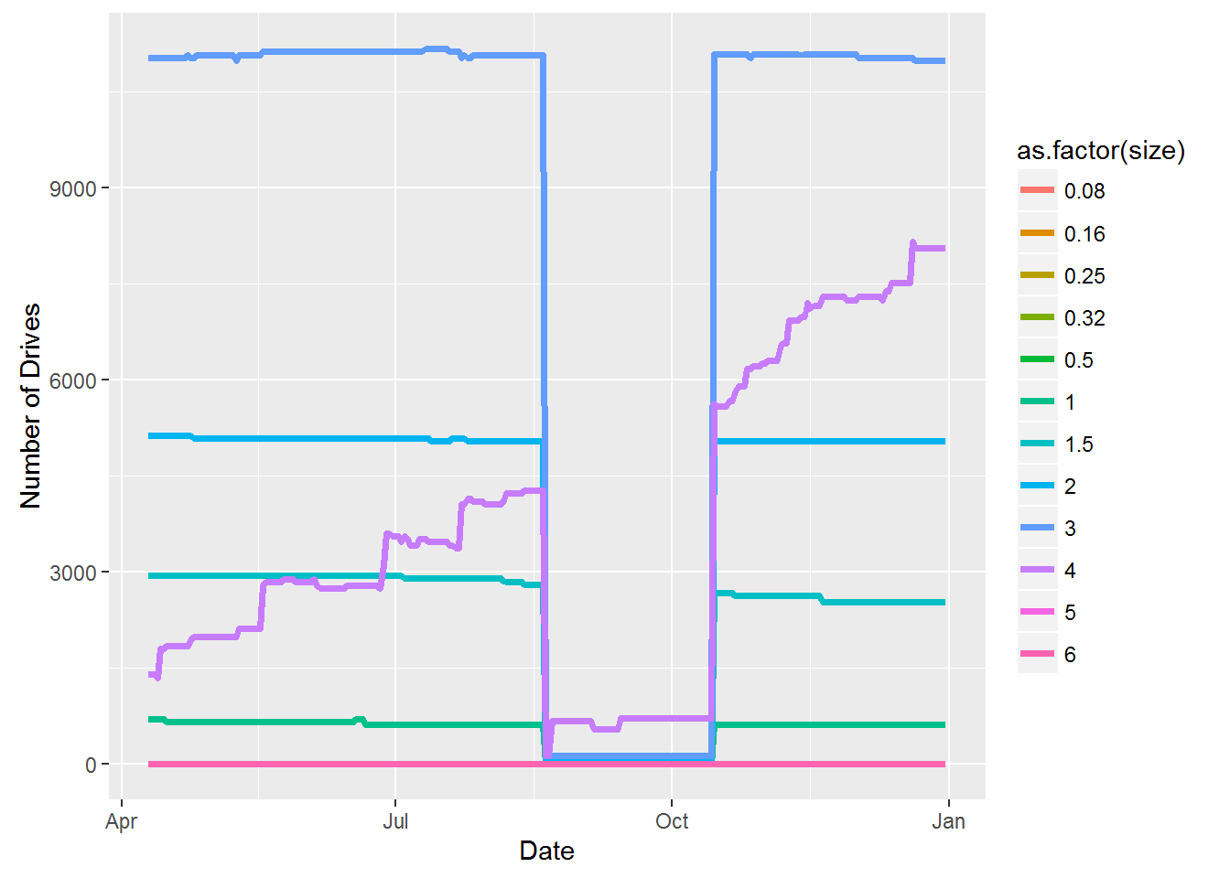
Number of Hard Drives of Different Capacity Over Time
Most 3GB
Hard drive sizes:
0.08, 0.16, 0.25, 0.32, 0.5, 1, 1.5, 2, 3, 4, 5, 6 TB
Increased installation
of 4 GB
Year 2013 (from 2013-04-10 to 2013-12-31)

Slide 18
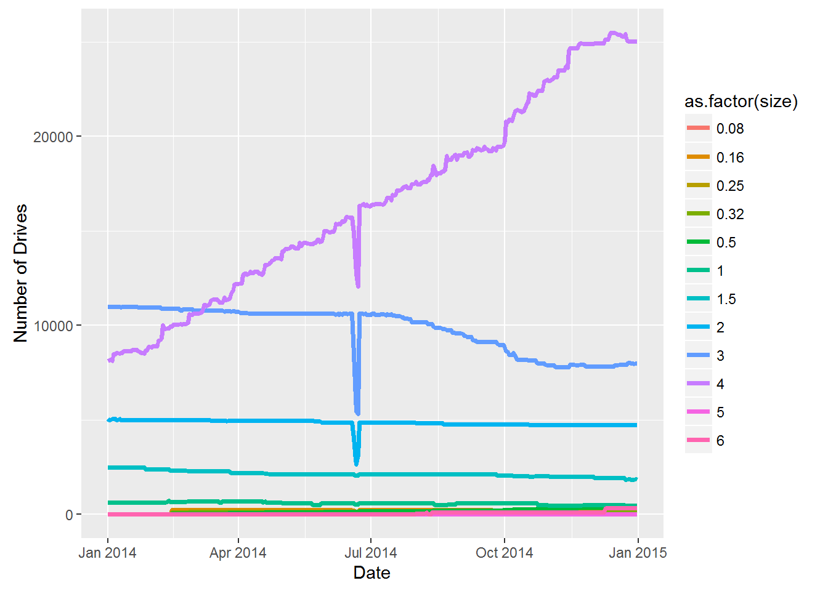
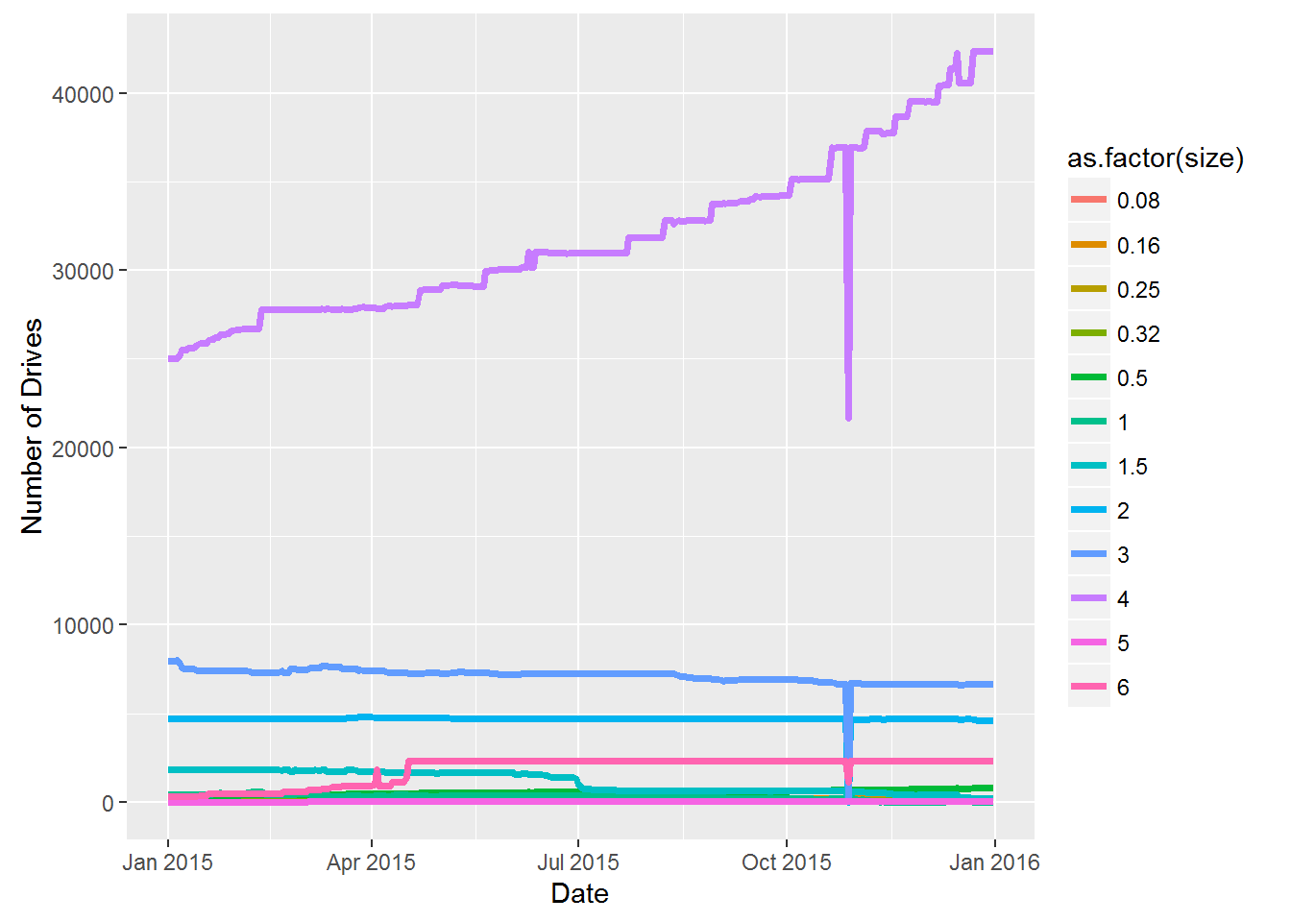
Number of Hard Drives of Different Capacity Over Time
Increased installation
of 4 GB
Increased installation
of 4 GB
Year 2014 (from 2014-01-01 to 2014-12-31)
Year 2015 (from 2015-01-01 to 2015-12-31)

Slide 19
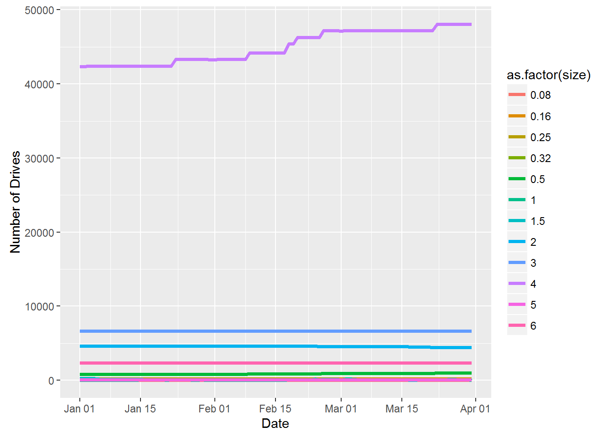
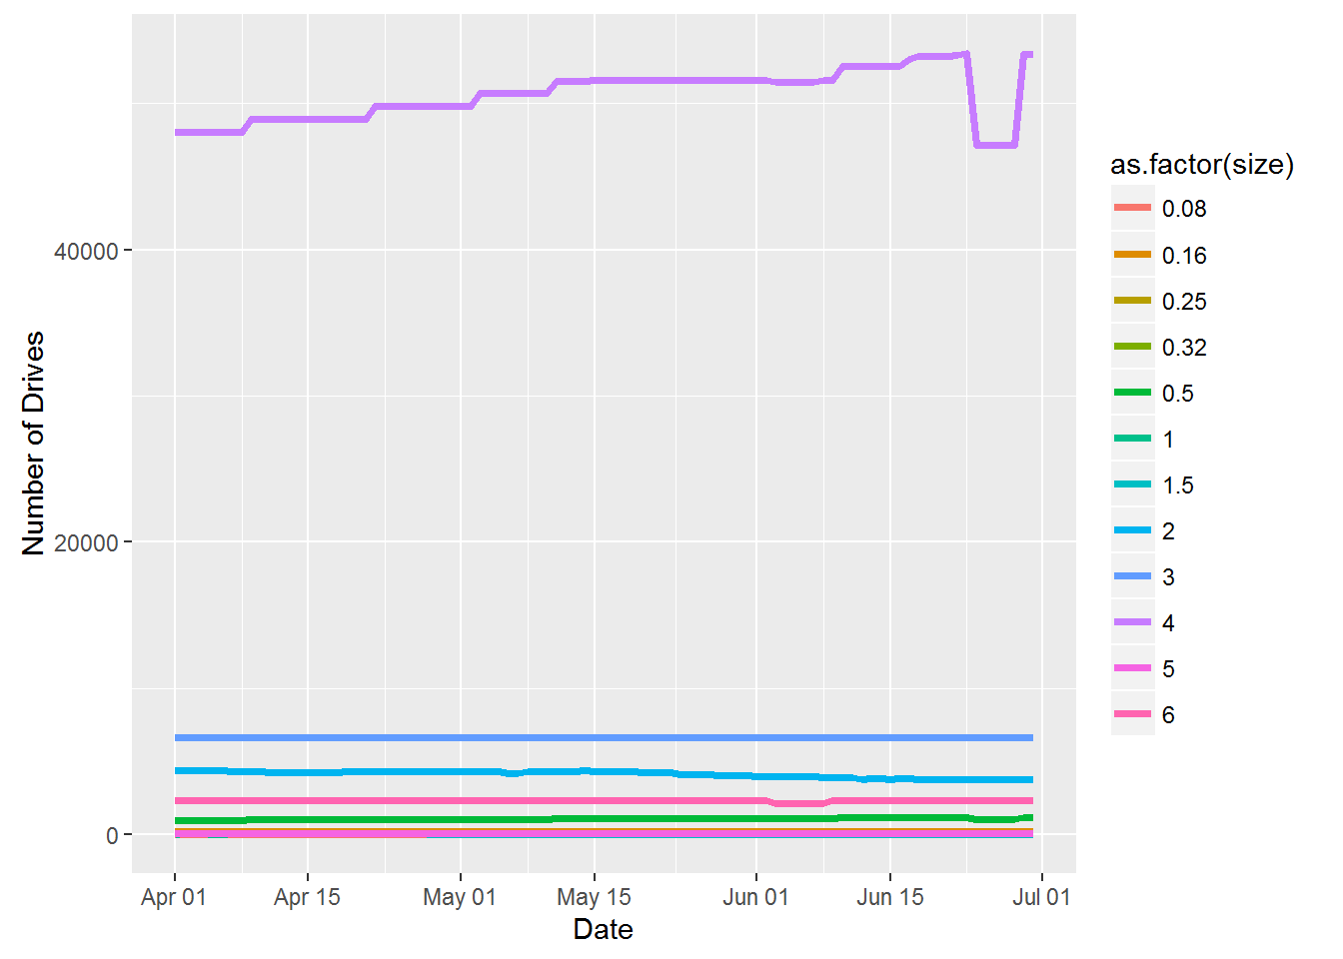
Number of Hard Drives of Different Capacity Over Time
Most 4GB
Most 4GB
Q1 of Year 2016 (from 2016-01-01 to 2016-03-31)
Q2 of Year 2016 (from 2016-04-01 to 2016-06-30)

Slide 20
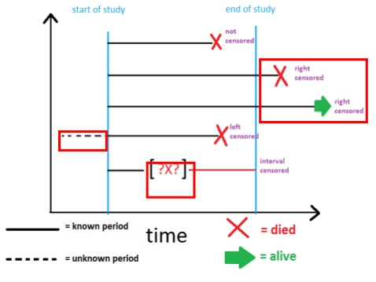
Hard Drive Reliability Performance – Survival Analysis
The suitable analysis to be studied on the data is the survival analysis.
Survival analysis is to analyze the expected duration of time until an event occurs.
R has a package "survival" (https://cran.r-project.org/web/packages/survival/survival.pdf) to perform the analysis.

Slide 21

Quick Intro to Survival Analysis
Suppose probability of duration time < t is:
Survival function is the probability that the duration of at least t as:
Hazard function is defined as the probability that the duration will end after time t given that it has lasted until time t as:
In the case of hard drive, our interest is to understand the expected duration of the hard drive can "survive" on the shelf before it fails.
https://docs.google.com/file/d/0BwogTI8d6EEiM2wxZW9qdzdvV2M/edit

Slide 22
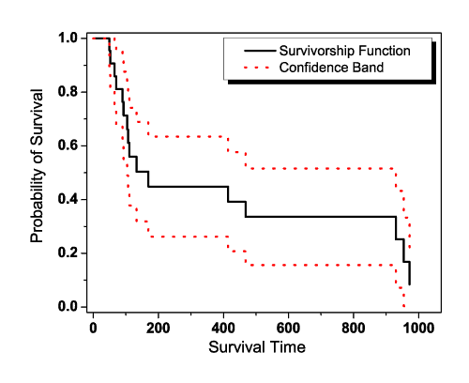
Survival Models
Non-parametric models:
Arranging the durations of the observations from smallest to largest.
Kaplan-Meier calculation can be plotted on a graph to see the decrease of survival function over the duration.
Nelson-Aalen calculation can be used to calculate the corresponding hazard rate.
Parametric models:
Fit to popular models: exponential, Weibull, Gompertz and log-logistics.
In advantages of these are the performance can be compared using parametric values. In this project, we will not focus on this method as the interpretation of the parameters can be highly dependent on the model used.
http://www.keyword-suggestions.com/c3Vydml2YWwgYW5hbHlzaXM/
https://docs.google.com/file/d/0BwogTI8d6EEiM2wxZW9qdzdvV2M/edit

Slide 23
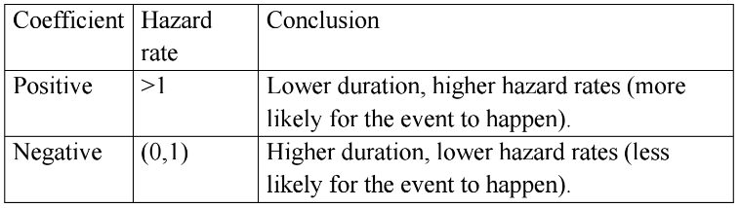
Survival Models (Cont’d)
Semiparametric models:
Cox proportional hazard model is also another more intuitive (and less ambiguous) method of evaluating the hazard rate.
Meaning of coefficients:
https://docs.google.com/file/d/0BwogTI8d6EEiM2wxZW9qdzdvV2M/edit

Slide 24
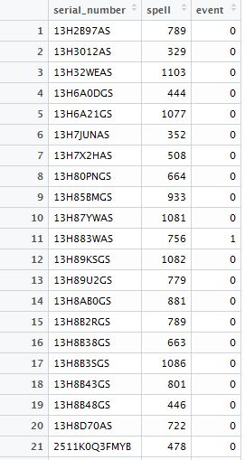
Three Survival Analysis Cases
Use dplyr to put the data in the correct form to perform survival analyses for the following cases:
Case 1: Overall survival of the hard drives in Backblaze server

Slide 25
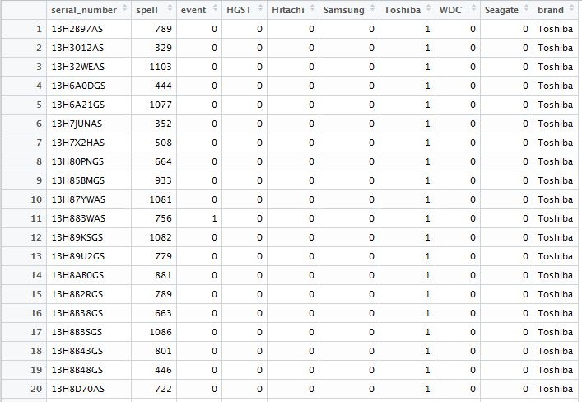
Three Survival Analysis Cases
Case 2: The survival/hazard based on different brands/manufacturer

Slide 26
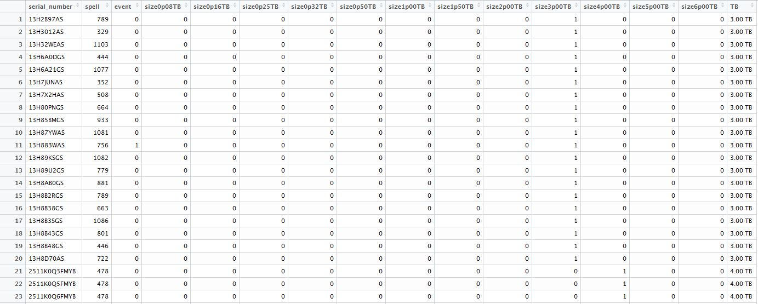
Three Survival Analysis Cases
Case 3: The survival/hazard based on different sizes/capacity

Slide 27
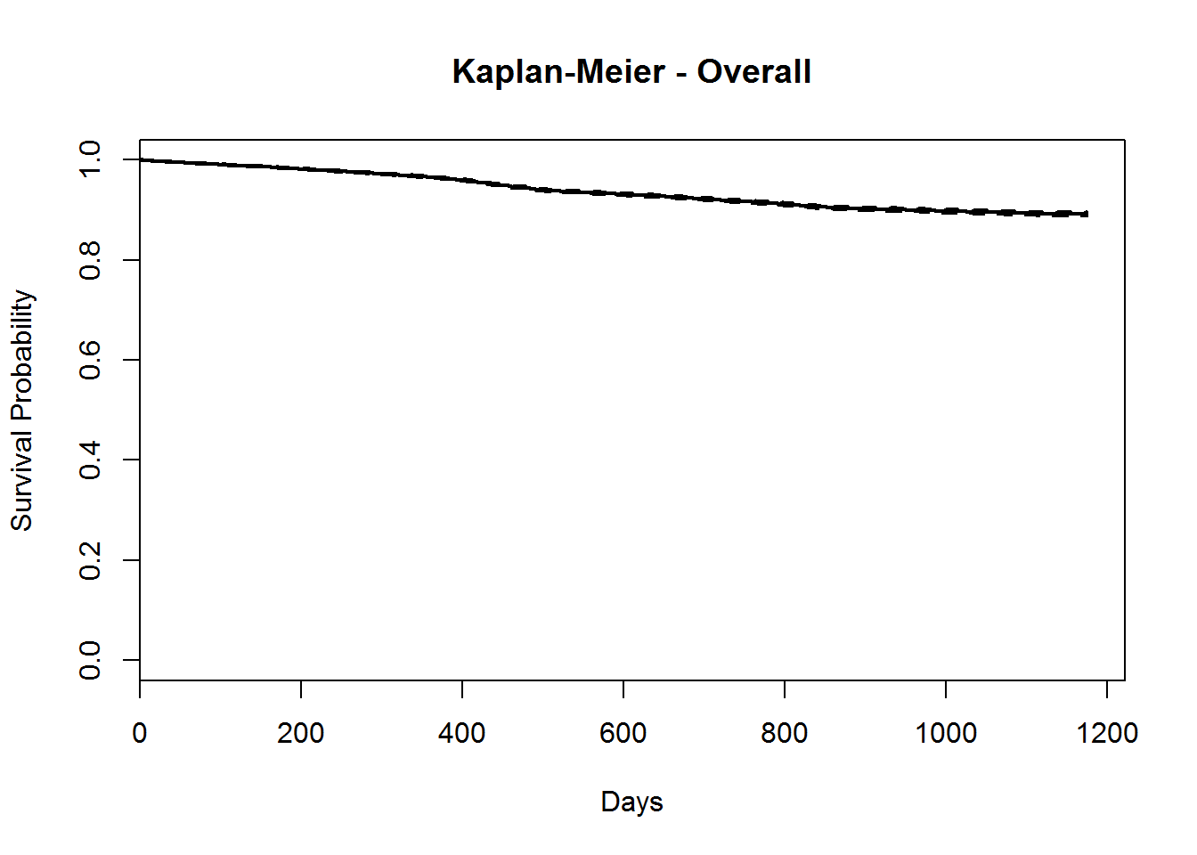

Case 1 Result: Overall Survival
Overall, it can be seen that hard drives are pretty reliable products where the survival probability stays above 85% at about 1200 days (3+ years) of operation.

Slide 28
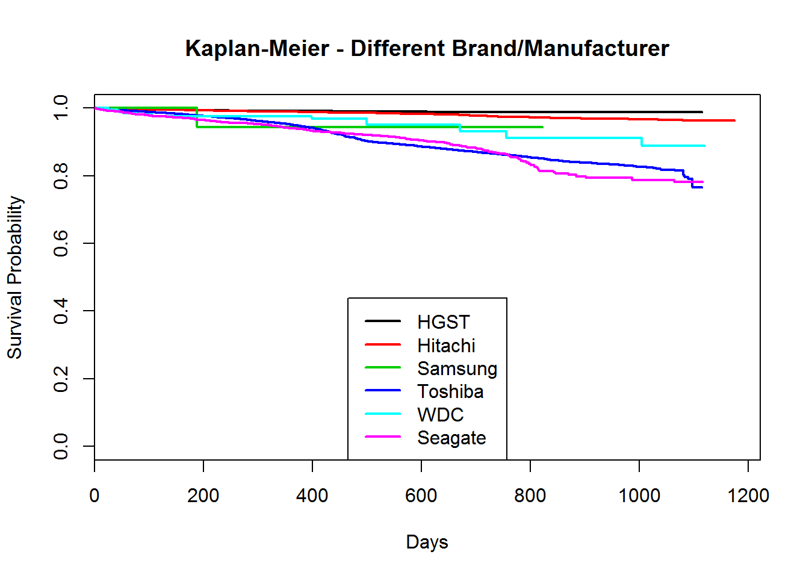
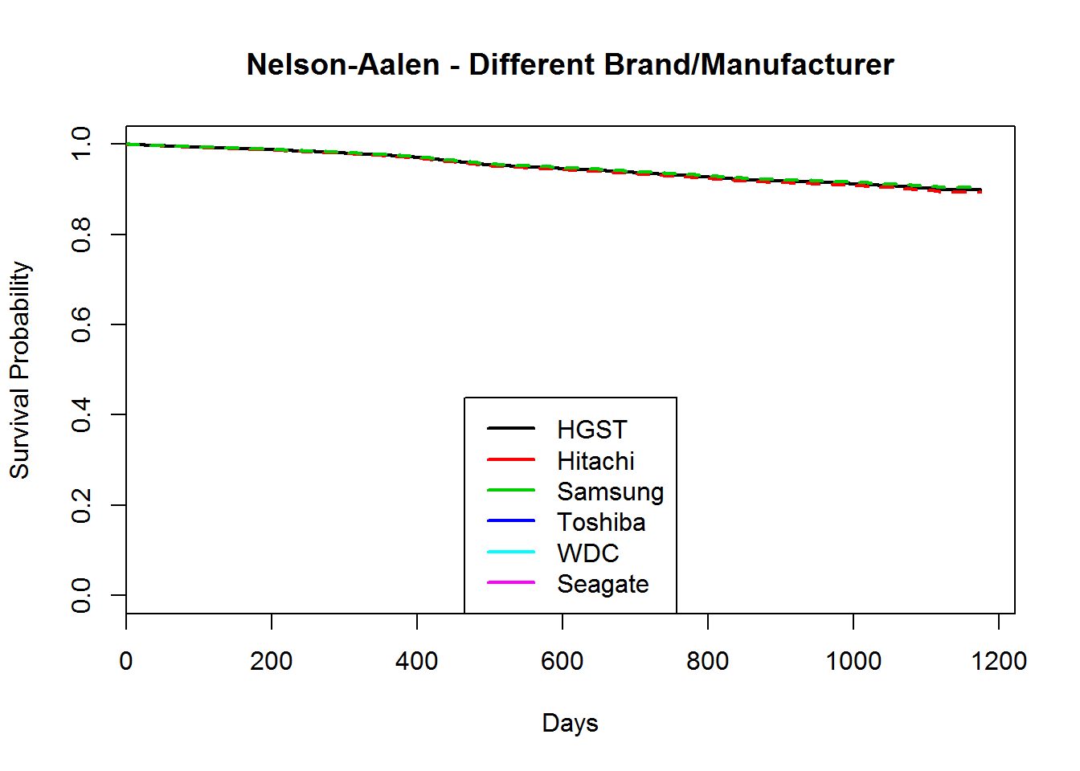
Case 2 Result: Survival Based on Different Brand/Manufacturer
HGST & Hitachi are safer
Toshiba & Seagate are risker

Slide 29
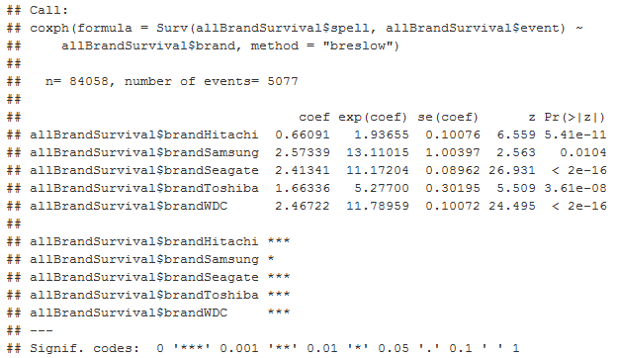

Case 2 Result: Survival Based on Different Brand/Manufacturer
Hitachi has least risk
Samsung has most risk (but note that Samsung has the least history among other drives)
With the comparative history, WDC probably has the highest risk

Slide 30
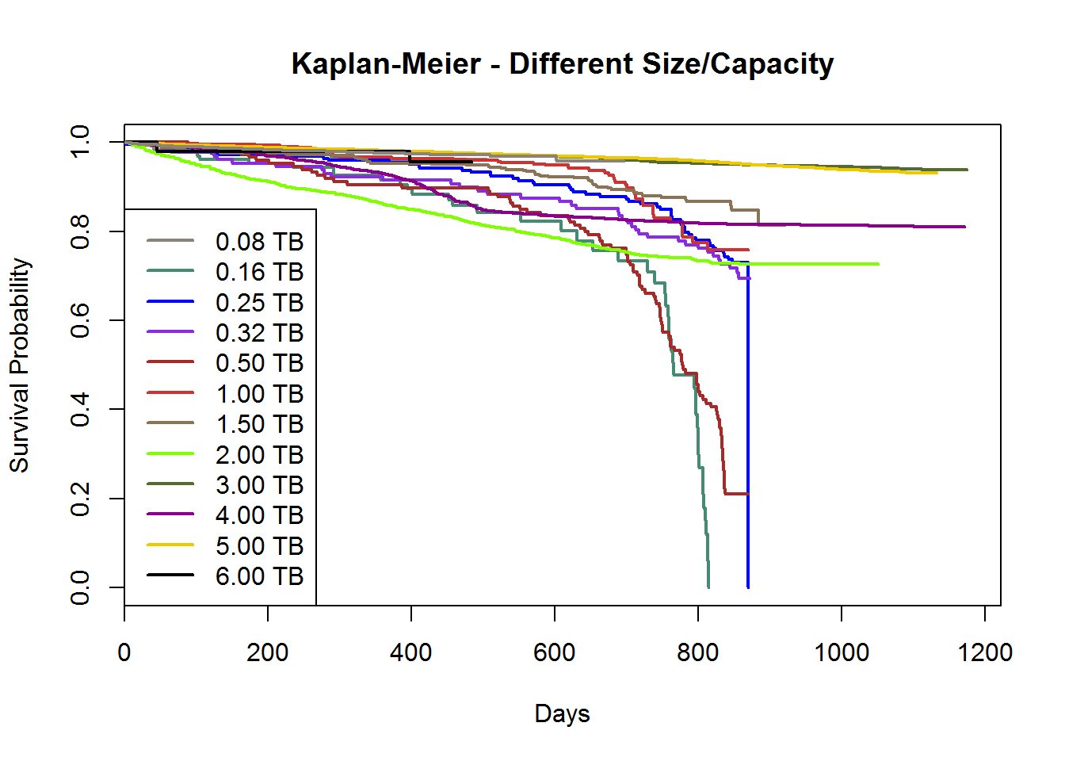
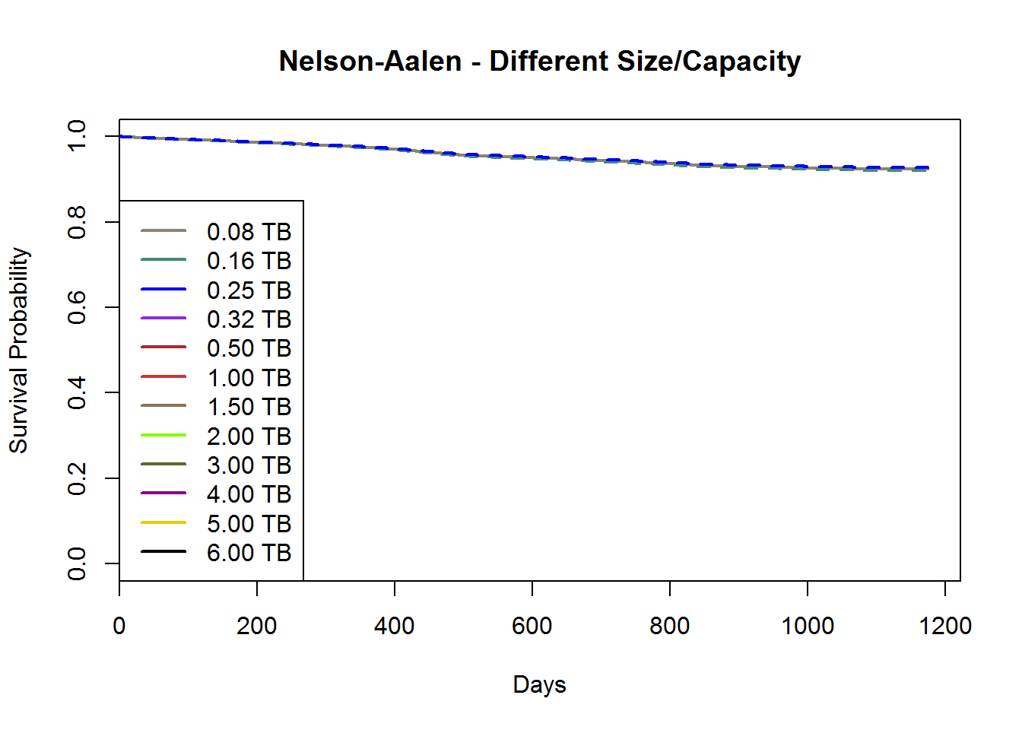
Case 3 Result: Survival Based on Different Size/Capacity
6 TB drives are early to tell
With comparable history, from highest to lowest survival probability:
3 TB > 5 TB > 4 TB
Smaller size drives

Slide 31
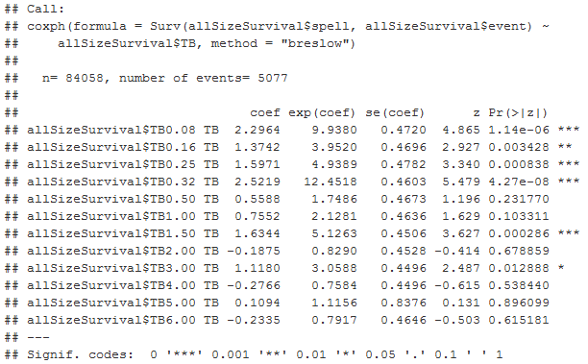
Case 3 Result: Survival Based on Different Size/Capacity
2 TB, 4 TB and 6 TB have the best hazard performance

Slide 32
Conclusion
The study is very preliminary since only brand/manufacturer and size/capacity are evaluated, in this study:
Hitachi has the best reliability, Toshiba and Seagate have the least reliability.
3 TB, 5 TB and 4 TB drives have high survival rates, but 2 TB, 4 TB and 6 TB drive have the lowest hazard rates.
Recommendation: stay with Hitachi, and 4 TB drives (highest survival and lowest hazard rate)
Limitation of the analysis:
The reliability of the hard drive data collection may affect the results. As seen in the exploratory time-series plots, quite significant amount of data were dropped or missing.
The performance can also be heavily affected by some external factors, i.e. how the data center install the hard drives, and the quantity of each of the models.
Overall, the project produces reasonable analytical results for decision making.

Slide 33
Future Work
Survival analysis of each model (about 100+ of them) for more serious consideration.
Look into censoring more carefully.
Take the time-series SMART data into account for much more advanced analysis.

Slide 34
Notes to the Codes
The codes can be found at: https://github.com/chinpeitang/Springboard_FDS/tree/master/CapstoneProject
The hard drive data by Backblaze can be downloaded at: https://www.backblaze.com/b2/hard-drive-test-data.html
In each of the codes, make sure you change the filePathRoot of where you save your data. Once you downloaded data_xxxx.zip file, extract it to the data_xxxx directory, and don’t make any changes within the directory.
filePathRoot <- "C:/Users/Chinpei/Documents/R/HardDriveReliability/“
Major codes:
harddrive_readdata.R: Create the RData files for time series plotting and survival analysis for each year.
harddrive_quickloaddata.R: Quick plot of the imported data from harddrive_readdata.R.
harddrive_allsurvivalanalysis_savedata.R, harddrive_brandSurvivalAnalysis.R, harddrive_sizesurvivalanalysis_savedata.R: Create the RData file of full set of available data (2013, 2014, 2015 and 2016) for survival analysis. Due to time limitation, the authors did not make the convenience to select different function and filePathRoot setup.
Main calculation can be found in the Rmarkdown document: https://github.com/chinpeitang/Springboard_FDS/blob/master/CapstoneProject/CapstoneProjFinalReport_HardDrive.html

Slide 35
Acknowledgment
The author would like to acknowledge:
Backblaze huge effort in logging the hard drive data and making them open source. The work is impossible without their hard work.
Mentor Jeff Lipkowitz for introducing survival analysis for this work.
Springboard for providing the platform for the author to learn data science.
Disclaimer:
Use the codes and analysis results at your own risk. This project is mainly for exercise purpose.
The codes and analysis results comes with no warranty.
The author is not responsible for the consequence that may result in any form of lost should the reader use the result from this codes and analysis.

Slide 36
Backup Slides: Misc Achieved Errors Encountered

Slide 37

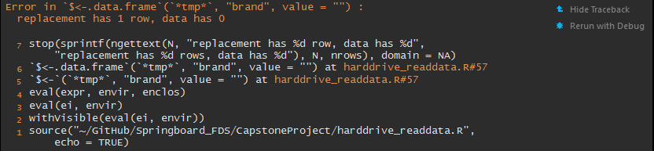
Misc Achieved Errors
Error: cannot allocate vector of size 41.0 Mb
In addition: There were 50 or more warnings (use warnings() to see the first 50)
Error: cannot allocate vector of size 64.0 Mb
In addition: Warning messages:
1: In structure(.Call(C_objectSize, x), class = "object_size") :
Reached total allocation of 8075Mb: see help(memory.size)
2: In structure(.Call(C_objectSize, x), class = "object_size") :
Reached total allocation of 8075Mb: see help(memory.size)
3: In structure(.Call(C_objectSize, x), class = "object_size") :
Reached total allocation of 8075Mb: see help(memory.size)
4: In structure(.Call(C_objectSize, x), class = "object_size") :
Reached total allocation of 8075Mb: see help(memory.size)
Error in `$<-.data.frame`(`*tmp*`, "brand", value = "") :
replacement has 1 row, data has 0
7 stop(sprintf(ngettext(N, "replacement has %d row, data has %d",
"replacement has %d rows, data has %d"), N, nrows), domain = NA)
6 `$<-.data.frame`(`*tmp*`, "brand", value = "") at harddrive_readdata.R#57
5 `$<-`(`*tmp*`, "brand", value = "") at harddrive_readdata.R#57
4 eval(expr, envir, enclos)
3 eval(ei, envir)
2 withVisible(eval(ei, envir))
1 source("~/GitHub/Springboard_FDS/CapstoneProject/harddrive_readdata.R",
echo = TRUE)

Slide 38
Backup Slides: SMART (Self Monitoring, Analysis and Reporting Technology) Data (Summary from Wikipedia)

Slide 39
SMART (Self-Monitoring, Analysis and Reporting Technology)
The technical documentation for SMART is in the AT Attachment (ATA) standard. First introduced in 2004, it has undergone regular revisions, the latest being in 2008.
Each drive manufacturer defines a set of attributes and sets threshold values beyond which attributes should not pass under normal operation.
Each attribute has:
a raw value, whose meaning is entirely up to the drive manufacturer (but often corresponds to counts or a physical unit, such as degrees Celsius or seconds)
a normalized value, which ranges from 1 to 253 (with 1 representing the worst case and 253 representing the best)
a worst value, which represents the lowest recorded normalized value. Depending on the manufacturer, a value of 100 or 200 will often be chosen as the initial normalized value.
Manufacturers that have implemented at least one SMART attribute in various products include Samsung, Seagate, IBM (Hitachi), Fujitsu, Maxtor, Toshiba, Intel, sTec, Inc., Western Digital and ExcelStor Technology.

Slide 40
Google Field Study Dec 2005 – Aug 2006
100,000 hard drives studied.
39x more likely to fail with first uncorrectable error on drive (SMART ID 198) detected.
High probability of failure with reallocation error (SMART ID 5 & 196) and unstable sector counts (SMART ID 197) detected.
Little correlation was found for increased temperature, no correlation for usage level.
56% failed drive without the above “4 strong SMART warnings”.
36% drives failed without recording any SMART error.

Slide 41
Strong 4 SMART Warnings
ID 198: The total count of uncorrectable errors when reading/writing a sector.
A rise in the value of this attribute indicates defects of the disk surface and/or problems in the mechanical subsystem.
ID 196: Count of remap operations.
The raw value of this attribute shows the total count of attempts to transfer data from reallocated sectors to a spare area. Both successful & unsuccessful attempts are counted.

Slide 42
Strong 4 SMART Warnings (Cont’d)
ID 5: Count of reallocated sectors.
When the hard drive finds a read/write/verification error, it marks that sector as "reallocated" and transfers data to a special reserved area (spare area). This process is also known as remapping, and reallocated sectors are called "remaps".
The raw value normally represents a count of the bad sectors that have been found and remapped. Thus, the higher the attribute value, the more sectors the drive has had to reallocate.
ID 197: Count of "unstable" sectors (waiting to be remapped, because of unrecoverable read errors).
If an unstable sector is subsequently read successfully, the sector is remapped and this value is decreased. Read errors on a sector will not remap the sector immediately (since the correct value cannot be read and so the value to remap is not known, and also it might become readable later); instead, the drive firmware remembers that the sector needs to be remapped, and will remap it the next time it's written.

Slide 43
Potential Indicators of Imminent Electromechanical Failure
ID 5: Reallocated Sector Count
ID 10: Spin Retry Count
ID 183 (WD, Samsung, Seagate): SATA Downshift Error Count/Runtime Bad Block
ID 184: End-to-End error
ID 187: Reported Uncorrectable Errors
ID 188: Command Timeout
ID 196: Reallocation Event Count
ID 197: Current Pending Sector Count
ID 198: Uncorrectable Sector Count
ID 201: Soft Read Error Rate
ID 230: Drive Life Protection Status

Slide 44
Some Interesting Attributes
ID 9/233: Power-On Hours (POH)
ID 12: Power Cycle Count
ID174: Unexpected power loss count
ID 194: Temperature
ID 222: Loaded Hours
ID 231: Drive Temperature
ID 231: SSD Life Left
ID 232: Endurance Remaining

Slide 45
Questions can be asked
How many drives used total in 3 years? How many failed? How many survived all 3 years?
Provide some statistics? Manufacturer, drive size?
Which hard drives have the highest and lowest reliability?
Count # of hard drives of each manufacturer. Count # of failures of each manufacturer. Determine the percentage.
Correlation of hard drive size with failure?
What are the most likely event that cause hard disk failure?
Look at all the failed drive, check the statistics of SMART attributes.
Compare the SMART attributes of all the drives not failed in 3 years.
Some interesting graphs (more on application):
Number of hard drives in production per day over time.
Number of failures per day over time.

