Slide 1
Bank Campaign and Propensity to Buy
Predictor.Ai - Chintan Desai

Slide 2
Business Case
We are a Data Science Consulting company Predictor.Ai and will be helping your bank with Campaign design to target the customers who are most likely to subscribe to a term deposit by using predictive analytics and data science.
As we know there has been a revenue decline at the bank and the management would like to know what actions to take. After investigation, we found out that the root cause is that their clients are not depositing as frequently as before.
Knowing that term deposits allow banks to hold onto a deposit for a specific amount of time, so banks can invest in higher gain financial products to make a profit.
In addition, banks also hold better chance to persuade term deposit clients into buying other products such as funds or insurance to further increase their revenues.
As a result, the bank management would like to identify existing clients that have higher chance to subscribe for a term deposit and focus marketing effort on such clients.

Slide 3
Goal
Goal it two fold:
Predict the Propensity to engage/buy
Predict if the customer will subscribe to bank deposit given the campaign with highest possible accuracy.
Identify the most important factors leading to successful outcome.

Slide 4
Workflow
EDA (Exploratory Data Analysis) with Outlier detection and correction.
Statistical Analysis (T-Test and Chi-Square Test).
Feature Engineering.
Removing highly correlated features.
Machine Learning.

Slide 5
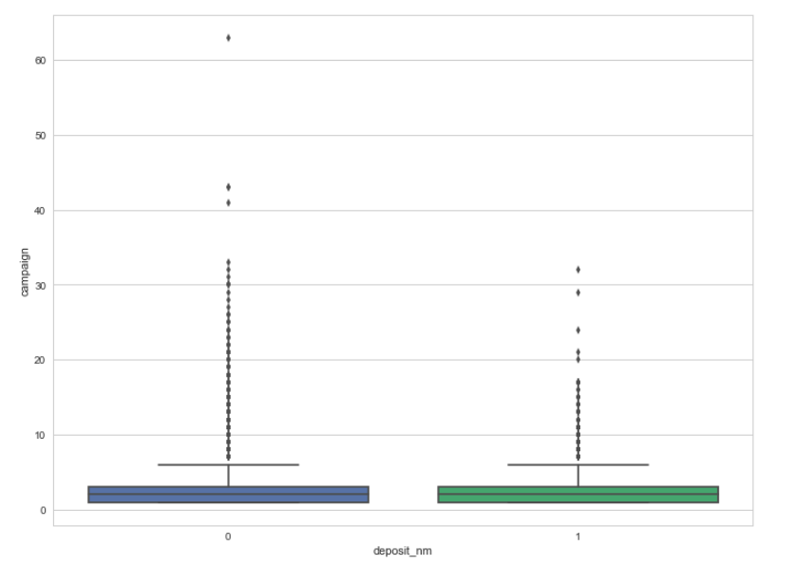
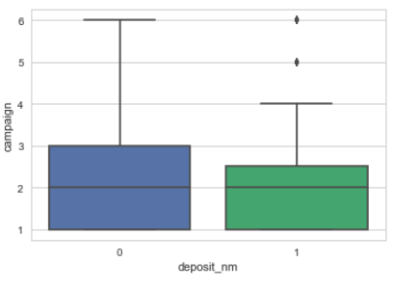
Outlier Removal For Continuous Variable (Example : ‘Campaign’)
As shown above we are applying outlier detection and removal for the feature ‘Campaign’.
We check any values smaller then [(Q1-1.5* IQR) or larger then (Q3+1.5*IQR)
After identifying these values that fall outside our range, we impute them by "mean" of respective variable.

Slide 6
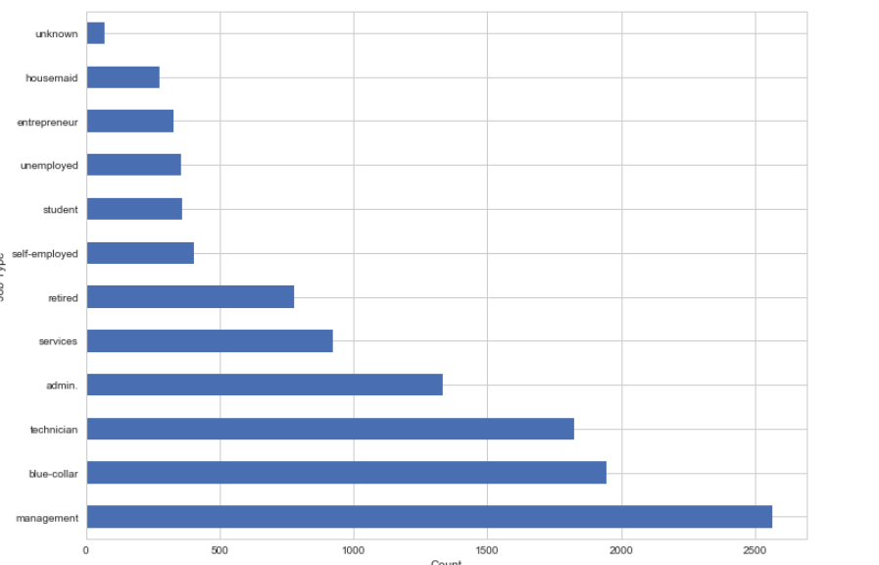
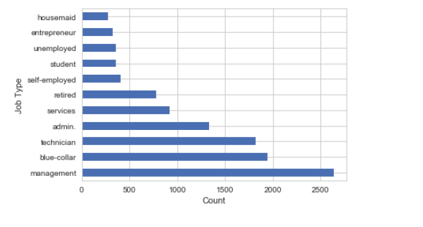
Outlier Removal For Categorical Variable (Example : ‘JobType’)
If any Categorical variable has more than 50% unknown values or seems highly unbalanced, we can drop that variable from dataset.
If unknown values are less than 50% than we can replace them by Mode of respective variable as shown above where we replace the ‘unknown’ with ‘Management’.

Slide 7
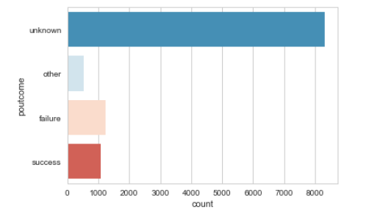
Outlier Removal For Categorical Variable (Example : ‘poutcome’)
If any Categorical variable has more than 50% unknown values or seems highly unbalanced, we can drop that variable from dataset; as shown above where we drop the feature ‘poutcome’.

Slide 8
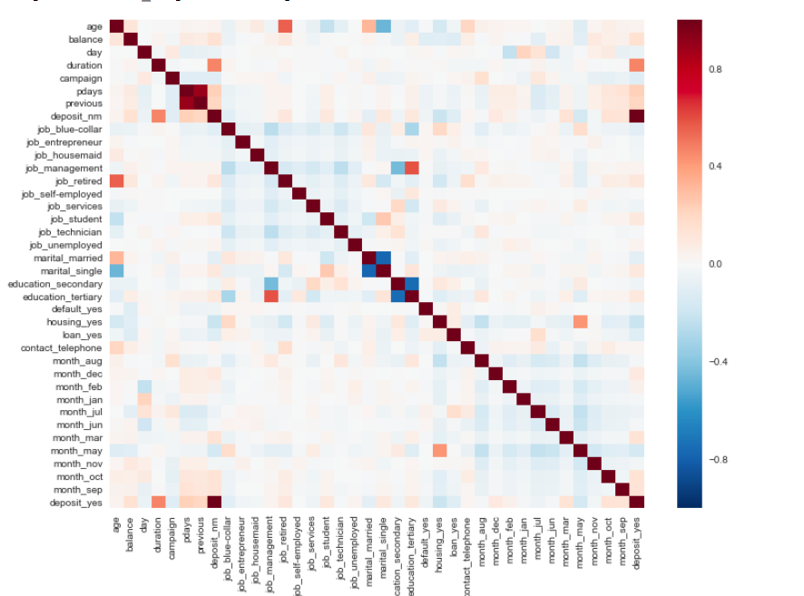
Correlation among variables
As shown in the diagram to the right we can clearly see high correlation among some of the independent variables and we drop these variables that are highly correlated to make sure we reduce the dimension and at the same time don’t affect the effective power of the features that are important.

Slide 9
Machine Learning
Applied the following Algorithm
Logistic Regression
Decision tree
Random Forest
Support Vector Machine

Slide 10
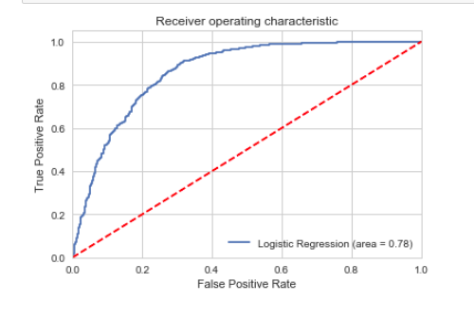
Logistic Regression
Tuned with model parameter – C
Used 10—fold cross validation with Grid search to pick the best tuning parameter.
As shown in the ROC curve the accuracy was around 78%

Slide 11
Logistic Regression
logistic regression is not a useful unless we have already identified all the relevant independent variables.
Logistic regression requires that each data point be independent of all other data points. If observations are related to one another, then the model will tend to overweight the significance of those observations.
Logistic regression attempts to predict outcomes based on a set of independent variables, but logit models are vulnerable to overconfidence thus resulting in overfitting issues.

Slide 12
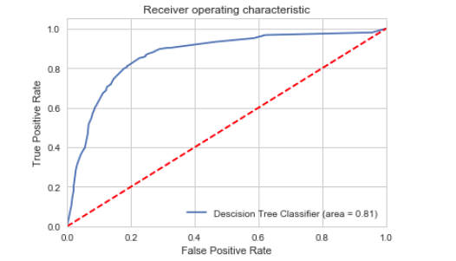
Decision Tree
Tuned with model parameter – MaxDepth
Used 10—fold cross validation with Grid search to pick the best tuning parameter.
As shown in the ROC curve the accuracy was around 81%

Slide 13
Decision Tree
Decision tree is prone to overfitting.
One way to combat this issue is by setting a max depth. This will limit our risk of overfitting; but as always, this will be at the expense of error due to bias. So for example Thus if we set a max depth of three, we would only ask three questions (i.e split three times). This is a simpler model with less variance sample to sample but ultimately will not be a strong predictive model.

Slide 14
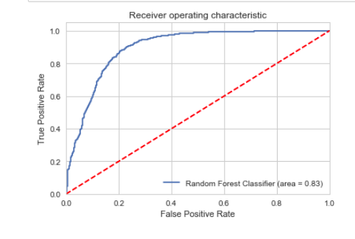
Random Forest
Tuned with model parameter – MaxDepth and N-Estimators
Used 10—fold cross validation with Grid search to pick the best tuning parameter.
As shown in the ROC curve the accuracy was around 83%

Slide 15
Random Forest
A random forest is simply a collection of decision trees whose results are aggregated into one final result. Their ability to limit overfitting without substantially increasing error due to bias is why they are such powerful models.
One way Random Forests reduce variance is by training on different samples of the data. A second way is by using a random subset of features.
Random Forest uses Bagging (Bootstrap with replacement) thus each tree only uses subset of data to train on and it also uses subset of features at each given tree This inclusion of subset of features randomly will help limit our error due to bias and error due to variance. If features weren’t chosen randomly, base trees in our forest could become highly correlated; This is because a few features could be particularly predictive and thus, the same features would be chosen in many of the base trees. If many of these trees included the same features we would not be combating error due to variance.

Slide 16
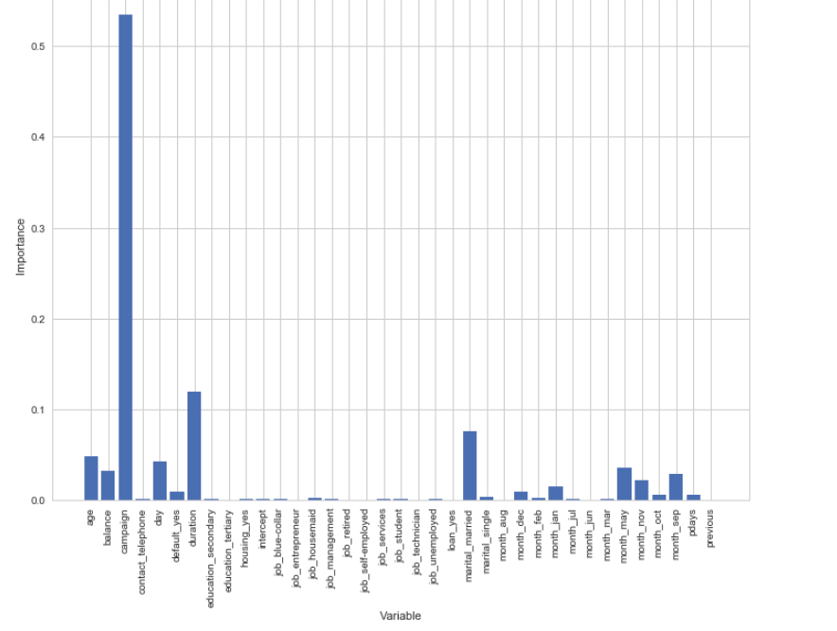
Feature Importance
One of the outcome from Random Forest is identifying the list of important features which can help our client identify the important factor.
As shown below we can easily identify the most important features as an outcome of our Random Forest classifier.

Slide 17
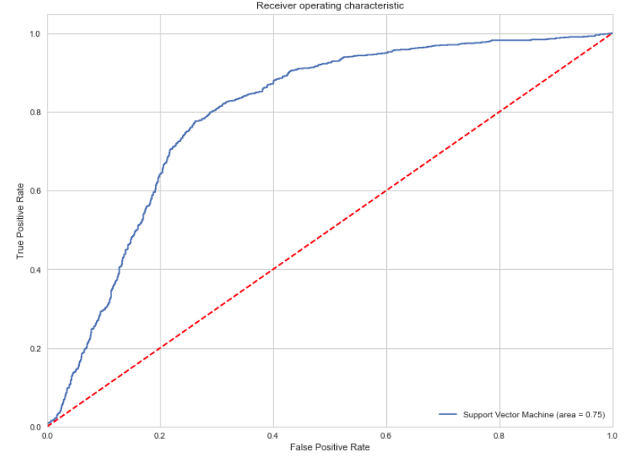
Support Vector Machine
Used RBF Kernel.
Tuned with model parameter – C and Gamma.
Used 10—fold cross validation with Grid search to pick the best tuning parameter.
As shown in the ROC curve the accuracy was around 75%

Slide 18
Support Vector Machine
SVM has a regularization parameter, which makes the user think about avoiding over-fitting.
Good at dealing with high dimensional data.
Works well on small data sets.
Secondly it uses the kernel trick, so you can build in expert knowledge about the problem via engineering the kernel.
The disadvantages are that the determination of the parameters for a given value of the regularization and kernel parameters are dependent on choice of kernel. In a way the SVM moves the problem of over-fitting from optimizing the parameters to model selection.
Picking up the right kernel and parameters can be computationally intensive.

Slide 19
Summary
Here is the summary of some of the machine learning algorithms we used and the accuracy obtained.
Algorithm | Accuracy
Logistic Regression | 78%
Decision Tree | 81%
Random Forest | 83%
Support Vector Machine | 75%
Based on the effectiveness of Random Forest Classifier we will move forward with Random Forest and use it for predicting the accuracy of the Campaign effectiveness.

