Slide 1
Recommender System
Predictor.Ai - Chintan Desai

Slide 2
Business Case
We are a Data Science Consulting company Predictor.Ai and We have been employed by a book publishing giant Ebooks.com to help them with recommender system for their E-Commerce channel based on their Loyalty Marketing historical data set containing past history of the users and their interaction with the goods (i.e books).
With the growth of E-commerce channel where more and more customers prefer to buy their goods online the business has an opportunity for maximizing their Marketing Campaign revenue by recommending goods that customer would like based on the past history of the customers buying similar products or based on the customer profile such that other customers with similar profile have bought certain goods which may be of interest to other customers with similar profile.

Slide 3
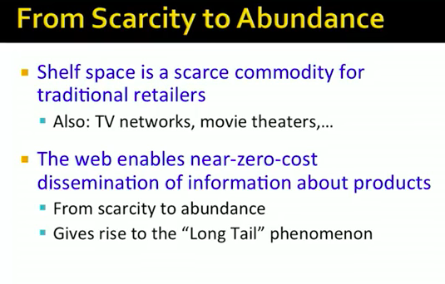
Goal

Slide 4
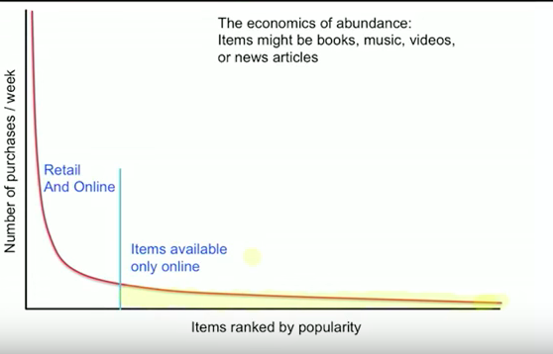
Longtail Problem
As shown above in the world where E-Commerce sales are outpacing the traditional retail channels its very easy to see a Long tail effect where only few products always bubble up at the top based on their popularity but with a properly designed recommendation interface we can recommend the items to users that suites their choice, liking and interests.

Slide 5
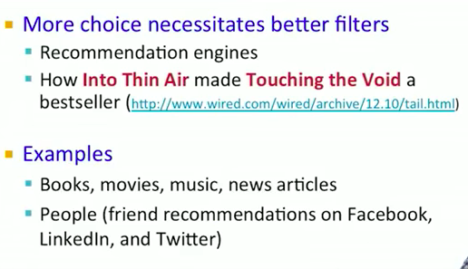
Longtail Problem
Recommendation engine is perfect for pushing the right product based on the user’s taste as well as based on the items that have been liked by the similar users.

Slide 6
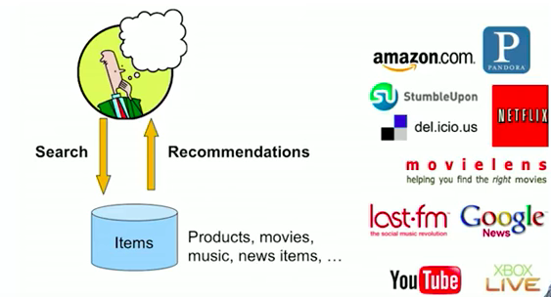
Objective
Our objective is to build a recommender system to recommend books that a given customer would most likely be interested in rather then have customer search the book on the website.

Slide 7
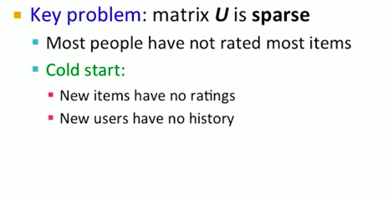
Main problem we are trying to solve for
Our objective is to build a recommender system to recommend books that a given customer would most likely be interested in rather then have customer search the book on the website.

Slide 8
Three main approaches that we are going to implement and then compare these approaches and wrap up with the best approach that we would go forward with for Ebooks.com
Recommender Systems
1> Popularity based recommender system.
2> Collaborative filtering based recommender system.
3> Latent Factor Based recommender system.

Slide 9
Popularity based recommender system
In this approach we always recommend the most popular items to the users, this system though naive and not considering personalization does not suffer from Cold-start problem and allows us to push the most popular items to the user in case the user is brand new and we do not have a history of likes/dis-likes for this user.

Slide 10
Collaborative Filtering based recommender system
Collaborative Filtering techniques fall into “Memory Based” recommender systems.
Two Type of Collaborative Filtering:
Item-Item Collaborative Filtering.
User-User Collaborative Filtering.
User-User filtering takes a particular user, find users that are similar to that user based on similarity of ratings, and recommend items that those similar users liked.
Item-item filtering will take an item, find users who liked that item, and find other items that those users or similar users also liked. It takes items and outputs other items as recommendations.
Item-Item Collaborative Filtering:“Users who liked this item also liked …”
User-User Collaborative Filtering:“Users who are similar to you also liked …”

Slide 11
Item-Item and User-Item CF
-In theory, User-User and Item-Item are dual approaches but in Practice Item-Item outperforms User-User in many use cases.
-Items are ‘Simpler’ than users:
- Items belong to a small set of ‘genres’, users have varied tastes.
-Item Similarity is more meaningful than User Similarity.

Slide 12
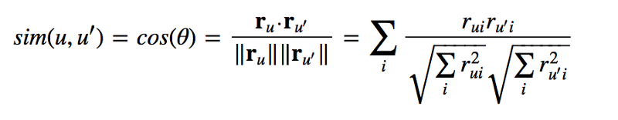
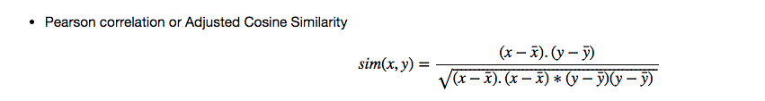
Cosine Similarity - Item-Item and User-User CF
A common distance metric is cosine similarity. The metric can be thought of geometrically if one treats a given user’s (item’s) row (column) of the ratings matrix as a vector. For user-based collaborative filtering, two users 'similarity is measured as the cosine of the angle between the two users 'vectors. For users u and u′, the cosine similarity is:
Often in practice normalized or adjusted the cosine similarity is used and its as shown below, basically subtracting the mean from the value to normalize :

Slide 13
Pros and Cons of Collaborative Filtering
Pros | Cons
As no training or optimization is involved, it is an easy to use approach. | Its performance decreases when we have sparse data which hinders scalability of this approach for most of the real-world problems.
No Feature selection needed , works for any type of item. | Cold-Start problem, for new Item or User there is no history also need enough Users/Items in the system to find a match.
 | Tend to recommend popular items.
 | User Rating matrix is sparse ,hard to find users that have rated the same items.

Slide 14
Latent Factor Based recommender system.
Latent Factor based recommender system falls into "Model Based ”recommender systems.
The key difference of memory-based approach from the model-based techniques is that we are not learning any parameter using gradient descent (or any other optimization algorithm). The closest user or items are calculated only by using Cosine similarity or Pearson correlation coefficients, which are only based on arithmetic operations.
Matrix Factorization based methods like SVD or NMF can be used to identify the latent factors in the data within high dimension space.
Here is a general intuition behind methods such as SVD or NMF.

Slide 15
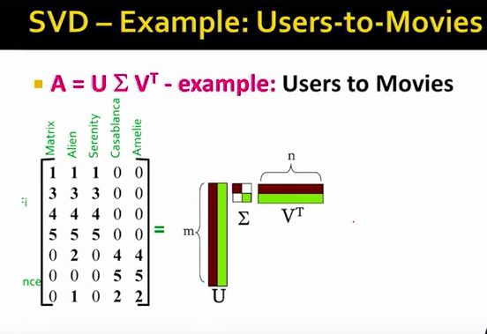
Intuition behind SVD
*
Assuming matrix A is user to item rating matrix.
With SVD we can decompose this matrix A into three matrix ‘U’,’Sigma’ and ‘V transpose’
*
Slide reference - Mining Massive Data Set – Stanford University - Jure Leskovec, Anand Rajaraman, Jeff Ullman

Slide 16
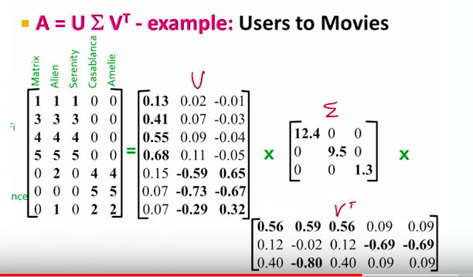
Intuition behind SVD
*
Note that as shown here we now have three matrices U,Sigma and V-transpose that we can use to get the predicted ratings for any user for the movie that they have not seen.
*
Slide reference - Mining Massive Data Set – Stanford University - Jure Leskovec, Anand Rajaraman, Jeff Ullman

Slide 17
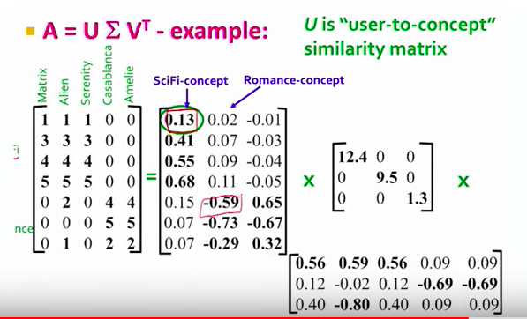
Intuition behind SVD
*
Assuming matrix A is user to item rating matrix.
With SVD we can decompose this matrix A into three matrix ‘U’,’Sigma’ and ‘V transpose’
*
Slide reference - Mining Massive Data Set – Stanford University - Jure Leskovec, Anand Rajaraman, Jeff Ullman

Slide 18
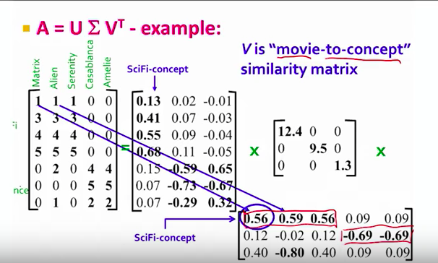
Intuition behind SVD
*
Assuming matrix A is user to item rating matrix.
With SVD we can decompose this matrix A into three matrix ‘U’,’Sigma’ and ‘V transpose’
*
Slide reference - Mining Massive Data Set – Stanford University - Jure Leskovec, Anand Rajaraman, Jeff Ullman

Slide 19
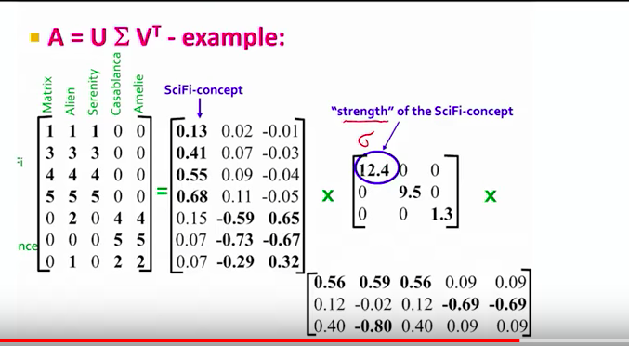
Intuition behind SVD
*
Assuming matrix A is user to item rating matrix.
With SVD we can decompose this matrix A into three matrix ‘U’,’Sigma’ and ‘V transpose’
*
Slide reference - Mining Massive Data Set – Stanford University - Jure Leskovec, Anand Rajaraman, Jeff Ullman

Slide 20
Workflow
Entity relationship
EDA (Exploratory Data Analysis) with Outlier detection and correction.
Removing unwanted variables from the feature set.
Replacing/Removing Null.
Feature Engineering.
Merging the data frames to get the User-Book-UserRating.
Feature engineering on Merged Data Frame
Data Wrangling on Merged data frame to get User-Item matrix like format.
Replacing Null.
Selecting data to be able to process condense the data suitable for the personal computer.
Machine Learning.

Slide 21
Entity relationship
Books
Users
1:m
1:m
User Rating
As shown above ‘Users’ data set contains the details on User, this is more of a User master table.
‘Books; data set contains the details on Books, this is more of a Books master table.
‘User Rating’ is a dataset that contains the rating of a book by a User.
Note that all the three data sets are contained within their own CSV file and so we load each of them separately into Pandas data frame and then merge the ‘Books’ and ‘Users’ with ‘User Rating’ to get the pandas data frame that contains all the details on Book as well as User along with the rating of the Book by User.

Slide 22
Removal Of Unwanted Variables from feature set
First we perform the data wrangling on each individual data set to remove unwanted features as well as replace null values and remove outliers.
Removed and Replaced the features from ‘Books', 'Users’ and ‘Ratings’ data set.
For the detailed steps and procedure involved in removing and replacing various features and outliers from the ‘Books', 'Users’ and ‘Ratings’ data set , please refer to the Technical_Design_Document.
Second we merge the data frame as shown below
df = pd.merge(user_book_ratings,books,on='ISBN’) - Merging User rating and Books
df_new = pd.merge(df,users,on='User-ID’) – Merging Users
Third we perform EDA and data wrangling on the Merged Data Frame
df = pd.merge(user_book_ratings,books,on='ISBN’) - Merging User rating and Books
df_new = pd.merge(df,users,on='User-ID’) – Merging Users

Slide 23
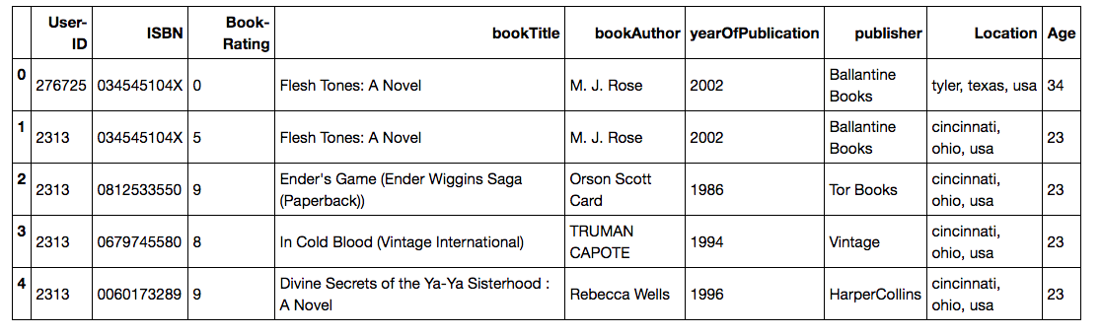
Merged Data Frame with User-Book-Rating
Here is how the Merged Data Frame looks like.
We can clearly see that it has User details (User-ID,Location,Age).
We can clearly see that it has Books details (ISBN,Book Title,Book Author,Year of Publication,Publisher).
We can clearly see that it has Ratings (Book-Rating) that a given user has given to a given book.

Slide 24
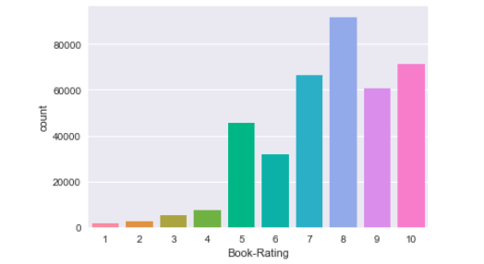
Merged Data Frame Data Wrangling and Feature Engineering
To make sure we remove any Books with total ratings that are zero ‘0’ so that we only have ratings that are either “1” or higher so that its much easier to process by the algorithms downstream and for this reason we will treat the rating of “0” as the fact that no user has read the book and we filter out those rows where the rating is“0”.
Note that we will have lot of books that user has not read or rated and these are the books that we will try to predict the ratings for.
After removing zero ratings we have the distribution of ratings as shown below.

Slide 25
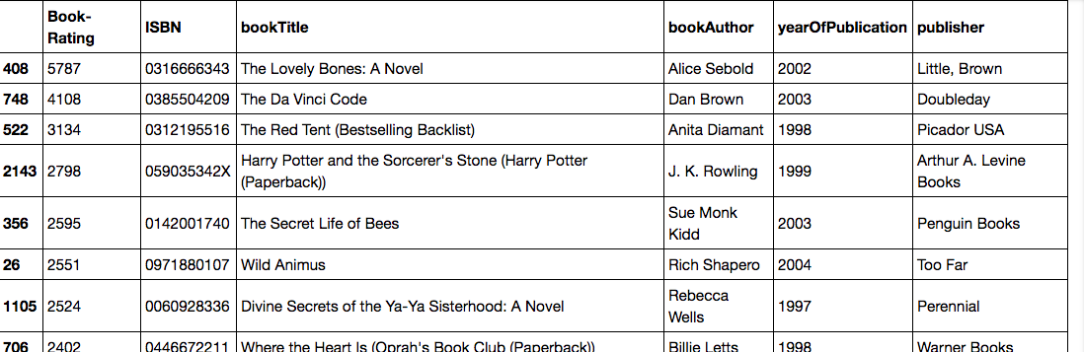
Popularity Based Recommender System
We pick the Top-10 books by popularity.
Here we pick the 10 books with the highest ratings by summing up the ratings of each book.
Here is the Top-10 recommended books purely based on Popularity.
Note that this approach is very useful when we start since it does not suffer from the ‘Cold-start’ problem.

Slide 26
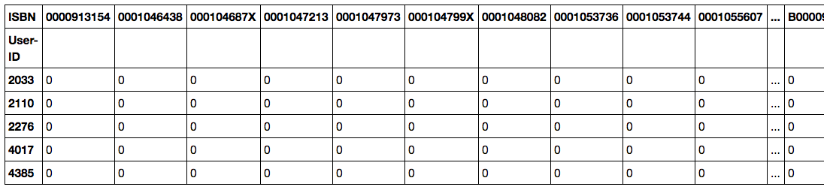
Transform the Data to get User-Item Matrix
In order for us to use Collaborative filtering we will need to transform the dataset into the following format so that we can then calculate the distances by using techniques like Manhattan distance, Euclidean distance,Jaccard similarity or Cosine Similarity.
Book | Book-1 | Book-2 | Book-3 | Book-4
User
User-1 | 2 | 1 | 0 | 3
User-2 | 0 | 0 | 0 | 1
User-3 | 5 | 1 | 0 | 0
As shown below when we transform the dataset to User-Books what we get is a very sparse metrics since not all books have been rated by a given User and only few books are rated by a given User so as shown below what we get is lot of ‘0’ ratings for all the books that the User has not rated.

Slide 27
Collaborative Filtering
In order for us to use Collaborative filtering we will need to transform the dataset into the following format so that we can then calculate the distances by using techniques like Manhattan distance, Euclidean distance,Jaccard similarity or Cosine Similarity.
Book | Book-1 | Book-2 | Book-3 | Book-4
User
User-1 | 2 | 1 | 0 | 3
User-2 | 0 | 0 | 0 | 1
User-3 | 5 | 1 | 0 | 0
As shown below when we transform the dataset to User-Books what we get is a very sparse metrics since not all books have been rated by a given User and only few books are rated by a given User so as shown below what we get is lot of ‘0’ ratings for all the books that the User has not rated.

Slide 28
User-User Collaborative Filtering
Here we check the users who are similar to a given user and see if they rated an item that is not yet rated by our user and if so we provide the predicted rating for this item for our user.
Note that for each User we try to find two other similar users using the Cosine similarity between the users.
Item-Item Collaborative Filtering
Here we check the Items that are similar to a given Item and see if they were rated by our User and if so we provide the predicted rating for this item for our user.
Note that for each Item we try to find two other similar Items using the Cosine similarity between the Items.

Slide 29
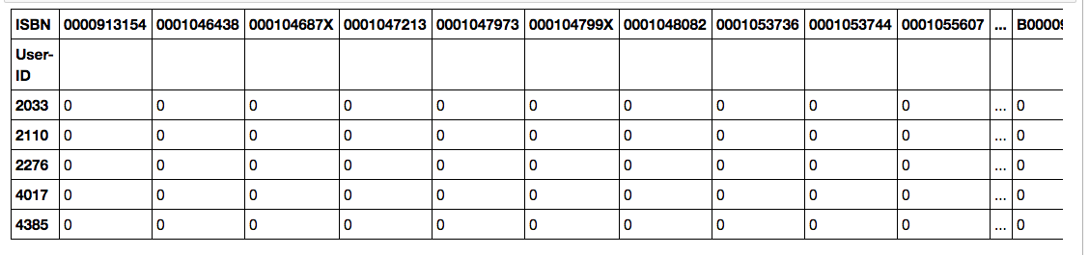
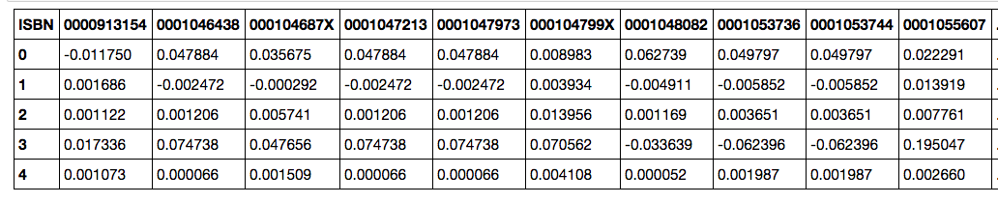
Matrix Factorization Based Recommendations
In order to optimize for the Matrix Factorization based recommender systems we first need to convert the Pandas data frame to Matrix since Matrix factorization will need Matrix multiplication.
As shown below we convert the panda data frame to matrix
as_matrix()

Slide 30
Matrix Factorization Based Recommendations
Next we follow the process outlined below to optimize for hyper parameter ‘K’ that is part of ‘SVD’ algorithm of Sklearn and try to find the value of ‘K’ that gives us lowest RMSE.
RMSE here is the error , lower then better and its calculated based on the difference in Actual rating versus predicted rating.
Once we find the value of ‘K’ that gives us lowest RMSE we go with this ‘K’ and run SVD on the entire matrix to get the prediction for each user for each Book.
Train_Test_Split
SVD on Training Data for a Given Value of ‘K’
Try Different Value of ‘K’
If RMSE lower than previous
If RMSE not lower than previous
Use RMSE to assess the quality of the prediction
STOP

Slide 31
Matrix Factorization Based Recommendations
Here is the table showing various values of ‘K’ along with the RMSE
K | RMSE
50 | 0.515
20 | 0.486
8 | 0.457
As we can see ’K’ = 8 is the best value as it gives us the minimum RMSE so we will go with K=8.
As shown below for each User we will get the probability of the ratings for each book and so we pick the top-10 ratings and present it to the user.

Slide 32
Closing Comments
As we can see Collaborative Filtering is great but it suffers from cold-start problem as well as performance issues due to sparsity of matrix.
Matrix factorization works best but the factors are cryptic and so its not possible to learn/understand the factors that were considered by SVD.

