Slide 1
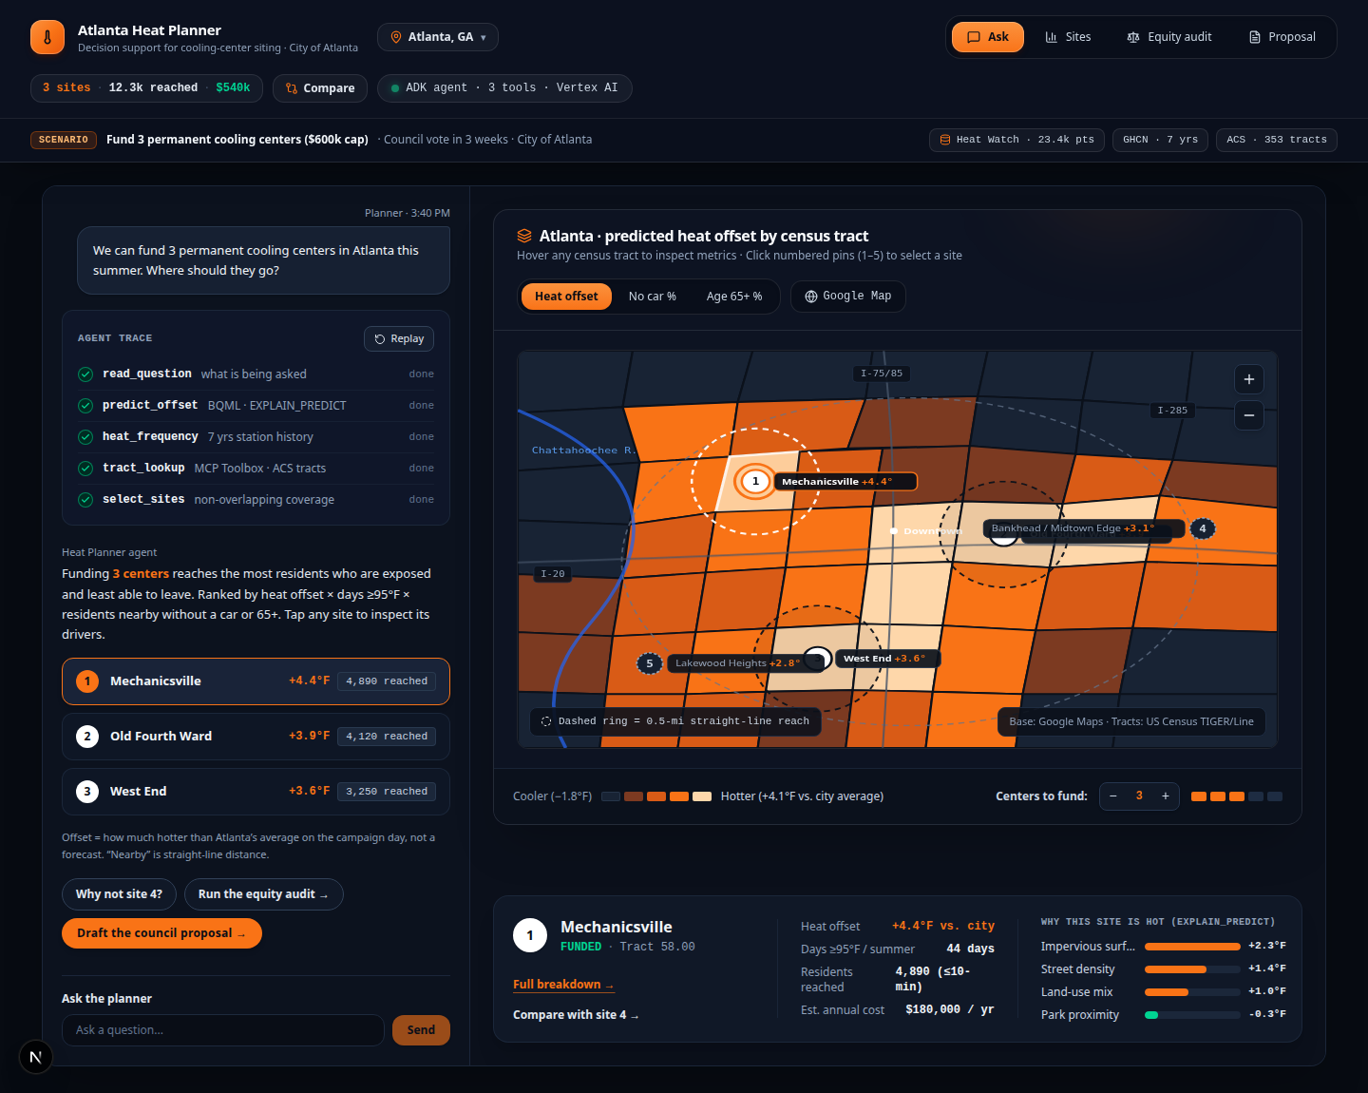
CHALLENGE 1: CLIMATE RESILIENCE · CITY OF ATLANTA · TRACK: THIS BUDGET CYCLE
Slide 1 of 6
Three Permanent Cooling Centers, Sited Where Heat Hurts Most
The Municipal Decision Scenario (Atlanta, GA)
▸ Who Is Asking: Dana, Mayor's Office of Sustainability & Resilience. It is 3:40 PM Tuesday; City Council votes in 3 weeks on the FY26 capital budget.
▸ The Budget Mandate: $600,000 capital allocation to fund 3 permanent cooling centers ($180k/yr each) across 353 Atlanta census tracts.
▸ The Microclimate Inequality: Airport forecasts report one city temperature, but 23,386 street-level Heat Watch traverses (city mean 82.06°F) show neighborhoods 2 miles apart differ by up to 13.5°F (-5.79°F to +7.70°F offset).
▸ Why Raw Sensors Fail Council: Siting on peak temperature alone places centers in unpopulated rail yards or clusters all 3 in one district; siting on politics leaves transit-dependent seniors unserved.
▸ Our Solution: A live Google Cloud ADK + BigQuery ML spatial decision assistant that predicts street-level heat offsets (°F above city mean), explains physical drivers, enforces non-overlapping catchments, and audits equity.
Speaker Note: "We chose Atlanta on the 'This Budget Cycle' track. Our planner has $600k to site 3 permanent cooling centers before Council votes in 3 weeks. We built an AI assistant that predicts microclimate heat offsets, proves who benefits, and survives a contested City Council hearing."
Atlanta Urban Heat Resilience Planner · Agents for Impact 2026 (Challenge 1)
Live Demo: https://urban-heat-ui-1042443035046.us-central1.run.app
Notes:
"We chose Atlanta on the 'This Budget Cycle' track. Our planner has $600k to site 3 permanent cooling centers before Council votes in 3 weeks. We built an AI assistant that predicts microclimate heat offsets, proves who benefits, and survives a contested City Council hearing."

Slide 2
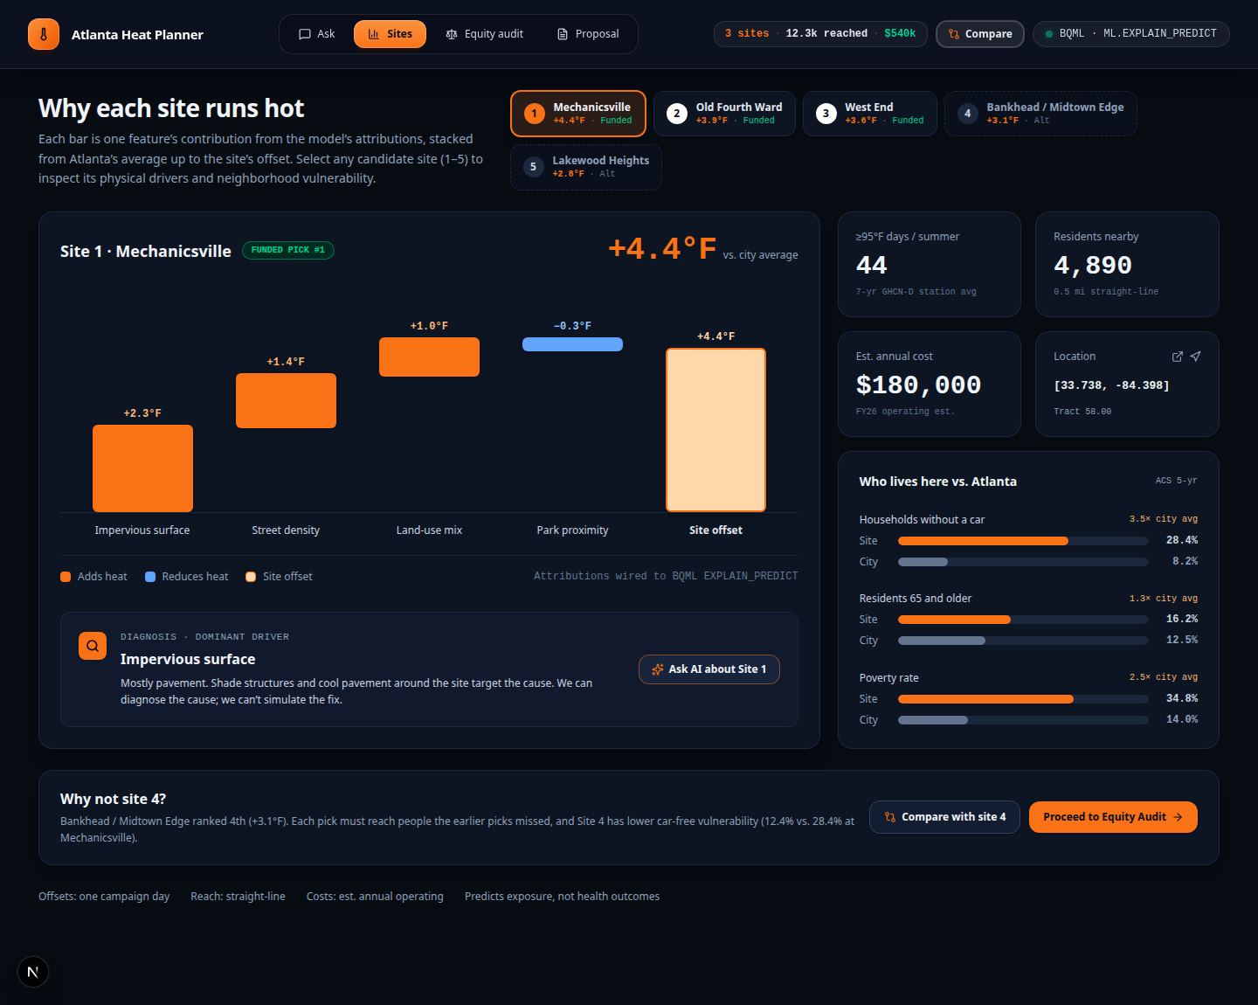
PLACEMENT RECOMMENDATION · BIGQUERY ML (ML.EXPLAIN_PREDICT) & SPATIAL SITING
Slide 2 of 6
The Answer: 3 Non-Overlapping Sites + Why Site #4 Was Displaced
3 Funded Picks ($540k / $600k Cap · 12,260 Reached in 0.5 mi)
▸ Offset, Never Raw Temperature: Every site is scored on predicted thermal offset (+°F vs. 82.06°F city mean) × 7-yr NOAA GHCN hot days (≥95°F) × car-free & 65+ senior density, with greedy ≥2.0 km spacing.
▸ Site #1 · Mechanicsville (Tract 58.00 / 76.03): +4.4°F vs. city mean · 44 days/yr ≥95°F · 4,890 residents in 0.5 mi (28.4%–56.4% no-car, 16.2% 65+). EXPLAIN_PREDICT drivers: Impervious surface (+2.3°F), Street density (+1.4°F), Land-use mix (+1.0°F), Park proximity (-0.3°F).
▸ Site #2 · Old Fourth Ward / Ashview (Tract 42.00): +3.9°F vs. city mean · 42 days/yr ≥95°F · 4,120 residents (24.1%–46.7% no-car, 17.8% 65+). Drivers: Impervious surface (+1.9°F), Street density (+1.4°F).
▸ Site #3 · West End / Summerhill (Tract 48.00): +3.6°F vs. city mean · 41 days/yr ≥95°F · 3,250 residents (22.5%–38.0% no-car, 14.6%–24.2% 65+). Unmeasured tract predicted via BQML.
▸ Why Not Site #4 (Bankhead / Midtown Edge)? Runs +3.1°F (39 days ≥95°F) but has less than half the car-free rate (12.4% vs. 28.4% at Site #1) and reaches 2,480 vs. 4,890 residents.
Speaker Note: "Notice two critical things: first, we predict thermal offset above the city mean—never fake point forecasts—and decompose every site into °F physical drivers via ML.EXPLAIN_PREDICT. Second, we explicitly answer why runner-up Site 4 in Bankhead was passed over."
Atlanta Urban Heat Resilience Planner · Agents for Impact 2026 (Challenge 1)
BQML Model: qwiklabs-gcp-04-ec3596addc43.a4i_ml.offset_model_v1
Notes:
"Notice two critical things: first, we predict thermal offset above the city mean—never fake point forecasts—and decompose every site into °F physical drivers via ML.EXPLAIN_PREDICT. Second, we explicitly answer why runner-up Site 4 in Bankhead was passed over."

Slide 3
OUR TEAM · CROSS-FUNCTIONAL ENGINEERING LANES · AGENTS FOR IMPACT 2026
Slide 3 of 6
Our Team: Built Across Four Specialized Engineering Lanes
Rama Chintamaneni (@chintamanenirc · chintamaneni.rc@gmail.com)
CLOUD PLATFORM, ADK AGENT & MCP LEAD
• Google ADK & Tooling: Architected the HeatPlanner ADK agent, system instructions, ground-rule refusal gates, and Google Maps Geocoding integration.
• Managed MCP Toolbox: Deployed private Cloud Run MCP Toolbox (heat-toolbox) with parameterized BigQuery tools (tools.yaml) and workload identity auth.
• Spatial Siting Engine: Built Haversine greedy spacing (spread_sites >= 2.0 km) and VizSpecBuilder contracts across PRs #6, #7, #10, and #11.
Harika (@harika126 · harika126@gmail.com)
DATA ARCHITECTURE & ORCHESTRATION LEAD
• 4-Layer Medallion Warehouse: Engineered a4i_core, a4i_semantic, and a4i_ml in BigQuery (353 tracts, 2,020 geohash-7 cells, 17,452 GHCN station-days).
• Data Quality & Licensing: Resolved -9999.0 sentinels, LPAD 11-char FIPS, joined US Census TIGER & ACS 65+ (100% match), and passed 13/13 validation checks.
• Zero-Skew Feature TVF: Built a4i_ml.point_features(pts) with 500 m campaign footprint refusal gate and co-built Stage 1/2 HeatPlannerOrchestrator.
Faizan Chundrigar (@faizy31796 · faizy31796@gmail.com)
MACHINE LEARNING & EQUITY ANALYTICS ENGINEER
• Leak-Free BQML Model: Trained a4i_ml.offset_model_v1 (LINEAR_REG, enable_global_explain=TRUE, l2_reg=0.1) with zero drive-day or racial features.
• Spatial-Block Validation: Designed geohash-5 (~4.9 km) spatial-block holdout (1,378 train / 484 eval cells) beating baseline (MAE 1.254°F vs. 1.355°F).
• Grid Scoring & Equity Audit: Pre-computed 5,618 ~250 m ML.EXPLAIN_PREDICT points (grid_predictions) and authored sql/audit/audit.sql outcome audit.
N. Viradiya (@nviradiya · Urban Heat Team)
FULL-STACK AI & GEOSPATIAL UX LEAD
• Production Next.js 16 + React 19 UI: Built the 4-tab municipal workbench (Ask, Sites, Equity Audit, Proposal) with interactive Voronoi census tract tessellation.
• Grounding Verifier & Live API: Implemented GroundingVerifier & FallbackRenderer to verify every °F, %, and headcount against live BigQuery semantic data.
• Human-in-the-Loop Governance: Created interactive Site 1 vs. Site 4 trade-off modal, Equity Audit scatter plot, and signed Council Proposal PDF exporter.
Speaker Note: "Our four-person team split into parallel engineering lanes—Data & Medallion Architecture, BigQuery ML & Equity Analytics, ADK Agent & Managed MCP Toolbox, and Full-Stack Geospatial UI—governed by a shared contract and decision log (DEC-001 through DEC-011)."
Atlanta Urban Heat Resilience Planner · Agents for Impact 2026 (Challenge 1)
GitHub: https://github.com/chintamanenirc/A4I2026-challenge-1-walkability
Notes:
"Our four-person team split into parallel engineering lanes—Data & Medallion Architecture, BigQuery ML & Equity Analytics, ADK Agent & Managed MCP Toolbox, and Full-Stack Geospatial UI—governed by a shared contract and decision log (DEC-001 through DEC-011)."

Slide 4
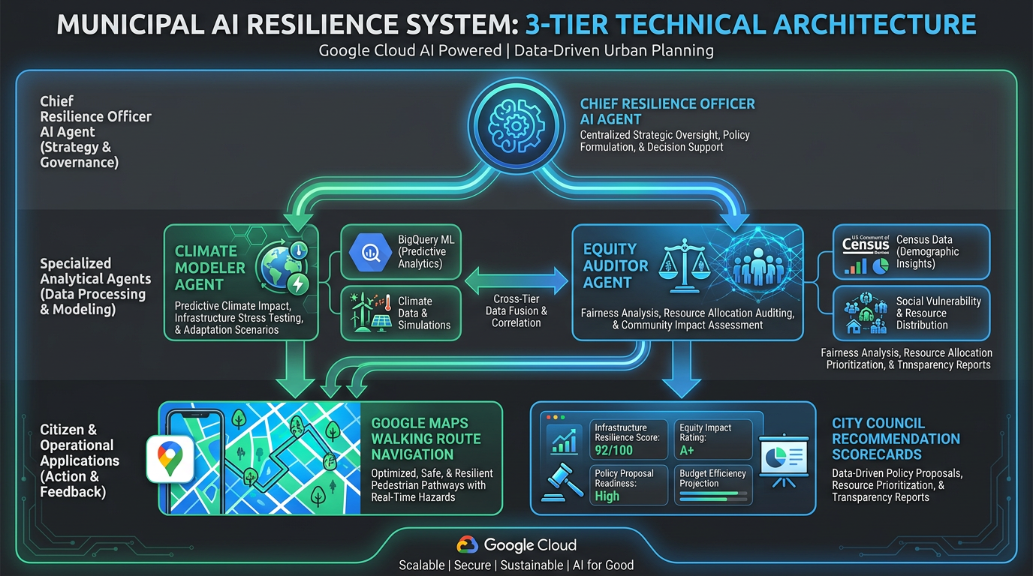
TECHNICAL EXECUTION & RIGOR · GOOGLE ADK + BIGQUERY ML + MANAGED MCP TOOLBOX
Slide 4 of 6
Architecture & Why You Can Trust It: Leak-Free Spatial Holdout
End-to-End Google Cloud Stack & Validation Rigor
▸ Google ADK + Gemini 2.5 Flash: Multi-agent orchestrator calling custom Python tools (explain_heat_offset, select_cooling_center_sites, run_equity_audit) + GroundingVerifier.
▸ Managed MCP Server (heat-toolbox): Cloud Run MCP Toolbox for Databases exposing parameterized SQL tools over a4i_semantic (dim_tract, site_hot_days, vulnerable_population) with least-privilege IAM (toolbox-sa, heat-agent-sa).
▸ Where vs. How Often Separation: Heat Watch (23,386 readings, 100% NULL timestamps) answers spatial WHERE; 7-year NOAA GHCN daily history (17,452 station-days across 7 stations) answers temporal HOW OFTEN via site_hot_days(offset_f).
▸ Defeating 1 Hz Spatial Leakage: Aggregated 23,386 points into 2,020 geohash-7 (~150 m) cells and held out 6 whole geohash-5 (~4.9 km) blocks (484 eval / 1,378 train). Excluded temp_f, heat_index_f, humidity_pct, and all race columns.
▸ Verified BQML Performance: a4i_ml.offset_model_v1 beats predict-zero baseline on held-out spatial blocks (MAE = 1.254°F vs. 1.355°F; RMSE = 1.542°F vs. 1.622°F) and passes 13/13 SQL validation checks.
Speaker Note: "A random split on 1 Hz road readings leaks adjacent points and yields a fake 0.98 R². We aggregated to 150m geohash-7 cells, held out entire 5km geohash-5 spatial blocks, stripped all drive-day temperatures and race columns, and beat the baseline honestly (1.254°F vs 1.355°F MAE)."
Atlanta Urban Heat Resilience Planner · Agents for Impact 2026 (Challenge 1)
Project: qwiklabs-gcp-04-ec3596addc43 · Region: us-central1
Notes:
"A random split on 1 Hz road readings leaks adjacent points and yields a fake 0.98 R². We aggregated to 150m geohash-7 cells, held out entire 5km geohash-5 spatial blocks, stripped all drive-day temperatures and race columns, and beat the baseline honestly (1.254°F vs 1.355°F MAE)."

Slide 5
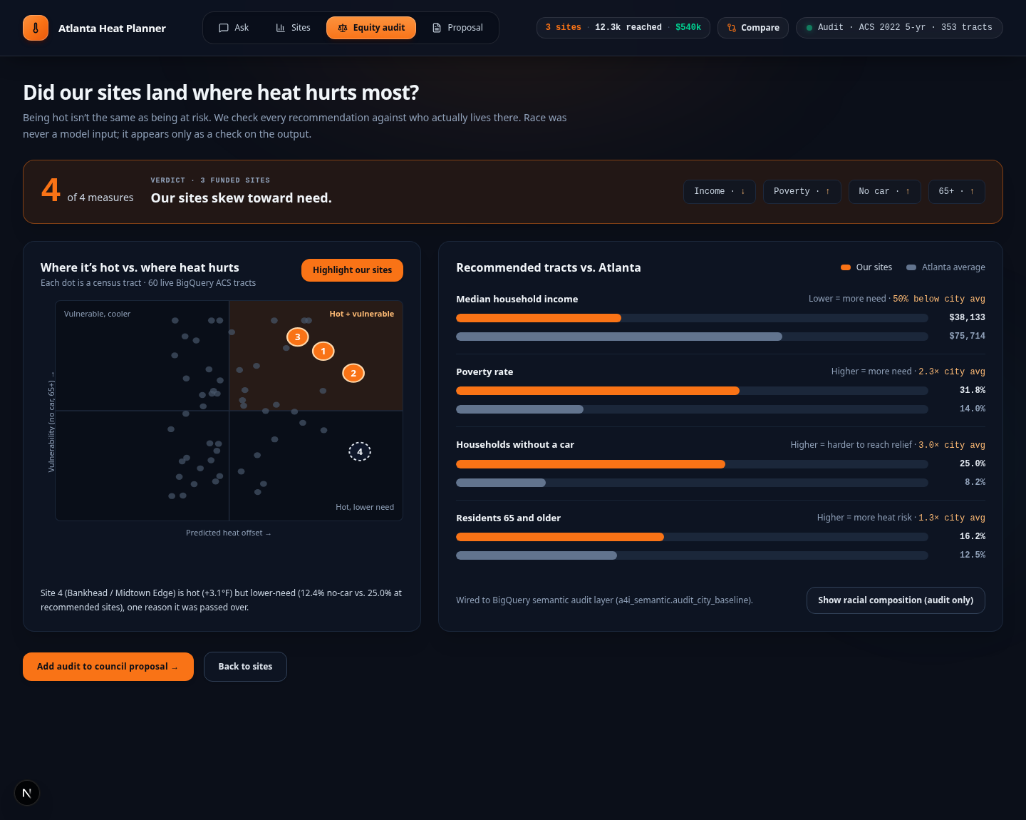
ETHICAL AI & OUTCOME AUDIT · RACE EXCLUDED FROM INPUTS, AUDITED ON OUTPUTS
Slide 5 of 6
Equity Audit: 4 of 4 Measures Confirm Need-Based Prioritization
Post-Hoc Equity Audit vs. Atlanta Baseline (353 Tracts)
▸ Strict Ethical Guardrail (DEC-005): Race and ethnicity are never used in a4i_core, BQML training features, or site ranking. We audit the recommended outputs post-hoc against a4i_semantic.audit_city_baseline.
▸ Households Without a Vehicle: 25.0% in 0.5-mi catchment (50.41% in core tracts) vs. 8.23% Atlanta average → 3.0x to 6.12x higher transit dependency.
▸ Poverty Rate: 31.8% in catchment (44.05% in core tracts) vs. 13.95% Atlanta average → 2.3x to 3.16x higher poverty concentration.
▸ Seniors Aged 65+: 16.2% in catchment (19.44% in core tracts) vs. 12.47% Atlanta average → 1.3x to 1.56x higher senior vulnerability.
▸ Median Household Income: $38,133 in catchment ($17,853 in core tracts) vs. $75,714 Atlanta average (50% to 76% below citywide median).
▸ Post-Hoc ACS Racial Check (Output Only): Selected tracts are 90.81% Black residents vs. 41.66% citywide (2.18x), proving physical heat + transit siting reaches historically redlined neighborhoods without demographic bias in the model.
Speaker Note: "Race was never a model input. Yet when we run our post-hoc equity audit across all 353 Atlanta census tracts, our 3 recommended sites reach communities with 3.0x to 6.1x higher car-free households, 2.3x to 3.2x higher poverty, and half the citywide median income."
Atlanta Urban Heat Resilience Planner · Agents for Impact 2026 (Challenge 1)
Audit View: qwiklabs-gcp-04-ec3596addc43.a4i_semantic.audit_city_baseline
Notes:
"Race was never a model input. Yet when we run our post-hoc equity audit across all 353 Atlanta census tracts, our 3 recommended sites reach communities with 3.0x to 6.1x higher car-free households, 2.3x to 3.2x higher poverty, and half the citywide median income."

Slide 6
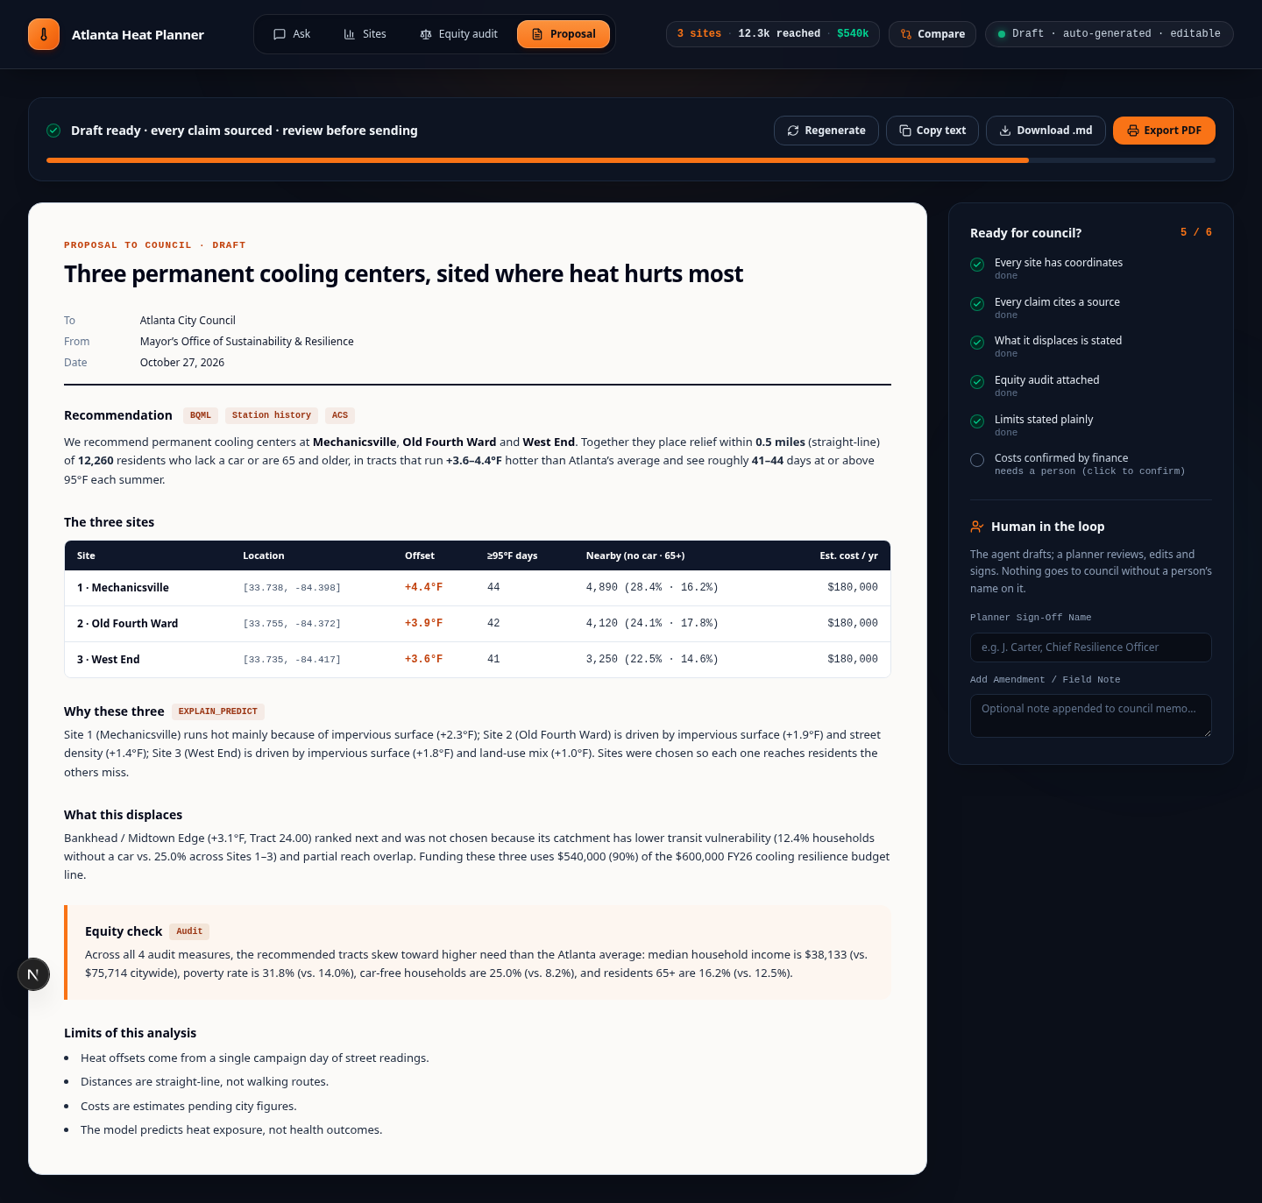
CRAFT, LIMITATIONS & SUBMISSION PACKAGE · COUNCIL-READY DELIVERABLE
Slide 6 of 6
Human-in-the-Loop Council Memo, Honest Limits & Live Links
Why Custom UI, Honest Boundaries & Submission Links
▸ Why Custom Next.js UI on Cloud Run: Planners defending a $600k vote need interactive Voronoi tract maps, Site 1 vs. Site 4 trade-off cards, and a Human-in-the-Loop sign-off memo (not a raw developer chat). Pinned min-instances=1.
▸ Honest Refusal Gate (DEC-007): a4i_ml.point_features enforces in_footprint (<=500 m from Heat Watch route). Queries in Marietta (12.3 km out) or Chicago are refused honestly.
▸ Known Model Limitations: (1) Single-day Heat Watch campaign snapshot; (2) Predicts current exposure offset, cannot simulate cooling ΔT from planting new trees; (3) Straight-line 0.5-mi / 1.5-km buffers, not turn-by-turn walk isochrones; (4) 100% US Gov/CC0 data (zero OSM/ODbL).
▸ Explore Qwiklabs Project: qwiklabs-gcp-04-ec3596addc43 · https://console.cloud.google.com/welcome?project=qwiklabs-gcp-04-ec3596addc43
▸ GitHub Repository: https://github.com/chintamanenirc/A4I2026-challenge-1-walkability
▸ Live Demo & Agent URLs: UI: https://urban-heat-ui-1042443035046.us-central1.run.app | Agent: https://urban-heat-agent-1042443035046.us-central1.run.app
Speaker Note: "Finally, the agent drafts a cited City Council memo, but nothing leaves without human planner sign-off. It states its limits plainly—single campaign day, straight-line buffers, and honest refusal outside the 500m footprint. Data: NOAA & CAPA Strategies Heat Watch (CC0), NOAA GHCN-Daily, US Census ACS. Thanks to the volunteers who drove the routes."
Atlanta Urban Heat Resilience Planner · Agents for Impact 2026 (Challenge 1)
Data: NOAA & CAPA Heat Watch (CC0), NOAA GHCN-Daily, US Census ACS/TIGER
Notes:
"Finally, the agent drafts a cited City Council memo, but nothing leaves without human planner sign-off. It states its limits plainly—single campaign day, straight-line buffers, and honest refusal outside the 500m footprint. Data: NOAA & CAPA Strategies Heat Watch (CC0), NOAA GHCN-Daily, US Census ACS. Thanks to the volunteers who drove the routes."

