Slide 1
Page Object Model
By Chintamani Manjare

Slide 2
Agenda
What, Why and How?
Architecture
Demo for a simple application
Q&A

Slide 3
What is Page object Model
Class for every webpage
Web elements as variables
Actions as Methods

Slide 4
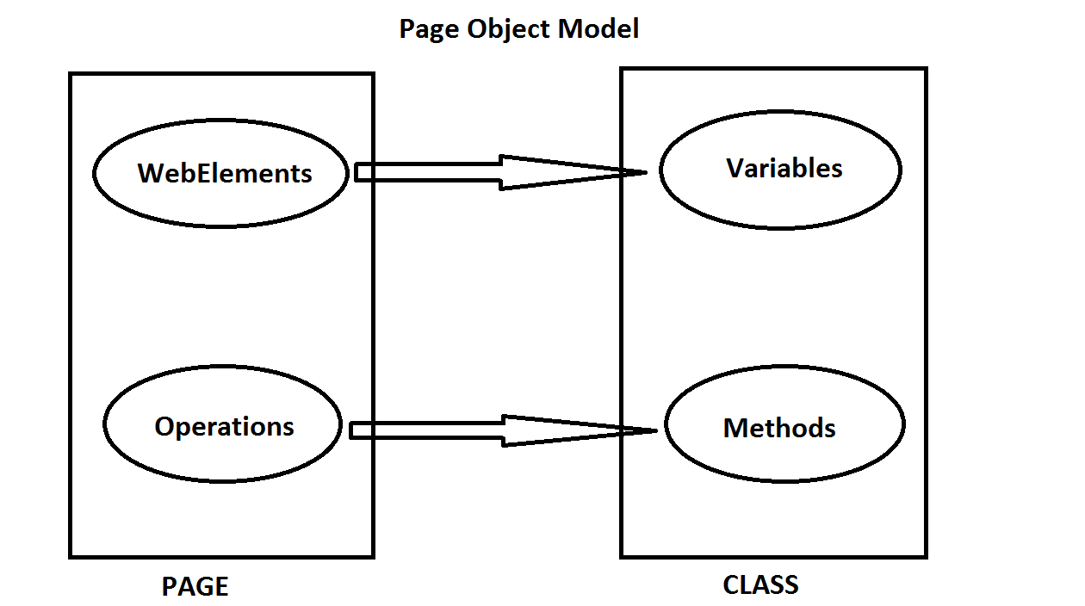
What is Page object Model

Slide 5
Why Page object model
Clean
Maintainable
Speed
Independent test execution
Avoid code duplication/ Reusability

Slide 6
Architecture
Test base
Classes for pages
Page factory
Actions
Test cases for every class
Utility
Configuration
Test data
Report

Slide 7
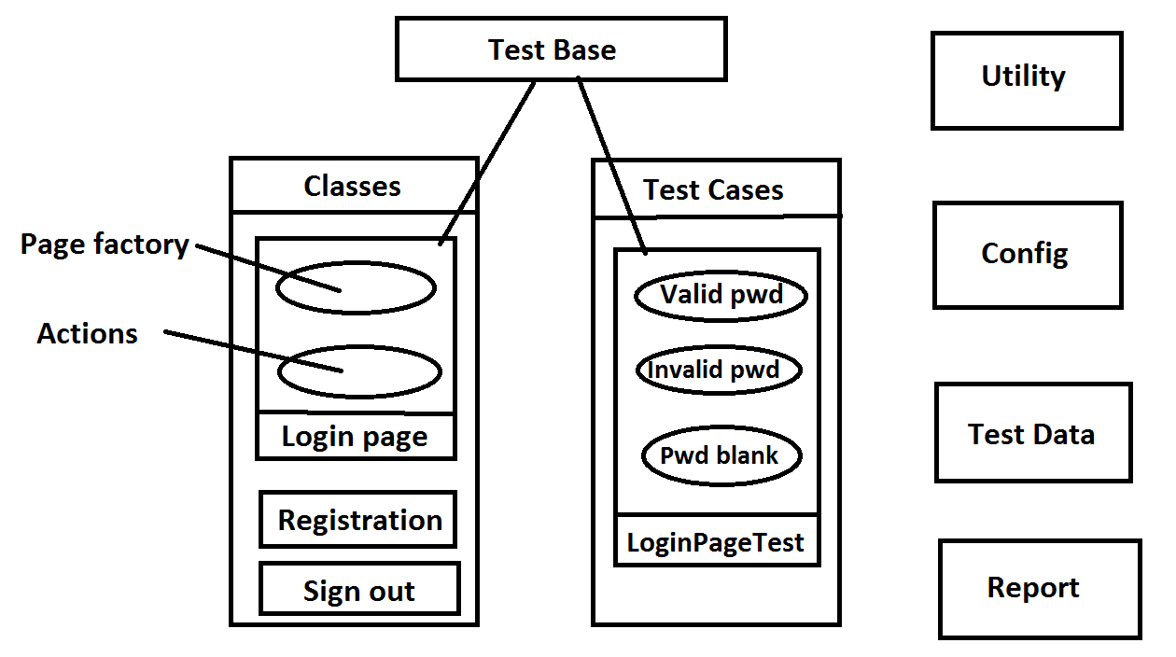
Architecture

Slide 8
Demo
Demo site - https://www.queness.com/resources/html/ajax/simple.php#page1
Selenium
TestNG
Page object model
Java

Slide 9
Some tips…
Every testcase should be independent.
Use assertion in every test case.
Assertion should be at last inside the test method.
Start new browser for every test and clean after the test.

Slide 10
Thank You

