Slide 1






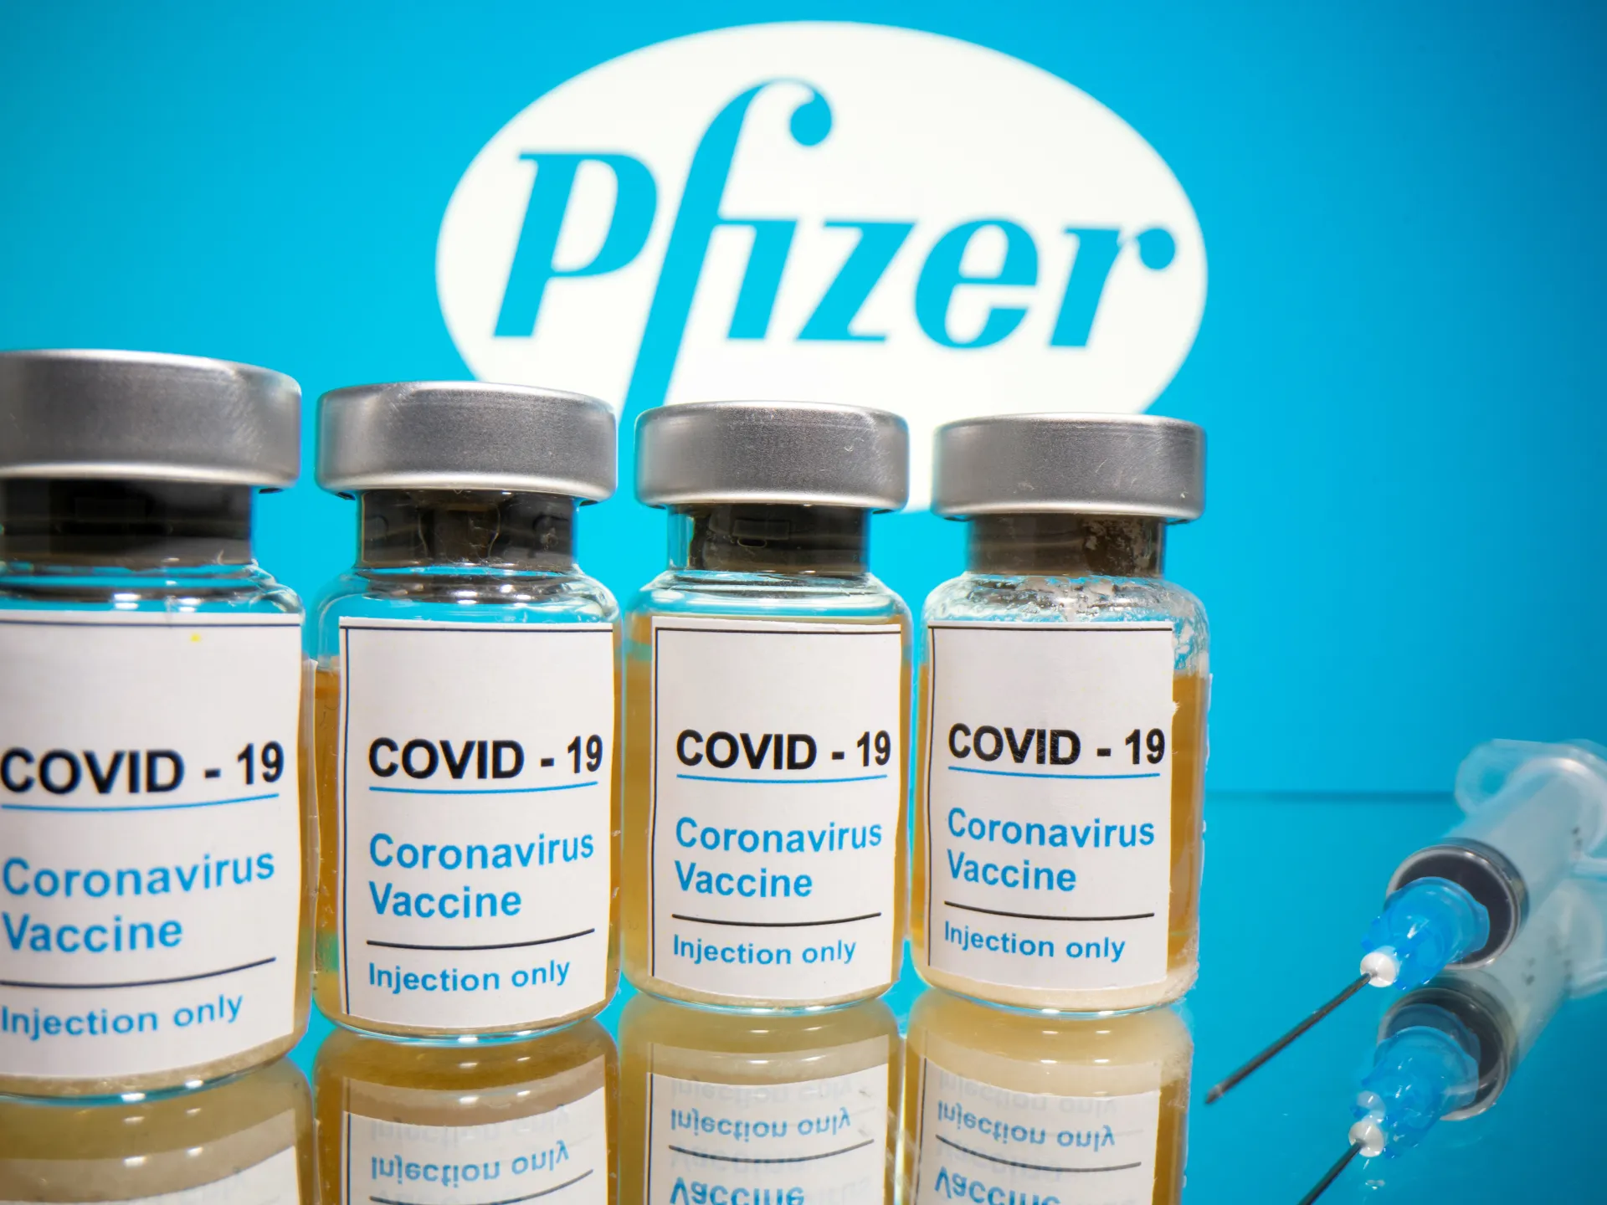






Organizational Behavior in Crisis: Pfizer’s Response to COVID-19
A Critical Evaluation Using Robbins & Judge’s OB Framework

Slide 2











Introduction
COVID-19: A test of resilience and leadership
Pfizer developed a Covid-19 vaccine in less than 9 months
Leadership
Key focus areas:
Change Management
Teamwork
Ethics
Motivation

Slide 3




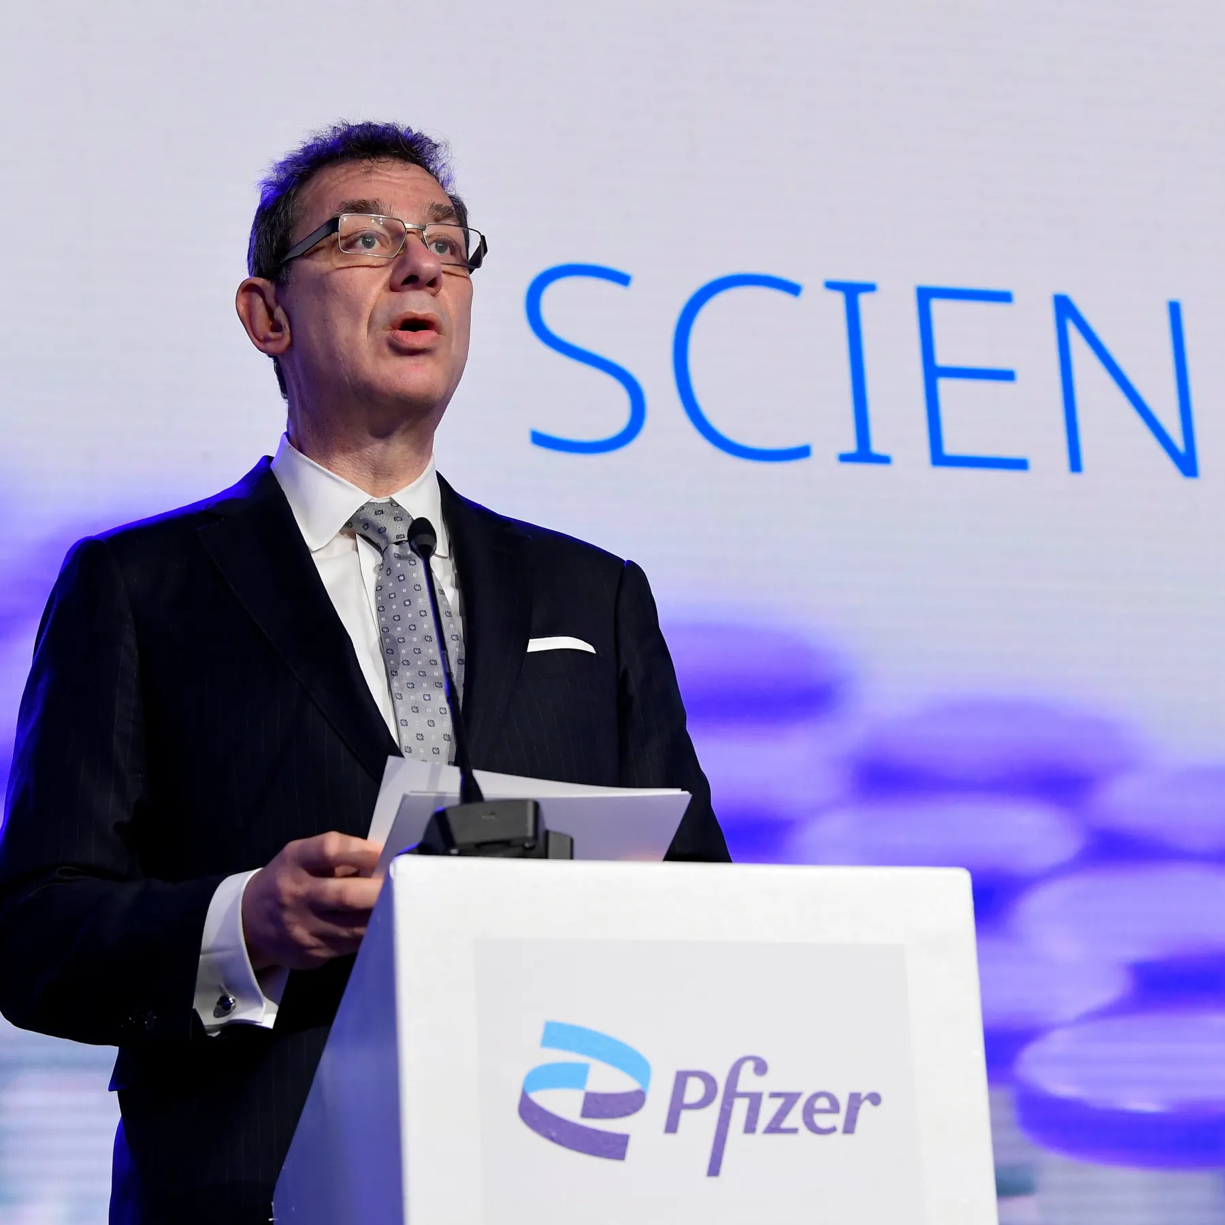




Transformational & Charismatic Leadership
CEO Albert Bourla: visionary, risk-taking leadership.
Self funded $2 billion vaccine R&D - no government contract
“Science will win” – motivational messaging across global teams.
Used bounded rationality to partner with BioNTech.

Slide 4











Team Dynamics & Communication
02
Real-time collaboration: Slack, Teams, shared dashboards.
01
Agile, self-managed, cross-functional teams (not hierarchical).
TEAM
03
Psychological safety encouraged dissent and learning.
04
Fast feedback loops

Slide 5




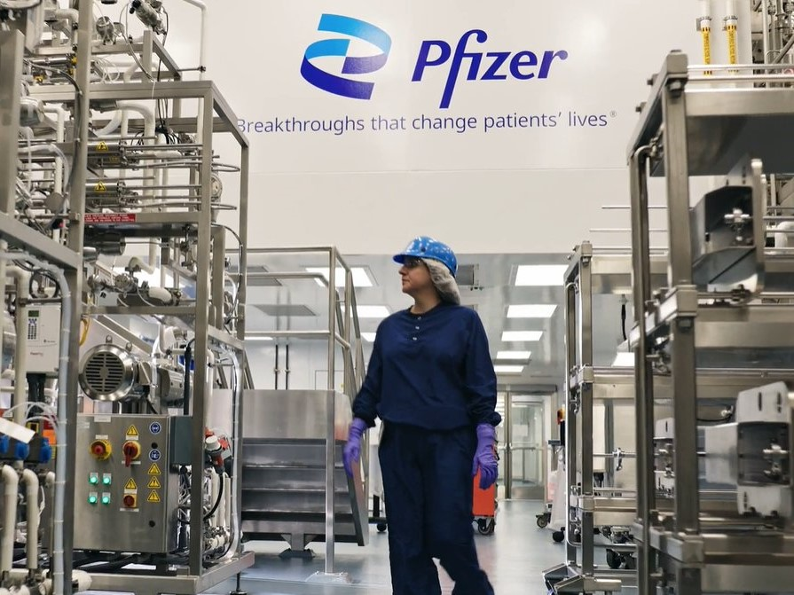




Culture & Motivation
Culture: Science + public accountability
Intrinsic: Humanitarian mission drove engagement (SDT).
Extrinsic: Bonuses, career growth, KPIs tied to mission
88% of employees found their work meaningful (Pulse Survey 2021).

Slide 6
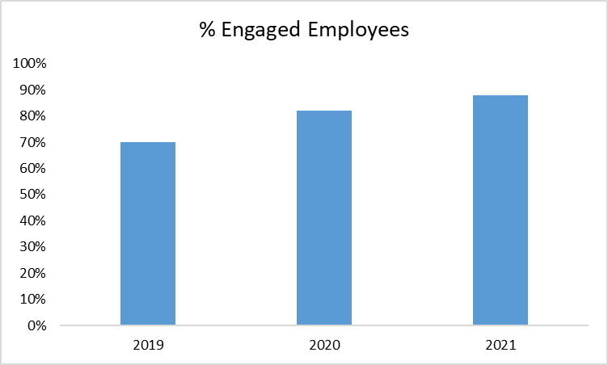
Employee Engagement at Pfizer (2019–2021)

Slide 7



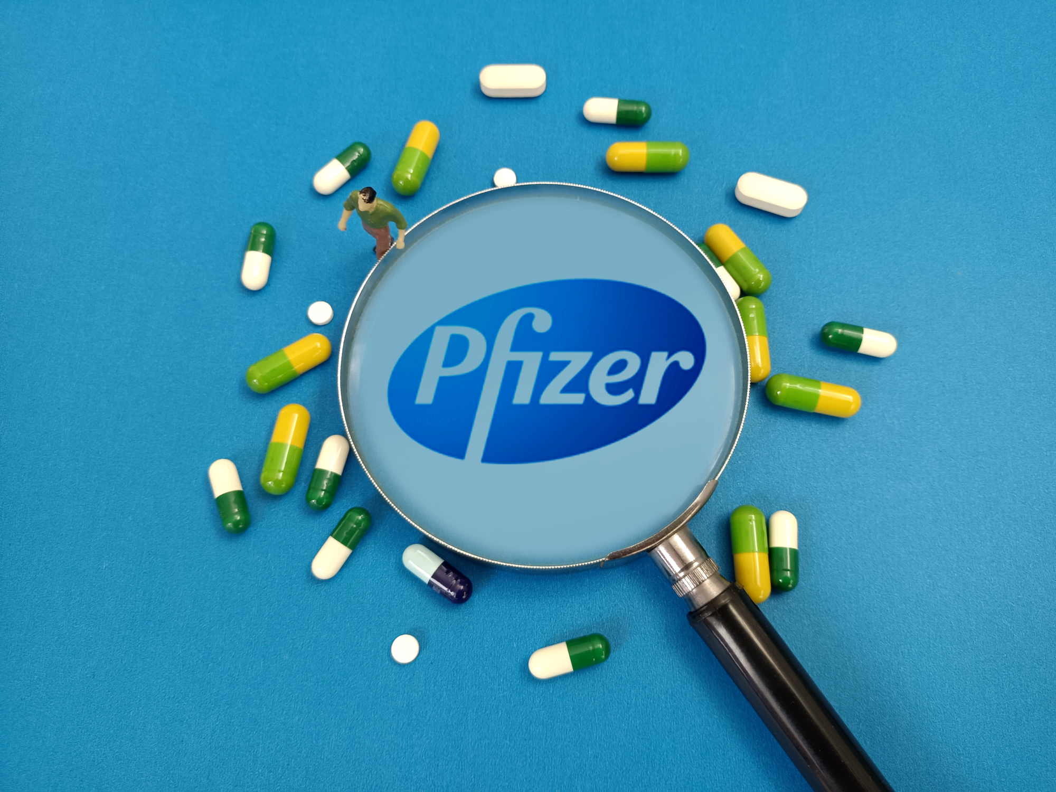




Ethical Leadership
& Conflict Resolution
Made vaccine available at-cost to low-income nations (COVAX).
Balanced speed and safety through task conflict resolution.
5-step ethical decision model used consistently.
89% said “leaders do the right thing” (Gallup 2021).

Slide 8
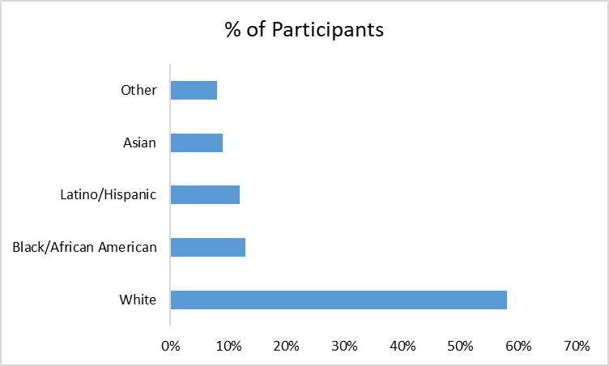
Diversity in Pfizer’s U.S. Phase 3 Trial Participants

Slide 9





Diversity & Change Management
42% of U.S. Phase 3 trial participants were from minority groups.
Launched company-wide unconscious bias training.
Social identity theory: Inclusion fosters stronger teams.

Slide 10
Diversity & Change Management
Lewin’s 3-step model:
Unfreeze
Change
Refreeze
Shifted to hybrid work, decentralized decisions, AI integration.
Created Digital Ops Center for real-time supply chain response.

Slide 11
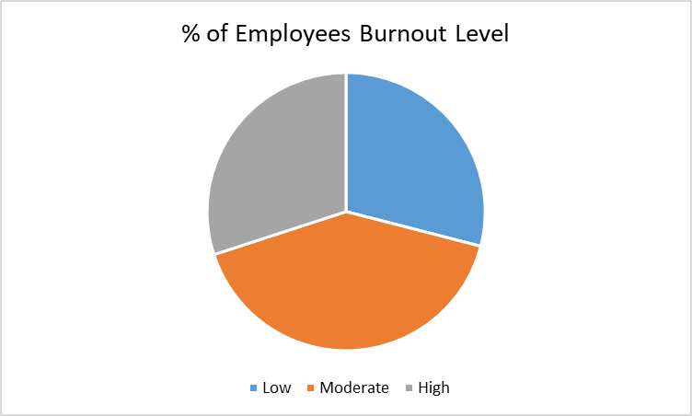
Burnout Reported Among Pfizer Employees

Slide 12

Challenges & Recommendations
Challenges:
41% of employees reported high stress in late 2021.
Gaps in emotional intelligence support and wellness tools.
External vendors lacked oversight (D&I, labor practices).
Weakness in predictive scenario planning.

Slide 13
Challenges & Recommendations
Recommendations:
Mental health protocols
Better data forecasting tools
EQ training and coaching
D&I in supply chain

Slide 14




Conclusion
Future focus: sustainability, emotional intelligence, external ethics.
Pfizer’s OB execution turned a crisis into opportunity.
Leadership + culture + systems = high-impact performance.
“In crisis, we reveal who we truly are.”

Slide 15











References:
· Albert Bourla. (2021, March). Science will win: A conversation with Pfizer’s CEO. Harvard Business Review.
· Bourla, A. (2022). Moonshot: Inside Pfizer's nine-month race to make the impossible possible. Harper Business.
· Edmondson, A. (2019). The fearless organization: Creating psychological safety in the workplace for learning, innovation, and growth. Wiley.
· Goleman, D. (1998). Working with emotional intelligence. Bantam Books.
· McKinsey & Company. (2022, January). Leading through the COVID-19 crisis: How culture enabled performance.
· Pfizer. (2021). Environmental, Social and Governance (ESG) Report 2021.
· Pfizer. (2022). ESG and Responsibility Summary Report.
· Robbins, S. P., & Judge, T. A. (2019). Organizational behavior (18th ed.). Pearson.
· World Health Organization. (2021). COVAX: Working for global equitable access to COVID-19 vaccines.
· Yukl, G. (2013). Leadership in organizations (8th ed.). Pearson.

Slide 16
Thank you!

