Slide 1

A pocket travel assistant

Slide 2
Team Members
Krishna Patel
Chintan Tundia
Mithil Dave
Karnav Kikani
Saprem Shah

Slide 3
Outline
Introduction
Features
Wireframes (User story)
Future Scope

Slide 4
Introduction
“A journey is a person in itself; no two are alike. And all plans, safeguards, policing, and coercion are fruitless. We find that after years of struggle that we do not take a trip; a trip takes us.”
-John Steinbeck

Slide 5
Features
Discover new places
Plan a Trip
Ask a friend/family to join
Suggestions of Transportation
Travel Companion
Make and Share your Story
Trip Expense Calculator

Slide 6
Wireframes

Slide 7

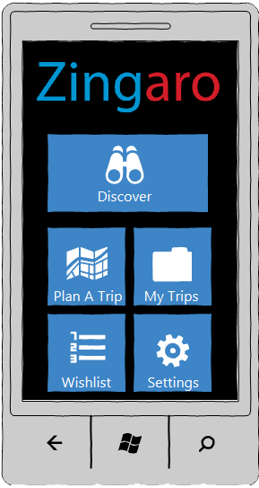
Start Screen
Home Screen

Slide 8
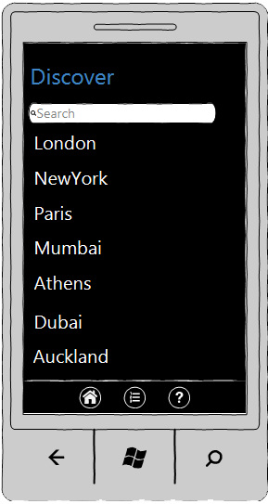
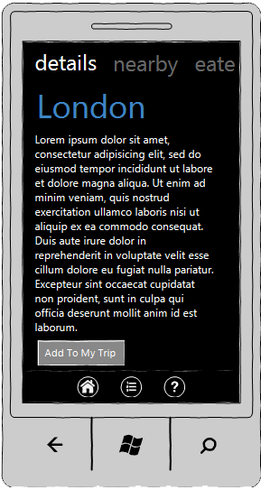
Discover
Description of Place

Slide 9
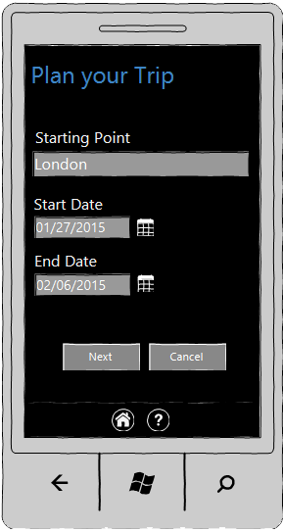
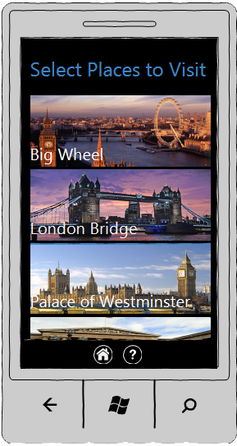
Planning Trip begins

Slide 10
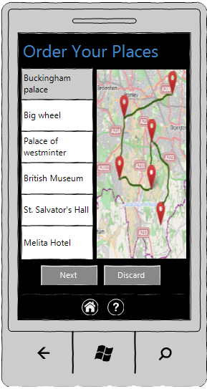
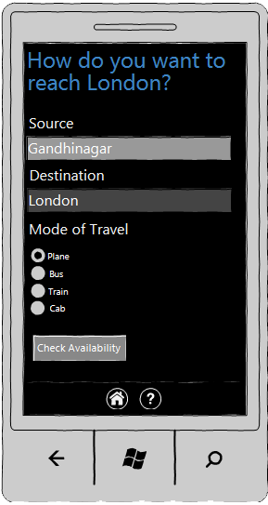
Ordering places and selecting travel mode

Slide 11
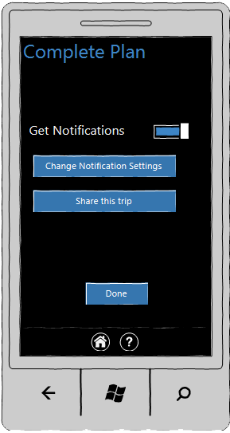
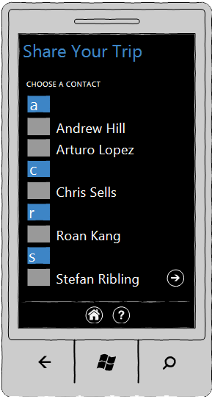
Completing the plan and inviting friends

Slide 12
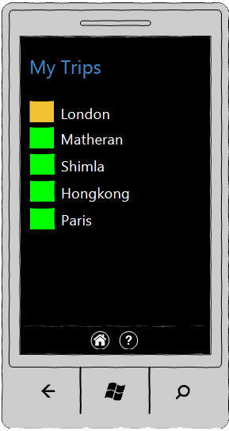
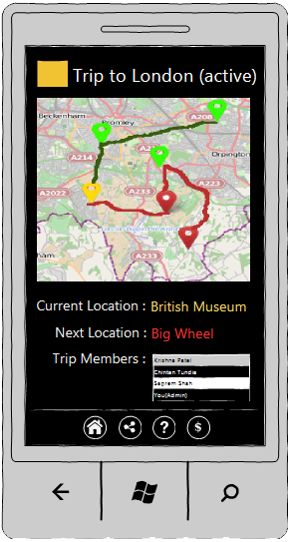
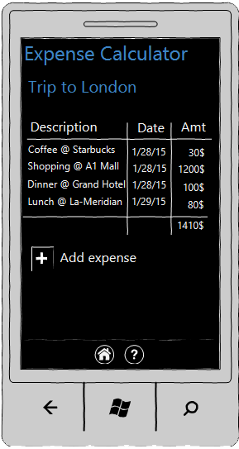
Viewing current & past trips
Current trip status
Expense Calculator

Slide 13
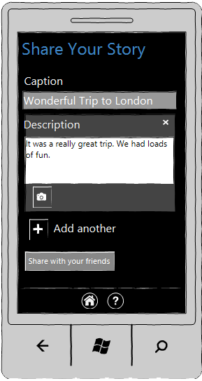
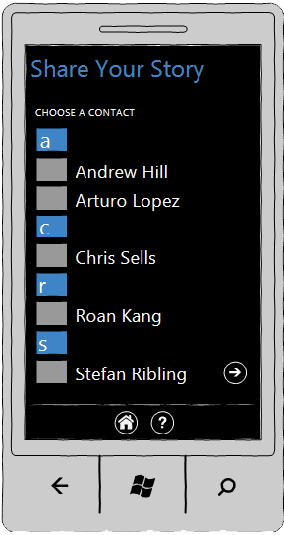
Sharing personal experiences and pics

Slide 14
Future Scope
Ticket Booking (Train/Air/Bus)
Cab Booking
Car Renting
Accommodation Booking

Slide 15
Questions?

Slide 16
Thank You

