Slide 1


32-BIT MIPS PROCESSOR

Slide 2

CONTENT
01
INTRODUCTION TO MIPS
02
BLOCK DIAGRAM
03
INSTRUCTION USED IN CODE
04
EXPLANATION
05
RTL VIEW
06
TTL VIEW
07
SIMULATION
08
CONCLUSION

Slide 3

INTRODUCTION TO MIPS
The MIPS (Microprocessor without Interlocked Pipeline Stages) processor is a type of reduced instruction set computer (RISC) architecture developed by MIPS Computer Systems (now MIPS Technologies).
The single cycle Datapath of MIPS consist of PC (Program Counter), instruction memory, register, ALU, data memory, next address.

Slide 4

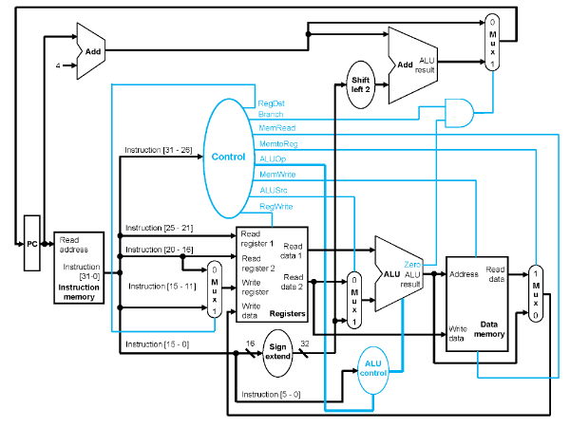
BLOCK DIAGRAM

Slide 5
INSTRUCTION USED
Mem[0] <= 32'h00221820; // add: R3, R1, R2
Mem[1] <= 32'hAC010000; // sw: R1, 0(R0)
Mem[2] <= 32'h8C240000; // lw R4, 0(R1)
Mem[3] <= 32'h10210001; // beq R1, R1, +8
Mem[4] <= 32'h00001820; // add R3, R0, R0
Mem[5] <= 32'h00411822; // sub R3, R2, R1

Slide 6
EXPLANATION
We have created sub-module of every block of the single cycle MIPS processor and all are connected to the main MIPS CPU module.
We have given a instruction set which is being called from instruction module and every instruction is having different data path according to its type.

Slide 7
CONTINUE..
In instructions we have taken add ,sub, lw, sw, beq out of which-
add sub are R - Type instruction
lw ,sw, beq are I - Type instruction

Slide 8
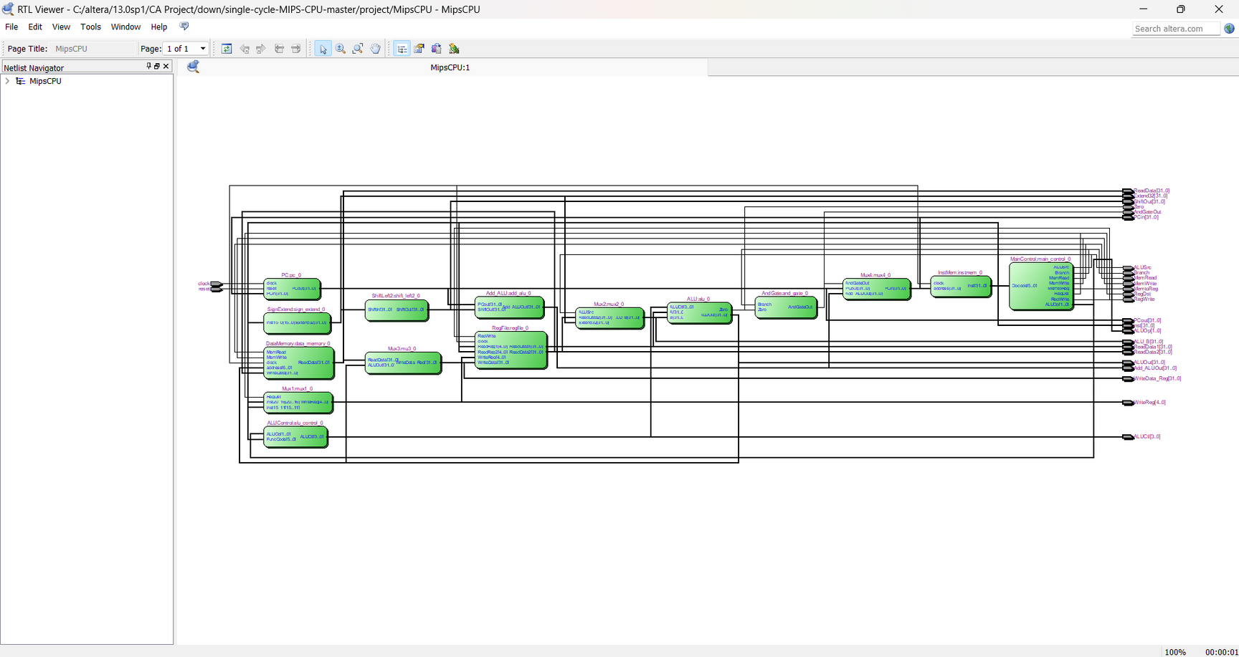
RTL VIEW

Slide 9
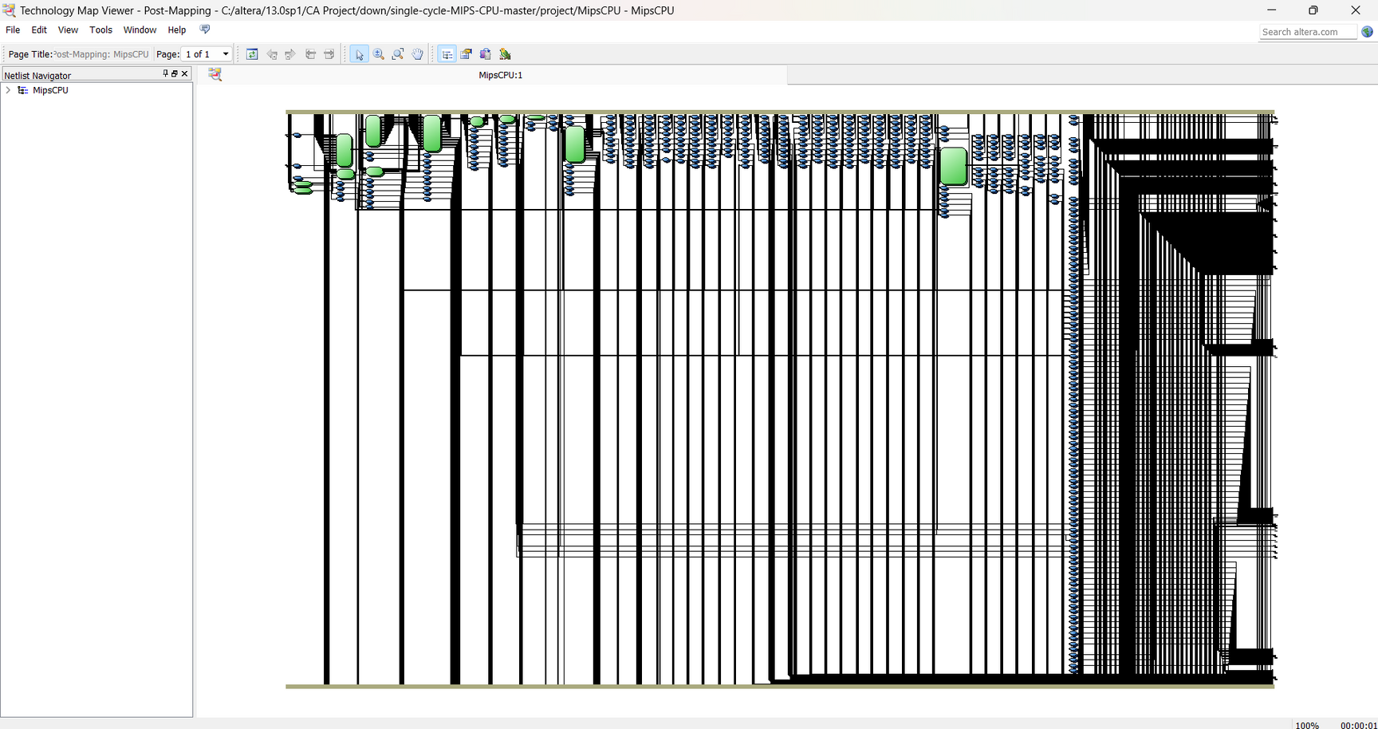
TTL VIEW

Slide 10
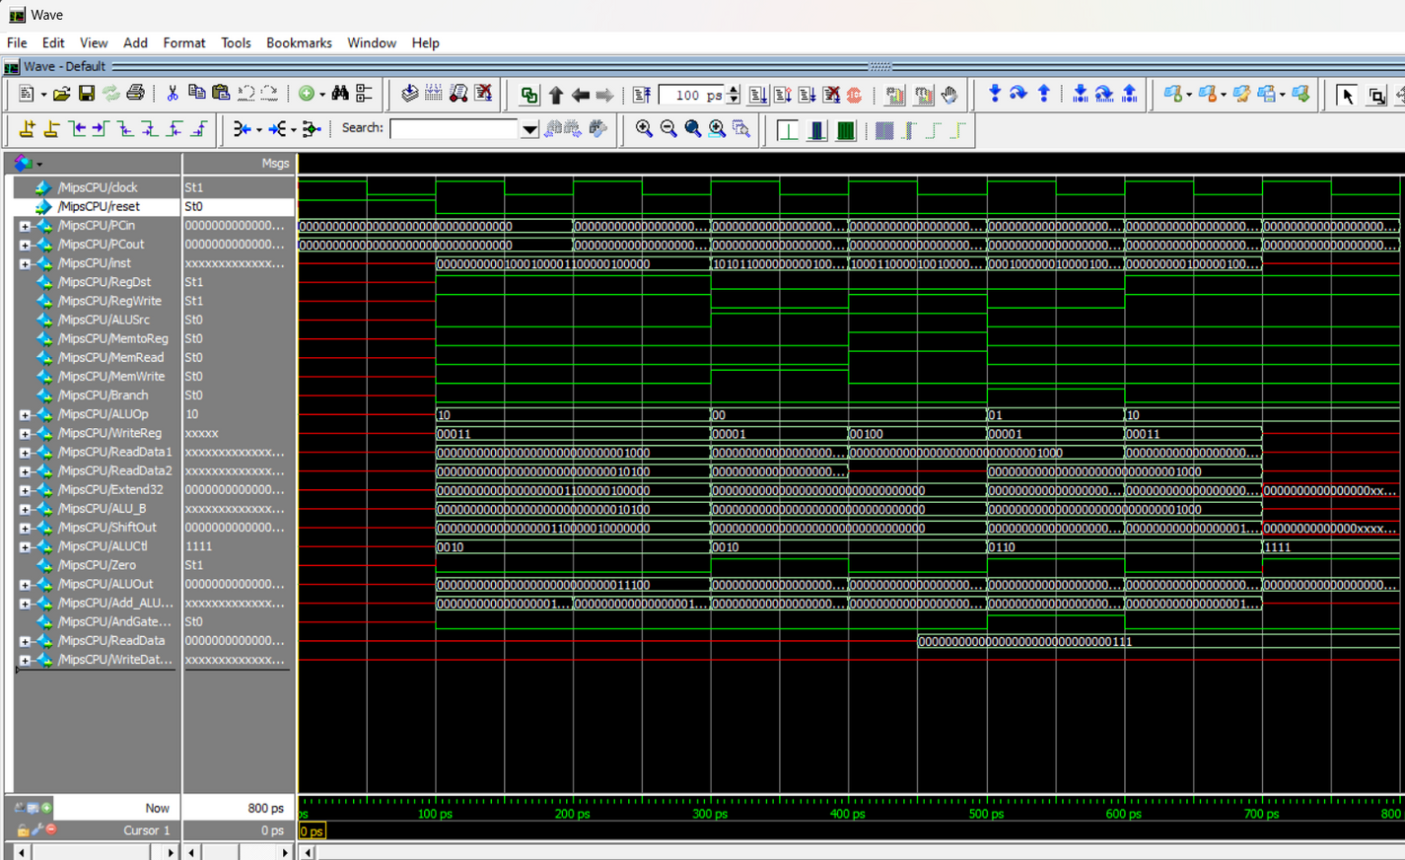
SIMULATION

Slide 11

THANK YOU

