Slide 1
Food Order System

Slide 2
Use of Food Order System
This system is use for ordering food in less time.
This system is more useful for collage students and employees who have a very less time to lunch.
Food order system is also use in mobile application in different restores.

Slide 3
Topic covered in Food Order system
Header Files
Choice Based Statements
(a) If Else Statement
(b) Switch Case Statement

Slide 4
About Project
This function is for the main menu.
ii. In the code given below, which is for the function for the main menu.
iii. Which is you have five choices to choose in the fast food menu such as choice 1 Pizzas, choice 2 burgers, choice 3 sandwich, choice 4 cold drinks and choice 5 fried

Slide 5
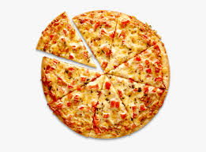
Choice For Pizza
The function for choosing the pizza.
In this code you will choose what kind
of pizza you want to order and the
calculation of total cost of your order.

Slide 6
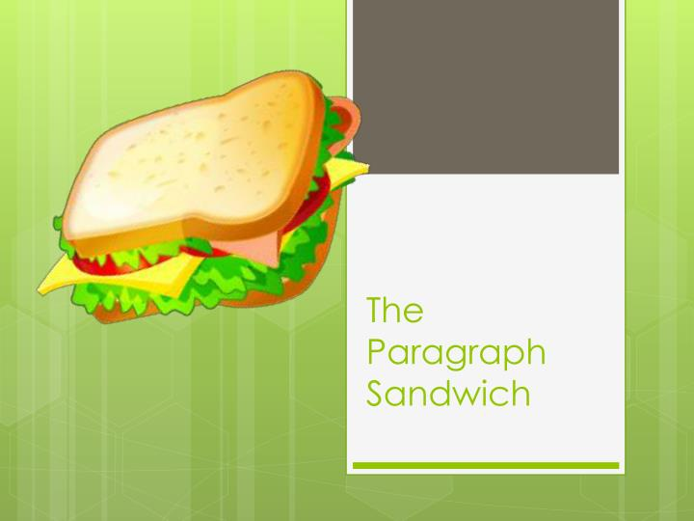
Choice for Sandwich
The function for choosing the sandwich.
In this code you will choose what kind of
sandwich you want to order and also the
calculation of total cost of your order for sandwich.

Slide 7

Choice for Drinks
The function for choosing the drinks.
In this code you will choose what kind
of drinks you want to order and also
the calculation of total cost of your
order for drinks.

Slide 8

Choice for Fried
The function for choosing the fried.
In this code you will choose what kind
of fried you want to order and also the
calculation of total cost of your order for fried.

Slide 9
Thank You !!

