Slide 1

DREAM STUDIO ARCHITECTURE
COMPANY MANAGEMET SYSTEM
Group No :- 50
Submitted By:-
Chintan Bhimani A.(3009), Pratiksha Chopda B.(3025) and Jasmin Bhanderi V.(3379)
Guided by :- Prof. Jaimini Patel

Slide 2

HELLO!
Today, our group represent company management system in details.

Slide 3

OVERVIEW
Introduction
Technical Profile
Scope & Planning
Data Flow Diagram
UML Modeling
Testing
Conclusion
Bibliography & References

Slide 4

1. INTRODUCTION
Let’s start with the Introduction

Slide 5

The "Company Management System" has been developed to override the problems prevailing in the practicing manual system. This software is supported to eliminate and, in some cases, reduce the hardships faced by this existing system.
Moreover, this system is designed for the particular need of the company to carry out operations in a smooth and effective manner. The application is reduced as much as possible to avoid errors while entering the data. It also provides error message while entering invalid data. No formal knowledge is needed for the user to use this system. Thus, by this all it proves it is user-friendly. Company Management System, as described above, can lead to error free, secure, reliable and fast management system. It can assist the user to concentrate on their other activities rather to concentrate on the record keeping.

Slide 6
TECHNICAL PROFILE
Project Title: | Dream Studio Architecture Ltd.
Definition: | Architecture, the art and technique of designing and building, as distinguished from the skills associated with construction.
Developed For: | S.D.J. International College, Vesu, Surat
Project Guide: | Prof. Jaimini Patel
Front End: | HTML, CSS, Bootstrap, JavaScript
Scripting Language: | PHP, JavaScript
Back End: | My SQL, PHP

Slide 7

SCOPE & PLANNING

Slide 8
REQUIREMENT ANALYSIS
Employee Information Management
The system should allow for easy storage, retrieval and modification of employee information such as name, contact details, department, job title, employment history, etc.
Leave Management
The system should allow employees to record their leaves, with a dashboard that displays this information to the management.

Slide 9
Performance Management:
The system should allow managers to set goals, provide feedback, and conduct performance reviews for employees. It should also track and report on employee progress towards their goals
Training and Development:
The system should facilitate employee training and development by providing access to relevant courses, workshops, and other resources.
Security:
The system should have strong security measures to protect sensitive employee data. It should also be able to comply with relevant data protection regulations.

Slide 10
TECHNOLOGY DETAILS
Hardware:
Processor : Intel(R) Pentium i3 CPU @ 2.30GHz
Memory: 6 GB
Hard Disk : 256 GB or Higher
Software:
Operating System: Window 10/11
Browser: All Supported

Slide 11
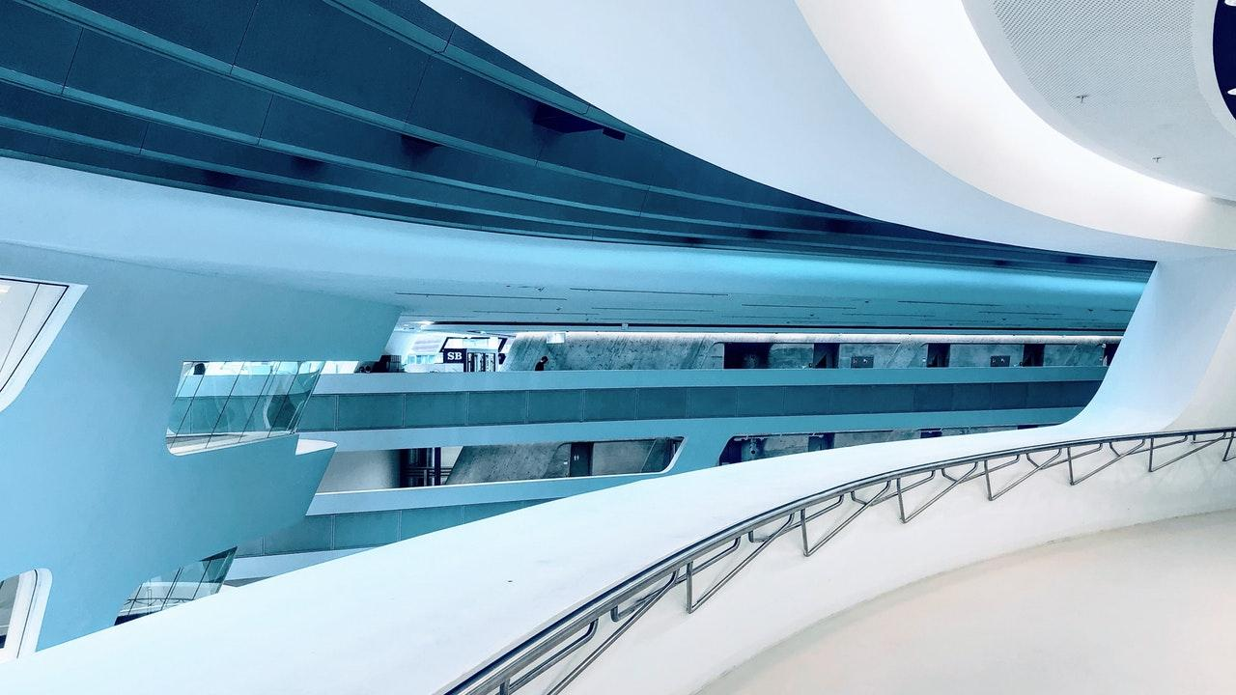
DATA FLOW DIAGRAM
A data flow diagram (DFD) is a graphical or visual representation using a standardized set of symbols and notations to describe a business’s operations through data movement.

Slide 12
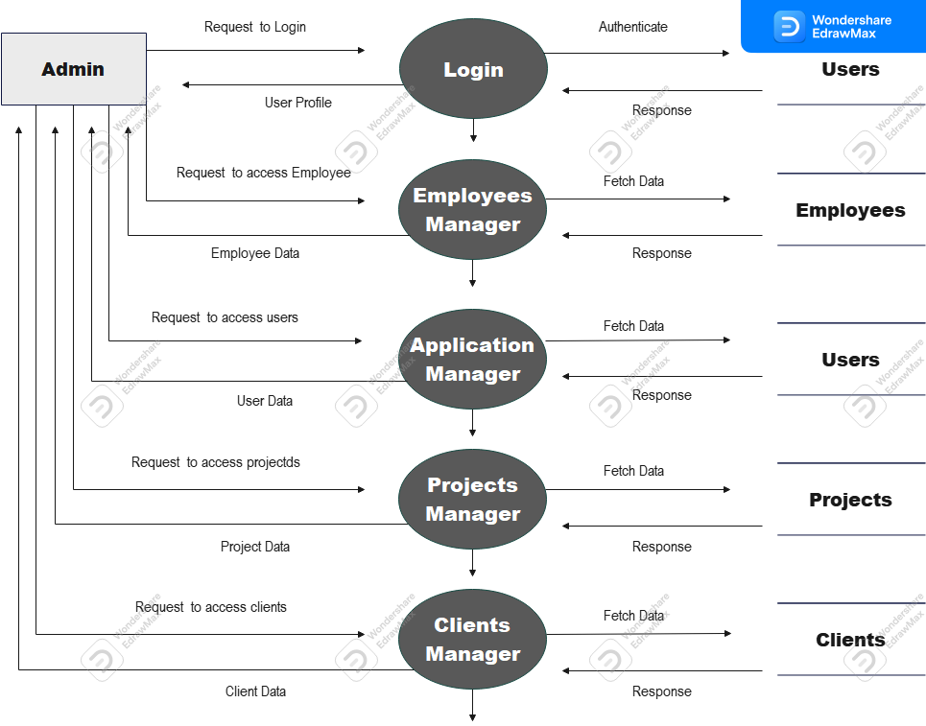

Slide 13
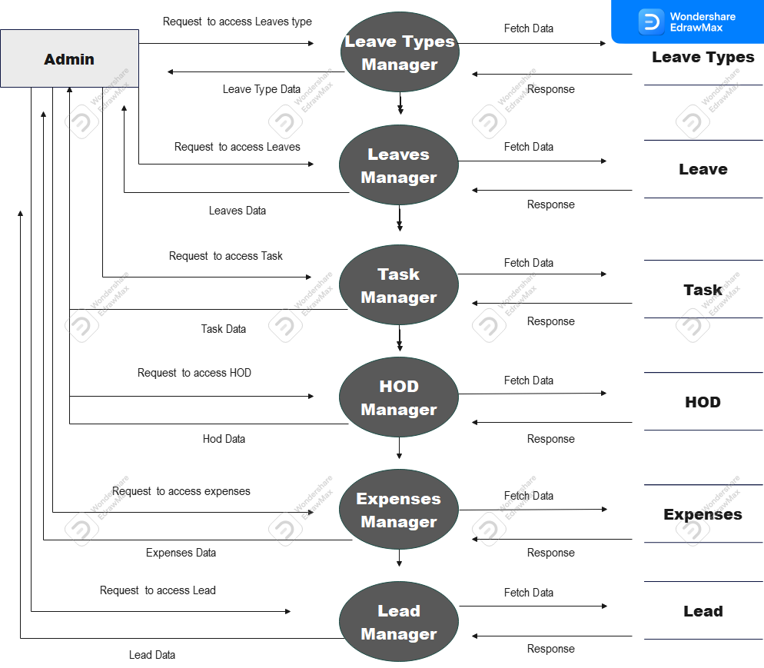

Slide 14
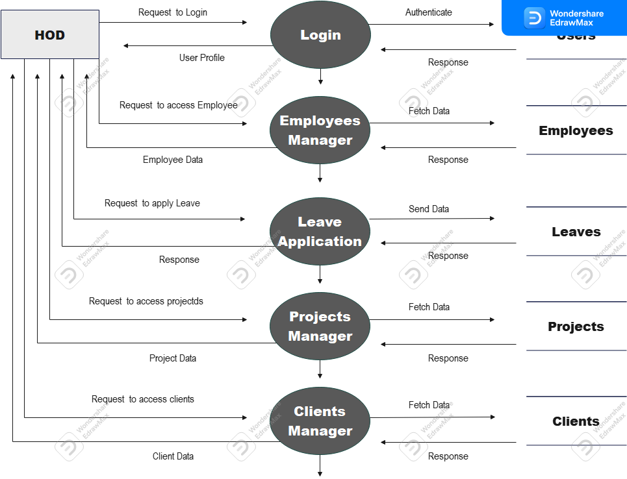

Slide 15
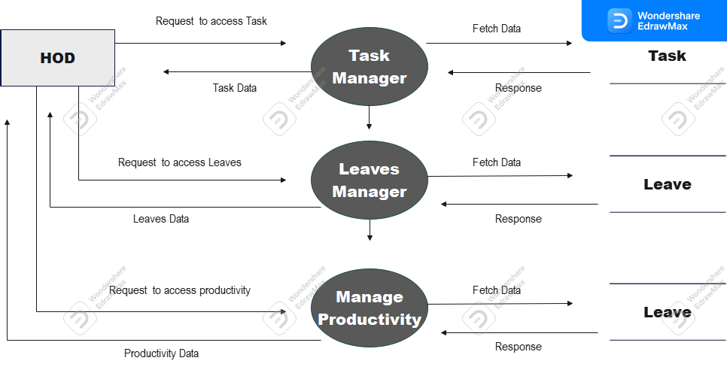

Slide 16
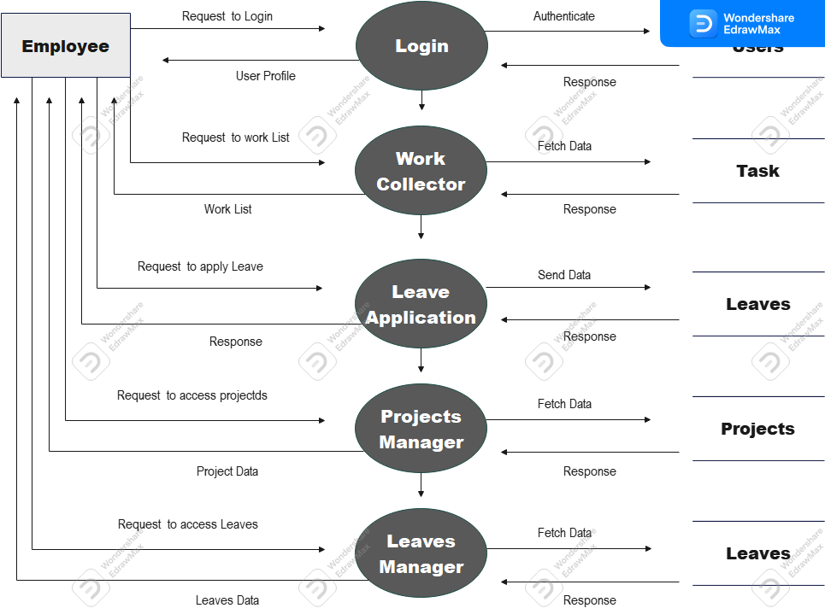

Slide 17

UML MODELLING

Slide 18

THIS DIAGRAMS EXPLAIN AUTHORITY
Employee Authority
HOD Authority
Admin Authority

Slide 19
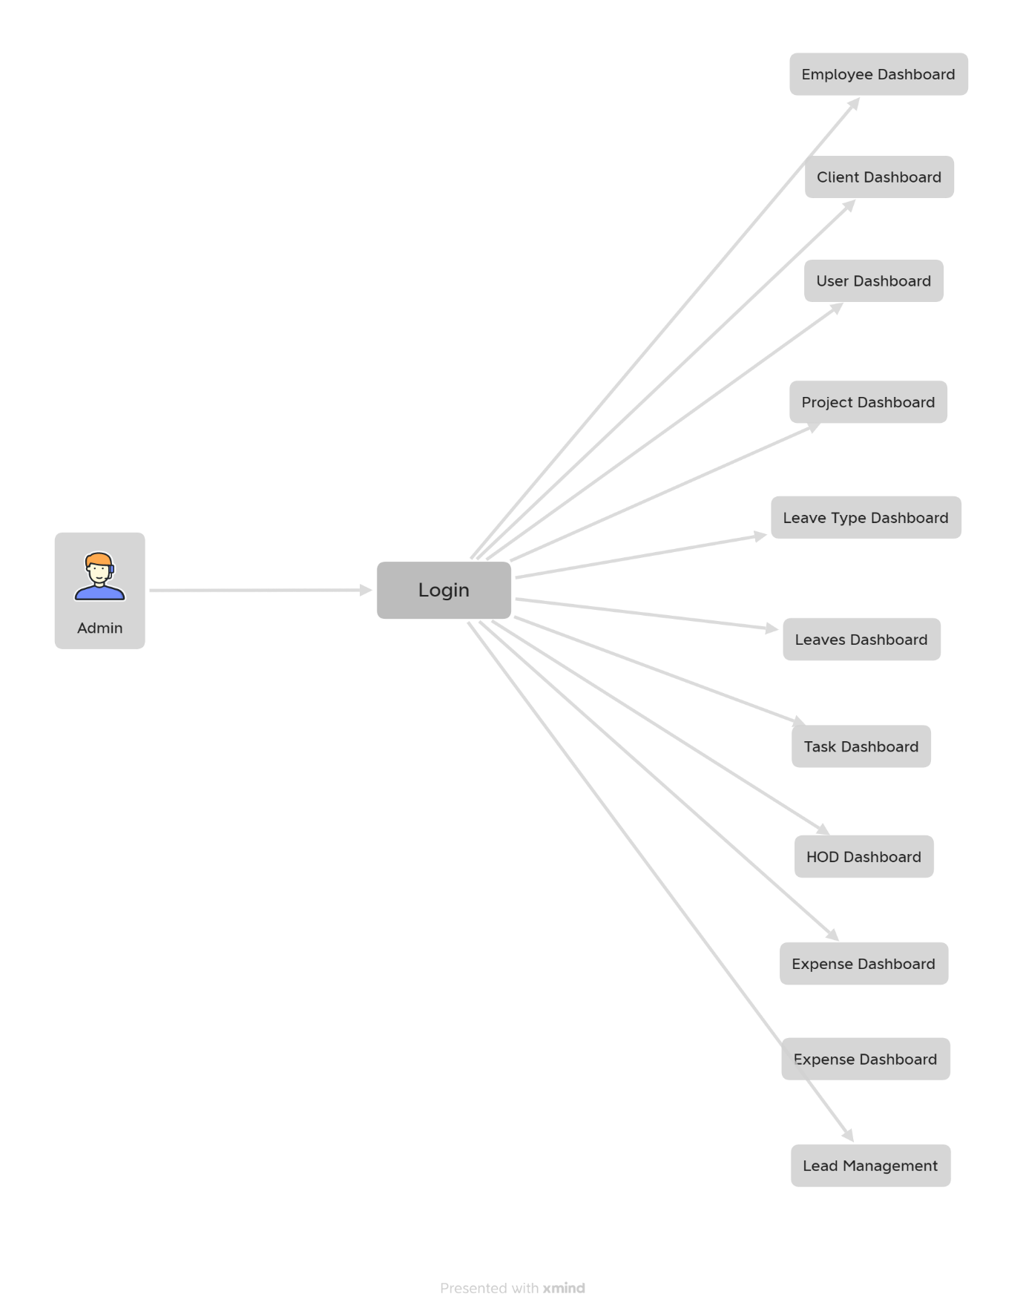

Slide 20
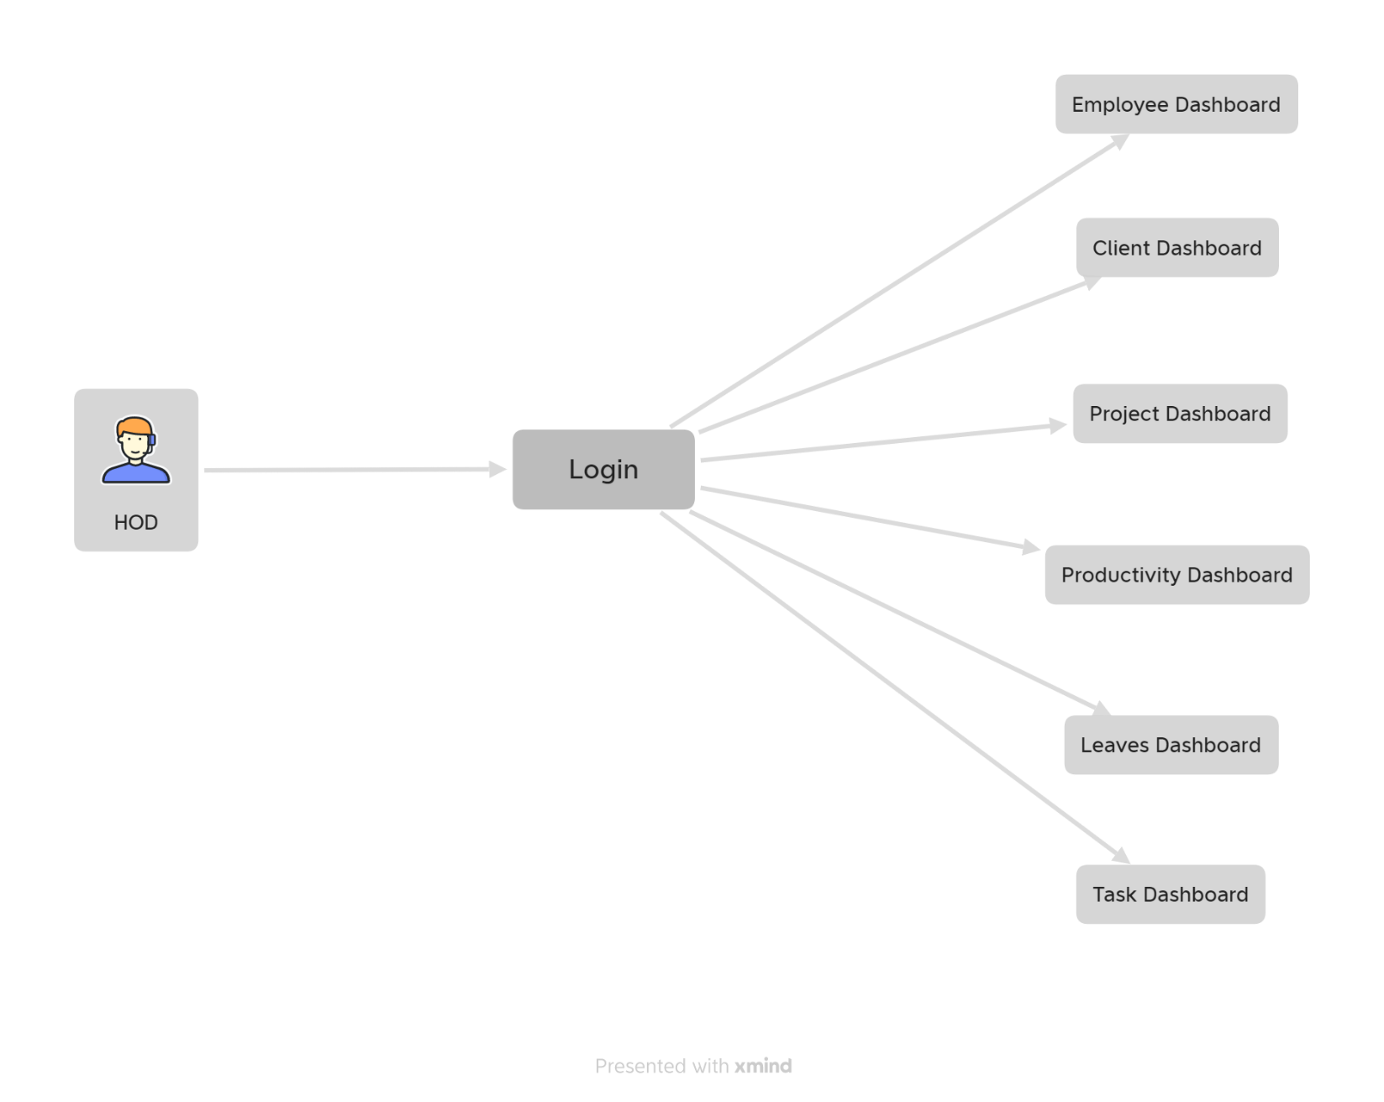

Slide 21
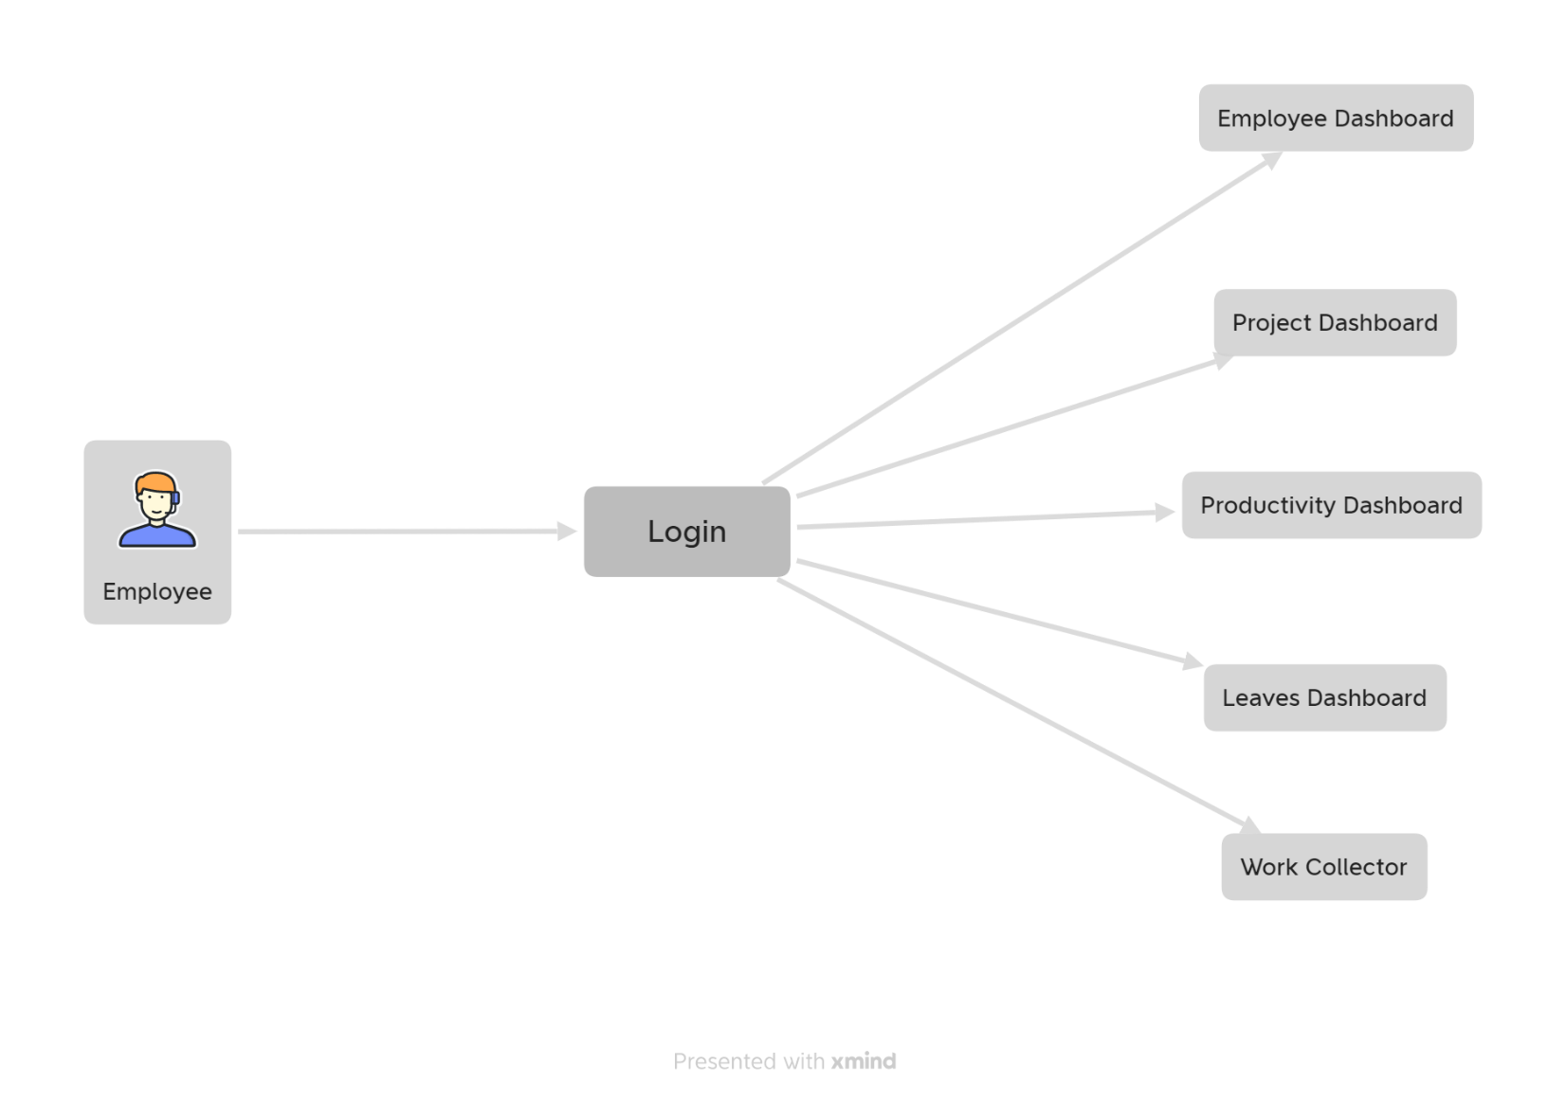

Slide 22
TESTING
Testing is very important and critical to the success of any project that aims at delivering working software. There are many types of testing that a system may be subjected to, however only the ones in the testing objectives will be carried out for this system.
The overall purpose of testing is to ensure the Employee Management System meets all of its functional and business requirements. The purpose of this chapter is to describe the overall test plan and strategy for testing the system.

Slide 23
The goals in testing this system include validating the quality, usability, reliability and performance of the application. Testing will be performed from a black-box approach. Tests will be designed around requirements and functionality.
System testing, or end-to-end testing, tests a completely integrated system to verify that it meets its requirements. For example, a system test might involve testing a logon interface, then creating and editing an entry, plus sending or printing results, followed by summary processing or deletion (or archiving) of entries, then logoff.
Integration testing is any type of software testing that seeks to verify the interfaces between components against a software design. Software components may be integrated in an iterative way or all together ("big bang").

Slide 24
CONCLUSION

Slide 25
The aim of this chapter is to draw conclusions of the work done or achieved and to give an assessment of the completed system, discuss the Problems faced, limitations of the system and give future recommendations on how the system can be improved.
The software product produced was fairly good, it achieved most of the user requirements, the user interface is good and is very easy to navigate, and even novice users can find their way around the web application easily. The client-side validation is excellent. The lack of integration with a payroll system is the major drawback and the system was also unable to generate structured reports i.e., reports based on specific information the Human Resource is interested in.

Slide 26
BIBLIOGRAPHY & REFERENCES
https://www.udemy.com/course/getting-started-with-php-and-mysql-for-beginners/
https://www.phpclasses.org/
https://phptherightway.com/
https://github.com/
https://jquery.com/

Slide 27
THANKS!
Any questions?

